Slide 1


NEO of THINGS
The 1st Practical IoT Distributed Ledger Solution
norchain.io

Slide 2
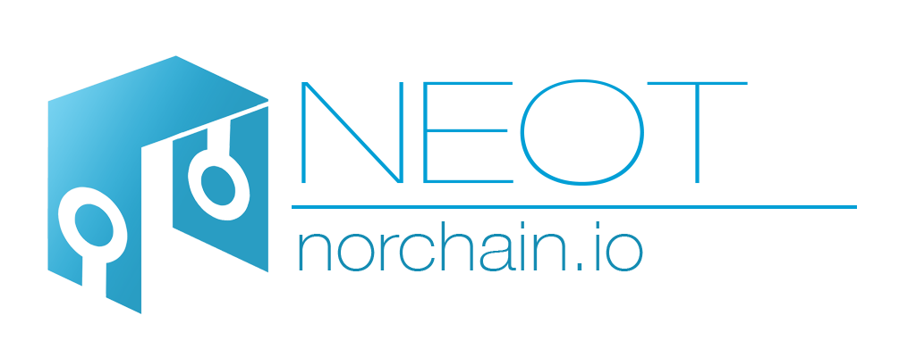
Content
Team: norchain.io
Practical IoT Solution: NEOT: PROV + NEO
Ongoing Cooperation

Slide 3
about norchain.io

Slide 4





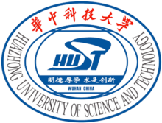

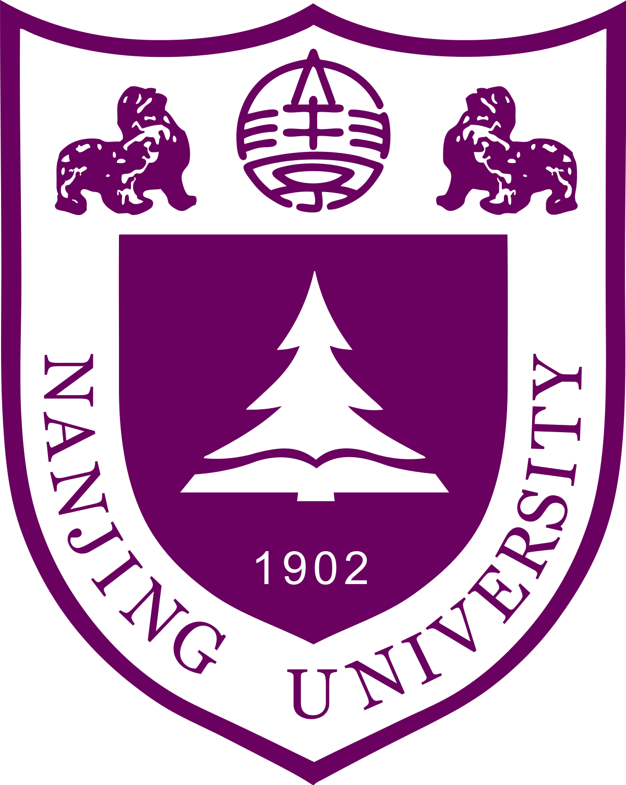
norchain.io - Education

Slide 5



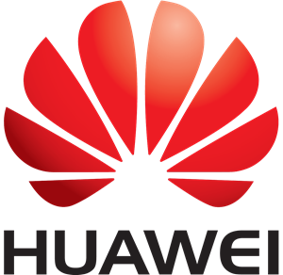
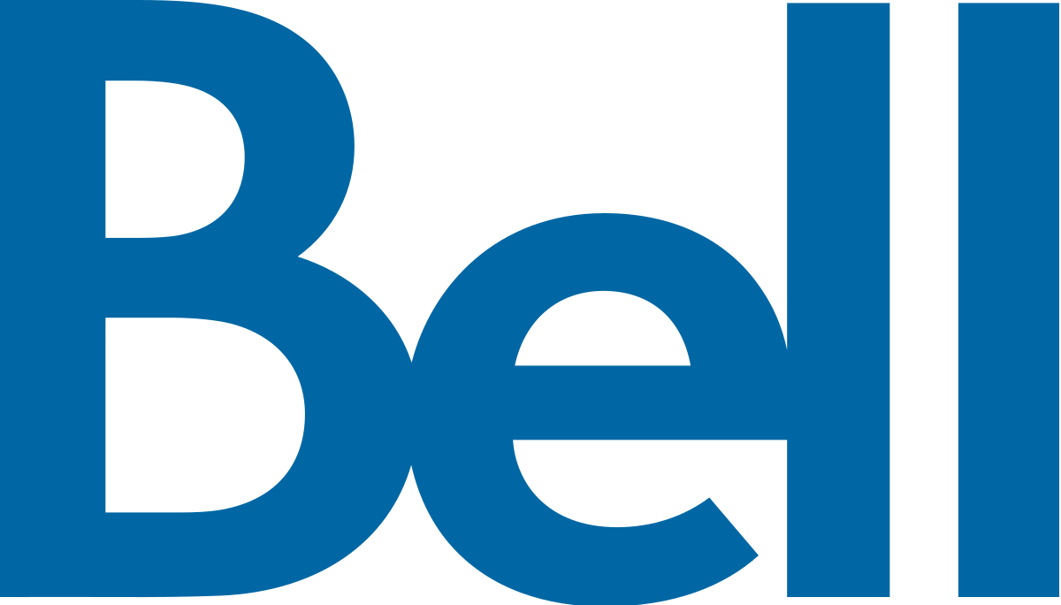
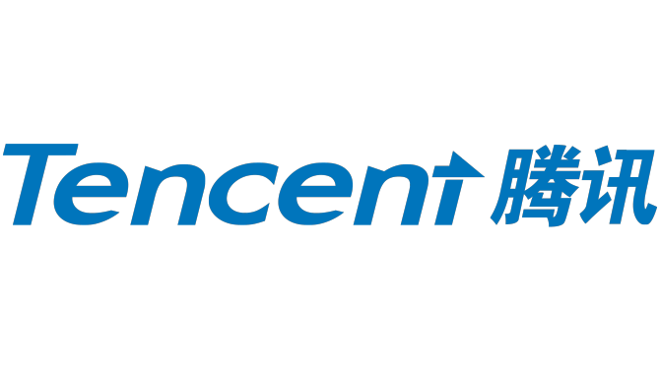

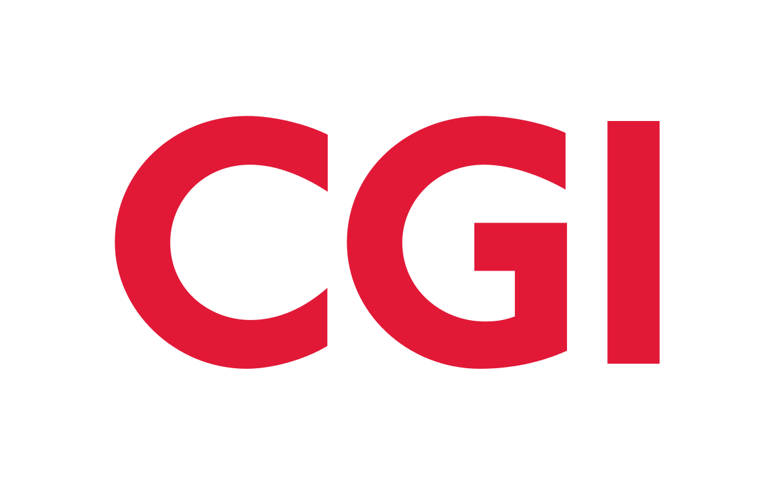
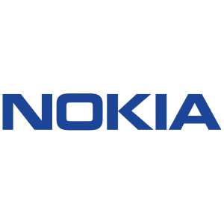
norchain.io - Expertise
Software Engineers
IoT Expert
Mng. & Marketing Guru
Big Data Scientists
Security Expert

Slide 6





norchain.io - Diversity
International team: ideas from varied backgrounds.
@Toronto, high-tech center of blockchain and AI. Passionate projects and funds.
@Canada, positive and stable policies to blockchain and cryptocurrency, more open than US and China.

Slide 7
NEOT: PROV + NEO
The 1st Practical IoT Distributed Ledger Solution

Slide 8





IoT: The Challenges
Security
Privacy
Compatibility
Connectivity

Slide 9
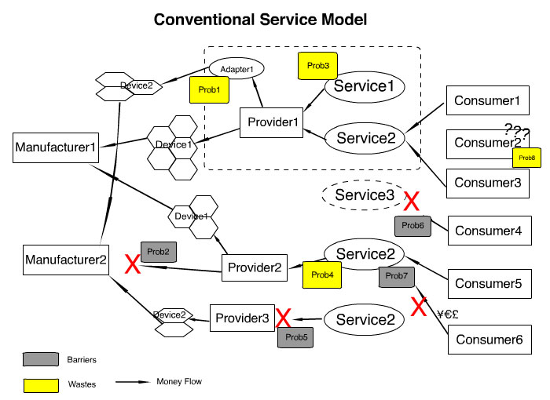
IoT: The Challenges
Conventional Service Model
Redundant works and barriers in many places. Waste of resource and accelerates monopoly.
For more details, please read our whitepaper session 2.1.

Slide 10
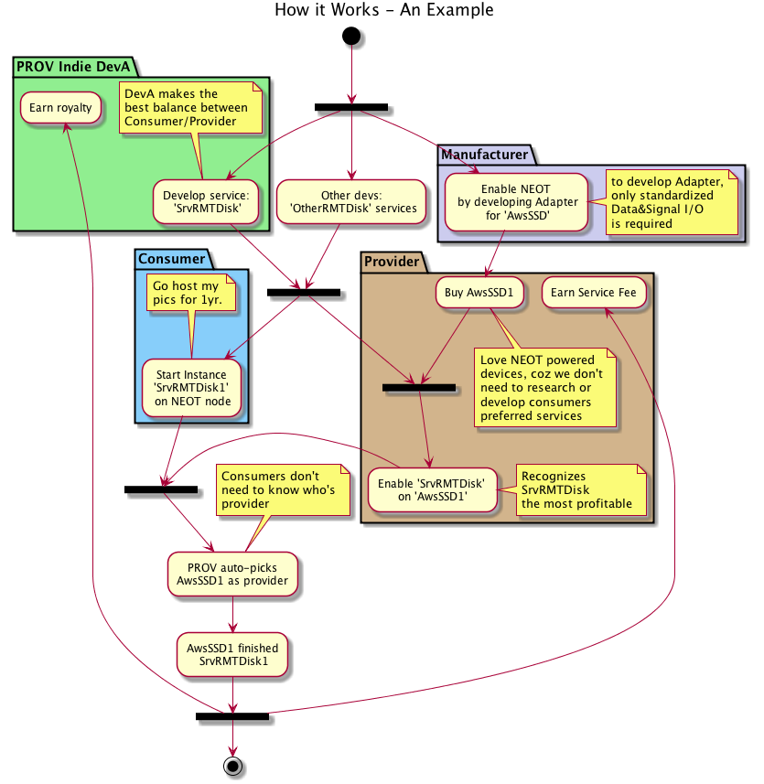
PROV: Service Model
The model of PROV
introduces a new role: Service Developer,
decouples Manufacturers and Providers from designing and implementing services;
brings in a competitive mechanism between service developers, with which the services with reasonable logic and better tradeoff of consumer-provider interest would win more support nodes from providers and consumers;
rewards service developers by taking royalties from every running instance of the service they wrote.

Slide 11
PROV: How to implement
To write a PROV service, developers only need to write 4 functions: Provision, Representation, Orientation and Verification.
Only 3 types of messages are recorded on blockchain, after being verified by bookkeepers.
Large files are transferred off-chain.
For more details, please refer to our yellow paper: PROV Service and Share Economy^{[beta]}
Provision
Representation
Orientation
Verification

Slide 12
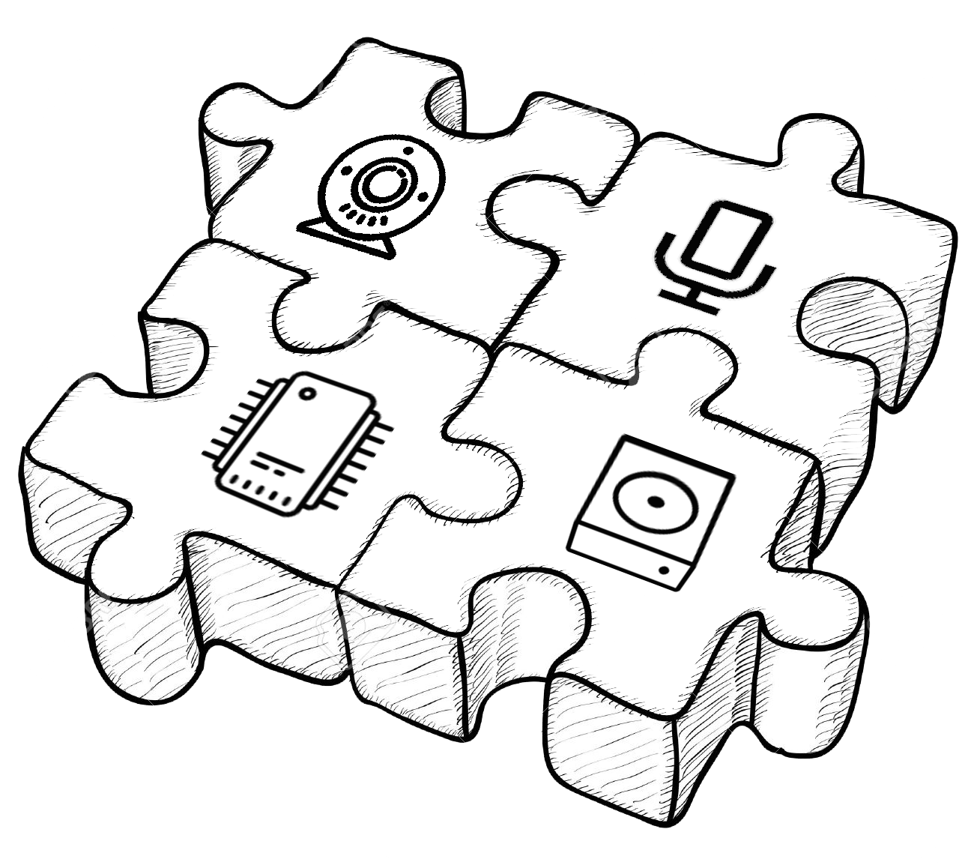
PROV Vision: Combined Service
In the future, PROV will also support combined services.
eg. a PROV service captures the images and voices via cameras and microphones around some place, passes the data to a remote GPU to train a Recurrent Neural Network (RNN), then stores the parameters to anther SSD node.
We’ll make it happen!

Slide 13
NEOT = PROV + NEO
We need a distributed ledger infrastructure which
provides FAST enough transaction speed,
supports LIGHT nodes to reduce IoT devices’ cost,
supports DAPPs, so we can deploy PROV’s logic.

Slide 14
Why NEO?
Feature | Ethereum Based | IOTA | NEO | Comments
Consensus | POW | A Little POW | dBFT | POW is eco-unfriendly. Concerns of IoT device’s battery life and computational overhead.
Light Node | Developing | YES | YES | IoT Device has limited capacity.
DApp | Solicity | N/A | C#/Java/Python | Dapp support is mandatory.
Tx Fee | GAS | Free | Free | IoT needs frequent transactions.
TPS | 15 | 1000 | 1000 | IoT has massive nodes.
Counting System | Binary | Ternary | Binary | Binary offers compatibility and reduces overhead for almost all devices.
Ledger Incentive | Mining | N/A | Stockholders’ GAS | Rational NEO stockholders maintain the value of ecosystem and are rewarded by GAS.

Slide 15
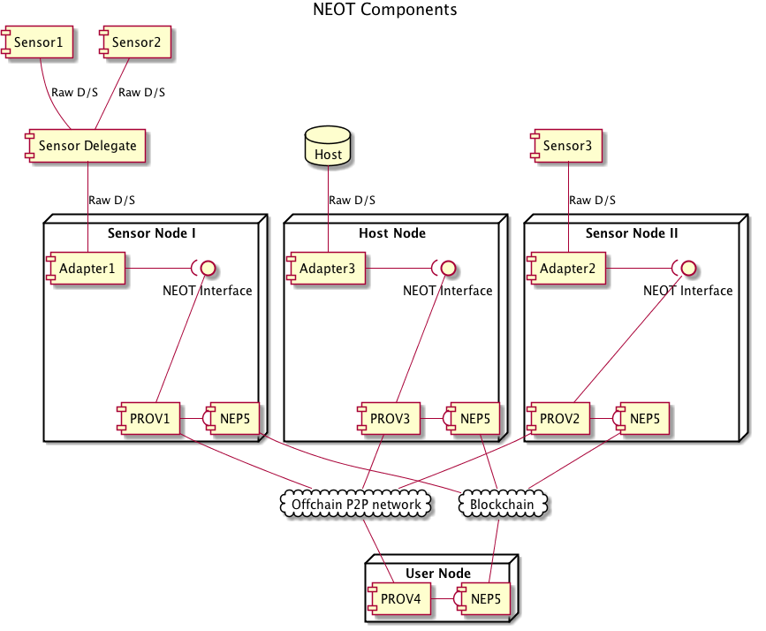
NEOT: The Components
Existing sensor/host systems access PROV services via standardized data/signal interfaces brought by Adapters.
PROV enables NEOT with both off-chain P2P network and NEP5 smart contract.
User nodes subscribe the service from sensor/host nodes via PROV.

Slide 16
NEOT: Leveraging NEO
PROV is designed to be independent from particular blockchain infrastructure. Developers can even design cross-chain services.
On-chain records of services, providers and users are retrievable in PROV logic to improve services’ quality.
Transactions can be made via unified token globally. Payment will never be a problem.
For more details, please read NEOT’s white paper.

Slide 17

NEOT: Overcome IoT Challenges
Decentralized ledger is DDoS-proof in nature.
In PROV, the service request beyond provider’s provision will be ignored by blockchain.
Security
In PROV, consumers and providers are free to select the type of service which protects their privacies most.
Standardized data input through Adapters also helps prevent privacy leakage before data streams to network.
Privacy

Slide 18
NEOT: Overcome IoT Challenges
PROV and cryptocurrency incentive will motivate manufacturers to develop the Adapters to join NEOT network.
Compatibility
With P2P connection, nodes can post the message to chain through all possible connections to minimize the chance of losing signal.
Connectivity

Slide 19
ongoing cooperation

Slide 20

City of Markham: Smart City
PROV + NEO, as a part of the proposal of Markham City’s “Smart Transportation”, will
reward drivers with safe driving habits by crypto tokens,
allow citizens to check on-chain records to insure the privacies collected by sensors are not leaked or meddled,
enable 3rd party big data experts to utilize on-chain records for analysis,
provide a new credit checking reference when citizens prove the ownership of their on-chain accounts.
This proposal is also possible to run for federal government’s “Smart City” Challenge.

Slide 21
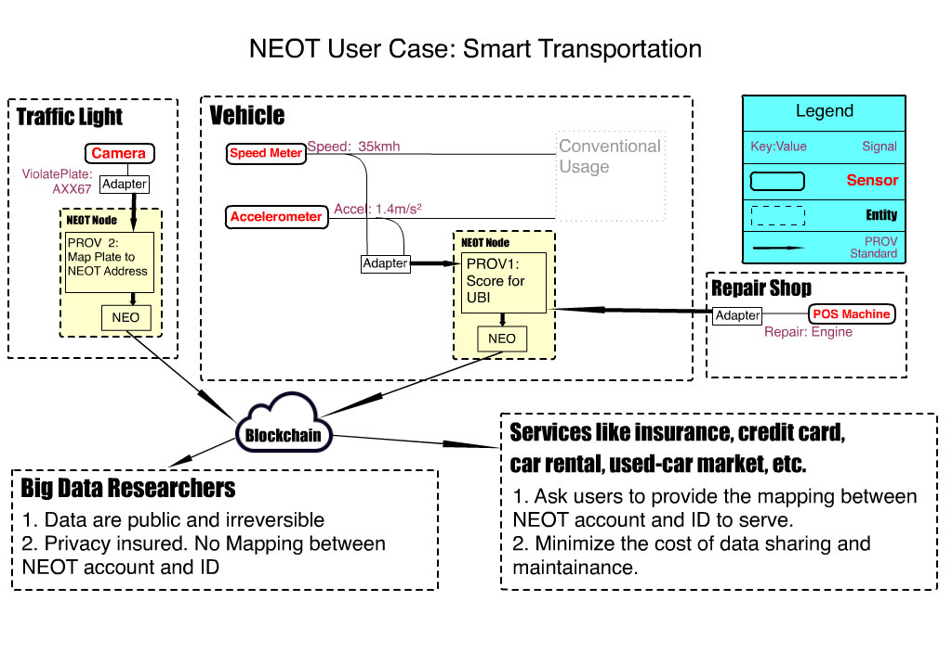
City of Markham: Smart City

Slide 22
CGI: Bravo
CGI plans to use tokens instead of dollars as a gift to the colleagues whose contribution to the company’s value is recognized. The project is named ”Bravo”.
Norchain’s core member is the principle developer of this project and responsible to design the smart contract with elaborated requirements.

Slide 23

China Mobile
China Mobile plans to utilize blockchain technology to assist its NB-IoT project and data leakage prevention system.
Norchain is in conversation with China Mobile for the potential cooperation.

Slide 24

MiGu
MiGu is planning a mobile app to enable users to mine by steps. Users can redeem the “Proof of Steps” coins for the official offered prizes.
Norchain’s core member is bidding for the blockchain consultant role.

Slide 25
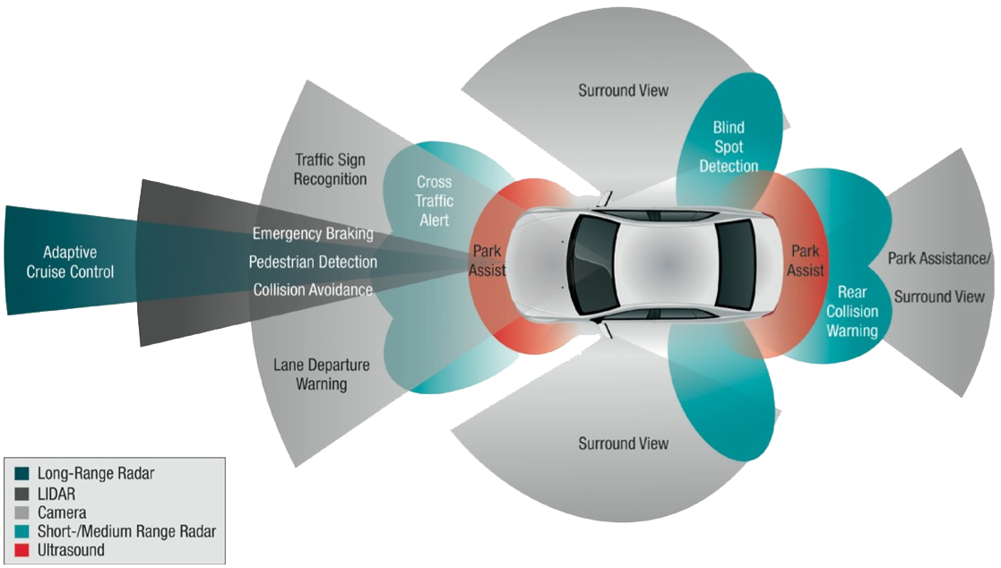
Self-driving vehicles and UBI
Norchain is also proactively connecting with self-driving startups and insurance companies in Toronto and Silicon Valley.

Slide 26
Mar. 8, 2018

