Slide 1


Python for
Bioinformatics
Intro & Foundations

Slide 2






Websites
NEOF: https://neof.org.uk/
NERC: https://nerc.ukri.org/
CGR:
https://www.liverpool.ac.uk/genomic-research/
Twitter
NEOF: @NERC_EOF
NERC: @NERCscience
CGR: @CGR_UoL

Slide 3

Upcoming workshops
https://neof.org.uk/training/
Population genomics
17th & 19th January 2023
Bacterial 16S metabarcoding
7th & 9th February 2023
Metabarcoding for diet analysis and environmental DNA
28th February & 2nd March 2023
Microbial shotgun metagenomics
21st & 23rd March 2023

Slide 4

Format & Schedule
This intro
Bookdown
Theory
Practice
Supplementary materials
Work at your own pace

Slide 5

Map
Plans and goals
What is Python?
The Python Shell
Python foundations

Slide 6

Calendar
Morning 1: Foundations of Python
Afternoon 1: Data Structures, Conditions, & Loops
Morning 2: Reading & Manipulating DNA Data
Afternoon 2: Reading and Writing Files

Slide 7

Goals
Understand Python Code
Know what the next steps are to improve further
Write & run Python scripts
Learn data flow and conditions
Read in DNA data files
Manipulate DNA sequence data
Write out data files

Slide 8
Latest: Python (v 3.11.1 - released Oct 2022)
https://www.python.org
Clear syntax
File and Data manipulation
Popular in bioinformatics
February 1991
Most used language on TIOBE
Well maintained and updated
Lots of resources, libraries

Slide 9

Why use Python?
Powerful
Flexible
Clear syntax
Widely used
Many Packages

Slide 10

Foundations of Python

Slide 11
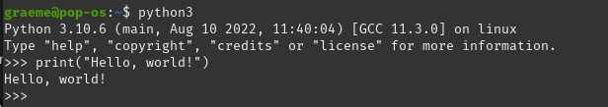
The Python Shell
www.python.org
Download & install the latest Python interpreter (Free and open source)
Basic interaction - one command at a time

Slide 12
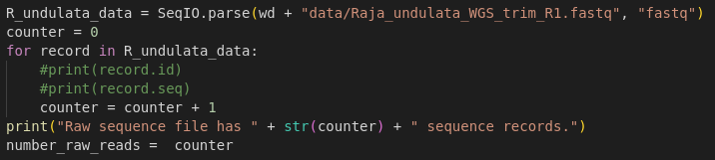


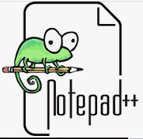
Running a Python script
Lots of commands
Complex programs
Any “plain-text” editor

Slide 13
Python Foundations
Operators
Comments
Variables
Classes
Functions & Methods
Indentation

Slide 14



Operators & Comments
Python supports all the usual mathematical operators and follows BODMAS.
Comments use the ‘#’

Slide 15
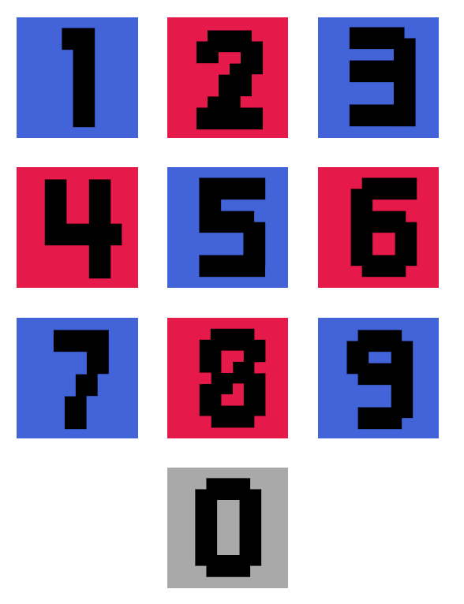

Variables &
Classes
Variables
Class is the ‘type’ of variable:
Integer / Float
String
Logical
“a_string_variable”

Slide 16

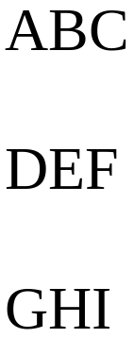

Functions & Methods
A function/method is used to run the same task repeatedly

Slide 17

Indentation
Zero indentation
Python is very
particular about
line indentations.
This will make more sense in the practical!
One level of indentation
Two levels
Three
Zero indentation

Slide 18

Course info

Slide 19

Pace
Work at your own pace through the book
If you get stuck:
1st check for typos
2nd ask for help
No such thing as a dumb question, just dumb answers by me

Slide 20

Book
HTML book
Theory and practical code

Slide 21

Experiment
Experiment
Different commands
Combining functions
You will not break anything

Slide 22

Ask questions!
Here to help!
Don’t understand a concept?
Don’t understand the objective of an exercise?

Slide 23



Reminders and Tips
Work at your own pace
Typos
Ask questions
Breaks are important

Slide 24


Workshop sessions
Zoom - Ask via microphone if no question currently being asked/answered
Slack - Ask questions via the channel or ask to go into a zoom breakout room with one of us
Breakout rooms upon request

Slide 25

Recap
Plans and goals
What is Python
Python Foundations
Course Information

Slide 26

Thank you!
Questions?

