Slide 1

Python for
Bioinformatics
Structures, Conditions & Loops

Slide 2

Map
Lists
Set
Dictionary
Index positions
Loops

Slide 3

Calendar
Morning 1: Foundations of Python
Afternoon 1: Data Structures, Conditions, & Loops
Morning 2: Reading & Manipulating DNA Data
Afternoon 2: Reading and Writing Files

Slide 4

Data Structures

Slide 5


Data Structures
[
]
, , , , , ,
Lists [ ]

Slide 6





Data Structures
[
]
, , , , , ,
Lists [ ]

Slide 7
Data Structures
[
]
, , , , , ,
Lists [ ]
Set { }

Slide 8
Data Structures
]
[
]
[
, , , , , ,
Lists [ ]
Set { }
{
}
, , , ,

Slide 9
Data Structures
{ key : value }
Dictionary
{ key : value}
{
:
:
:
20
15
8
,
,
}

Slide 10
Index Positions
[
]
, , , , , ,
Every item in the list
has an index
(start from zero!)
List[0] =
List[2] =
List[5] =

Slide 11
Conditions

Slide 12
Conditions
“GATC” == “GATC”
TRUE or FALSE
“GATC” != “GATC”
==
!=
>
<
7 > 5
9 < 4

Slide 13

Conditions
“GATC” == “GATC”
TRUE or FALSE
“GATC” != “GATC”
==
!=
>
<
7 > 5
9 < 4

Slide 14
Conditions
“GATC” == “GATC”
TRUE or FALSE
“GATC” != “GATC”
==
!=
>
<
7 > 5
9 < 4

Slide 15
Conditions
“GATC” == “GATC”
TRUE or FALSE
“GATC” != “GATC”
==
!=
>
<
7 > 5
9 < 4

Slide 16
Conditions
“GATC” == “GATC”
TRUE or FALSE
“GATC” != “GATC”
==
!=
>
<
7 > 5
9 < 4

Slide 17
Loops

Slide 18

Loops
Repeat until…..
Recycle code
Apply a process
over-and-over

Slide 19
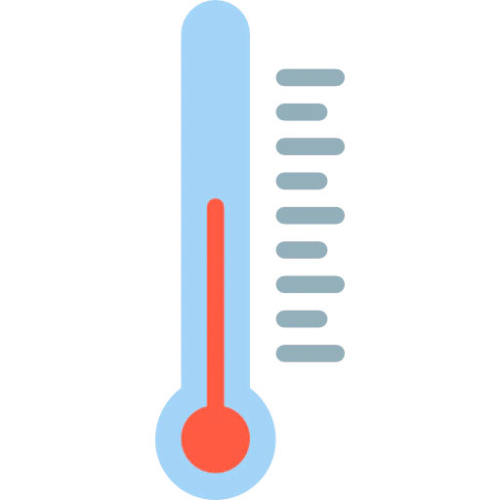
Loops
…an example
Recycle code
Apply a process
over-and-over
℃ ℉

Slide 20
Loops
℉
Recycle code
Apply a process
over-and-over
(67
(58
(54
(66
(70
(59

Slide 21
Loops
℉
℃
Recycle code
Apply a process
over-and-over
(67 - 32) * 5/9 = 19.4
(58 - 32) * 5/9 = 14.4
(54 - 32) * 5/9 = 12.2
(66 - 32) * 5/9 = 18.9
(70 - 32) * 5/9 = 21.1
(59 - 32) * 5/9 = 59.0

Slide 22
Loops
Recycle code
Apply a process
over-and-over
For each value in fahrenheit_list:
(value-32) * 5/9

Slide 23
Loops
℉
Recycle code
Apply a process
over-and-over
(67
(58
(54
(66
(70
(59
(value-32) * 5/9

Slide 24
Loops
℉
℃
Recycle code
Apply a process
over-and-over
(67 - 32) * 5/9 = 19.4
(58 - 32) * 5/ 9 = 14.4
(54 - 32) * 5 /9 = 12.2
(66 - 32) * 5/9 = 18.9
(70 - 32) * 5/9 = 21.1
(59 - 32) * 5/9 = 59.0
(value-32) * 5/9

Slide 25
Loops
℉
℃
Recycle code
Apply a process
over-and-over
(67 - 32) * 5/9 = 19.4
(58 - 32) * 5/9 = 14.4
(54 - 32) * 5/9 = 12.2
(66 - 32) * 5/9 = 18.9
(70 - 32) * 5/9 = 21.1
(59 - 32) * 5/9 = 59.0

Slide 26

Recap
Data Structures
Index positions
Conditions
Loops

Slide 27

Questions?

