Slide 1

Python for
Bioinformatics
Working with DNA Data

Slide 2

Map
DNA Sequence Data:
Biopython & SeqIO
The FASTQ Format

Slide 3

Calendar
Morning 1: Foundations of Python
Afternoon 1: Data Structures, Conditions, & Loops
Morning 2: Reading & Manipulating DNA Data
Afternoon 2: Reading and Writing Files

Slide 4

DNA Data Files

Slide 5

Biopython
Tools for working with DNA data in Python
https://biopython.org/

Slide 6
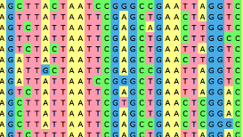
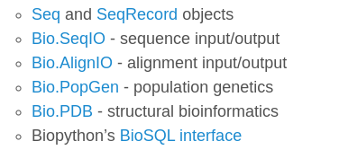
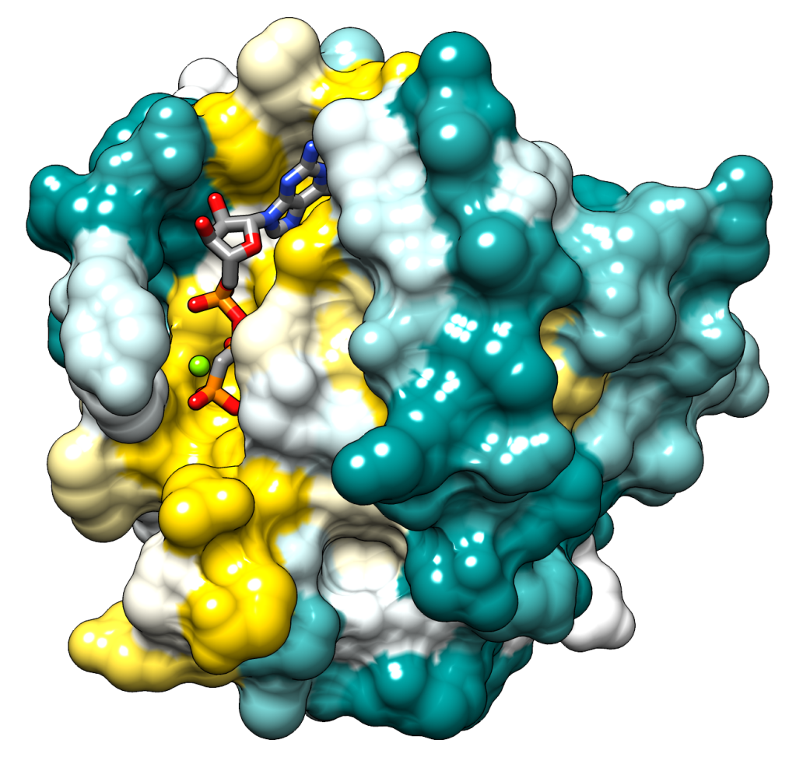

Biopython
https://biopython.org/
Tools for working with DNA data in Python

Slide 7


The FastQ
Format
@MISEQ:42:000000000-A8DD3:1:1101:15046:1468
TTCACATCCTGACCATTCAGTTGAGCAAAATAGTTCTTCAGT
+
CCFFFFFGHHHHJIJJJJIJJJIIJJJJIIIJJGFIIIJEDD

Slide 8
SeqIO.parse
seqIO.parse(sequence_file, format)
Format options: “fastq”, “fasta”
Use and options

Slide 9
SeqIO.parse
seqIO.parse(sequence_file, format)
seqIO.parse(my_seq_data.fastq, “fastq”)
Use and options

Slide 10
SeqIO.parse
print(id)
@MISEQ:42:000000000-A8DD3:1:1101:15046:1468
Read a sequence file
&
“Parse” the file into constituent parts
print(seq)
TTCACATCCTGACCATTCAGTTGAGCAAAATAGTTCTTCAGT

Slide 11
Modify Reads
print(record.seq) # full sequence
AAAAAAAAAAATCATCTATATCA
Components can then be modified

Slide 12
Modify Reads
print(record.seq) # full sequence
AAAAAAAAAAATCATCTATATCA
Components can then be modified

Slide 13
Modify Reads
print(record.seq) # full sequence
AAAAAAAAAAATCATCTATATCA
print(record.seq[11:]) # trim 11 bases
TCATCTATATCA
Components can then be modified

Slide 14

Recap
BioPython
FastQ Format
SeqIO
Modification

Slide 15

Questions?

