Slide 1

Python for
Bioinformatics
Reading & Writing Files

Slide 2

Map
Reading / Writing Files:
Data streams
Write FASTQ data

Slide 3

Calendar
Morning 1: Foundations of Python
Afternoon 1: Data Structures, Conditions, & Loops
Morning 2: Reading & Manipulating DNA Data
Afternoon 2: Reading and Writing Files

Slide 4

Reading and Writing Files

Slide 5
Reading and Writing Files

Slide 6

Opening files
# read file using ‘with’ and ‘open’
with open(“/path/to/file”, ‘r’) as input_file:
open (file, “mode”)
“Open” establishes a link to the file
Three options:
r = ‘read’
w = ‘write’
a = ‘append’

Slide 7
Opening files
# read file using ‘with’ and ‘open’
with open(“/path/to/file”, ‘r’) as input_file:
open (file, “mode”)
“Open” establishes a link to the file
Three options:
r = ‘read’
w = ‘write’
a = ‘append’

Slide 8
Opening files
# read file using ‘with’ and ‘open’
with open(“/path/to/file”, ‘r’) as input_file:
a)
with open( )
b)
as variable

Slide 9
Opening files
# read file using ‘with’ and ‘open’
with open(“/path/to/file”, ‘r’) as input_file:
# loop through the file
for row in input_file:
# do something
print(row)
a)
with open( )
b)
as variable

Slide 10
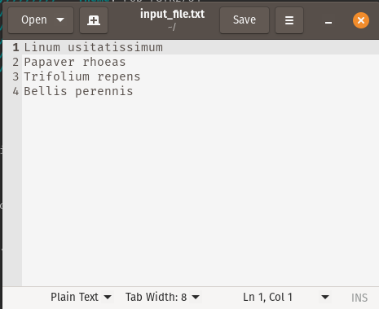
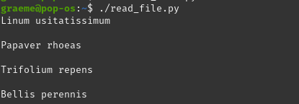
Opening files
a)
with open( )
b)
as variable

Slide 11
Reading and Writing Files

Slide 12

Writing files
Use the
.write()
method
# write file using ‘with’ and ‘open’
with open(“/path/to/file”, ‘w’) as output_file:

Slide 13
Writing files
Use the
.write()
method
# write file using ‘with’ and ‘open’
with open(“/path/to/file”, ‘w’) as output_file:

Slide 14
Writing files
Use the
.write()
method
# write file using ‘with’ and ‘open’
with open(“/path/to/file”, ‘w’) as output_file:
output_file.write(“text_to_write”)
output_file.write(“CGTGATGAG”)

Slide 15
Writing DNA Data to File

Slide 16

Writing DNA Sequence files
seqIO.write(list_of_sequence_records,
output_filename,
format)
Format options: “fastq”, “fasta”
Use the
SeqIO.write()
method

Slide 17
Writing DNA Sequence files
seqIO.write(list_of_sequence_records,
output_filename,
format)
Use the
SeqIO.write()
method
seqIO.write(sequence_records,
“output.fastq”, “fastq”)

Slide 18

Recap
with & open
read, write, append
SeqIO.write()

Slide 19

Questions?

