Slide 1
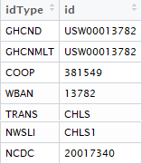




Repository #1:
Daily and monthly data products
Repository #2:
Hourly data products
Repository #3:
10-minute data products
Same station & data products
Different abbreviations, repositories, time scales & station identifiers

Slide 2
I need [environmental phenomenon] data for [spatial region of interest] from [start date] to [end date] that are produced every [temporal resolution]
Need accurate station metadata!!
Easily accessible metadata
Elusive metadata
Site Name(s)
Site IDs (e.g., NCDC, WBAN, GHCND)
Platform(s) (e.g., COOP, AWOS, NEON)
Geolocation data
Latitude
Longitude
Elevation
Absolute dates (site)
Variables measured (e.g., air temp, precipitation, etc.)
active dates for each measured phenomenon
Temporal Resolution of data product(s)

Slide 3
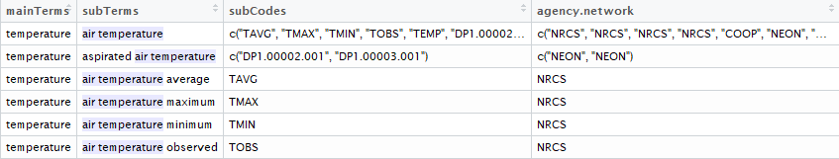
n-gram | Definition | Example
Uni-gram | One word | Temperature
Bi-gram | Two words | Air Temperature
Tri-gram | Three words | Minimum Air Temperature Maximum Air Temperature Average Air Temperature ….
Front end of metScanR
User searches for “Air Temperature”
Back-end of metScanR
Database link between n-grams & network-specific codes (subCodes)

