Slide 1
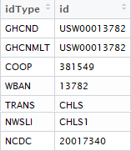




Repository #1:
Daily and monthly data products
Repository #2:
Hourly data products
Repository #3:
10-minute data products
Same station & data products
Different abbreviations, repositories, time scales & station identifiers

