Slide 1
Using R to Promote Data Interoperability in the Atmospheric Science Community
Josh Roberti
Robert Lee
Cody Flagg
Lee Stanish
National Ecological Observatory Network (NEON), Boulder, CO

Slide 2
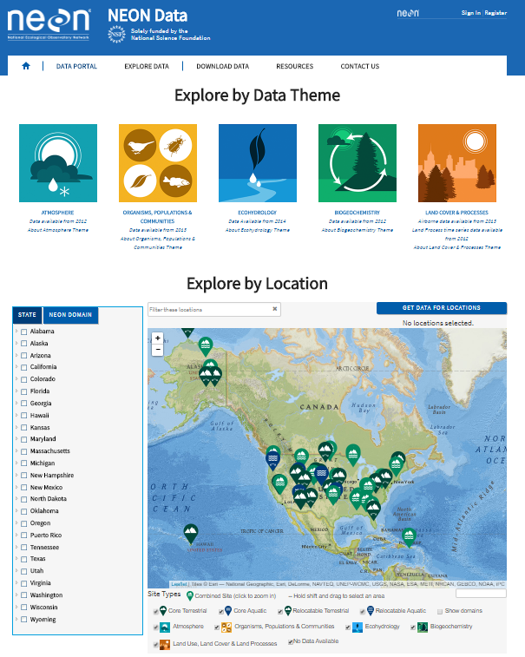
“NEON?... I’ve never heard of it”
A continental-scale ecological Observatory that gathers and synthesizes data on the impacts of climate change, land use change and invasive species on natural resources and biodiversity.
NEON’s open-access data, resources and infrastructure will enable scientists, educators, planners, decision makers and the public to map, understand and predict the effects of human activities on ecology and effectively address critical ecological questions and issues.

Slide 3
“NEON data commissioning”

Slide 4
NEON Data Commissioning

Slide 5
metScanR main points
Number of stations
Usability
Pros / cons

Slide 6
NEON commissioning via metScanR

Slide 7
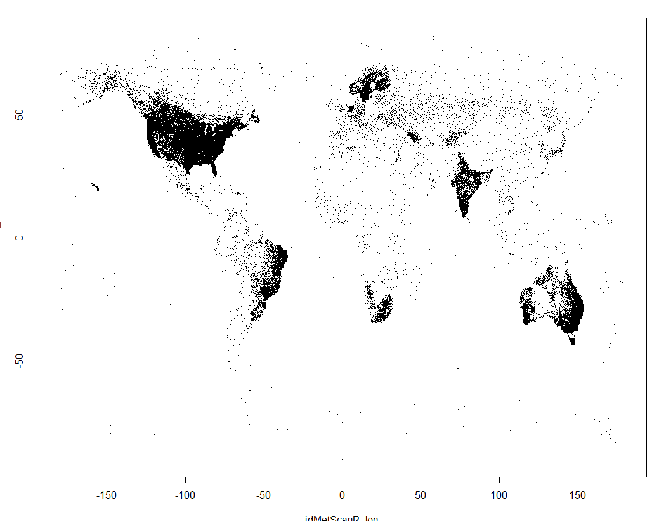
metScanR examples

Slide 8
Vietnam example

Slide 9
Future Plans
Funding – data munging and merging (same units, timestamps, etc.)

