Slide 1



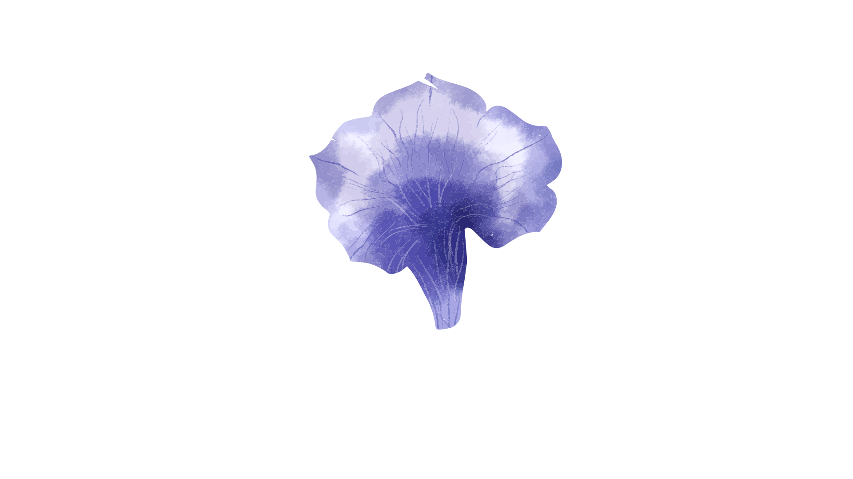
Iris Data Set

Slide 2
Answering Questions:
How to accurately predict the species of iris flower. | Building a machine learning template and using the correct formulas to classify the characteristics of the flower.
Why use the Iris Data Set to test the value of a machine learning program? | The iris dataset has been around since 1936 and has been used as a dataset because of the predictability
What information is expected to learn about machine learning programs from this dataset? | How to properly predict the outcome and test those predictions.

Slide 3
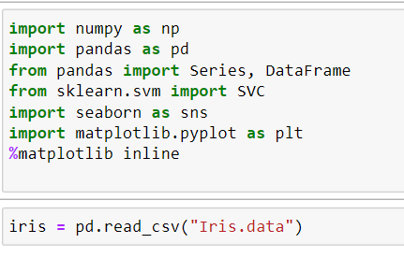
Libraries and Dataset

Slide 4
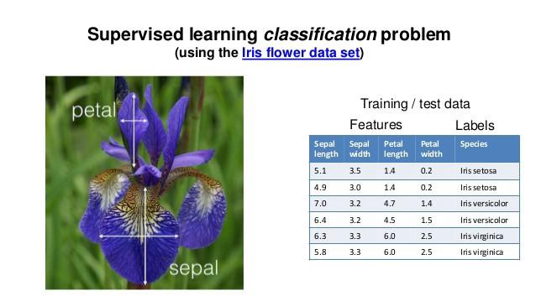
What is being measured in the data

Slide 5
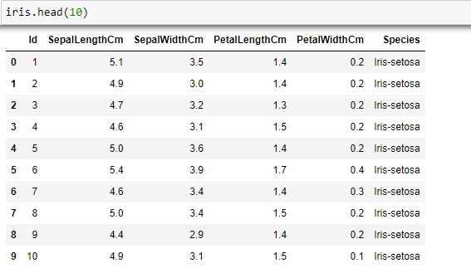
Iris Dataset
First 10 rows of data

Slide 6
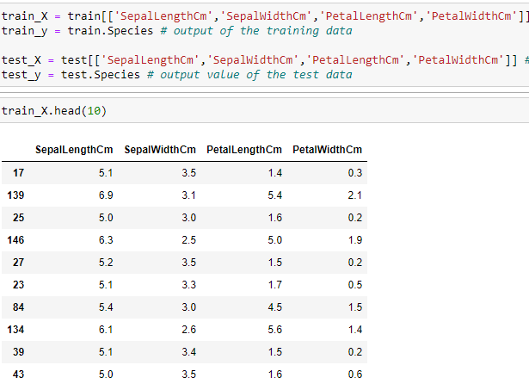
Test and Train Data

Slide 7
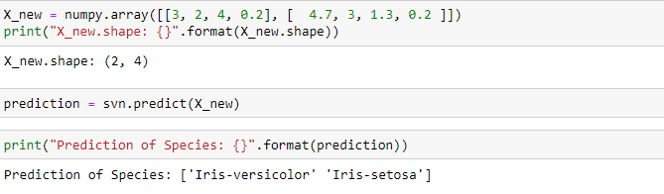
Predictions

Slide 8
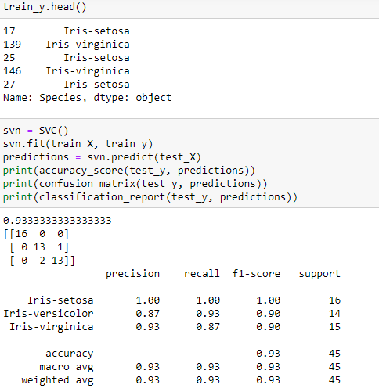
Notes:
Prediction

Slide 9
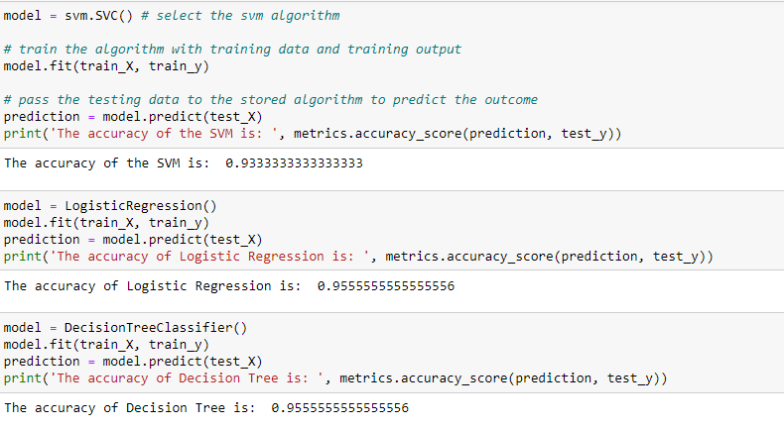

Slide 10
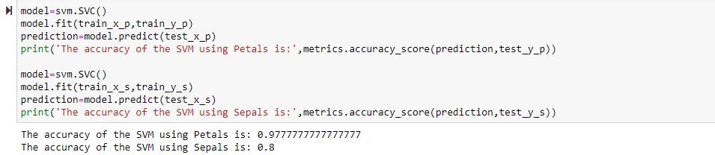
Support Vector Machine
Notes:
Support-Vector Machines (SVM)- Support vector machine is highly preferred by many as it produces significant accuracy with less computation power. Support Vector Machine, can be used for both regression and classification tasks. But, it is widely used in classification objectives.

Slide 11

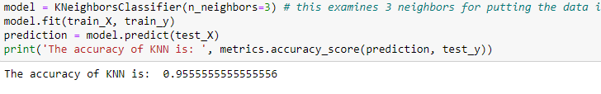
K-Nearest Neighbors
Notes:
K-nearest neighbors algorithm (K-NN)- algorithm is an index-based algorithm. It uses a non-parametric method for classification or regression. Training with the k-NN algorithm has three steps: sampling, dimension reduction, and index building, the main objective of k-NN's training is to construct the index.

Slide 12
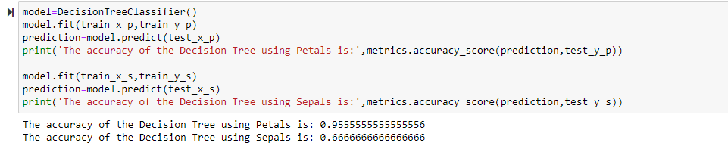
Decision Tree Classifier
Notes:
Decision Tree Classifier- can perform both classification and regression tasks. The intuition behind Decision Trees is that you use the dataset features to create yes/no questions and continually split the dataset until you isolate all data points belonging to each class.

Slide 13
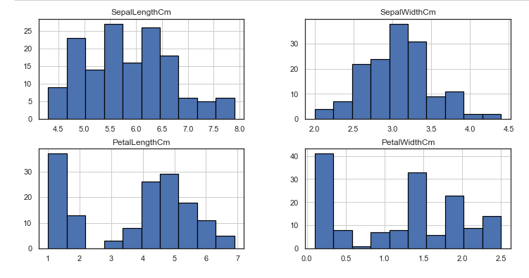
Notes:
A Histogram represents the distribution of a numeric variable for one or several groups. The values are split in bins, each bin is represented as a bar.

Slide 14
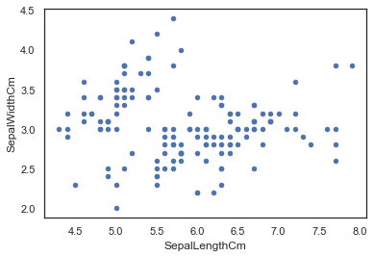
Scatter Plot
Notes:
Scatterplots use a collection of points placed displaying values from two variables. By displaying a variable in each axis, you can detect if a relationship or correlation between the two variables exists.

Slide 15

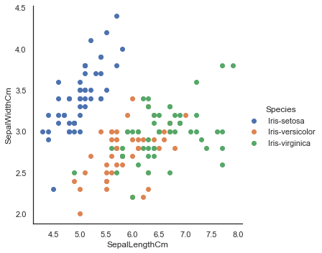
Facetgrid
Notes:
FacetGrid class helps in visualizing distribution of one variable as well as the relationship between multiple variables separately within subsets of your dataset using multiple panels.

Slide 16
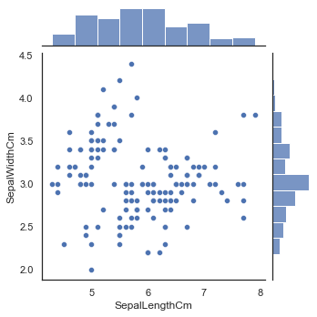
Seaborn Jointplot
Notes:
Seaborn Jointplot creates a scatter plot with two histograms at the top and right margins of the graph by default.

Slide 17
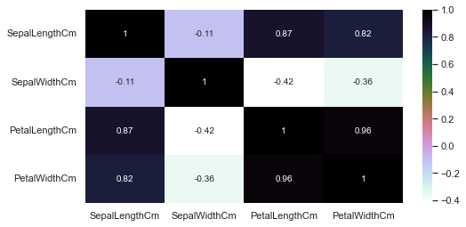
Heatmap
Notes:
Python seaborn heatmap is a graphical representation of 2D data. Each data value represents in a matrix and it has a special color. The main intention of Seaborn heatmap is to visualize the correlation matrix of data for feature selection to solve business problems.

Slide 18
Summary
The dataset consists of 150 cases (rows) and 5 variables (columns) named Sepal.Length, Sepal.Width, Petal.Length, Petal.Width, and Species of three species of the Iris flower: the Iris setosa, the Iris virginica and the Iris versicolor.
This discriminant analysis produces a simple function that, given the four measurements, will classify a flower correctly.
The purpose of this project was to gain introductory exposure to Machine Learning Classification concepts along with data visualization. The project utilizes Scikit-Learn, Pandas and Data Visualization Libraries.

Slide 19
Findings
For Iris Dataset it is evident that Support Vector Machine with a 97.7% accuracy rate is the best classification method. Following Decision Tree with a 95.6% accuracy rate and, K Nearest Neighbor at a 95.5% accuracy rate.

