Slide 1
AISIT: Hackathon Project Overview
08.09.2026 – NERC Digital Gathering
Charles Thorpe-Morgan, Ezra Kitson

Slide 2






Artificial Intelligence for Stable IsotopeTracers
OBJECTIVE
Develop a standardised and machine-readable database of Arctic freshwater tracer data

Slide 3
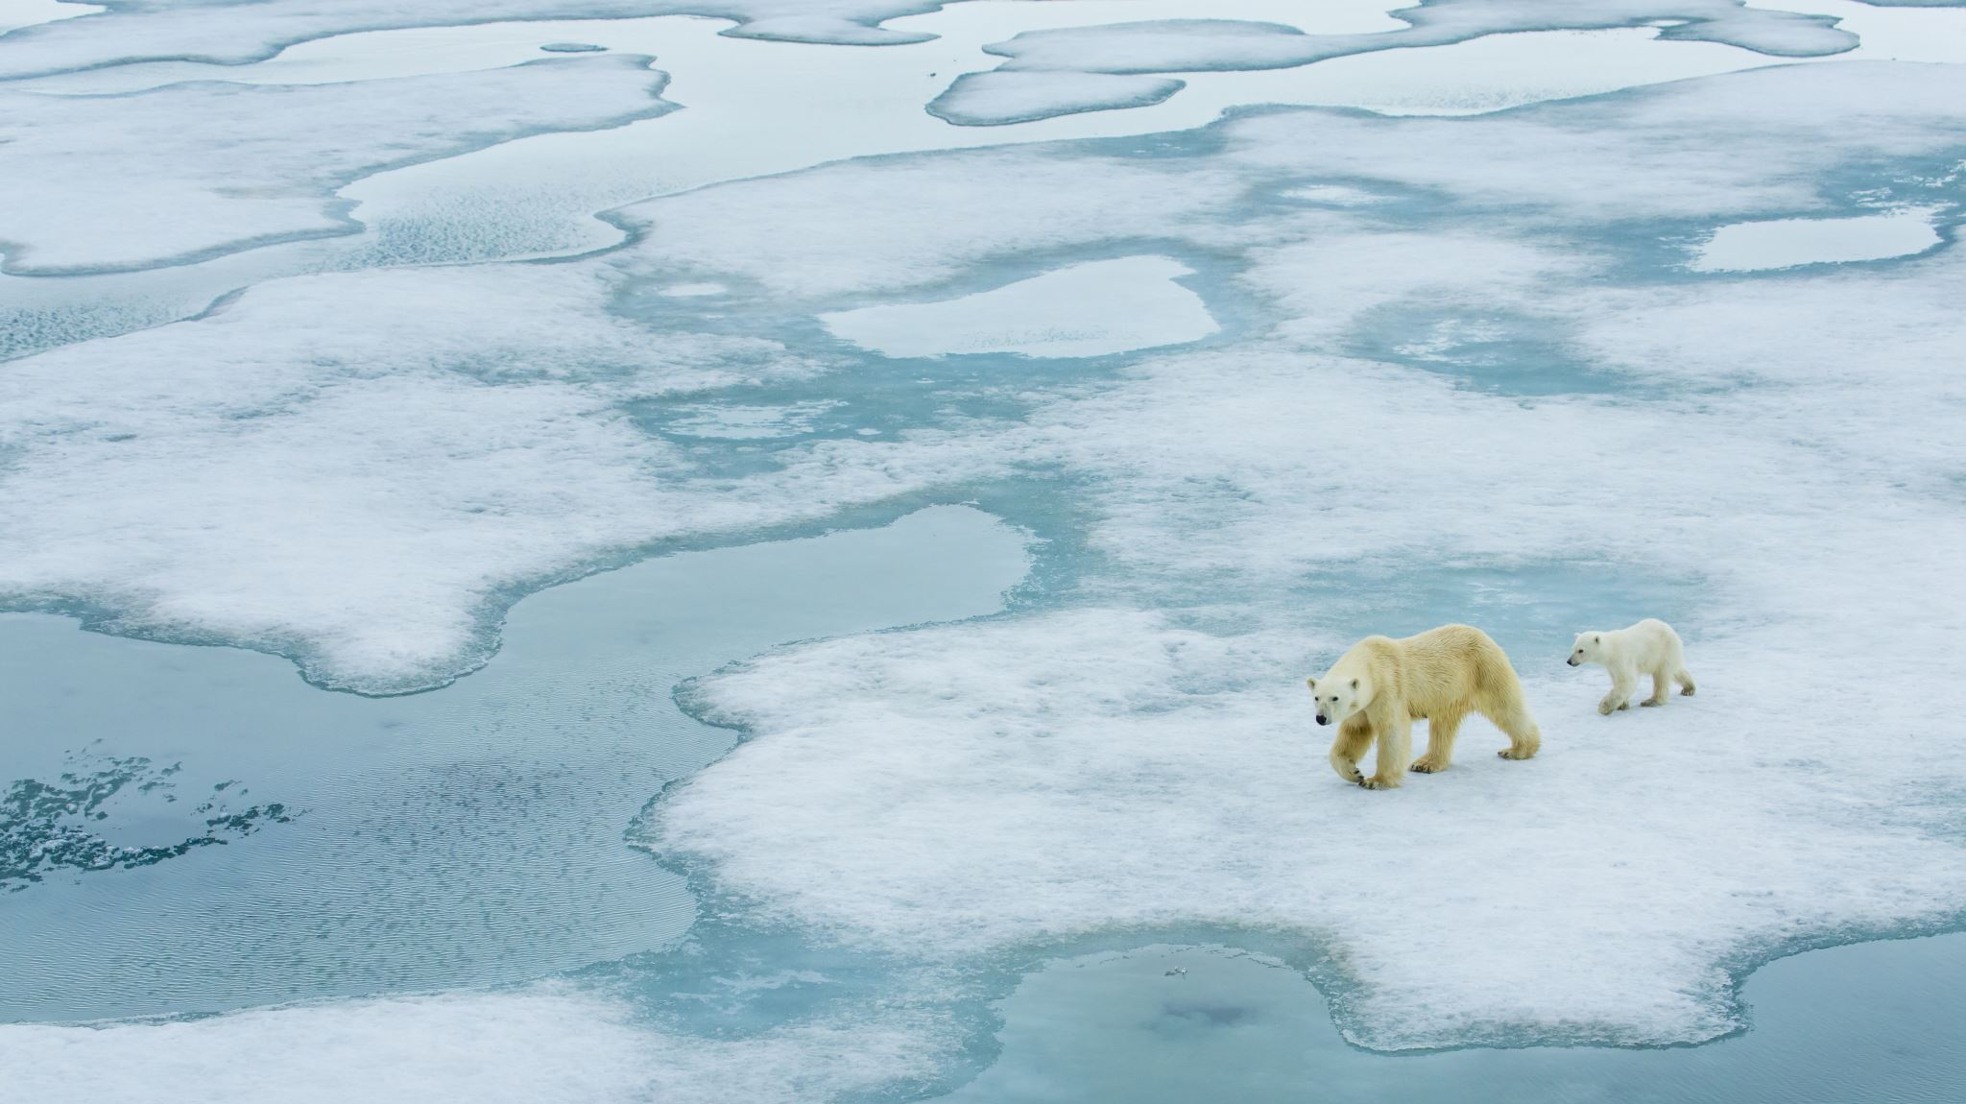
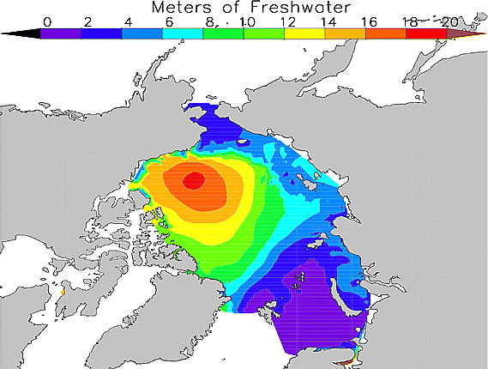
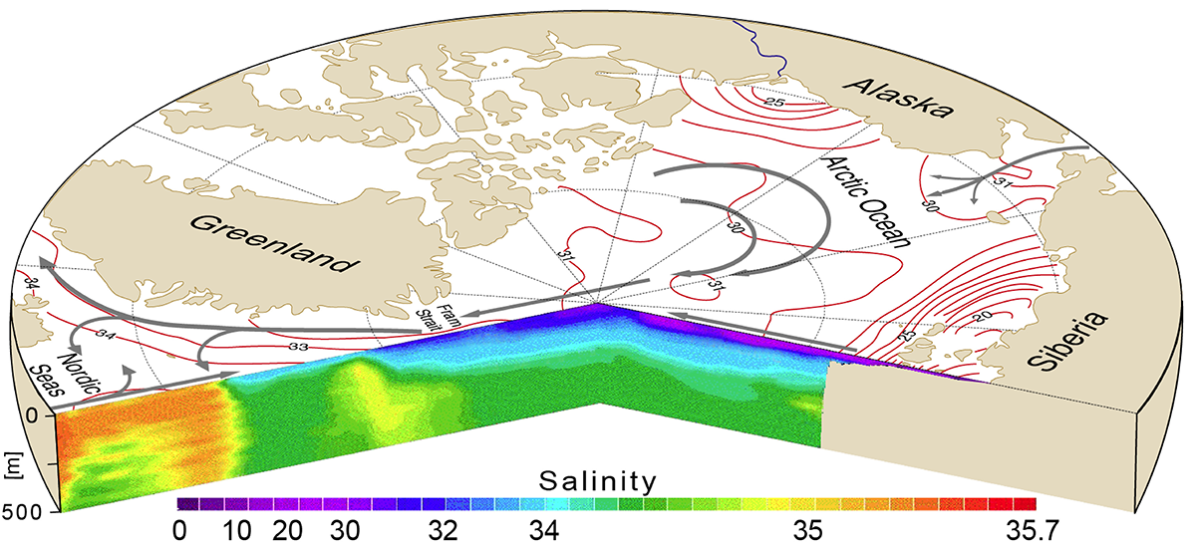
Arctic freshwater and circulation
Workpackage 1: Inputs
Modelled distribution of freshwater
in Arctic Ocean
Idealised salinity structure in Arctic Ocean
(also showing major flows – grey arrows)
Serreze et al. 2006
Spielhagen and Bauch, 2015
Freshwater inputs to the Arctic Ocean drive ocean currents
These inputs are changing rapidly
Modelling impacts requires validation by field-data

Slide 4
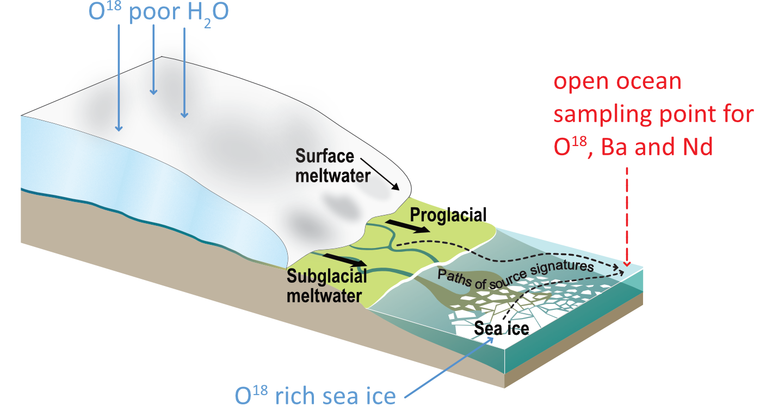
δ18 O as a freshwater tracer
Workpackage 1: Inputs
Potential freshwater sources
into the Arctic Ocean:
Glaciers
Sea ice
Rivers and precipitation
Inflows from other oceans
O¹⁸-poor H₂O
What is the mix of freshwater inputs to an open ocean sampling point?
Vast amounts of tracer data but highly fragmented
Repositories, papers and personal archives
No centralised, up to date, source of this data
O¹⁸-rich sea ice

Slide 5
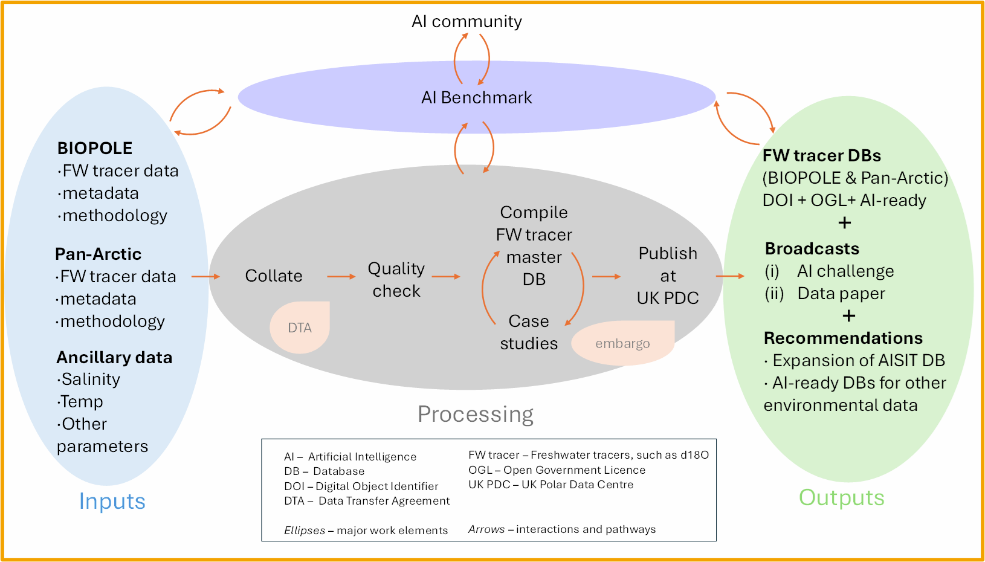
Schema & Metadata Standards
Schema co-designed with data management team, oceanography experts and ML teams
Schema that worked for all users
Four-tier field classification:
Essential (1)
Contributes to essential (2)
Essential for non-freshwater (2a)
Desirable (3)
10 mandatory fields incl. date, position δ¹⁸O value, salinity
Standards applied:
ACDD & CF conventions
ISO 8601 datetimes
WOCE QC flags
Custom flags for important dataset aspects
FAIR principles core to database / metadata
CROISSANT metadata file for machine readability
Notes:
The 2a category is the design decision I'm proudest of — a rigid 'salinity is essential' rule would have thrown away every freshwater record. The schema had to fit the real data without weakening the seawater requirement.

Slide 6
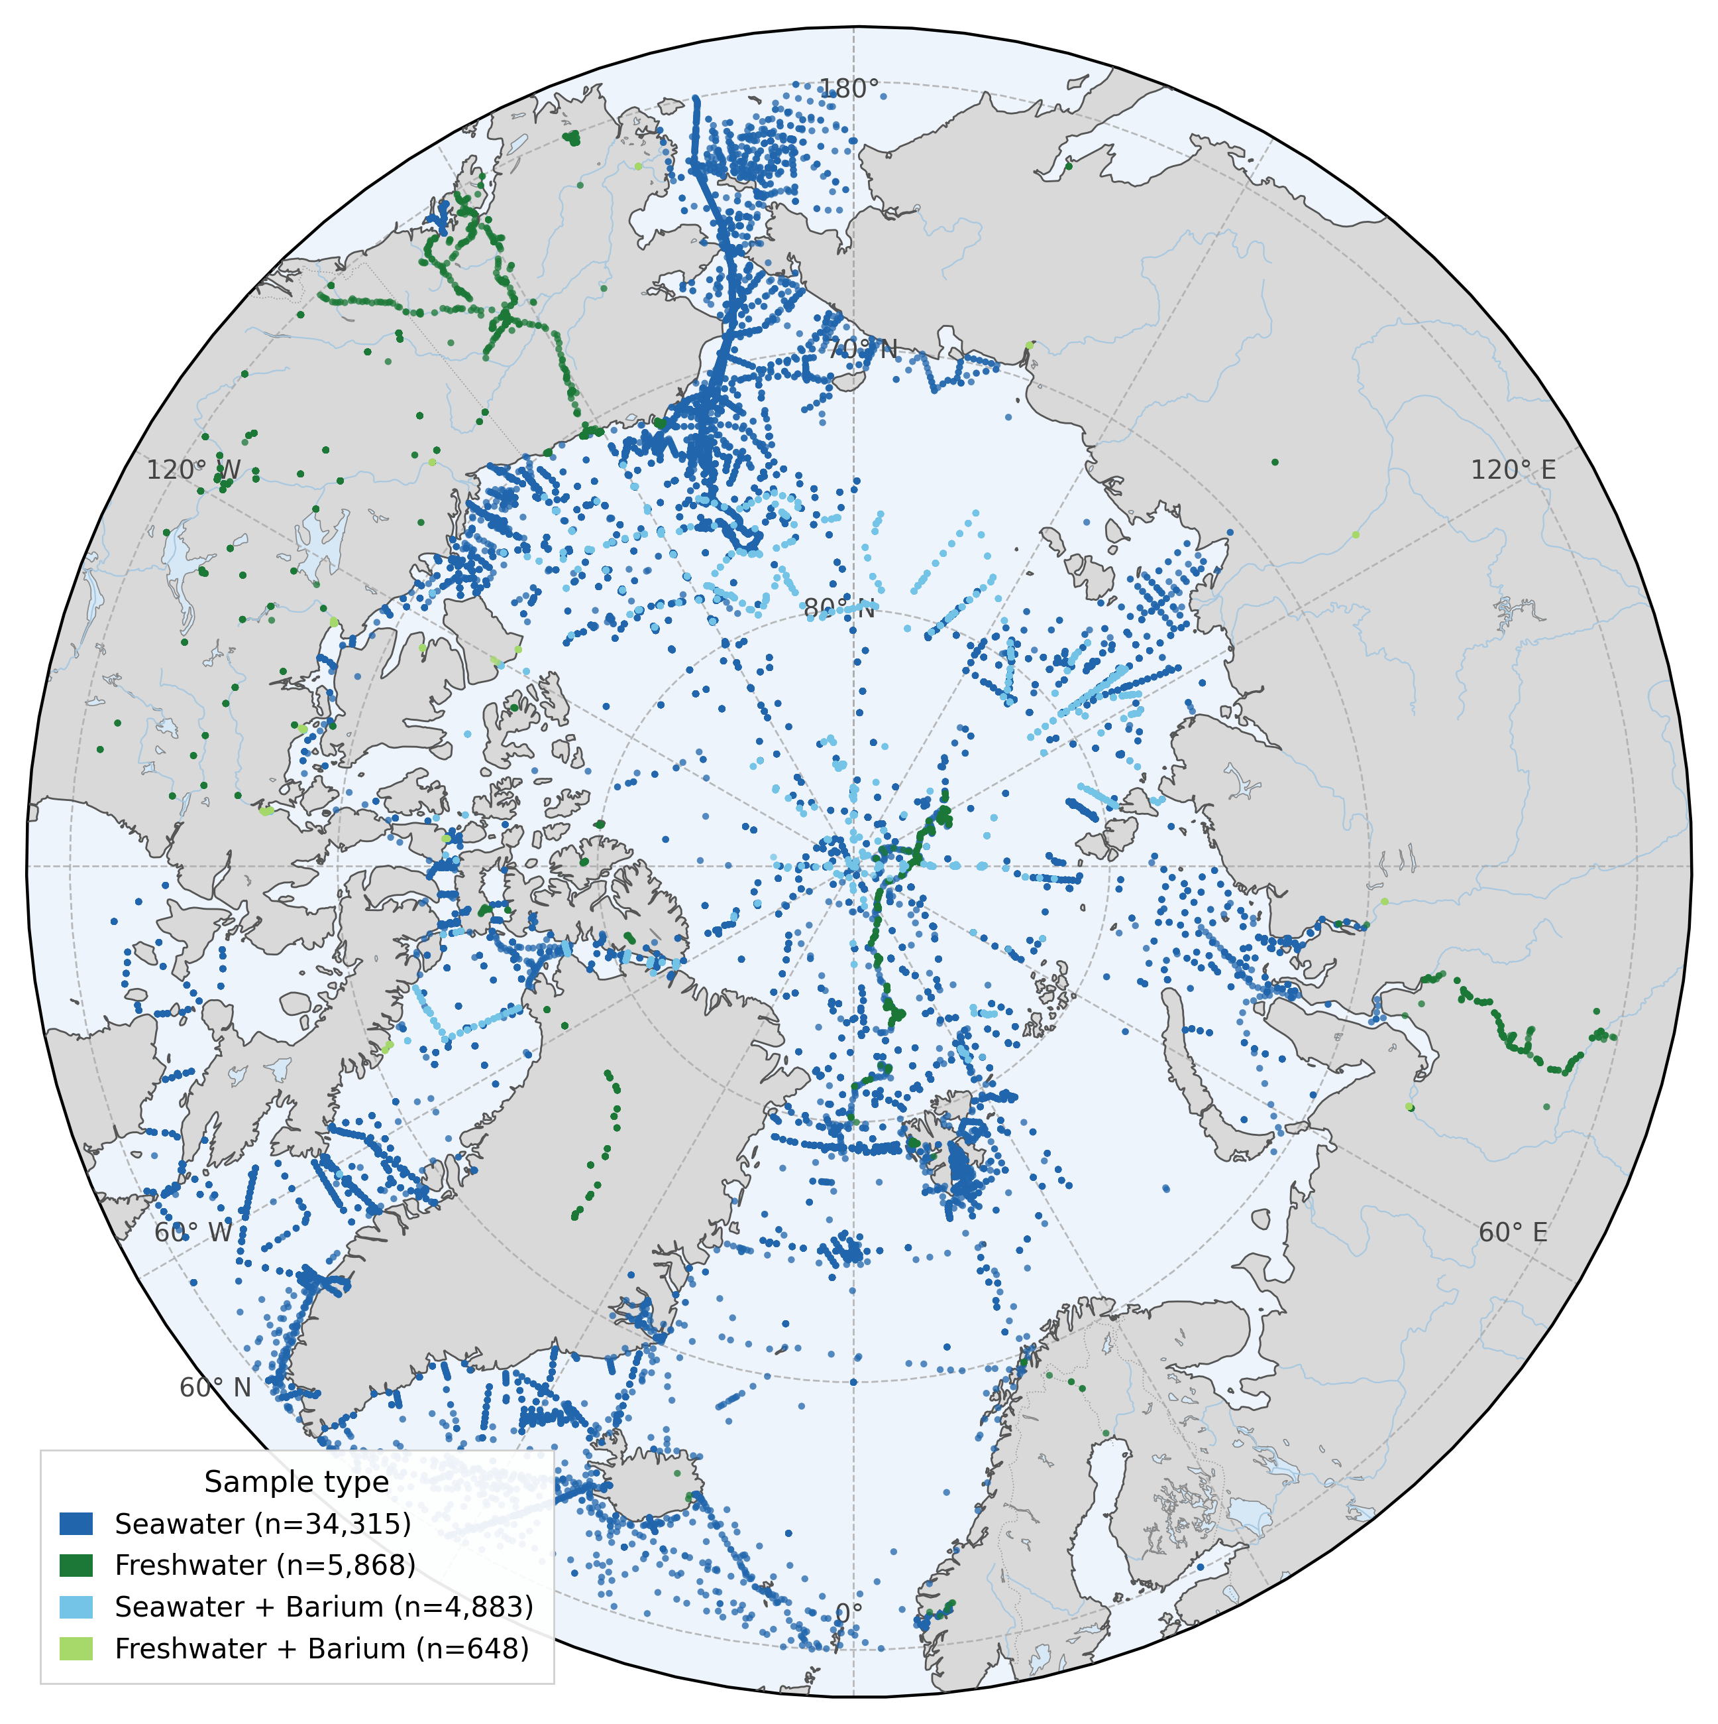
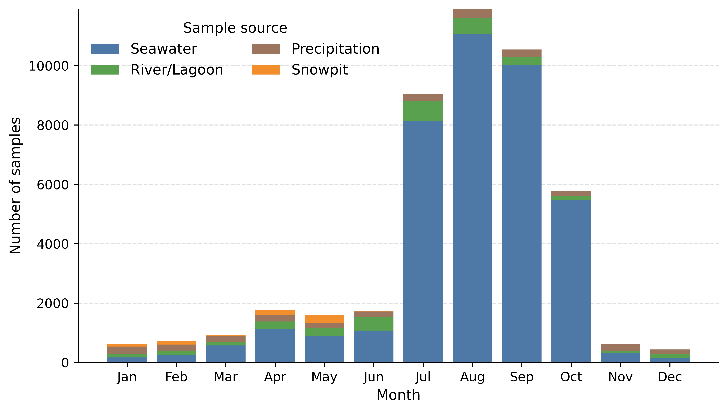
AISIT Database (version 1.0.0)
Database creators: Charles Thorpe-Morgan and Emily Rowlands - BAS
45,713 unique δ¹⁸O salinity pairs
99 datasets
Timespan: 1967 – 2025

Slide 7
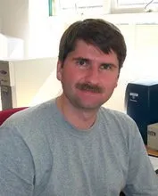
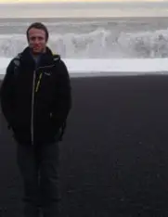

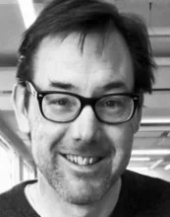
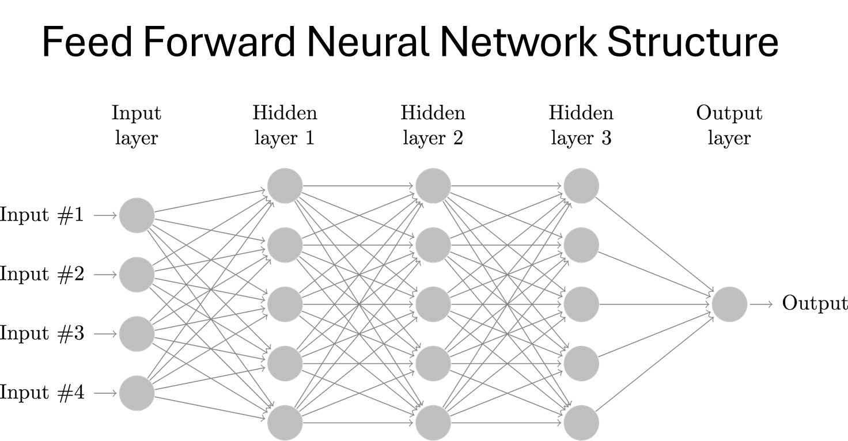
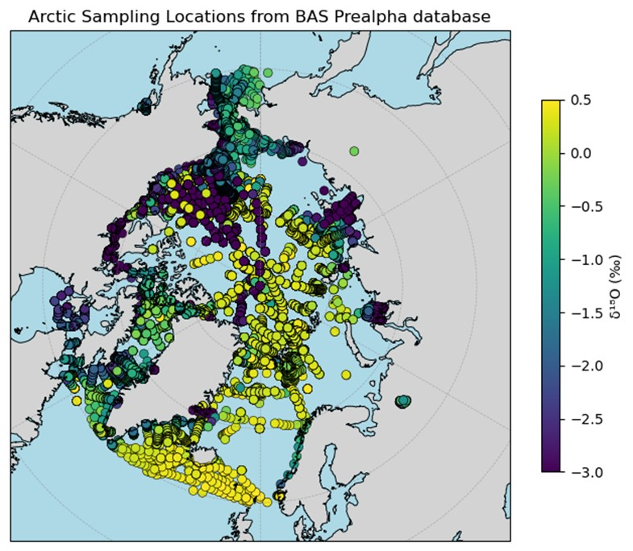
Initial Machine learning applications
See Tom’s talk Weds 9th 16:50
Yevgeny Aksenov, Tom Prime, Archie Cable, Adrian Martin - NOC
Reconstructing a gridded δ18 O distribution to determine major contributors to Arctic seawater across years and seasons
Subsetted dataset for training

Slide 8
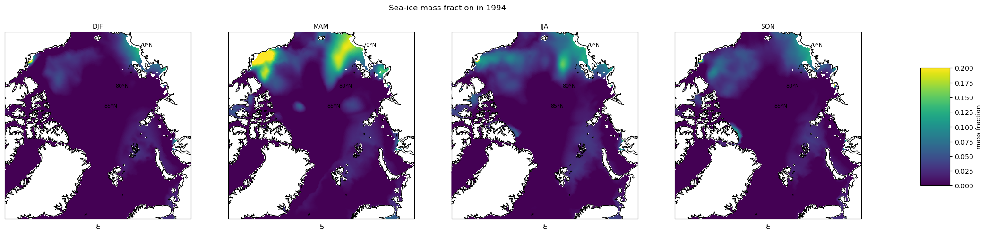
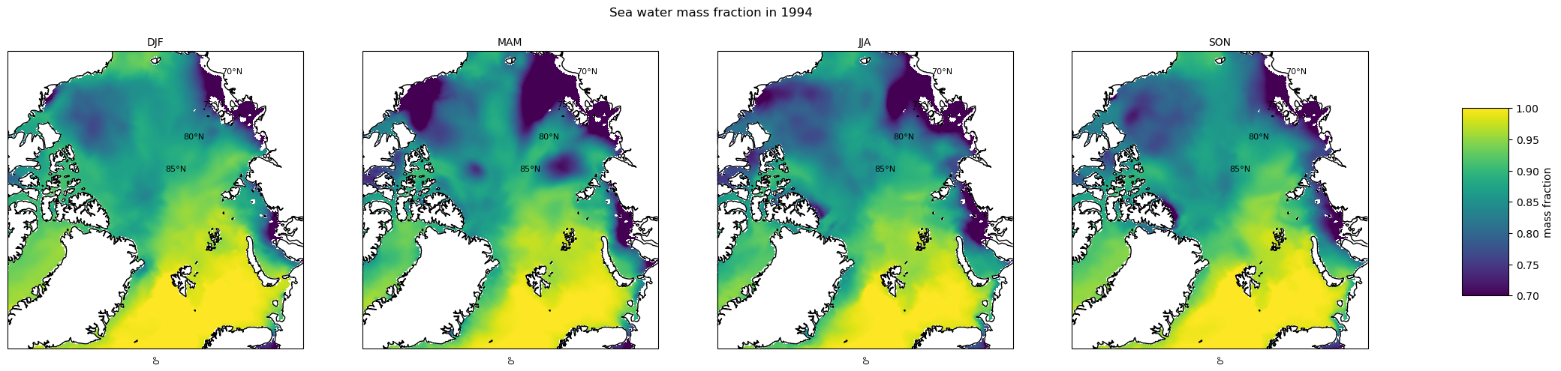
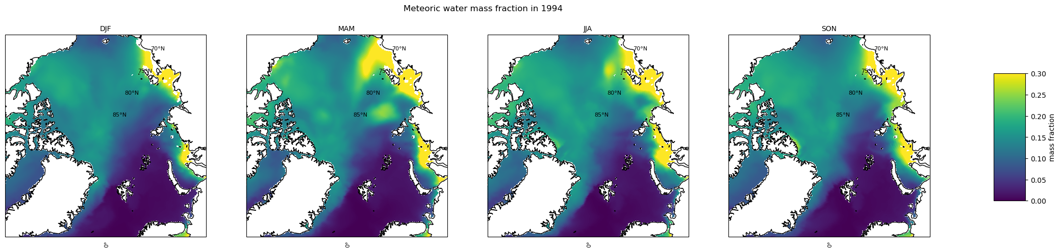
Initial Machine learning applications
Dec-Jan-Feb
Mar-Apr-May
Jun-Jul-Aug
Sep-Oct-Nov
Sea-ice mass fraction 1994
Sea-water mass fraction 1994
Meteoric-water mass fraction 1994

Slide 9
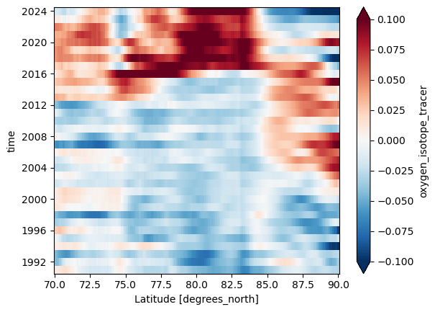
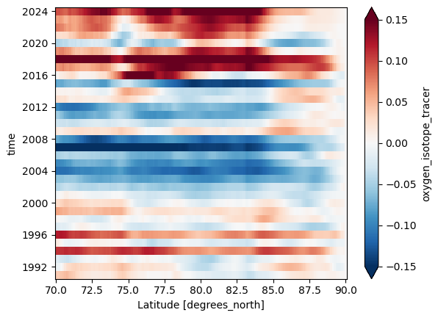
Initial Machine learning applications
Annual δ18 O anomaly averaged across longitude
Annual δ18 O anomaly gradient along latitude
Potential to identify influence of Arctic Ocean Oscillation on freshwater input anomalies

Slide 10
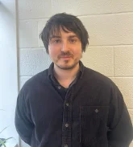
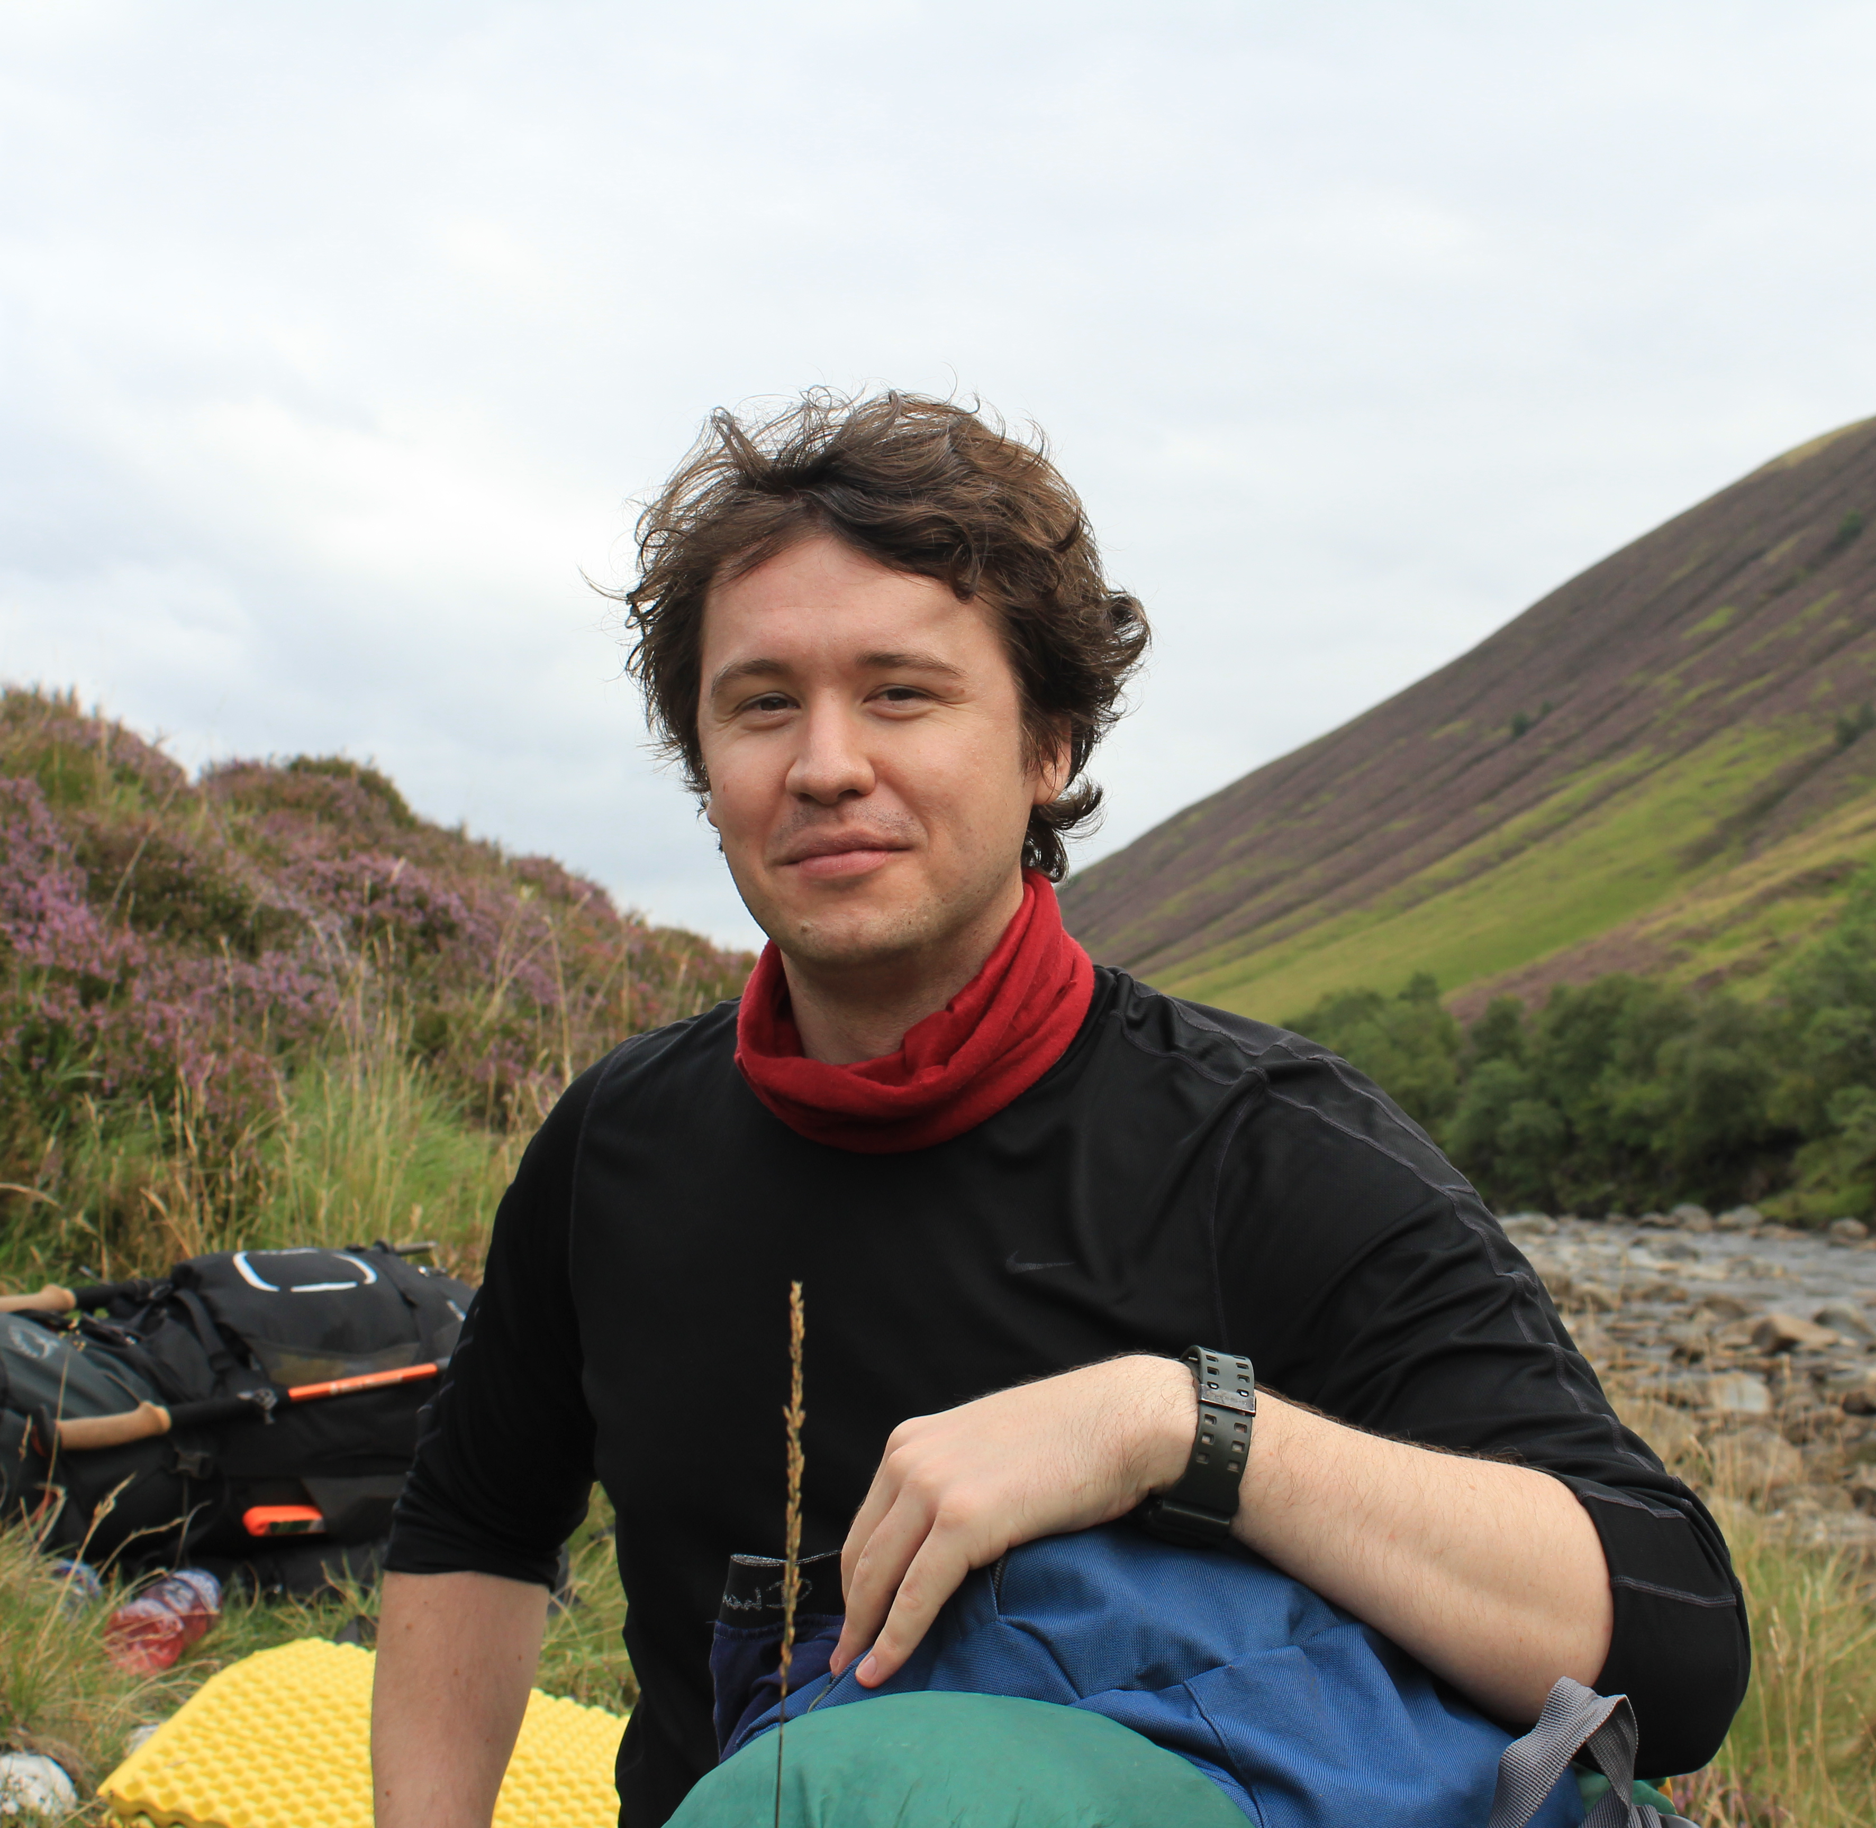
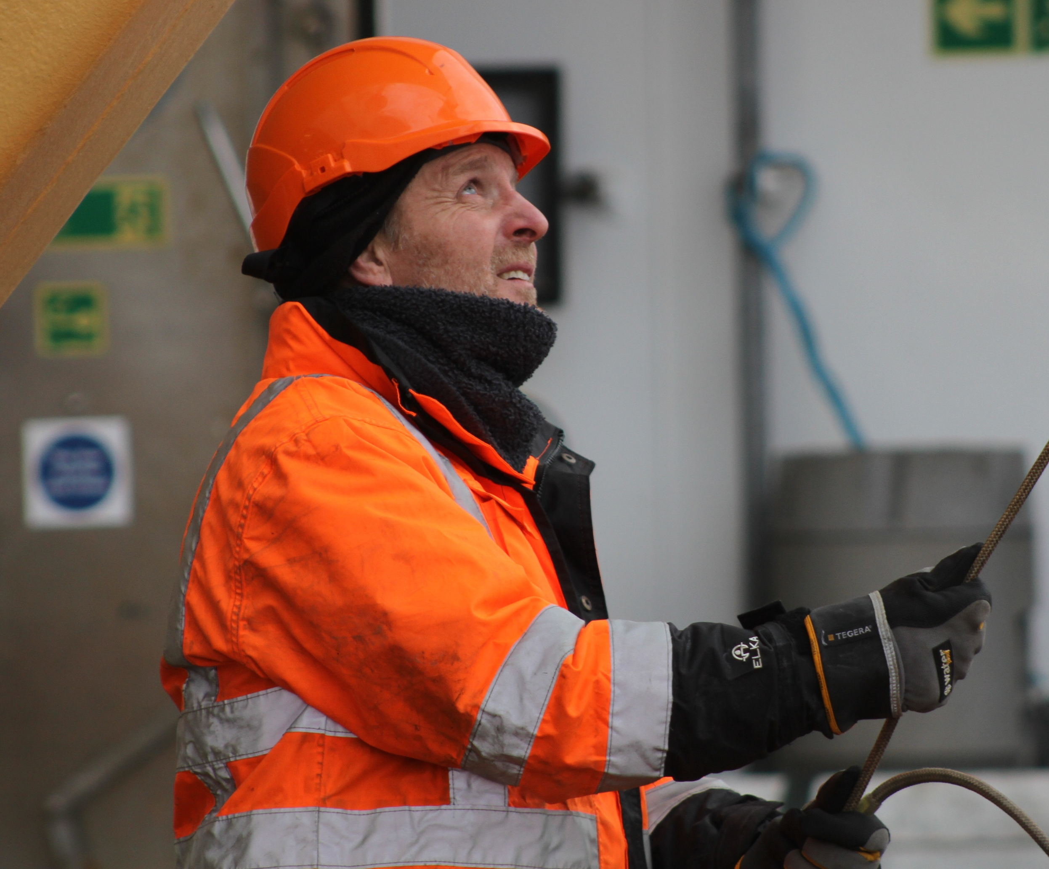
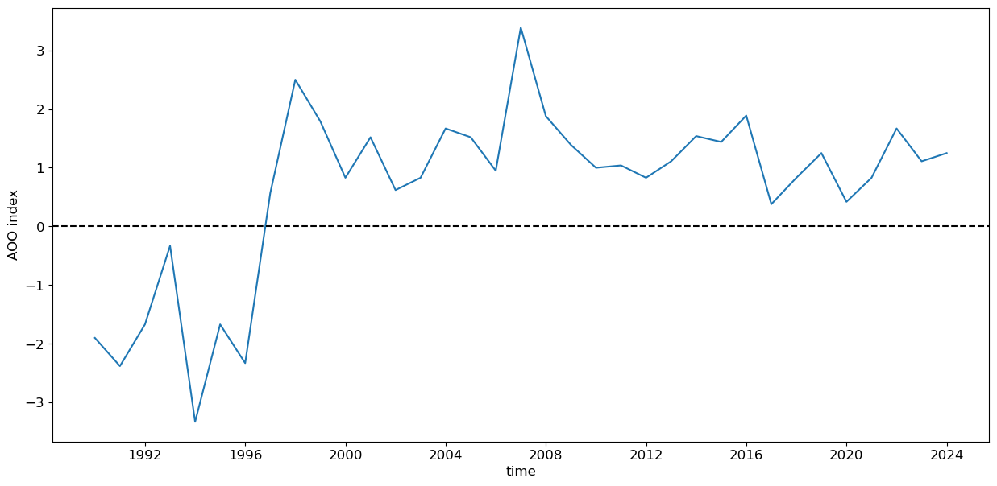
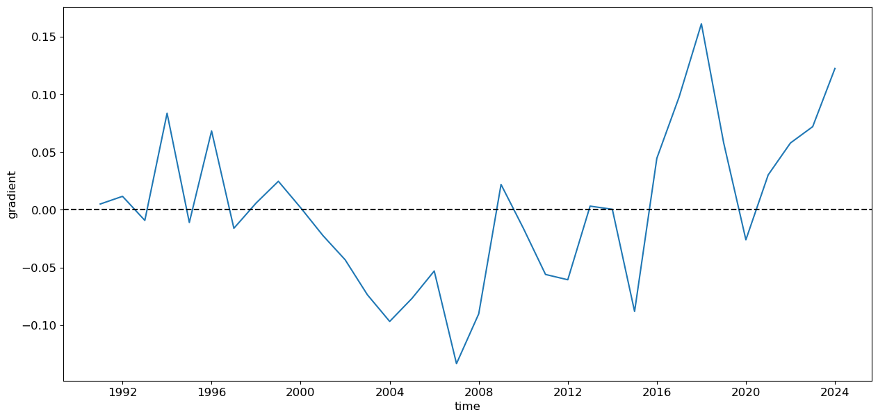
AI community challenge
Eza Kitson (UKCEH), Charles Thorpe-Morgan (BAS), Geraint Tarling (BAS)
Challenge:
Create a Jupyter notebook that identifies and visualises key features of Arctic freshwater flow using the AISIT database and supporting environmental datasets.
Example: simulating the Arctic Oscilllation index using the AISIT database
AO index
Neural network simulation using AISIT database

Slide 11
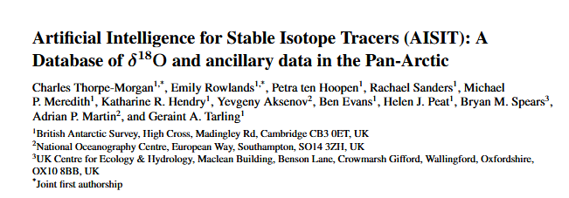
Publication of data
Paper currently in review
Work presented in several conferences
Public Apex portal: https://aisit.data.bas.ac.uk/
Data published at the PDC: https://doi.org/10.5285/0dfb14d6-73a9-4273-99ed-b231ca581b1d
OGL v3
XCSV, netCDF, Parquet
Croissant machine-readable metadata
Publicly accessible Arcgis map

Slide 12
https://github.com/NERC-CEH/AISIT-Hackathon-2026

Slide 13
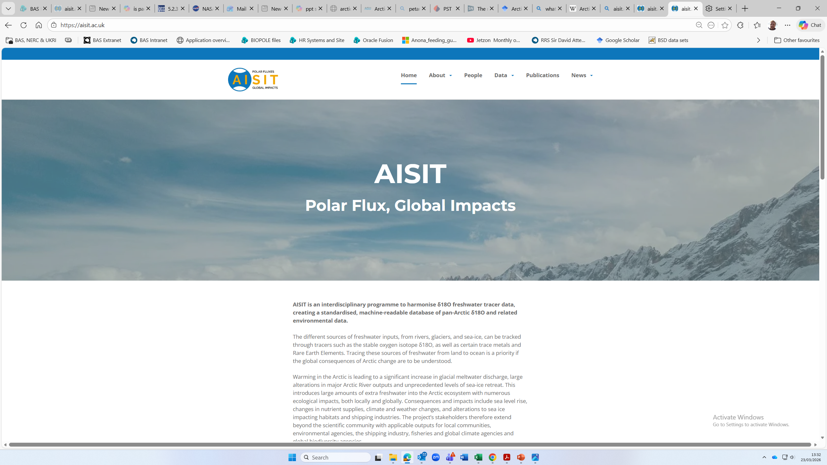
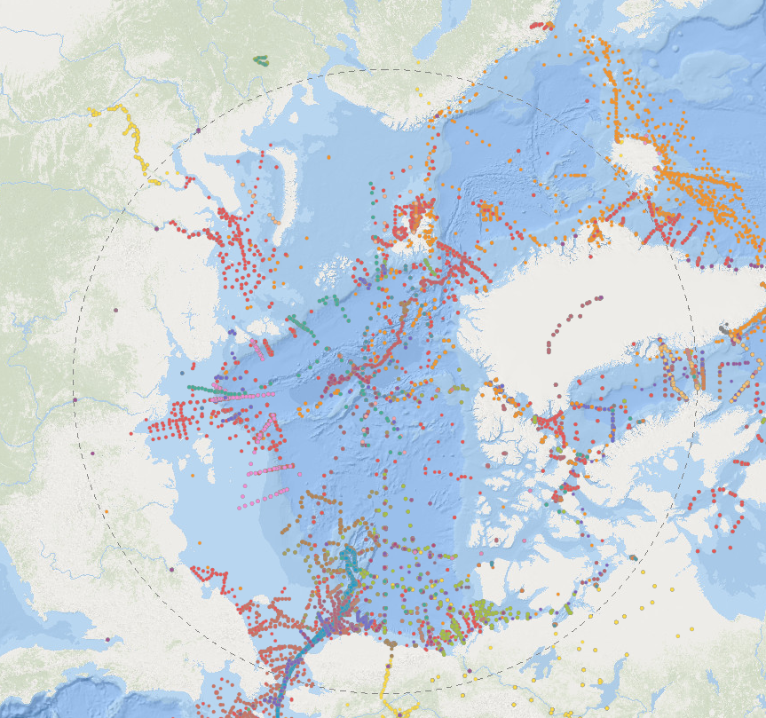
Find out more on our website
www.aisit.co.uk

