Slide 1
S H I N Y
I n t e r a c t i v e W e b A p p l i c a t i o n
i n R
Tom August

Slide 2
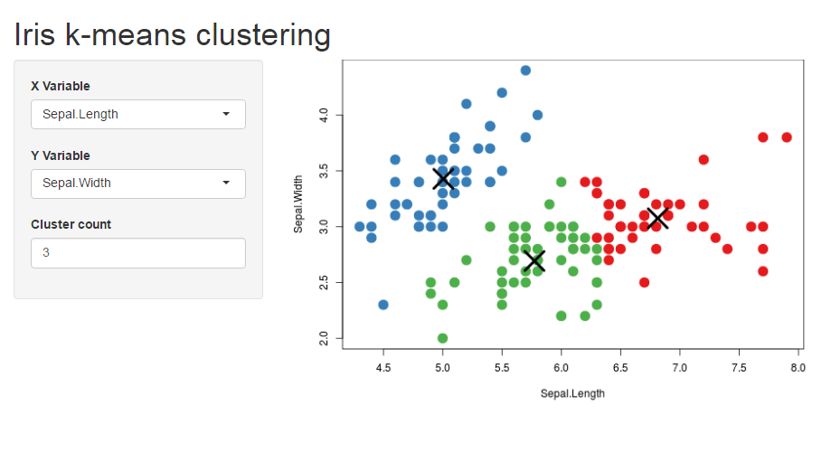
Make Your R Accessible

Slide 3
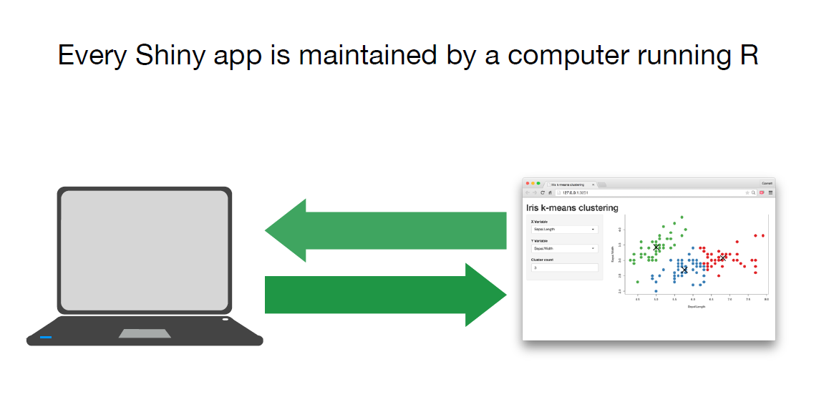
How does it work?
Server.R
UI.R

Slide 4
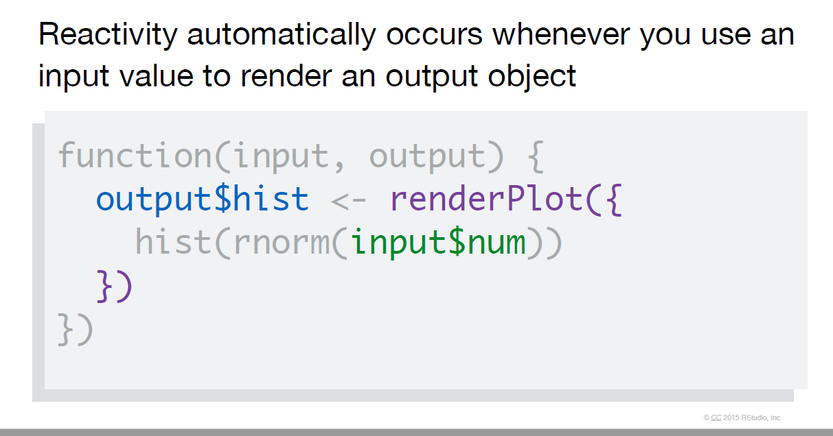
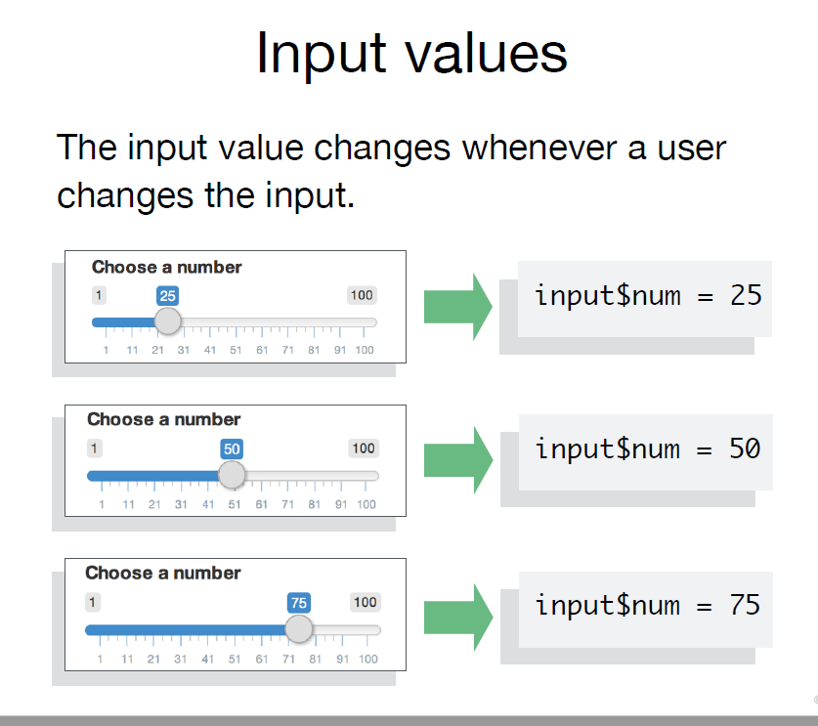
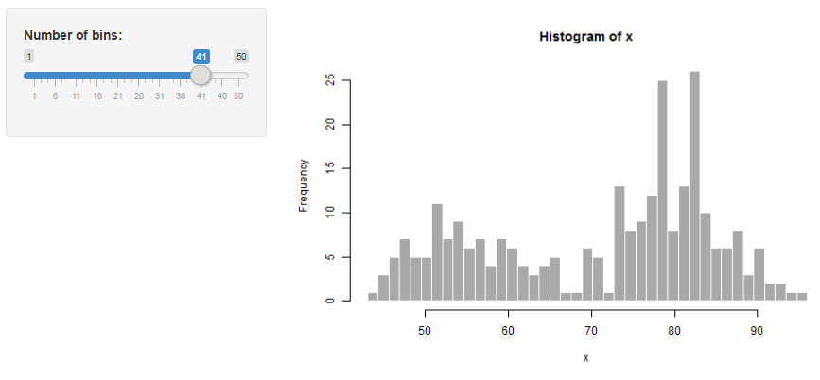
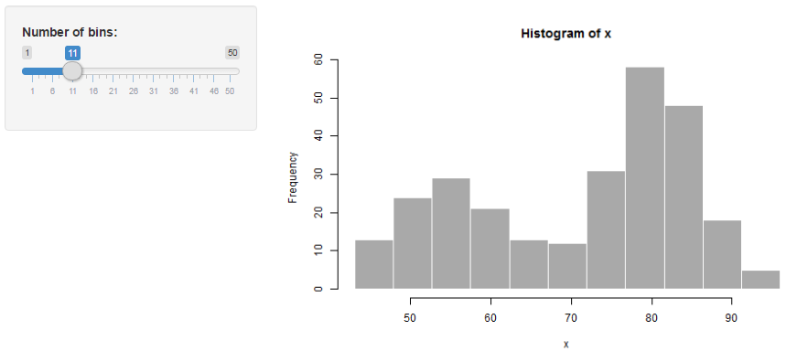
How does it work?

Slide 5
Examples
Shiny Gallery
User inputs define graph http://shiny.rstudio.com/gallery/kmeans-example.html
There are a range of widgets: http://shiny.rstudio.com/gallery/widget-gallery.html
Or with Google charts: http://shiny.rstudio.com/gallery/movie-explorer.html
Maps can be done ++ : http://shiny.rstudio.com/gallery/superzip-example.html
CEH Examples
Mapping Biological records data: https://shiny-apps.ceh.ac.uk/natures_postcode/
Exploring flood data: https://shiny-prod.nerc-lancaster.ac.uk:8443/droughts/reconstruction_explorer/

Slide 6
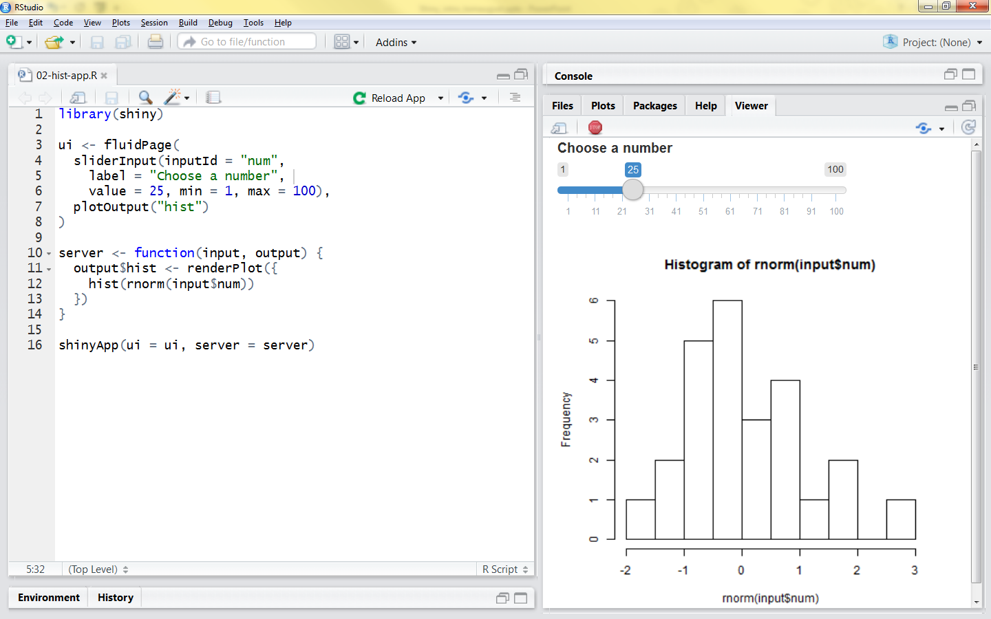
How Do I Do it?
Workshop

Slide 7
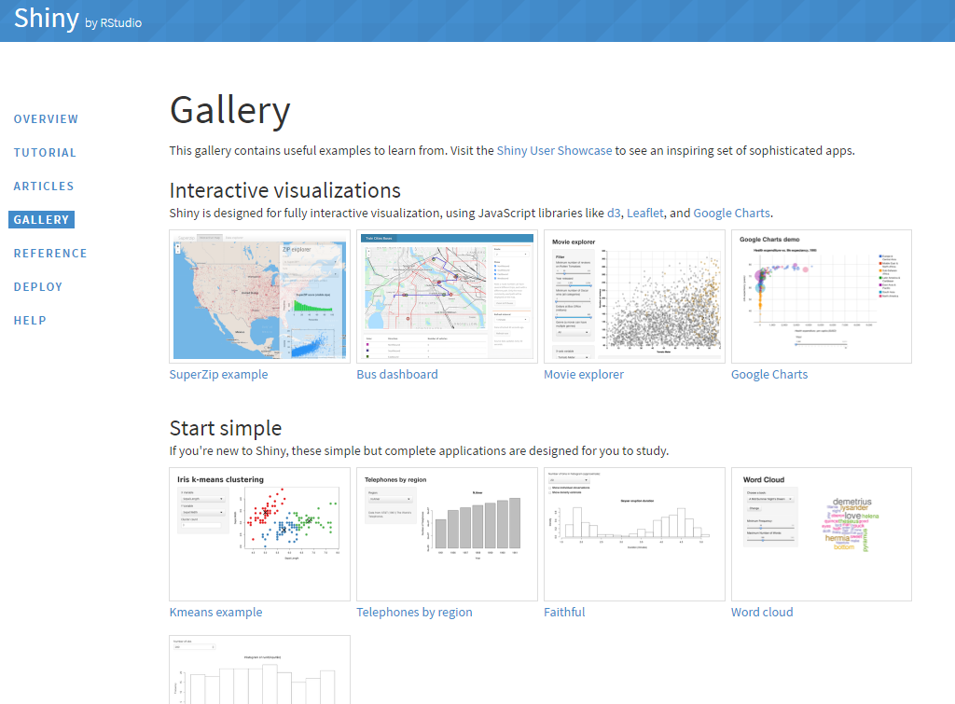
How Do I Do it?
Gallery
http://shiny.rstudio.com/gallery/

Slide 8
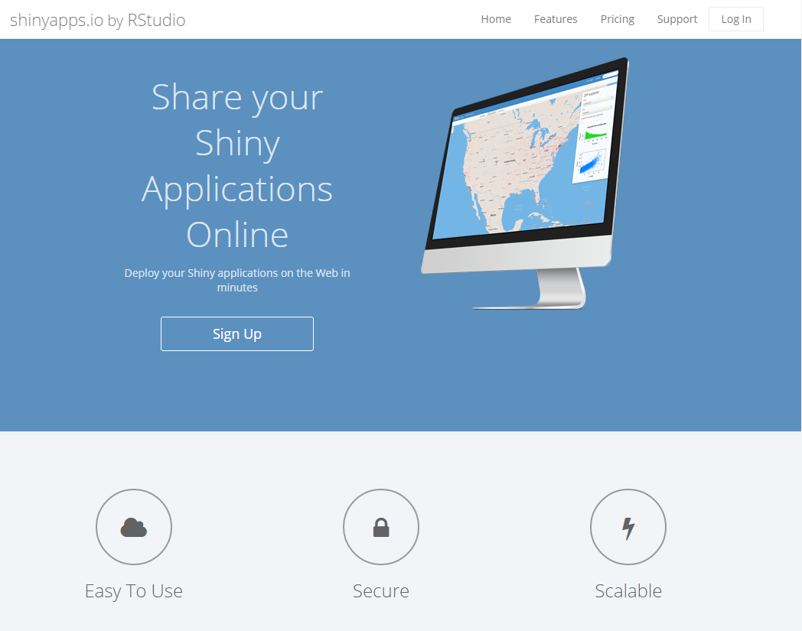
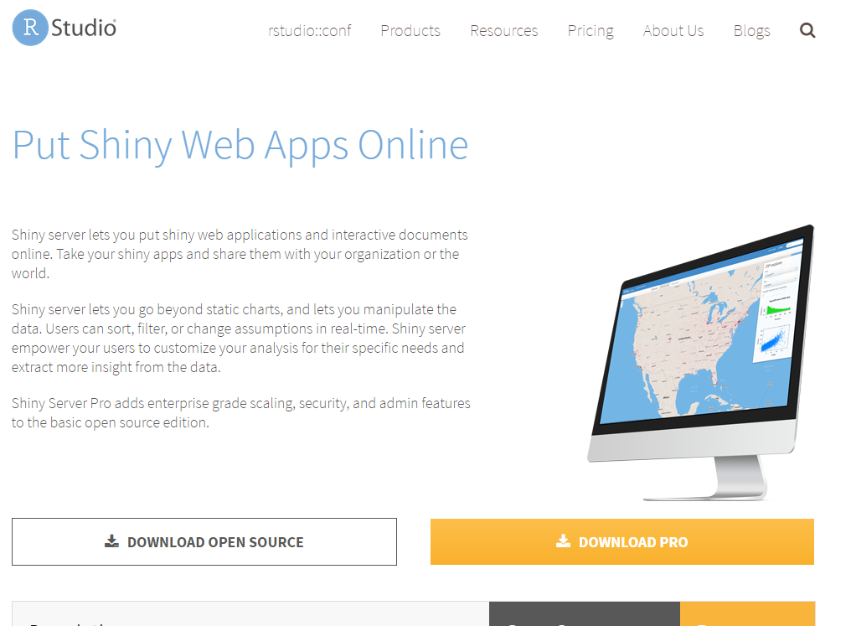
How Do I Do it?
Hosting
ShinyApps.io
CEH Server

