Slide 1

FastR BettR HappyR
How to speed up & Improve your code

Slide 2
Why?
Why do I need to speed up/improve my code
Analysis takes too long
Memory allocation issues
Other benefits/reasons
Improve the readability of your code
Make your life easier
Improve your knowledge
Notes:
Why do I need to speed up/improve my code
Analysis takes too long
Memory allocation issues
Improve the readability of your code
Make your life easier

Slide 3
Premature optimization is the root of all evil
“Programmers waste enormous amounts of time thinking about, or worrying about, the speed of noncritical parts of their programs, and these attempts at efficiency actually have a strong negative impact when debugging and maintenance are considered. We should forget about small efficiencies, say about 97% of the time: premature optimization is the root of all evil. Yet we should not pass up our opportunities in that critical 3%.”
Donald Knuth
In Structured Programming with Go To Statements
Notes:
Donald Knuth is a legendary American computer scientist who developed a number of the key algorithms that we use today (see for example ?Random). On the subject of optimization he give this advice.
Causus of inefficiencies may shift so optimising too early in development can be counter productive
Often a trade off between code speed and code readability
Optimising start with Low-hanging fruit

Slide 4
Get into Good Habits
Plan your code
Consider what object you need to store (avoid recalculating)
Remove objects you no longer need (especially large objects)
Avoid repeating sections of code
Use a loop
create a function
Avoid creating copies of objects
Subset using square brackets
Notes:
Plan your code
Consider what object you need to store (avoid recalculating)
Remove objects you no longer need (especially large objects)
Avoid repeating sections of code
Use a loop
create a function
Avoid creating multiple copies/subsets of objects
Subset using square brackets

Slide 5
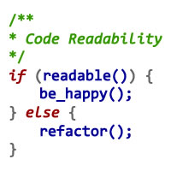
Get into Good Habits
Comment your code
Won’t speed up code but will improve readability & help if you have go back to your code in the future
Use formatting (indents and spacing) in your code to improve readability
Be consistent in your naming & formatting

Slide 6
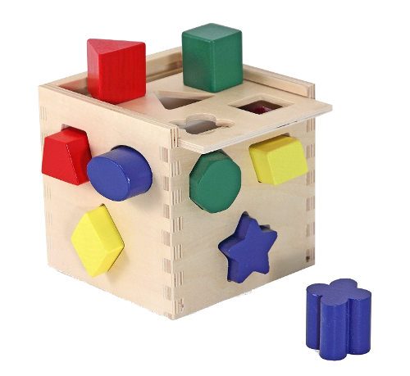
Appropriate data structures
Simple data structures more efficient
complex structures more flexible
matrix vs data.frame
Factors more efficient than characters
can cause unexpected issues (actually integer vectors with a names attribute)

Slide 7
Growing objects
Avoid storing data in loops by appending, e.g. using c(), rbind(), cbind(), append() were possible
Slow & uses more memory
Creates new second larger copy every time (before releasing previous memory)
Can fragment memory
Notes:
Typically objects need to be stored in a continuous memory block so if memory fragmented (i.e. full of lots of randomly scattered small holes) can cause issues

Slide 8
Avoiding growing objects
Create object at final size and insert
If final dimensions unknown
create larger object & reduce once filled
Requires good estimate of maximum dimensions
Save as elements of list (later reformed to single data.frame)
Save as multiple objects (joining later if required)
Save to other source
File(s)
database

Slide 9
Vectorise code
Applies operations/functions to all elements of a object at the same time
Alternative to loops in many cases
R supports vectorised operations (many base vectorised)
Vectorize() - vectorises non-vector functions
apply family - apply function across object
x | 1 | 2 | 3 | 4 | 5 | 6 | 7 | 8 | 9 | 10
x² | 1 | 4 | 9 | 16 | 25 | 36 | 49 | 64 | 81 | 100
Notes:
Many base functions vectorised
Vectorised if statement ifelse() function

Slide 10
Apply family
Most commonly used
apply – across rows/columns of matrix/df
lapply – across elements of list
sapply – version of lapply that simplifies output
tapply – object using list argument to specify subsets
by – subsets of data.frame
Return in different formats
Efficiency varies
Notes:
Many base functions vectorised
Vectorised if statement ifelse() function

Slide 11
True vectorisation
Vectorise function and apply functions criticised for being hidden loops
often optimised and/or in faster language
True vectorisation
Calculations that work on the whole function at the same time
Vector operations x * 6 or x * y
Matrix operations mat_x * 6 or mat_x * mat_y
For our purposes vectorisation avoiding base R loops
if it can be done with vector/matrix operations probably faster
Notes:
Many base functions vectorised
Vectorised if statement ifelse() function

Slide 12
User Functions
A function performs a clearly specified task with understood inputs/outputs
Novice behaviour is to write one function that does everything
Better to use series of smaller functions called by main function
Most functions return a value
There are exceptions (i.e. plot)

Slide 13
Why use functions
Makes code more compact
Removes duplication
Separates main program code from code to do individual tasks
Breaks process into discrete tasks
Modular
Can reuse functions in other work
Can be compiled (cmpfun)
Some R functions require a function. e.g. lapply()

Slide 14
R & Databases
With big datasets only load what you need now
Store rest elsewhere and load when required
Text files ( write.table() ) or Binary files ( save(), saveRDS() )
Database (RODBC package)
Benefits of database
Designed to deal with and process large amounts of data
Using packages such as RODBC can extract subset of data from DB as needed (faster than sub-setting in R)
Can append results directly to database (avoid growing objects)

Slide 15
Ways to Benchmark & Profile
Manually
proc.time()
save before then call again at end and substract saved start time
system.time(expr)
Returns user and system time required for the expression passed as an argument
Packages
microbenchmark
profvis

Slide 16
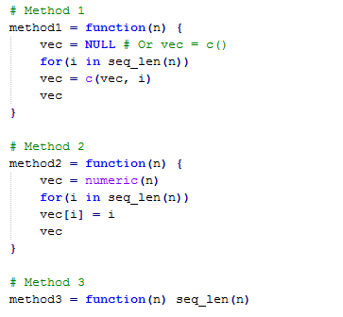

Benchmarking with Microbenchmark
1) grow vector in loop
2) initialise, assign via loop
3) create vector directly

Slide 17
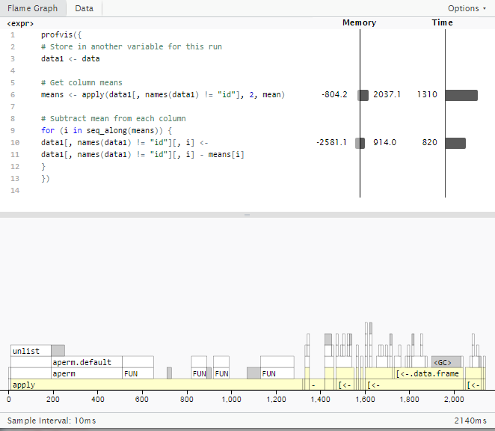
Profiling with profvis

Slide 18
Interfacing R with other languages
R relatively slow language
Code slow parts of code in other faster languages and call from within R
Python, C/C++, Fortran
Many of R’s base functions use code written in C
Need to know/learn other language(s)

Slide 19
Parallelisation
Uses multiple processors to work simultaneously on different parts of a problem
Simplest - open multiple instances of R and then run different code in these separate instances
Packages implement proper parallelisation, eg. parallel, snow/snowfall

Slide 20
Parallelisation
Ideally code with lots of independent tasks
Requires purpose built code
Trade off – parallelising code vs running existing code
Ideal for High performance computers clusters (e.g. CIRRUS, NEMISIS, JASMIN)
Larger number of processors
Larger amounts of memory available
Run longer code without issues
Leaves your computer free while running

Slide 21
Look for alternative code
Look for R packages/R code that do what you want
Better performing functions often exist
Trade of between spending time looking vs optimising code
bam() in mgcv package gam optimised for big datasets
speedglm package lm and glm for big datasets
Benchmark & test alternatives against existing code

Slide 22
Summary
Plan code
Vectorise where possible
Use custom functions to create modular code
Benchmark & profile to find bottlenecks
Consider parallelisation of code
Look for existing packages/code
Low hanging fruit approach till you get something that works and is quick enough

Slide 23
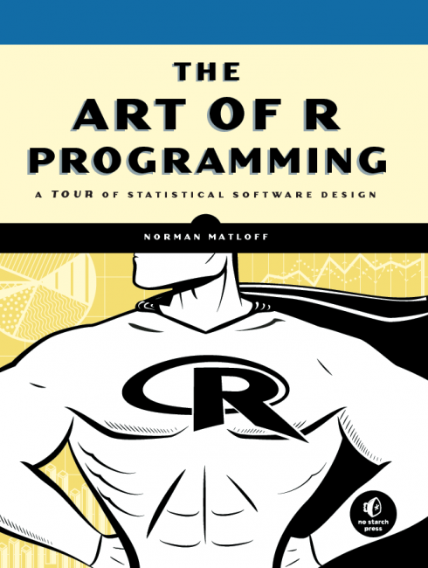
Helpful books
The art of R programming: a tour of statistical software design
Norman Matloff (2011)

Slide 24
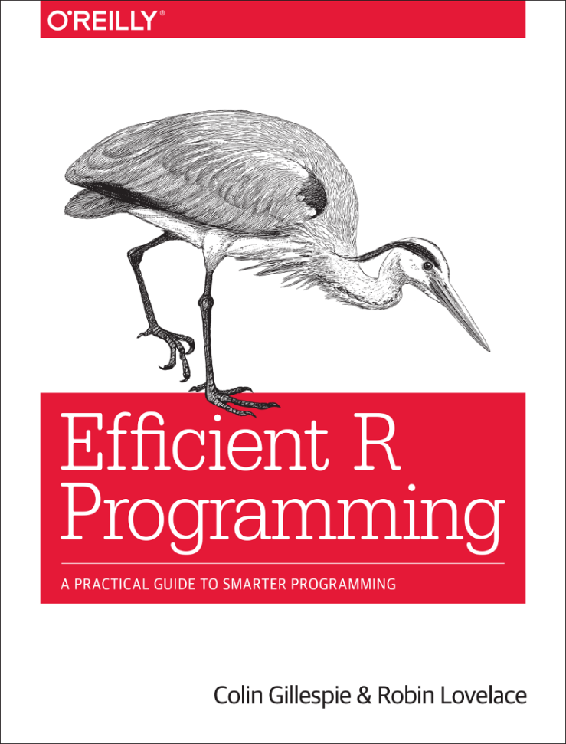
Helpful books
Efficient R Programming: a practical guide to smarter programming
Colin Gillespie & Robin Lovelace
31 Dec 2016
Online version:
https://csgillespie.github.io/efficientR/

Slide 25

Thanks

