Slide 1

FastR BettR HappyR
How to speed up & Improve your code

Slide 2
Why?
Why do I need to speed up/improve my code
Analysis takes too long
Memory allocation issues
Other benefits/reasons
Improve the readability of your code
Make your life easier
Improve your knowledge & future code
Notes:
Why do I need to speed up/improve my code
Analysis takes too long
Memory allocation issues
Improve the readability of your code
Make your life easier

Slide 3
Avoid common inefficiencies
Inapproiate/sub-optimal object types
Growing data
Not vectorising
Non-essential objects
Non-essential operations (e.g. print statements)
Memoization (storing results of resource heavy functions)
Function options/overheads
Notes:
Plan your code
Consider what object you need to store (avoid recalculating)
Remove objects you no longer need (especially large objects)
Avoid repeating sections of code
Use a loop
create a function
Avoid creating multiple copies/subsets of objects
Subset using square brackets

Slide 4
Profiling & Benchmarking
Benchmarking – testing timing of functions/small blocks of code
Manually (e.g. recording/print system time at start/end)
Using packages (microbenchmark)
Profiling – testing the run time, timings and memory usage of larger sections of code
profvis package
Allows identification of areas that may benefit from optimisation
Notes:
Plan your code
Consider what object you need to store (avoid recalculating)
Remove objects you no longer need (especially large objects)
Avoid repeating sections of code
Use a loop
create a function
Avoid creating multiple copies/subsets of objects
Subset using square brackets

Slide 5
Parallel processing
Running code across multiple processors at once
Not applicable to all problems
Best applied when has repeated sections (e.g. same analysis across different species and/or sites)
Ideally runs need to be independent
Run on local multi-processor computers (limited processors) or on High Performance Computing cluster (larger numbers of processors)
Notes:
Plan your code
Consider what object you need to store (avoid recalculating)
Remove objects you no longer need (especially large objects)
Avoid repeating sections of code
Use a loop
create a function
Avoid creating multiple copies/subsets of objects
Subset using square brackets

Slide 6
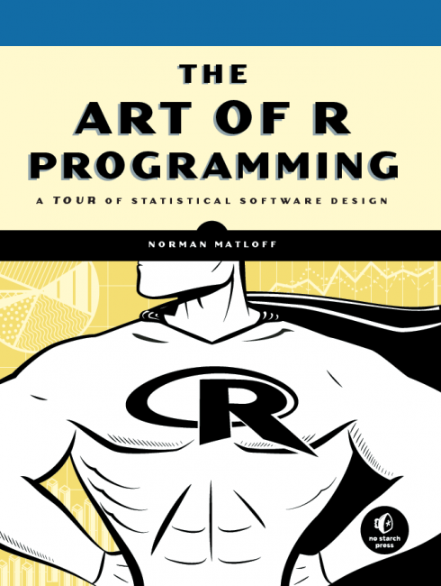
Helpful books
The art of R programming: a tour of statistical software design
Norman Matloff (2011)

Slide 7
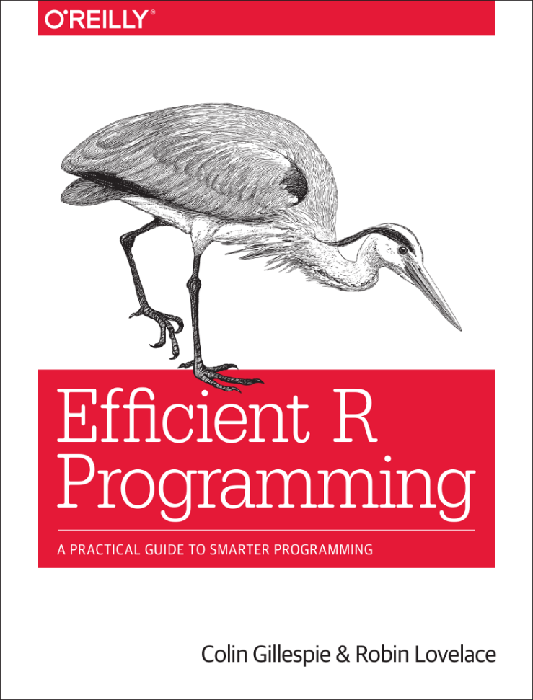
Helpful books
Efficient R Programming: a practical guide to smarter programming
Colin Gillespie & Robin Lovelace
31 Dec 2016
Online version:
https://csgillespie.github.io/efficientR/

