Slide 1
S H I N Y
I n t e r a c t i v e W e b A p p l i c a t i o n
i n R
Tom August

Slide 2
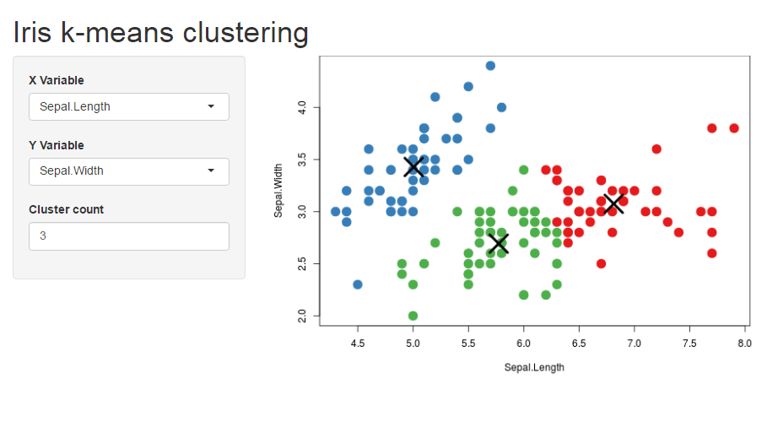
Make Your R Accessible

Slide 3
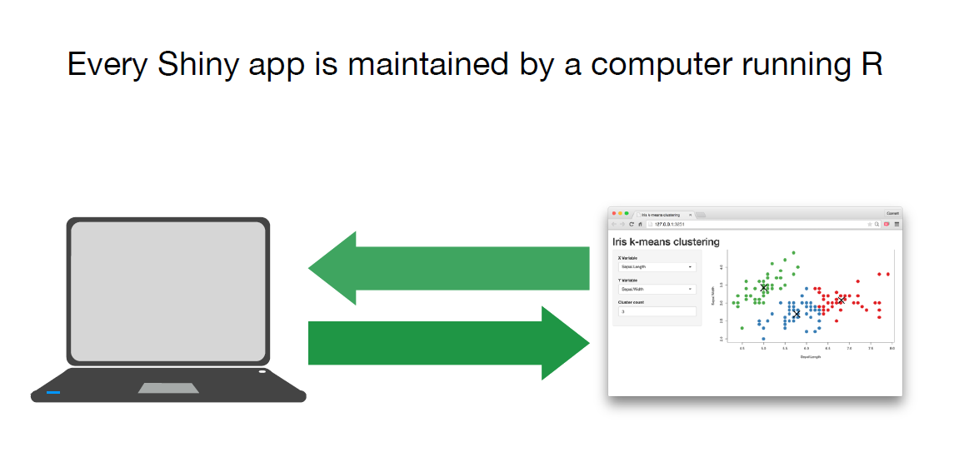
How does it work?
Server.R
UI.R

Slide 4
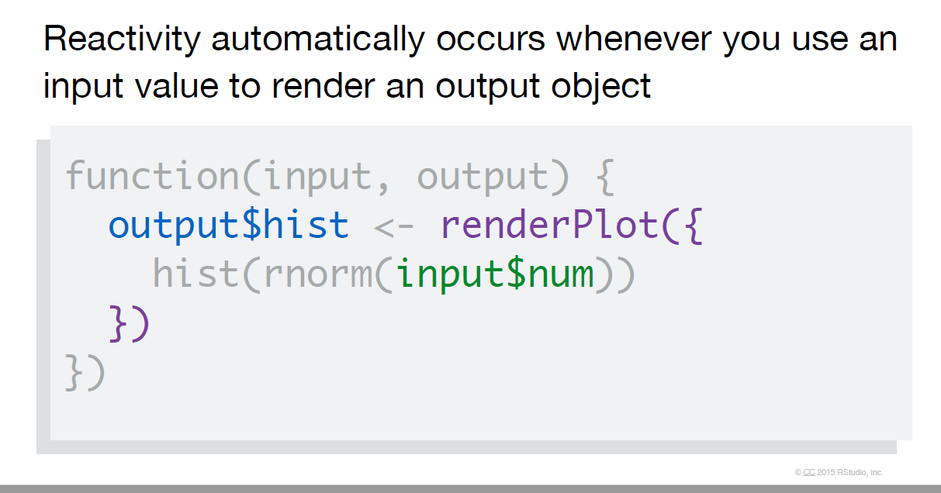
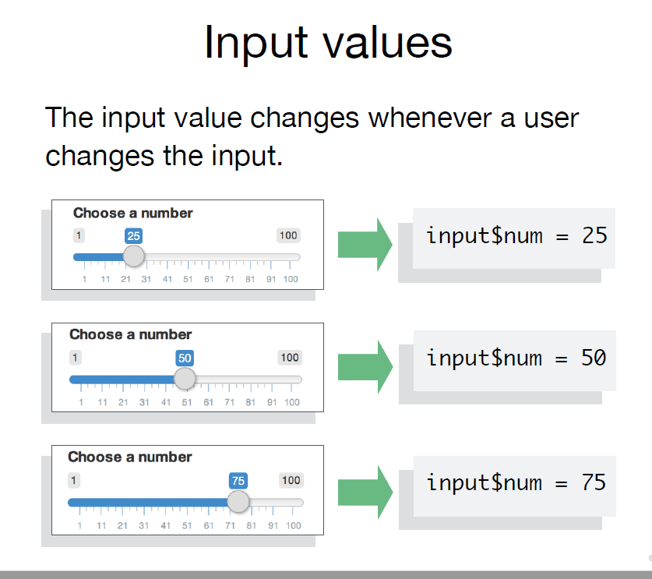
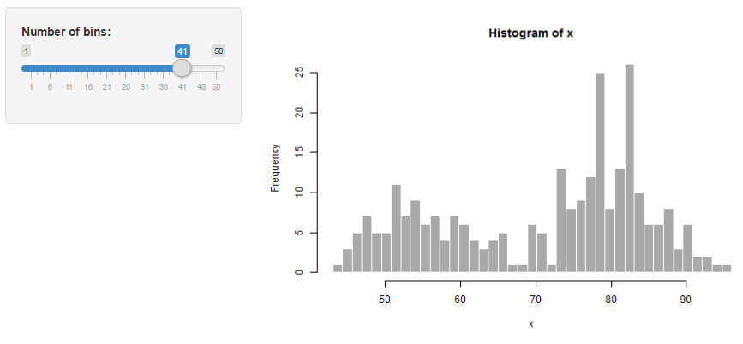
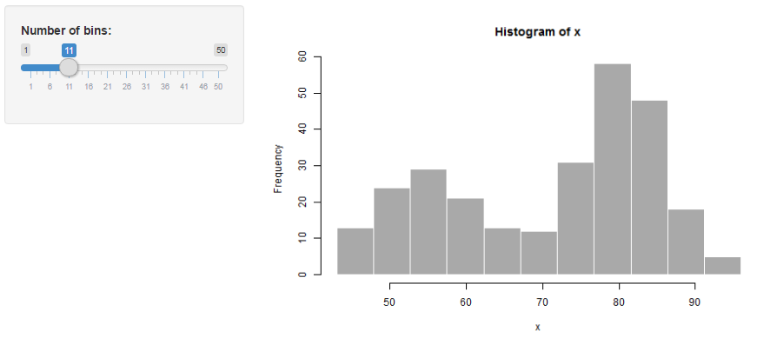
How does it work?

Slide 5
Examples – Shiny Gallery
User inputs define graph http://shiny.rstudio.com/gallery/kmeans-example.html
There are a range of widgets: http://shiny.rstudio.com/gallery/widget-gallery.html
Widgets can be customised: http://shiny.rstudio.com/gallery/sliders.html
You can output tables: http://shiny.rstudio.com/gallery/basic-datatable.html
People can download files: http://shiny.rstudio.com/gallery/file-download.html
Or a report (knitr): http://shiny.rstudio.com/gallery/download-knitr-reports.html
You can specify tabs: http://shiny.rstudio.com/gallery/navbar-example.html
And layout: http://shiny.rstudio.com/gallery/retirement-simulation.html
Submit button: http://shiny.rstudio.com/gallery/submitbutton-demo.html
Interacting with plot: http://shiny.rstudio.com/gallery/plot-interaction-selecting-points.html
Or with Google charts: http://shiny.rstudio.com/gallery/movie-explorer.html
Maps can be done ++ : http://shiny.rstudio.com/gallery/superzip-example.html

Slide 6
Examples – CEH
Provide data: https://shiny-prod.nerc-lancaster.ac.uk/tomaug/bbs_sssi_app/
Map visualisation: https://shiny-prod.nerc-lancaster.ac.uk/tomaug/interactive_plant_atlas/
Reuse code: https://shiny-prod.nerc-lancaster.ac.uk/tomaug/natures_postcode/
Blurred lines: https://shiny-prod.nerc-lancaster.ac.uk/tomaug/whats_flying_tonight/

Slide 7
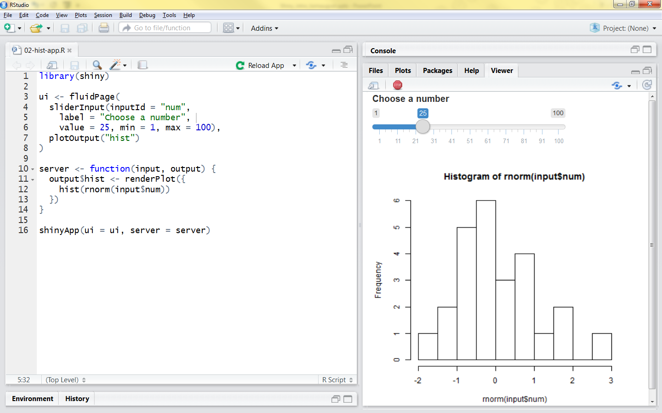
How Do I Do it?
Workshop

Slide 8
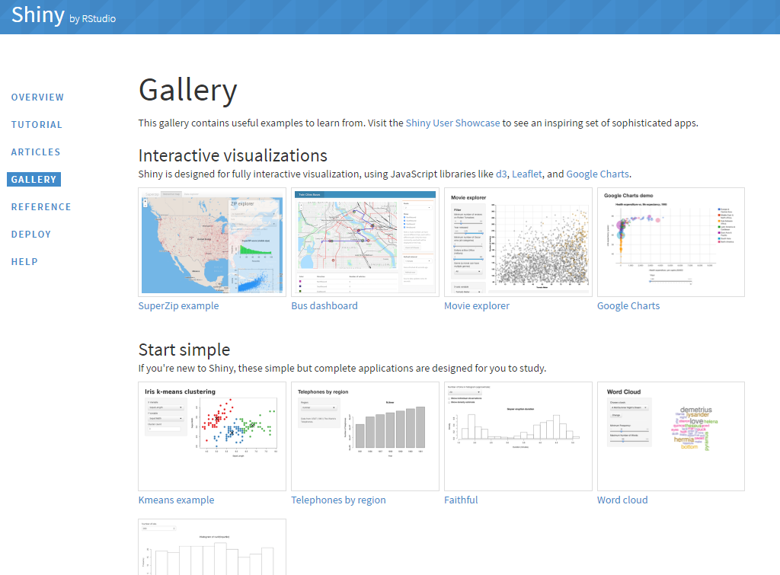
How Do I Do it?
Gallery
http://shiny.rstudio.com/gallery/

Slide 9
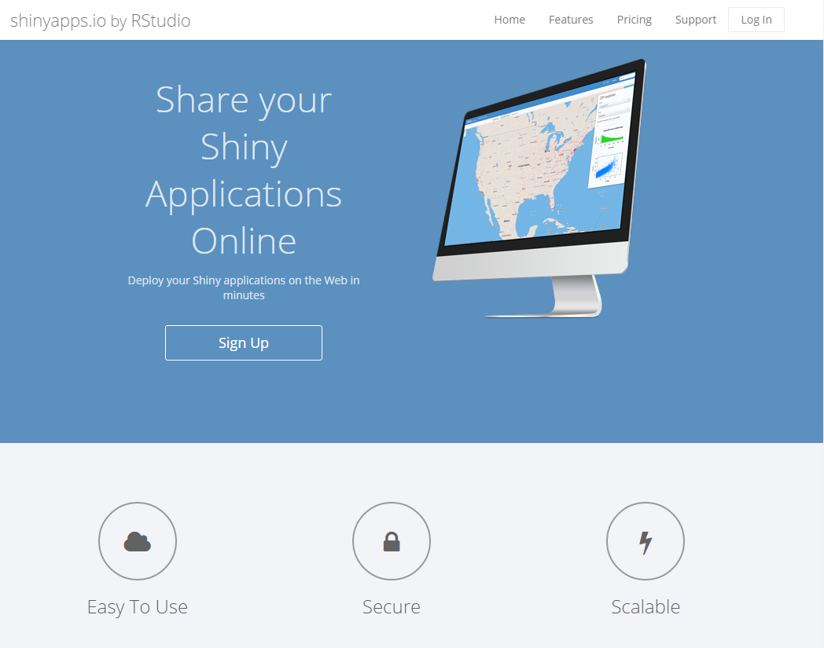
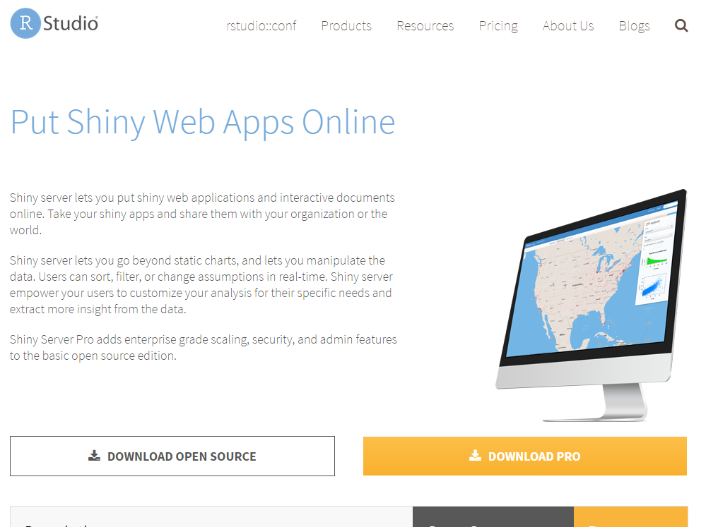
How Do I Do it?
Hosting
ShinyApps.io
CEH Server

