Slide 1





Adomi Bridge - Atimpoku
Single vs multi-reservoir model
For reservoir storage prediction
Helen Baron & Nathan Rickards
28/01/2026

Slide 2
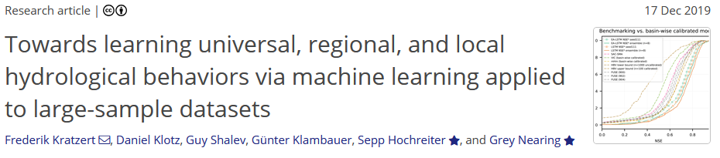
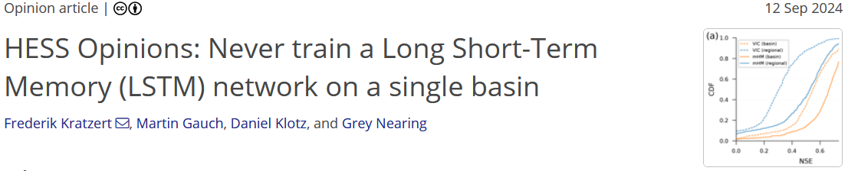
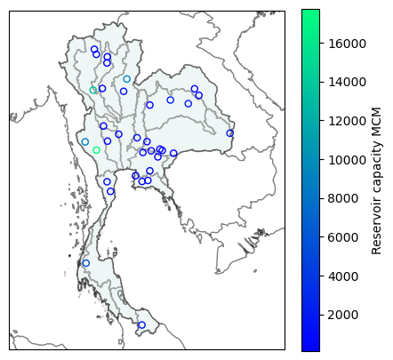
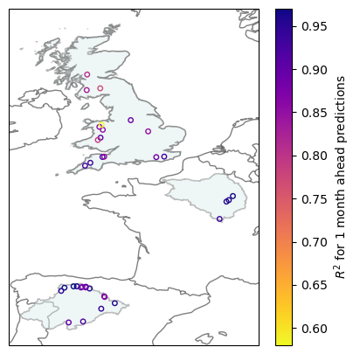
What & why
Single reservoir model trained at one reservoir on timeseries data
Multi reservoir model
trained on multiple reservoirs, using timeseries data from all sites + static catchment/reservoir characteristics
Thailand
Europe

Slide 3
What & why
Monthly time-series
Reservoir storage
Rainfall
Temperature
Reservoir characteristics
Total capacity
Catchment area
Purpose
etc.
Catchment characteristics
Elevation
Aridity
Degree of regulation
Landcover
Irrigated area
etc.
Local Data
ERA5
Single-reservoir model
GRanD
Multi-reservoir model
CARAVAN
Hydro-Atlas
ERA5

Slide 4
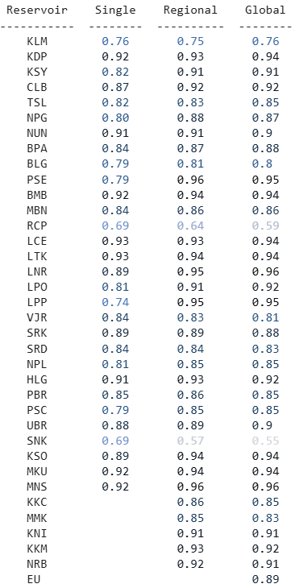
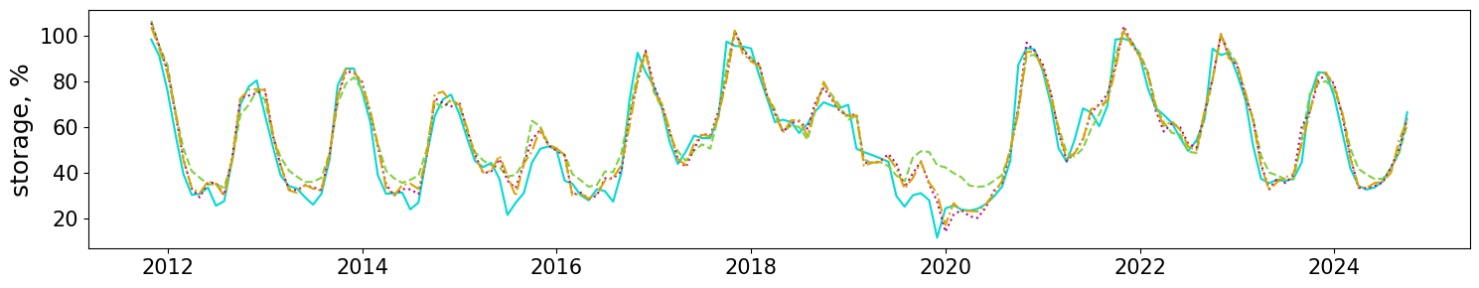
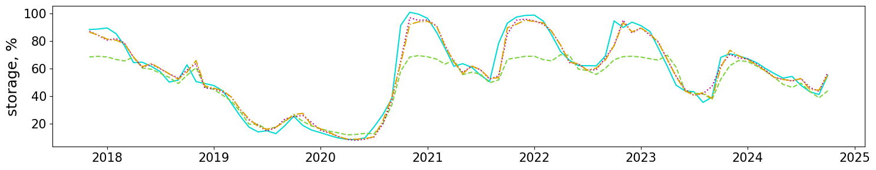
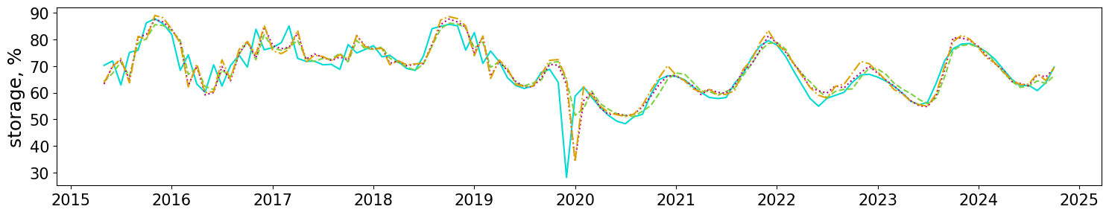
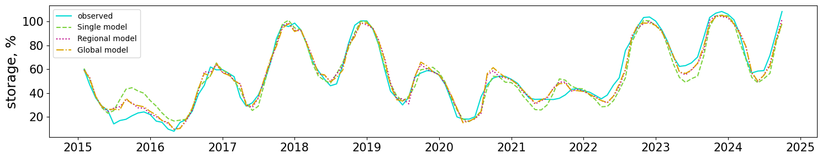
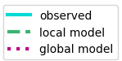
Comparing the single, regional and global models at 1 month ahead simulations
Results - Thailand
R^2 at CLB S: 0.87 R: 0.92 G: 0.92
R^2 at LPP S: 0.74 R: 0.95 G: 0.95
R^2 at RCP S: 0.69 R: 0.64 G: 0.59
R^2 score for 1 month ahead storage simulations for the different models

Slide 5
Comparing the single, regional and global models at 1 month ahead simulations
Results - Thailand
R^2 at CLB S: 0.87 R: 0.92 G: 0.92
R^2 at LPP S: 0.74 R: 0.95 G: 0.95
R^2 at RCP S: 0.69 R: 0.64 G: 0.59
R^2 score for 1 month ahead storage simulations for the different models

Slide 6
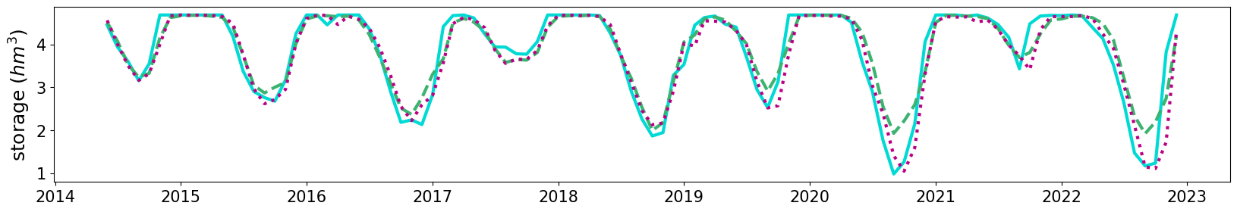
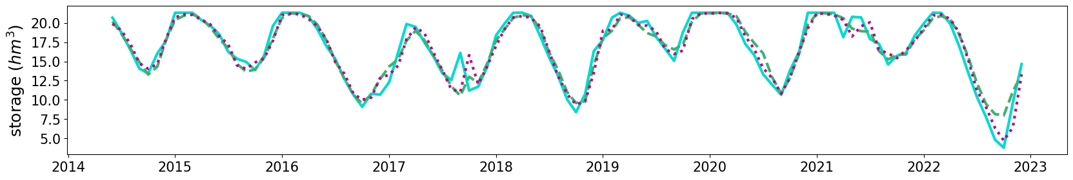
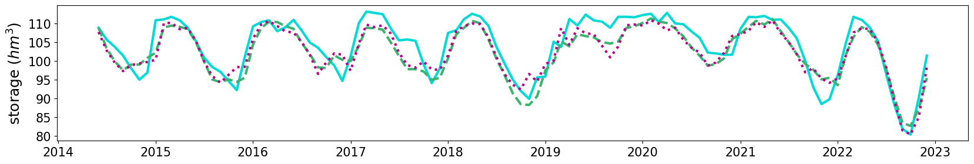
Results - UK
Comparing the local models to the regional model at 1 month ahead simulations
Ardingly
Wimbleball
Rutland

Slide 7
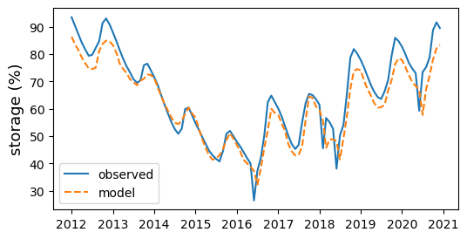
Example application to the Akosombo dam
Using a multi-reservoir model, trained on data from Thailand and Europe to predict monthly storage in Lake Volta.
MAE | 4.4
RMSE | 5.3
R^2 | 0.88
KGE | 0.86

Slide 8
Conclusions
Where does improved performance plateau?
Are some reservoirs more “useful” than others?
Does it depend on the static characteristics or the historical storage patterns?
Does it vary globally?
Multi-reservoir models generally improve simulations:
capture extreme highs/lows better
no significant difference between global/regional models
increased data requirement but can include reservoirs with shorter records
improved performance 1 month ahead
mixed picture at longer lead times
There is potential to train a model in a data-rich region, and apply it to a data-poor region
Would an LSTM-type model work better?

Slide 9
Adomi Bridge - Atimpoku
Exploration exercises
Helen Baron & Nathan Rickards
28/01/2026

Slide 10
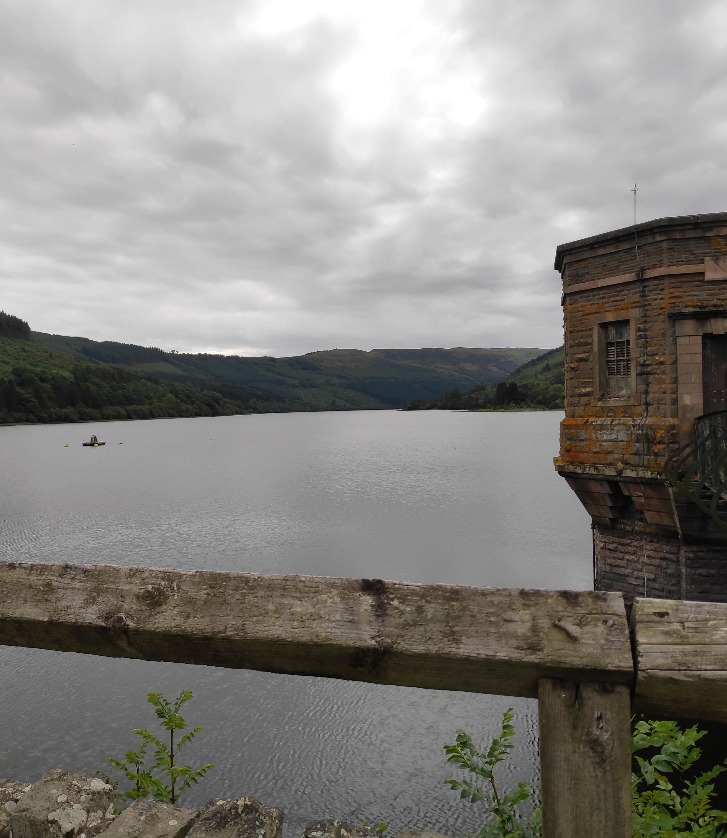
Morning session
We ran through this model flow for a Random Forest for the Vaal reservoir
Image caption goes here

Slide 11
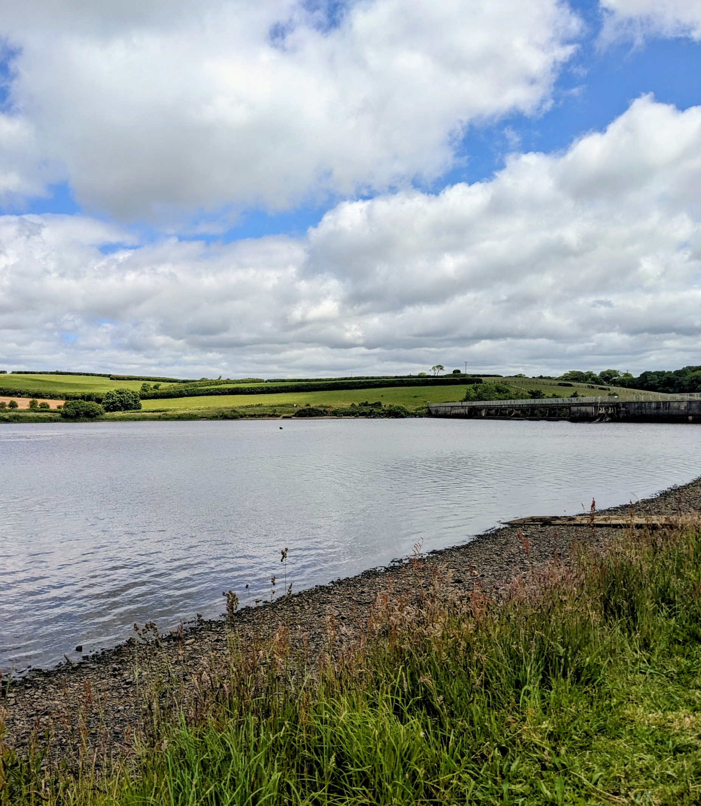
Afternoon session
Exploration session!
Options:
1. Repeating the model flow with a different reservoir
2. Repeating with a different model
3. Using the model for forecasting
Image caption goes here

Slide 12
Differences between models
The different ensemble-tree models vary in how they sample the data, and how they build the individual trees.
There is lots of information online, this is a high-level comparison of a subset of models.
Model | Build | Data sample | Split | Prediction
Bagging | Parallel | Random with replacement | Optimal | Average
Random Forest | Parallel | Random with replacement | Optimal, random subset of features | Average
Extra Trees | Parallel | Entire set | Random | Average
Gradient Boosting | Sequential | Entire set, trees are trained on pseudo-residuals | Optimal | Continually updated
Ada Boost | Sequential | Entire set, weighted by loss function | Optimal | Weighted average

Slide 13

Thank you
For more information
please contact:
[EMAIL US]
NC-international@ceh.ac.uk
[LEARN MORE]
ceh.ac.uk
[FOLLOW US]
@uk_ceh

