Slide 1
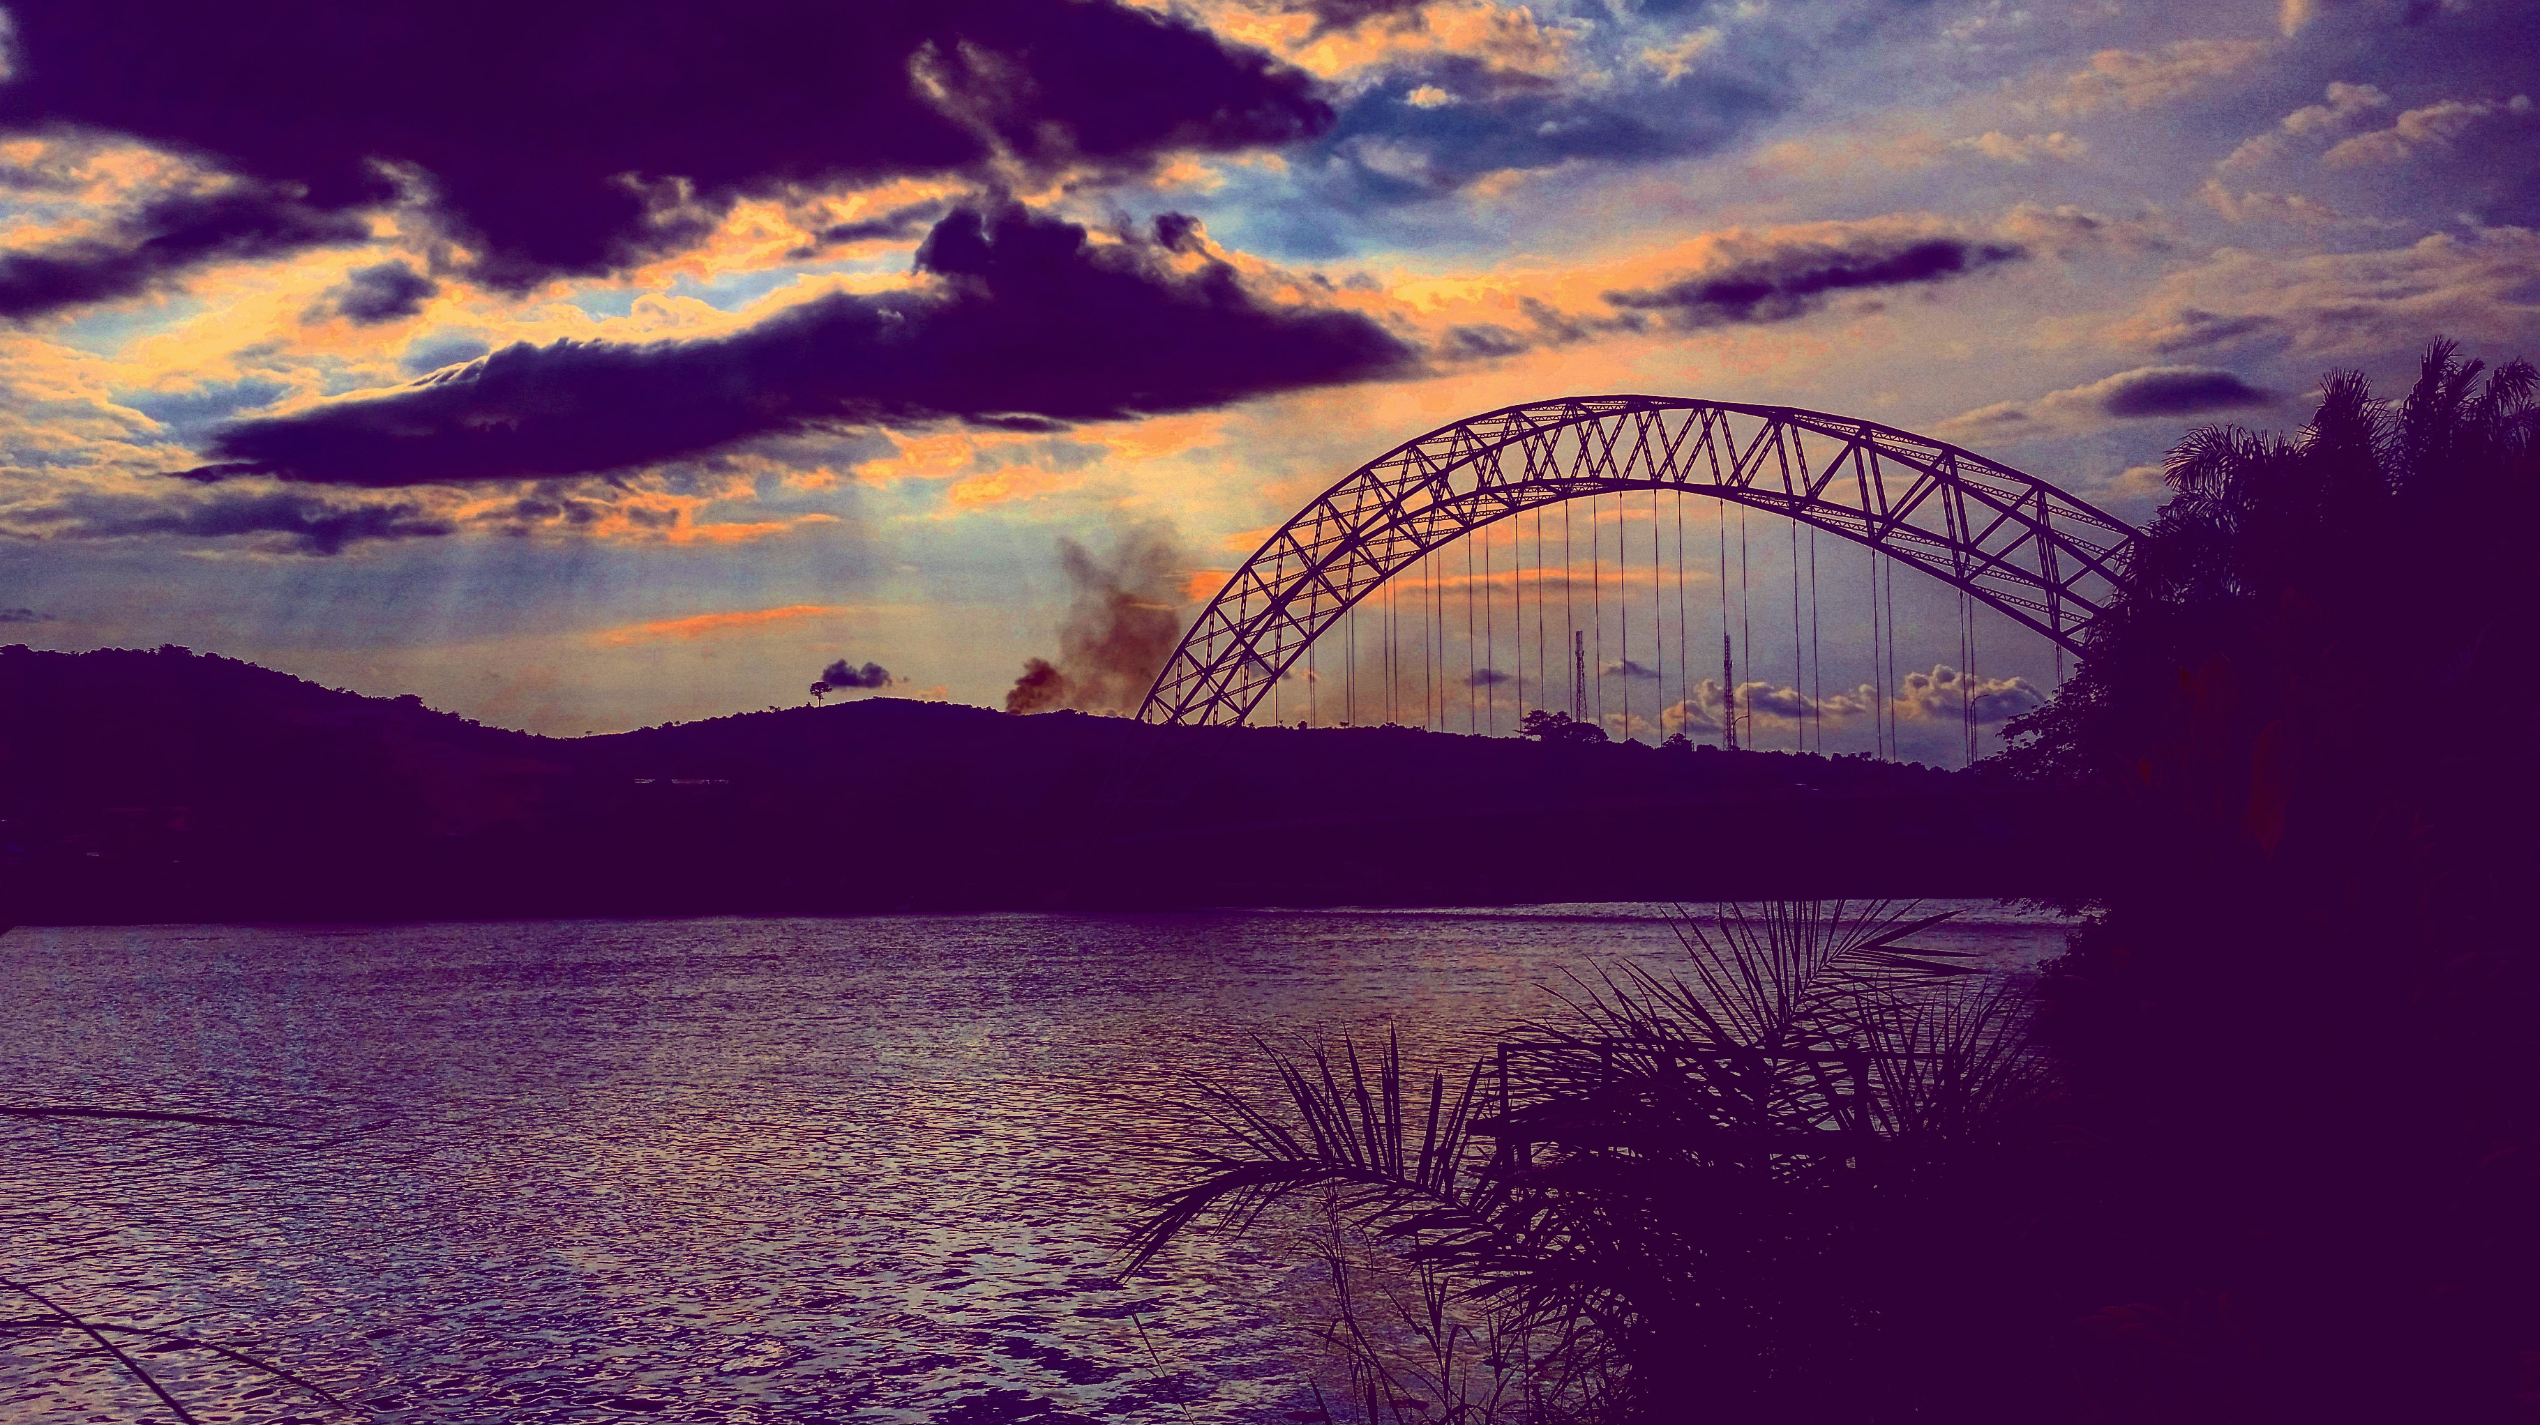



Adomi Bridge - Atimpoku
Reservoir modelling
Nathan Rickards & Helen Baron
28.01.2026

Slide 2



Introduction
Today’s training:
Reservoir forecasting using a machine learning approach
Both Helen and Nathan work in the Water Resources & Drought Group at UKCEH Wallingford.
Lots of experience in hydrological modelling, capacity building and international water resources – although this is our first time working in Ghana!
Helen Baron
Hydrological modeller
heron@ceh.ac.uk
Nathan Rickards
Hydrologist
natric@ceh.ac.uk

Slide 3
 | Day 2: Wednesday 28th January 2026
Reservoir forecasting using machine learning
09:00 - 10:00 | Talks: 1. Reservoirs 2. Introduction to Machine Learning (ML) based modelling
10:00 - 11:00 | Workshop: ML-based water resource modelling: Data/train/predict/visualise results
11:00 - 11:30 | BREAK
11:30 – 13.00 | Workshop: Explore feature selection/hyper parameter tuning.
13:00 - 14:00 | LUNCH
14:00 - 15:30 | Talk: 14.00-14.20: Presentation on multi-reservoir models Workshop: 14.20-15.30: ML exploration - different models, ensemble forecasting and different reservoirs
15:30 - 16:00 | BREAK
16:00 - 16:30 | Group feedback
16:30 - 17:00 | Q/A
18:00 - 21:00 | DINNER
What today looks like
We encourage you to:
Ask questions – hands up please!
Interact and engage
We ask you not to:
Speak over others
Talk on phones during the session
We only have a day, so please make the most of it, and enjoy it!

Slide 4
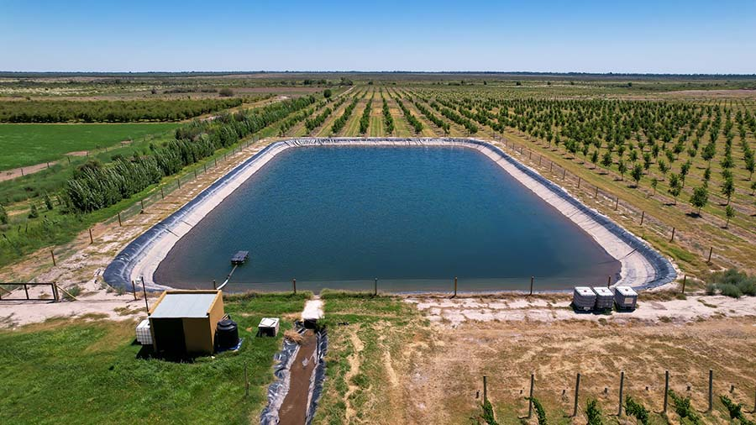
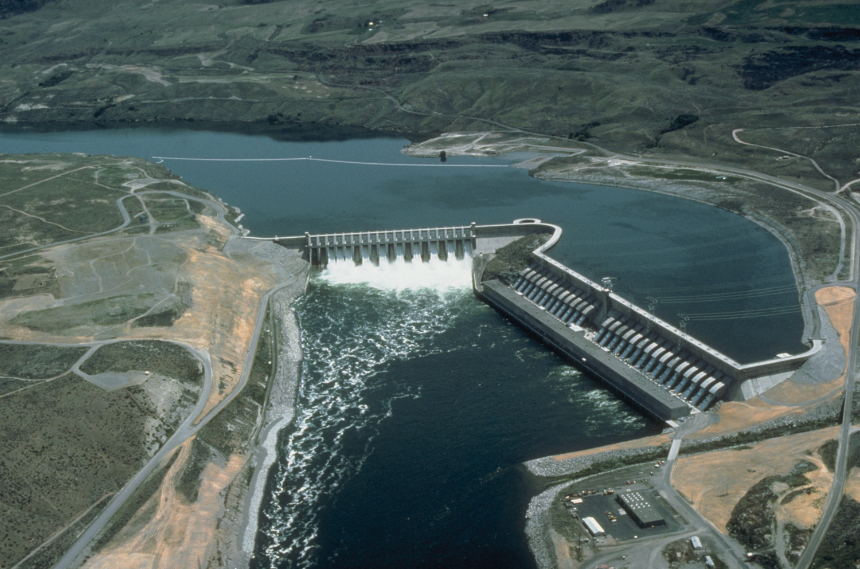
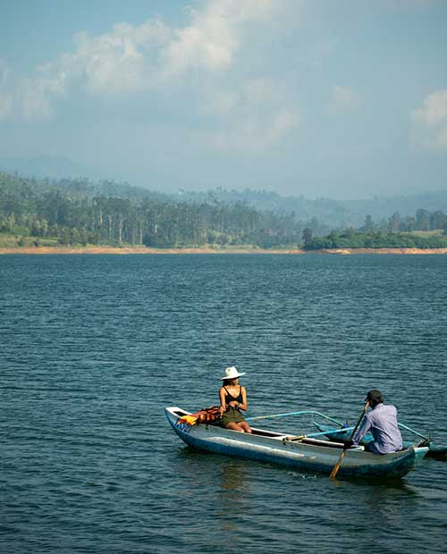
Reservoirs
Irrigation pond
Chief Joseph Dam, USA.
Boating in Sri Lanka
What do we use reservoirs for?
Water supply
Irrigation
Flood control
Hydro-power
Env. Sustainability
Navigation
Recreation & economy
Store water for long-term use
Reduce peak flows during heavy rainfall
Energy – may require less storage as water is required to pass through turbines
Compensation flows/e-flows
Leisure activities - boats, fishing, swimming.
Multi-purpose
Natural vs artificial reservoirs

Slide 5
Why model reservoirs?
Assess future climate change impacts
Protect dam safety
Manage flood risk
Forecast seasonal water availability
Optimize reservoir operations
Support hydropower generation
Coordination of multiple uses
Evaluate infrastructure performance
Support decision-making/policy
Plan for droughts
Notes:
To estimate water availability under varying inflow and demand conditions
To support operational decisions (releases, storage targets, rule curves)
To assess drought and flood risks
To optimize multipurpose use and manage trade-offs
To test scenarios (climate change, population growth, new infrastructure)
To support planning, policy, and investment decisions

Slide 6
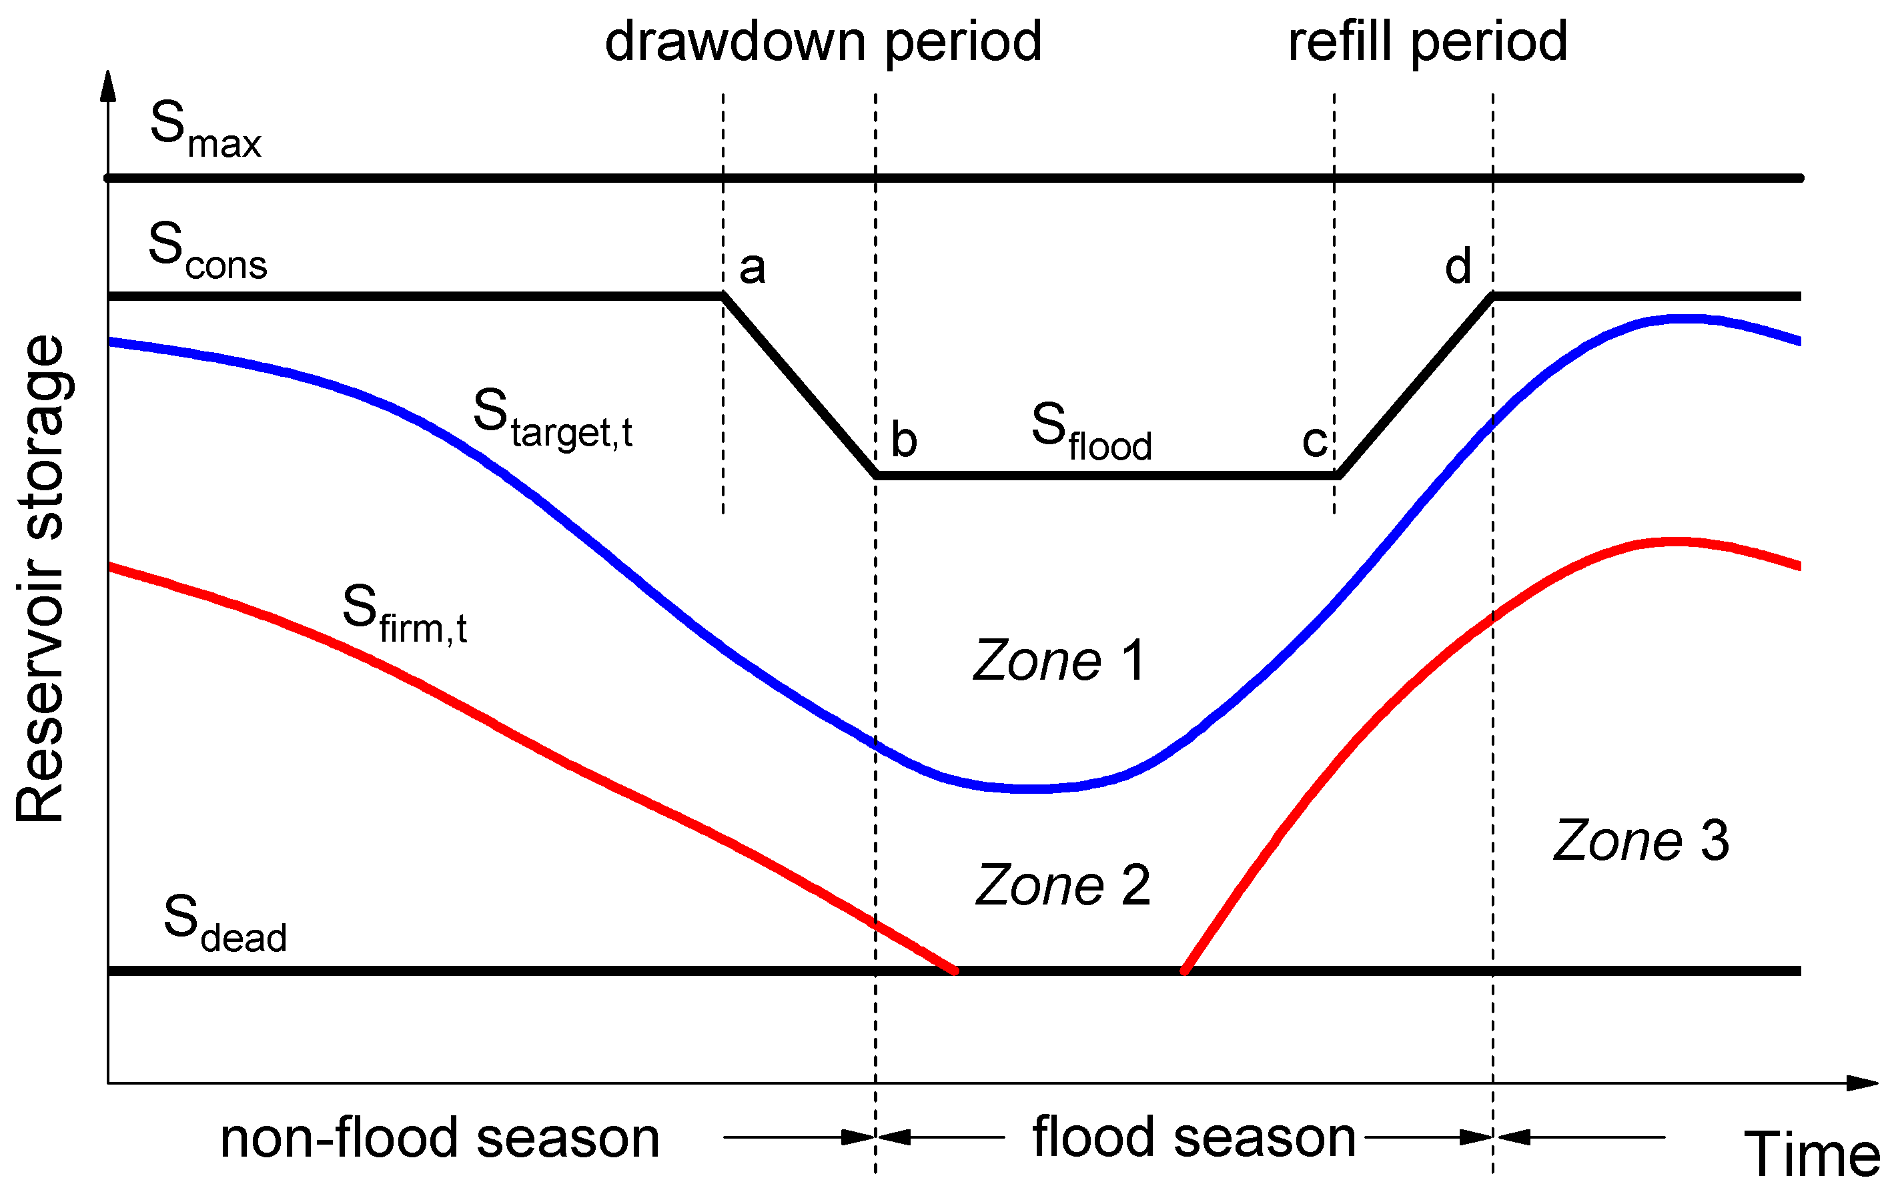
Reservoir models
There are many!
Has anybody here modelled reservoirs before?
Which models did you use, and why?
Example types of reservoir model
Water balance models
Track inflows, outflows, storage, and losses
Simulation models
Replicate reservoir behavior over time
Optimization models
Identify best operating rules to meet objectives
Hydrologic–hydraulic coupled models
Link catchment runoff with reservoir operations
Schematic of multi-purpose reservoir curve (Wan et al., 2019)

Slide 7

Data requirements
What data might we need for a reservoir model?
Data inputs vary depending on model type, but can include:
Hydrological data
Inflows, outflows
Reservoir characteristics
Live/dead storage, bathymetry
Operational data
Release rules, spillway capacity, abstractions
Demand data
Energy, domestic, irrigation, industry, e-flows
Climate data
Temperature, precipitation, evaporation
Historical records
Past storage levels, releases, extreme events

Slide 8
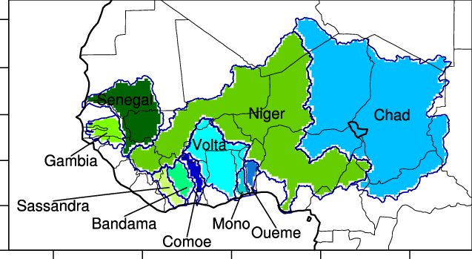
Reservoirs in the region
West Africa
Major river basins:
Volta, Niger, Senegal, Gambia
Reservoir purposes:
Hydropower, irrigation, flood control
Regional challenges:
High rainfall variability
Transboundary water management
Data limitations
Increasing need for reservoir modelling to support sustainable water management
Ghana
Key reservoirs:
Akosombo (Lake Volta) – hydropower, water supply, fisheries
Kpong – hydropower and water supply
Bui – hydropower and multipurpose use
Numerous small and medium reservoirs for irrigation and rural water supply
Challenges to management:
Climate variability
Sedimentation
Competing water demands
Sylla et al. 2018

Slide 9

Higher or lower…?!
Ghana has a number of large and significant reservoirs, but how much water do they hold relative to other countries?
A show of hands/call out for higher or lower…
West Africa has seen a continuing increase in dam/reservoir construction in recent decades, as has Africa as a whole, particularly for hydropower and multipurpose reservoirs.

Slide 10

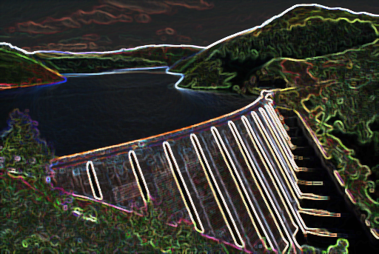
Why machine learning and reservoirs?
Reservoirs are an integral part of the hydrological cycle, providing water to millions of people for various uses
Knowing how water bodies respond to natural and anthropogenic influence is therefore extremely relevant, and important
ML is a rapidly growing area of hydrological science, now made possible by increasing data availability and system processing power
Reservoir operational data are often not available, and conventional modelling methods struggle to replicate operations
ML approaches can be powerful learning tools, establishing key behaviours, and are often transferable

Slide 11

A note on today's session
Using data from S. Africa & Spain to train a reservoir forecasting model
Re: W. Africa, we have 10 years of reservoir data kindly provided by Dr Obuobie from WRI of the CSIR for the Akosombo
If others would like to collaborate to explore the potential to build a regional reservoir forecasting model for W. Africa, then please let us know
AMLE

Slide 12
Group activity (10 mins)
Use the sticky notes to tell us:
Which models you’ve used previously, and for what purpose
Your interests in machine learning – can be hydrology or otherwise

Slide 13

Thank you
For more information
please contact:
[EMAIL US]
natric@ceh.ac.uk
heron@ceh.ac.uk
[LEARN MORE]
ceh.ac.uk
[FOLLOW US]
@uk_ceh

