Slide 2
1dDiscretization
Cell index
Cell
Node
0
1
2
3
4
$$T_{A}$$
$$T_{B}$$
Boundary A
Face
Boundary B

Slide 3
1dFacesAndDistances
W
w
P
e
E
$$Δx$$
$$Δx$$

Slide 4

1dBoundaryA
P
e
E
$$T_{A}$$
$$T_{B}$$
$$\frac{Δx}{2}$$
$$Δx$$

Slide 5





balanceNeighbors
$$\dot{m_{4}}$$
$$\dot{m_{1}}$$
$$\dot{m_{2}}$$
$$\dot{m_{3}}$$
$$\frac{∂m}{∂t}=∑\dot{{\text{m}}_{i}}$$

Slide 6
centralDifferencing
West face
$$T_{W}$$
Node W
$$T_{w}$$
$$T_{P}$$
Node P
$$Δx$$

Slide 7


1dconduction
W
w
P
e
E
$${\left(qA\right)}_{w}$$
$${\left(qA\right)}_{e}$$
$$Δx$$

Slide 8


2dConductionCV
$${\left(qA\right)}_{n}$$
$${\left(qA\right)}_{w}$$
$${\left(qA\right)}_{e}$$
$${\left(qA\right)}_{s}$$

Slide 9

2dConductionNotation
N
n
$Δ$y
w
e
W
P
E
s
S
y
x
$$Δx$$

Slide 10
Advection-conduction

Slide 11


1dadvectionConduction
W
w
P
e
E
$${\left(qA\right)}_{w}+{\left( \dot{m}h\right)}_{w}$$
$${\left(qA\right)}_{e}+{\left(\dot{m}h\right)}_{e}$$
$$Δx$$

Slide 12




1dConservativeness
0
1
2
$$q_{L}$$
$$q_{01}$$
$$q_{12}$$
$$q_{R}$$

Slide 13
upwind2d
N
n
n
n
W
P
E
n
u
S
y
x

Slide 14
Fluid flow

Slide 15



decoupling
$$p_{w}$$
=
$$p_{e}$$
$$p_{W}$$
$$>$$
$$p_{P}$$
$$<$$
$$p_{E}$$

Slide 16
Mesh

Slide 17
orthogonality
θ

Slide 18
skewError
x
error

Slide 19
WallLayers

Slide 20
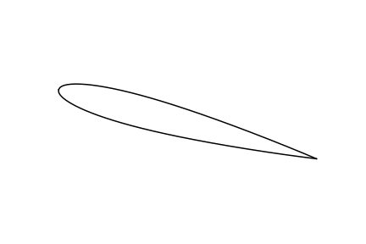

wing2d
$$u$$
$$u_{y}$$
$$α_{}$$
$$u_{x}$$

