Slide 1
KEB-45250 Numerical Techniques for Process Modeling
Spring 2018
Lecture 3
Introduction to Computational Fluid Dynamics
Antti Mikkonen

Slide 2
Last lecture
Lectures |  | Exercises
Introduction |  | Python basics and libraries
Basics. Matrix, NS,… |  | Lecture topic
CFD Basics |  | Lecture topic
ANSYS intensive course |  | ANSYS intensive course
Heat convection, FVM |  | Lecture topic with Python
Advection |  | Lecture topic with Python
Navier-Stokes |  | Navier-Stokes with ANSYS
Mesh |  | Mesh with ANSYS
Turbulence |  | Turbulence with ANSYS
Differential equations |  | Lecture topic
Linear systems |  | Lecture topic
Easter Holiday |  | Easter Holiday
Linear/Non-linear systems |  | Lecture topic
Non-linear systems |  | Lecture topic
Reacting systems |  | Lecture topic
Reacting systems |  | Lecture topic
Review of relevant subjects
Math
Equation types, matrices
Physics
Advection, Convection, Diffusion, Navier-Stokes
Dimensionless numbers
Chemistry
Arrchenius equation

Slide 3
Math review
Math
Algebraic equations
Differential equations
Partial differential equations
Matrix algebra

Slide 4
Physics review
Physics
Advection
Convection
Diffusion
Navier-Stokes
Dimensionless numbers

Slide 5
Chemistry review
Chemistry
Arrchenius equation

Slide 6
This lecture
Lectures |  | Exercises
Introduction |  | Python basics and libraries
Basics. Matrix, NS,… |  | Lecture topic
CFD Basics |  | Lecture topic
ANSYS intensive course |  | ANSYS intensive course
Heat convection, FVM |  | Lecture topic with Python
Advection |  | Lecture topic with Python
Navier-Stokes |  | Navier-Stokes with ANSYS
Mesh |  | Mesh with ANSYS
Turbulence |  | Turbulence with ANSYS
Differential equations |  | Lecture topic
Linear systems |  | Lecture topic
Easter Holiday |  | Easter Holiday
Linear/Non-linear systems |  | Lecture topic
Non-linear systems |  | Lecture topic
Reacting systems |  | Lecture topic
Reacting systems |  | Lecture topic
Introduction Computational Fluid Dynamics (CFD)
All subjects will be returned to later

Slide 7
Near future
Lectures |  | Exercises
Introduction |  | Python basics and libraries
Basics. Matrix, NS,… |  | Lecture topic
CFD Basics |  | Lecture topic
ANSYS intensive course |  | ANSYS intensive course
Heat convection, FVM |  | Lecture topic with Python
Advection |  | Lecture topic with Python
Navier-Stokes |  | Navier-Stokes with ANSYS
Mesh |  | Mesh with ANSYS
Turbulence |  | Turbulence with ANSYS
Differential equations |  | Lecture topic
Linear systems |  | Lecture topic
Easter Holiday |  | Easter Holiday
Linear/Non-linear systems |  | Lecture topic
Non-linear systems |  | Lecture topic
Reacting systems |  | Lecture topic
Reacting systems |  | Lecture topic
ANSYS intensive course next week
Tuesday 9-16 SB202
Wednesday 9-15 RG100C
NOTE THE NONSTANDARD DAYS

Slide 8
Computational Fluid Dynamics
Fluid flow calculation is the basis of all CFD simulations
Other physics and chemistry can be included
Naviers-Stokes equations govern fluid flow phenomena

Slide 9
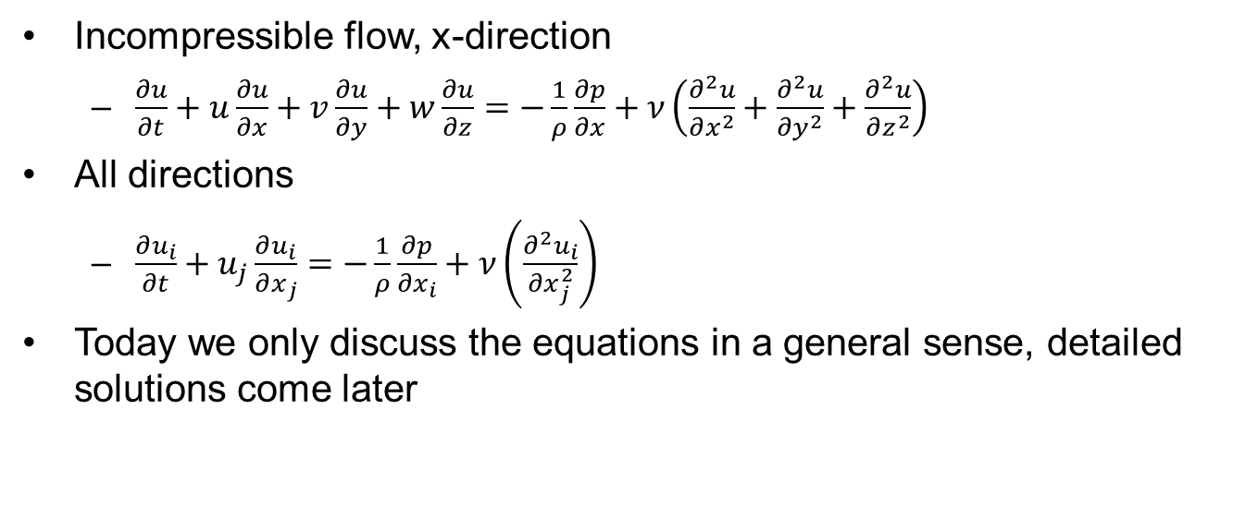
Navier-Stokes
Incompressible flow, x-direction
$\frac{∂u}{∂t}+u\frac{∂u}{∂x}+v\frac{∂u}{∂y}+w\frac{∂u}{∂z}=−\frac{1}{ρ}\frac{∂p}{∂x}+ν\left(\frac{∂^{2}u}{∂x^{2}}+\frac{∂^{2}u}{∂y^{2}}+\frac{∂^{2}u}{∂z^{2}}\right)$
All directions
$\frac{∂u_{i}}{∂t}+u_{j}\frac{∂u_{i}}{∂x_{j}}=−\frac{1}{ρ}\frac{∂p}{∂x_{i}}+ν\left(\frac{∂^{2}u_{i}}{∂x_{j}^{2}}\right)$
Today we only discuss the equations in a general sense, detailed solutions come later

Slide 10
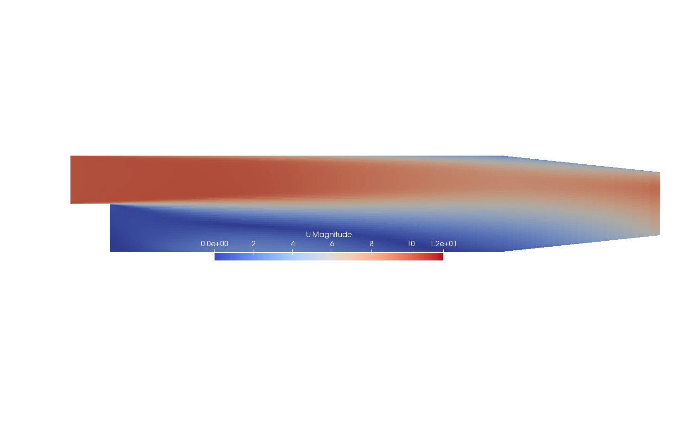


Example case
Classical test case by Pitz and Daily (1981)
$$V_{in}$$
$$p_{out}$$

Slide 11
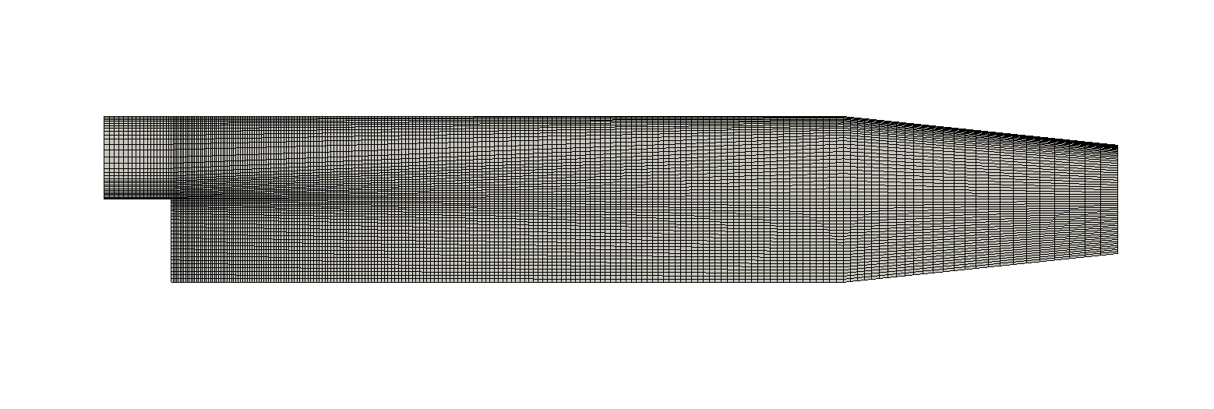
Mesh

Slide 12

Mesh close up

Slide 13

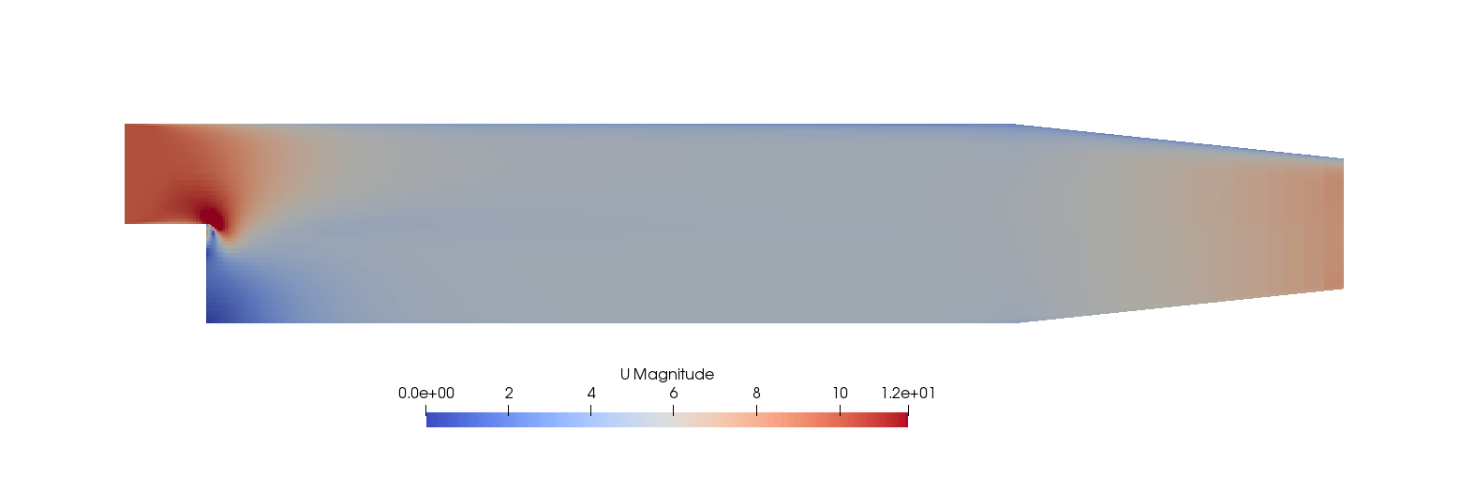
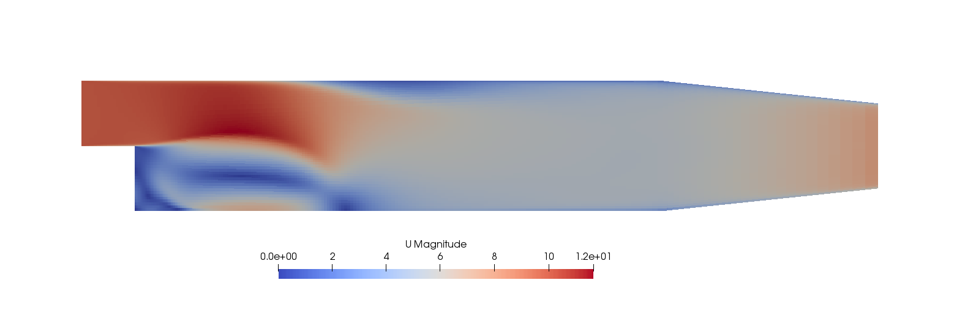
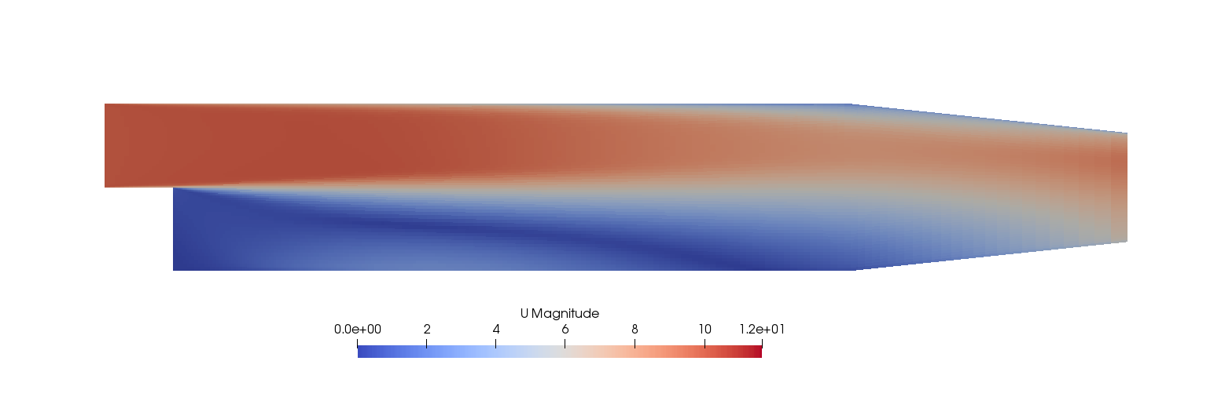




Development in time
$$t=0s$$
$$t=0.001s$$
$$t=0.03s$$
$$t=0.3s$$

Slide 14
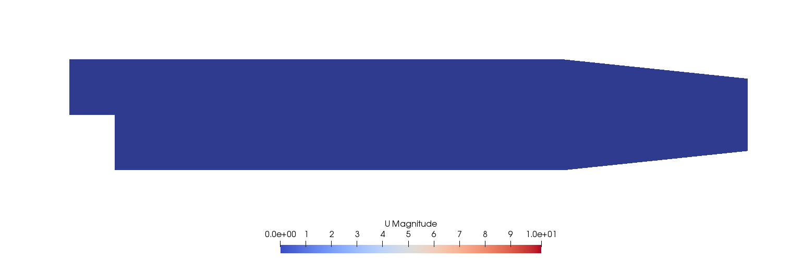
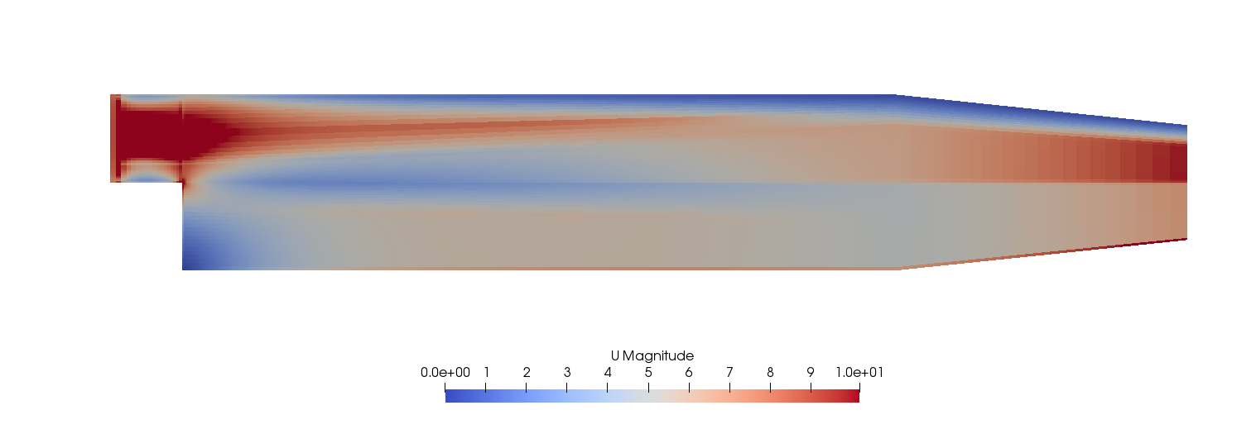
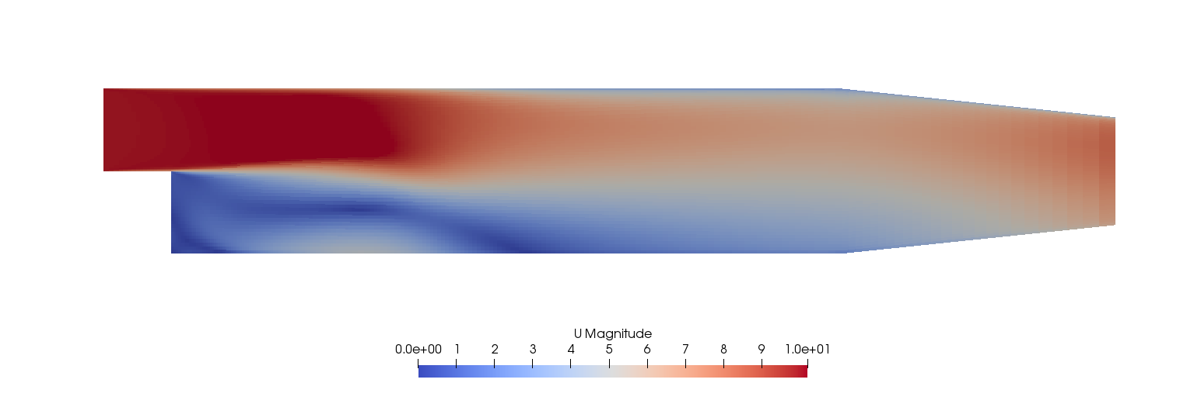
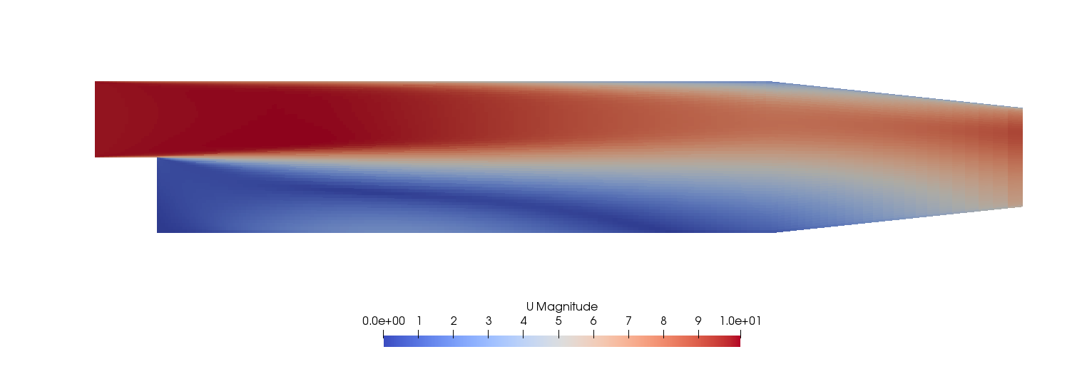




Steady state iterations
k is iteration step
$$k=0$$
$$k=1$$
$$k=70$$
$$k=287$$

Slide 15
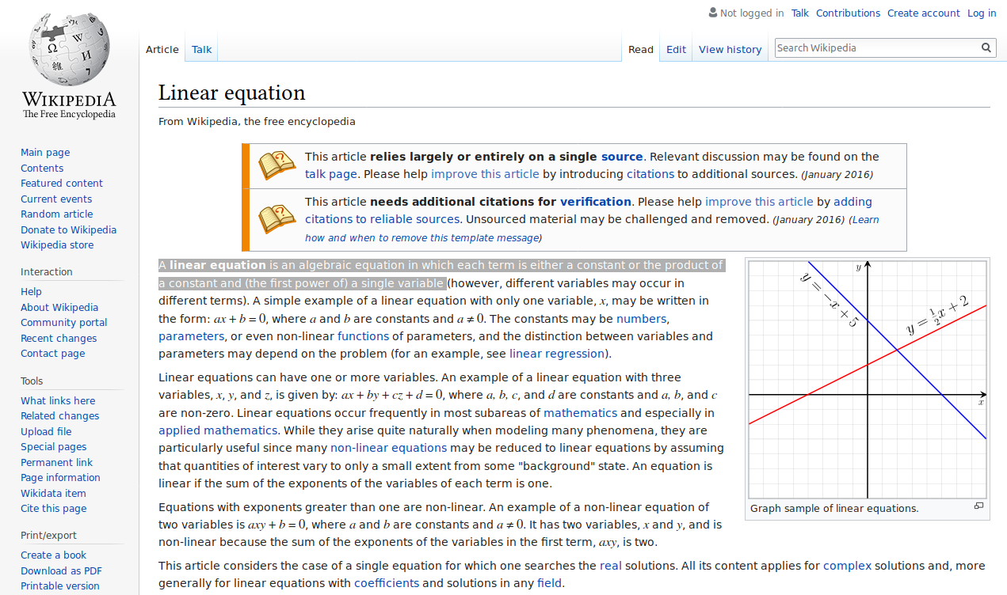

Slide 16
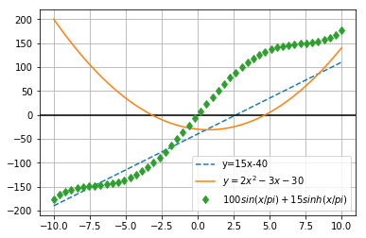
Linear vs. nonlinear
…all else is nonlinear
Nonlinear equations don’t always have analytical solutions
May be difficult to solve numerically
The same ideas can be extended to systems of equations

Slide 17
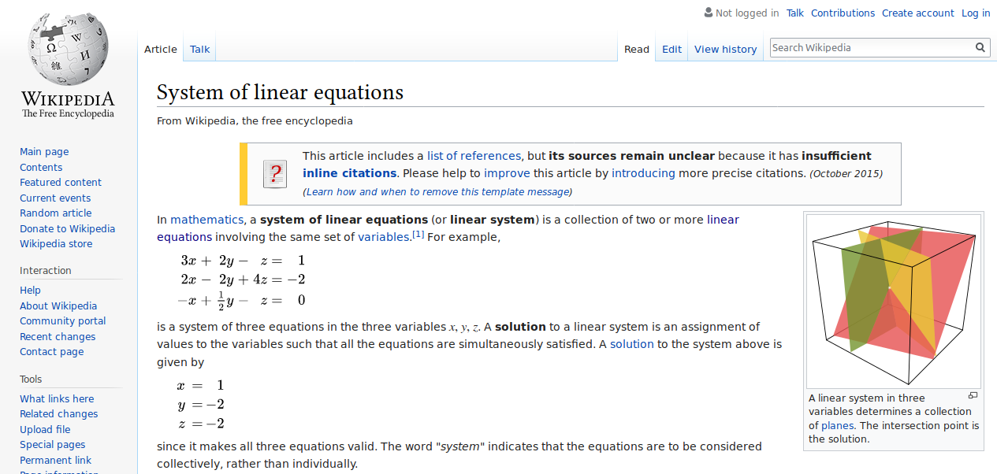
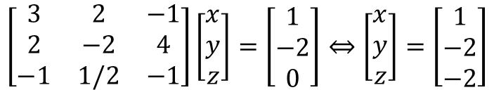
$$\left[\begin{matrix}3 & 2 & −1 \\ 2 & −2 & 4 \\ −1 & 1/2 & −1\end{matrix}\right]\left[\begin{matrix}x \\ y \\ z\end{matrix}\right]=\left[\begin{matrix}1 \\ −2 \\ 0\end{matrix}\right]⇔\left[\begin{matrix}x \\ y \\ z\end{matrix}\right]=\left[\begin{matrix}1 \\ −2 \\ −2\end{matrix}\right]$$

Slide 18
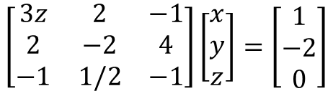
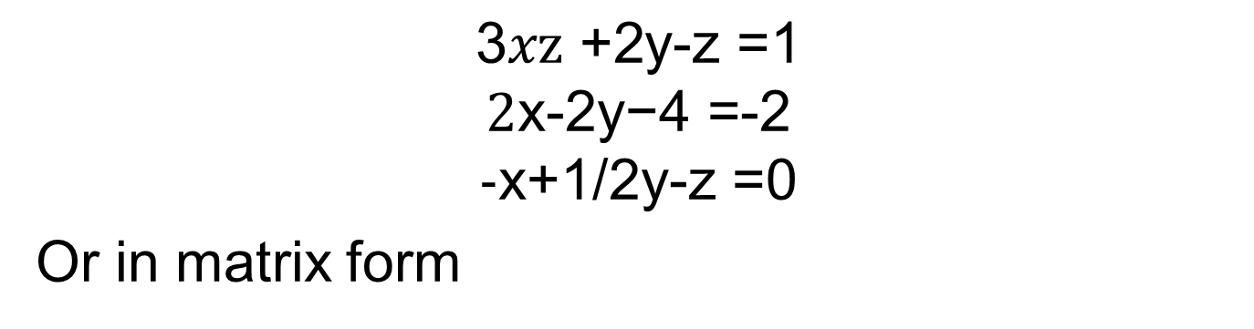
Nonlinear system
$$\text{3}x\text{z} \text{+2}\text{y}\text{-}\text{z}\text{ =1}$$
$$\text{2}\text{x}\text{-}\text{2}\text{y}\text{−4 =-}\text{2}$$
$$\text{-}\text{x}\text{+1/}\text{2}\text{y}\text{-}\text{z}\text{ =}\text{0}$$
Or in matrix form
$$\left[\begin{matrix}3z & 2 & −1 \\ 2 & −2 & 4 \\ −1 & 1/2 & −1\end{matrix}\right]\left[\begin{matrix}x \\ y \\ z\end{matrix}\right]=\left[\begin{matrix}1 \\ −2 \\ 0\end{matrix}\right]$$

Slide 19
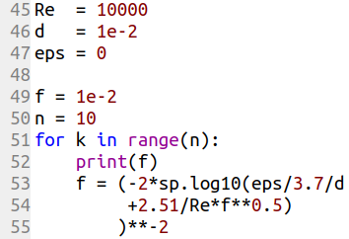
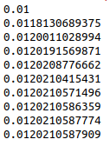
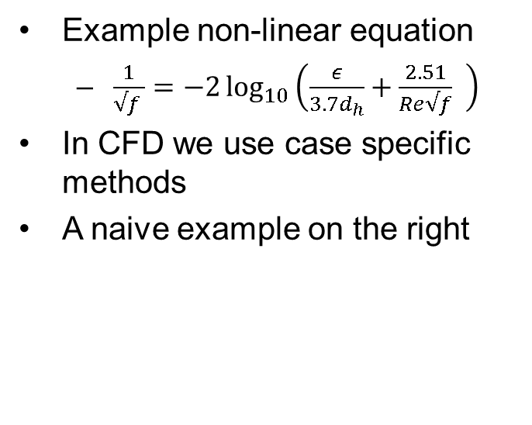
Iterative solution
Example non-linear equation
$\frac{1}{√f }=−2\log_{10}\left(\frac{ε}{3.7d_{h}}+\frac{2.51}{Re√f} \right)$
In CFD we use case specific methods
A naive example on the right
Out:

Slide 20
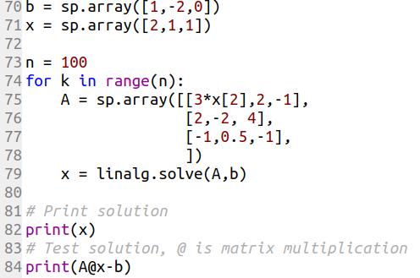
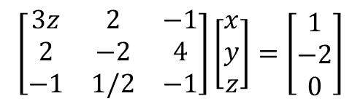
Nonlinear system solution
Naive iteration for matrix system
Gives x = [1 4 1]
Error
Ab-b=[0 0 -2e-16]
$$\left[\begin{matrix}3z & 2 & −1 \\ 2 & −2 & 4 \\ −1 & 1/2 & −1\end{matrix}\right]\left[\begin{matrix}x \\ y \\ z\end{matrix}\right]=\left[\begin{matrix}1 \\ −2 \\ 0\end{matrix}\right]$$

Slide 21
Disclaimer
Better methods for general nonlinear equations can be found from nearly any programming language
The naive method is used here for simplicity
In CFD special methods are used

Slide 22
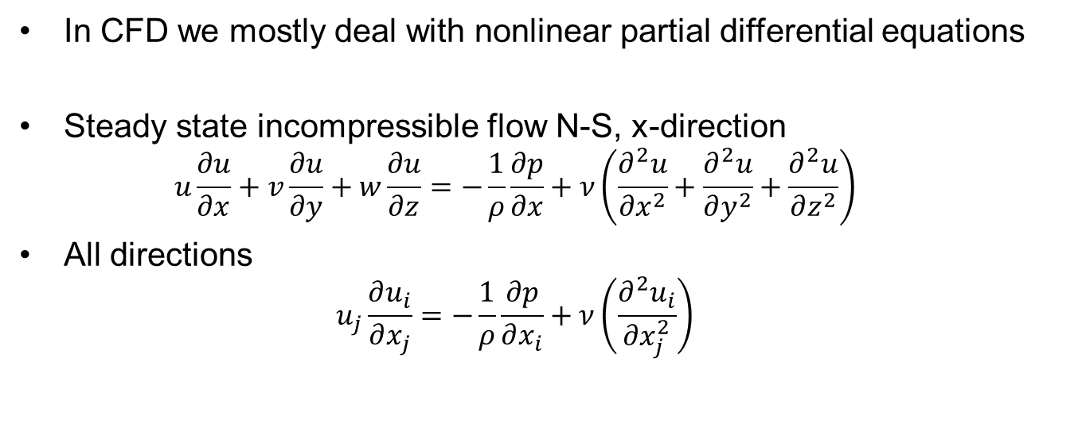
Nonlinear PDE
In CFD we mostly deal with nonlinear partial differential equations
Steady state incompressible flow N-S, x-direction
$$u\frac{∂u}{∂x}+v\frac{∂u}{∂y}+w\frac{∂u}{∂z}=−\frac{1}{ρ}\frac{∂p}{∂x}+ν\left(\frac{∂^{2}u}{∂x^{2}}+\frac{∂^{2}u}{∂y^{2}}+\frac{∂^{2}u}{∂z^{2}}\right)$$
All directions
$$u_{j}\frac{∂u_{i}}{∂x_{j}}=−\frac{1}{ρ}\frac{∂p}{∂x_{i}}+ν\left(\frac{∂^{2}u_{i}}{∂x_{j}^{2}}\right)$$

Slide 23
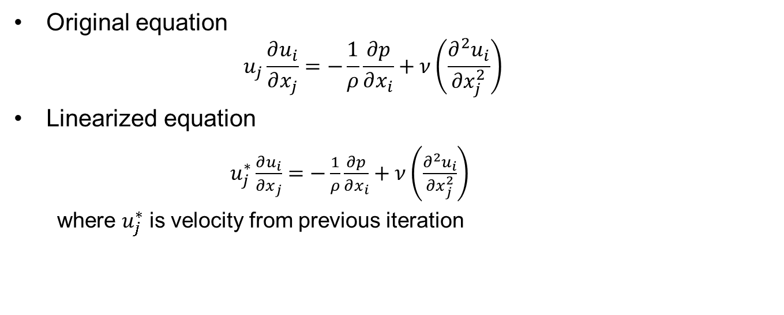
Simple linearization
Original equation
$$u_{j}\frac{∂u_{i}}{∂x_{j}}=−\frac{1}{ρ}\frac{∂p}{∂x_{i}}+ν\left(\frac{∂^{2}u_{i}}{∂x_{j}^{2}}\right)$$
Linearized equation
$u_{j}^{∗}\frac{∂u_{i}}{∂x_{j}}=−\frac{1}{ρ}\frac{∂p}{∂x_{i}}+ν\left(\frac{∂^{2}u_{i}}{∂x_{j}^{2}}\right)$
where $u_{j}^{∗}$ is velocity from previous iteration

Slide 24
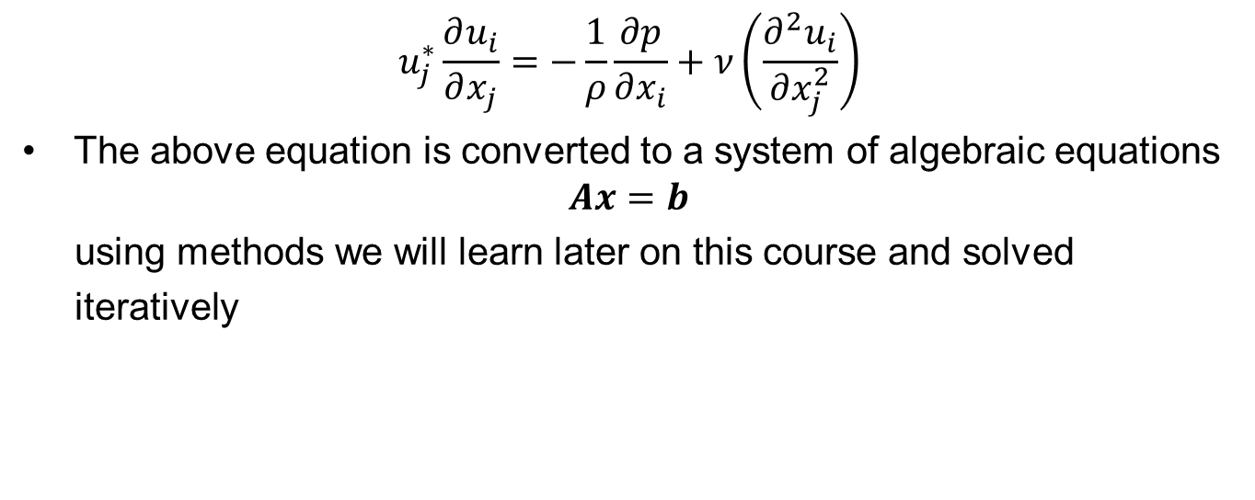
Iterative solution of NS
$$u_{j}^{∗}\frac{∂u_{i}}{∂x_{j}}=−\frac{1}{ρ}\frac{∂p}{∂x_{i}}+ν\left(\frac{∂^{2}u_{i}}{∂x_{j}^{2}}\right)$$
The above equation is converted to a system of algebraic equations
$$Ax=b$$
using methods we will learn later on this course and solved
iteratively

Slide 25
Scope of this course
Solution of NS is difficult
We will not program our own NS solver on this course
Unless you want to learn deeper understanding of CFD and program your own solver as the CFD assignment
The case is chosen so that is relatively easy to solve
We will program our own solver for simpler cases
We will use ANSYS for NS
You can do the CFD assignment with ANSYS

Slide 26
Iterations
k is iteration step
$$k=0$$
$$k=1$$
$$k=70$$
$$k=287$$

Slide 27
Development in time
$$t=0s$$
$$t=0.001s$$
$$t=0.03s$$
$$t=0.3s$$

Slide 28
Steps of CFD solution

Slide 29
Turbulence

Slide 30
More physics and chemistry

