Slide 1
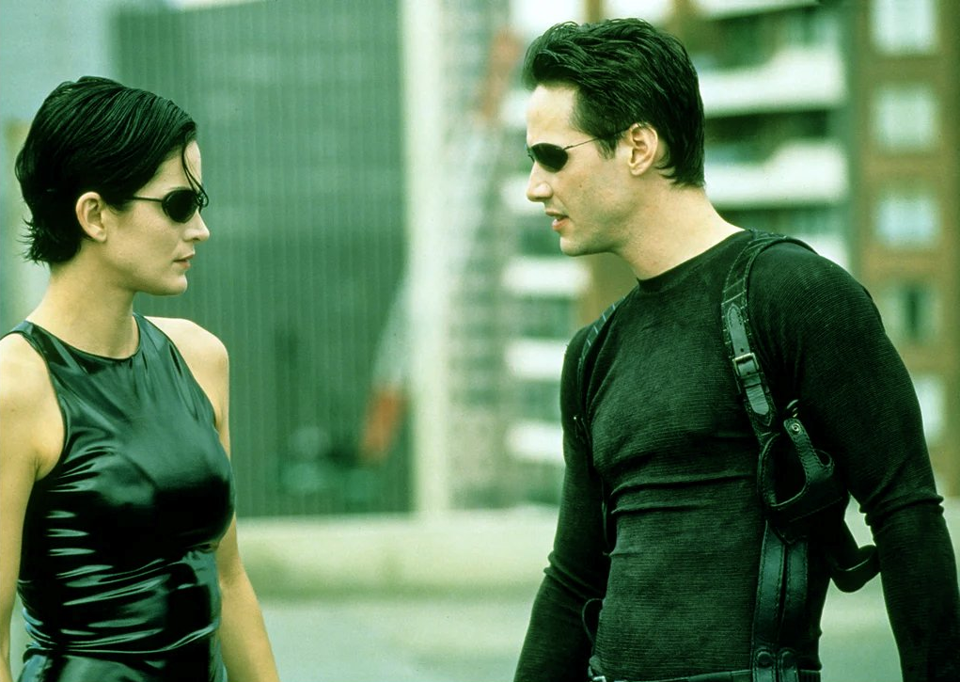

Talk title talk title talk title talk title
Eventname, Date
Speaker1name Speaker2name

Slide 2
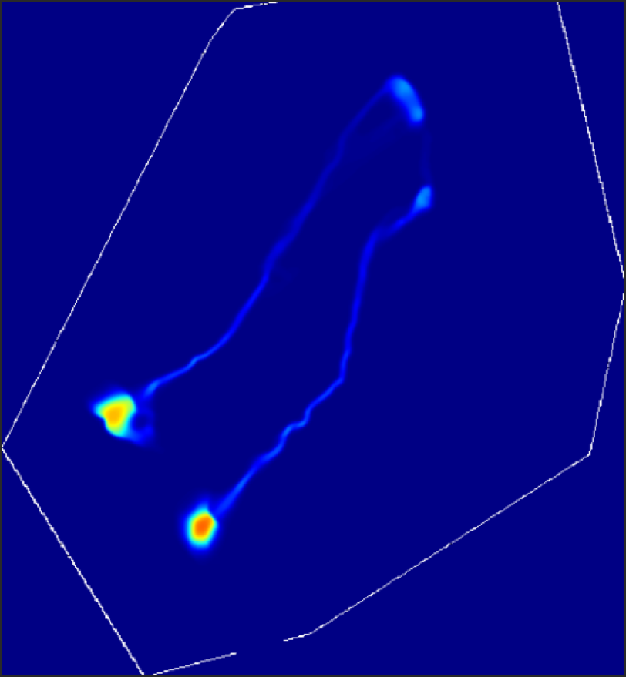

Today you will learn why, when, and how to use numpy
Scientific programming
Array manipulation
Data processing

Slide 3

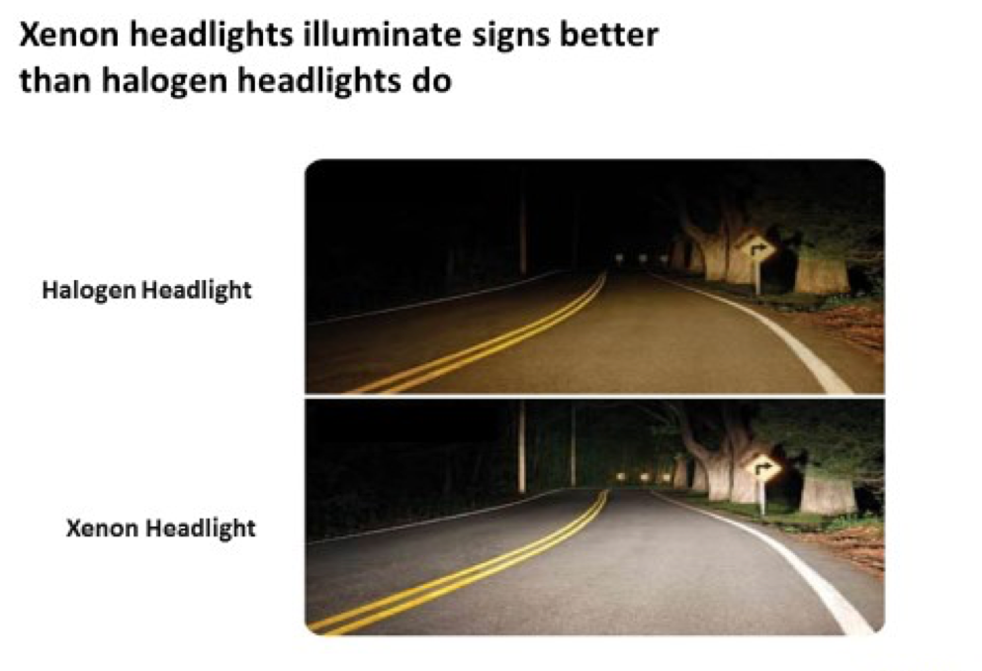
The assertion-evidence structure consists of a message headline supported by visual evidence
👌
https://www.assertion-evidence.com/

Slide 4

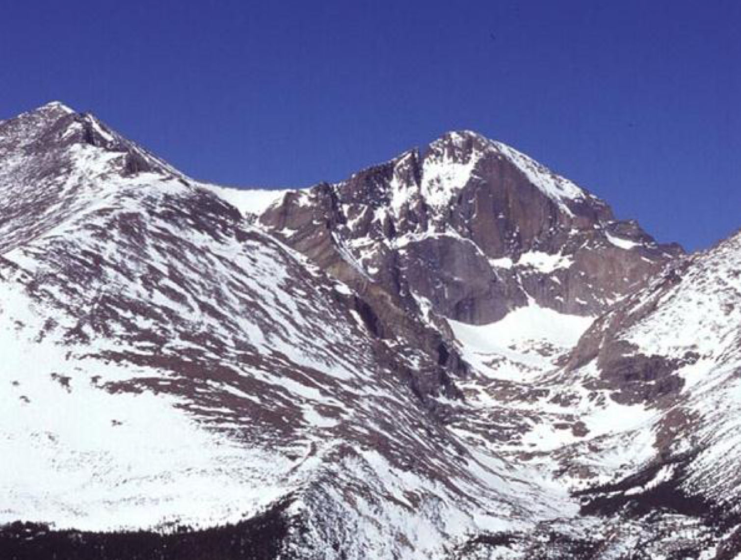

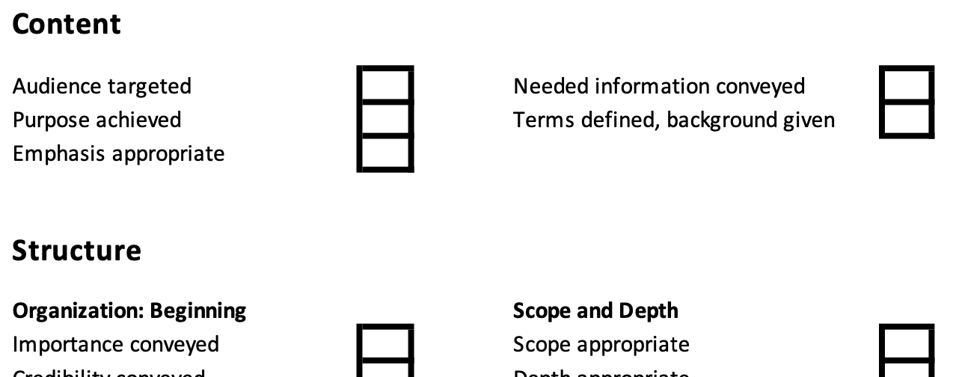
See these materials for how to design good slides
Book
Slides: Designing technical presentations
Checklist
https://www.assertion-evidence.com/

Slide 5
Assertion
Evidence
Attribution

Slide 6
Page title
Mentimeter
Body
Body small
Attribution

Slide 7
New section,
or important message

Slide 8
Page title
Terminal
Body
Body small
Attribution

Slide 10
Page title
Blackboard
Body
Body small
Attribution

Slide 11
Take home messages summary
Message 1
Message 2
Speaker1name: Contact / Web / Social
Speaker2name: Contact / Web / Social

Slide 12

Notes:
Optional slide about NERDS

