Slide 1
Fahim Tahmid Chowdhury Data Analytics & Service Group NERSC
Project Progress
July 27, 2018

Slide 2
Outline
HEP Benchmark
Comparison Between Local and Global Shuffle
Climate Data Benchmark
Plots using Merged Interval Strategy
Playing with 64 Nodes Results
Future Exploration Scopes

Slide 3
Outline
HEP Benchmark
Comparison Between Local and Global Shuffle
Climate Data Benchmark
Plots using Merged Interval Strategy
Playing with 64 Nodes Results
Future Exploration Scopes

Slide 4
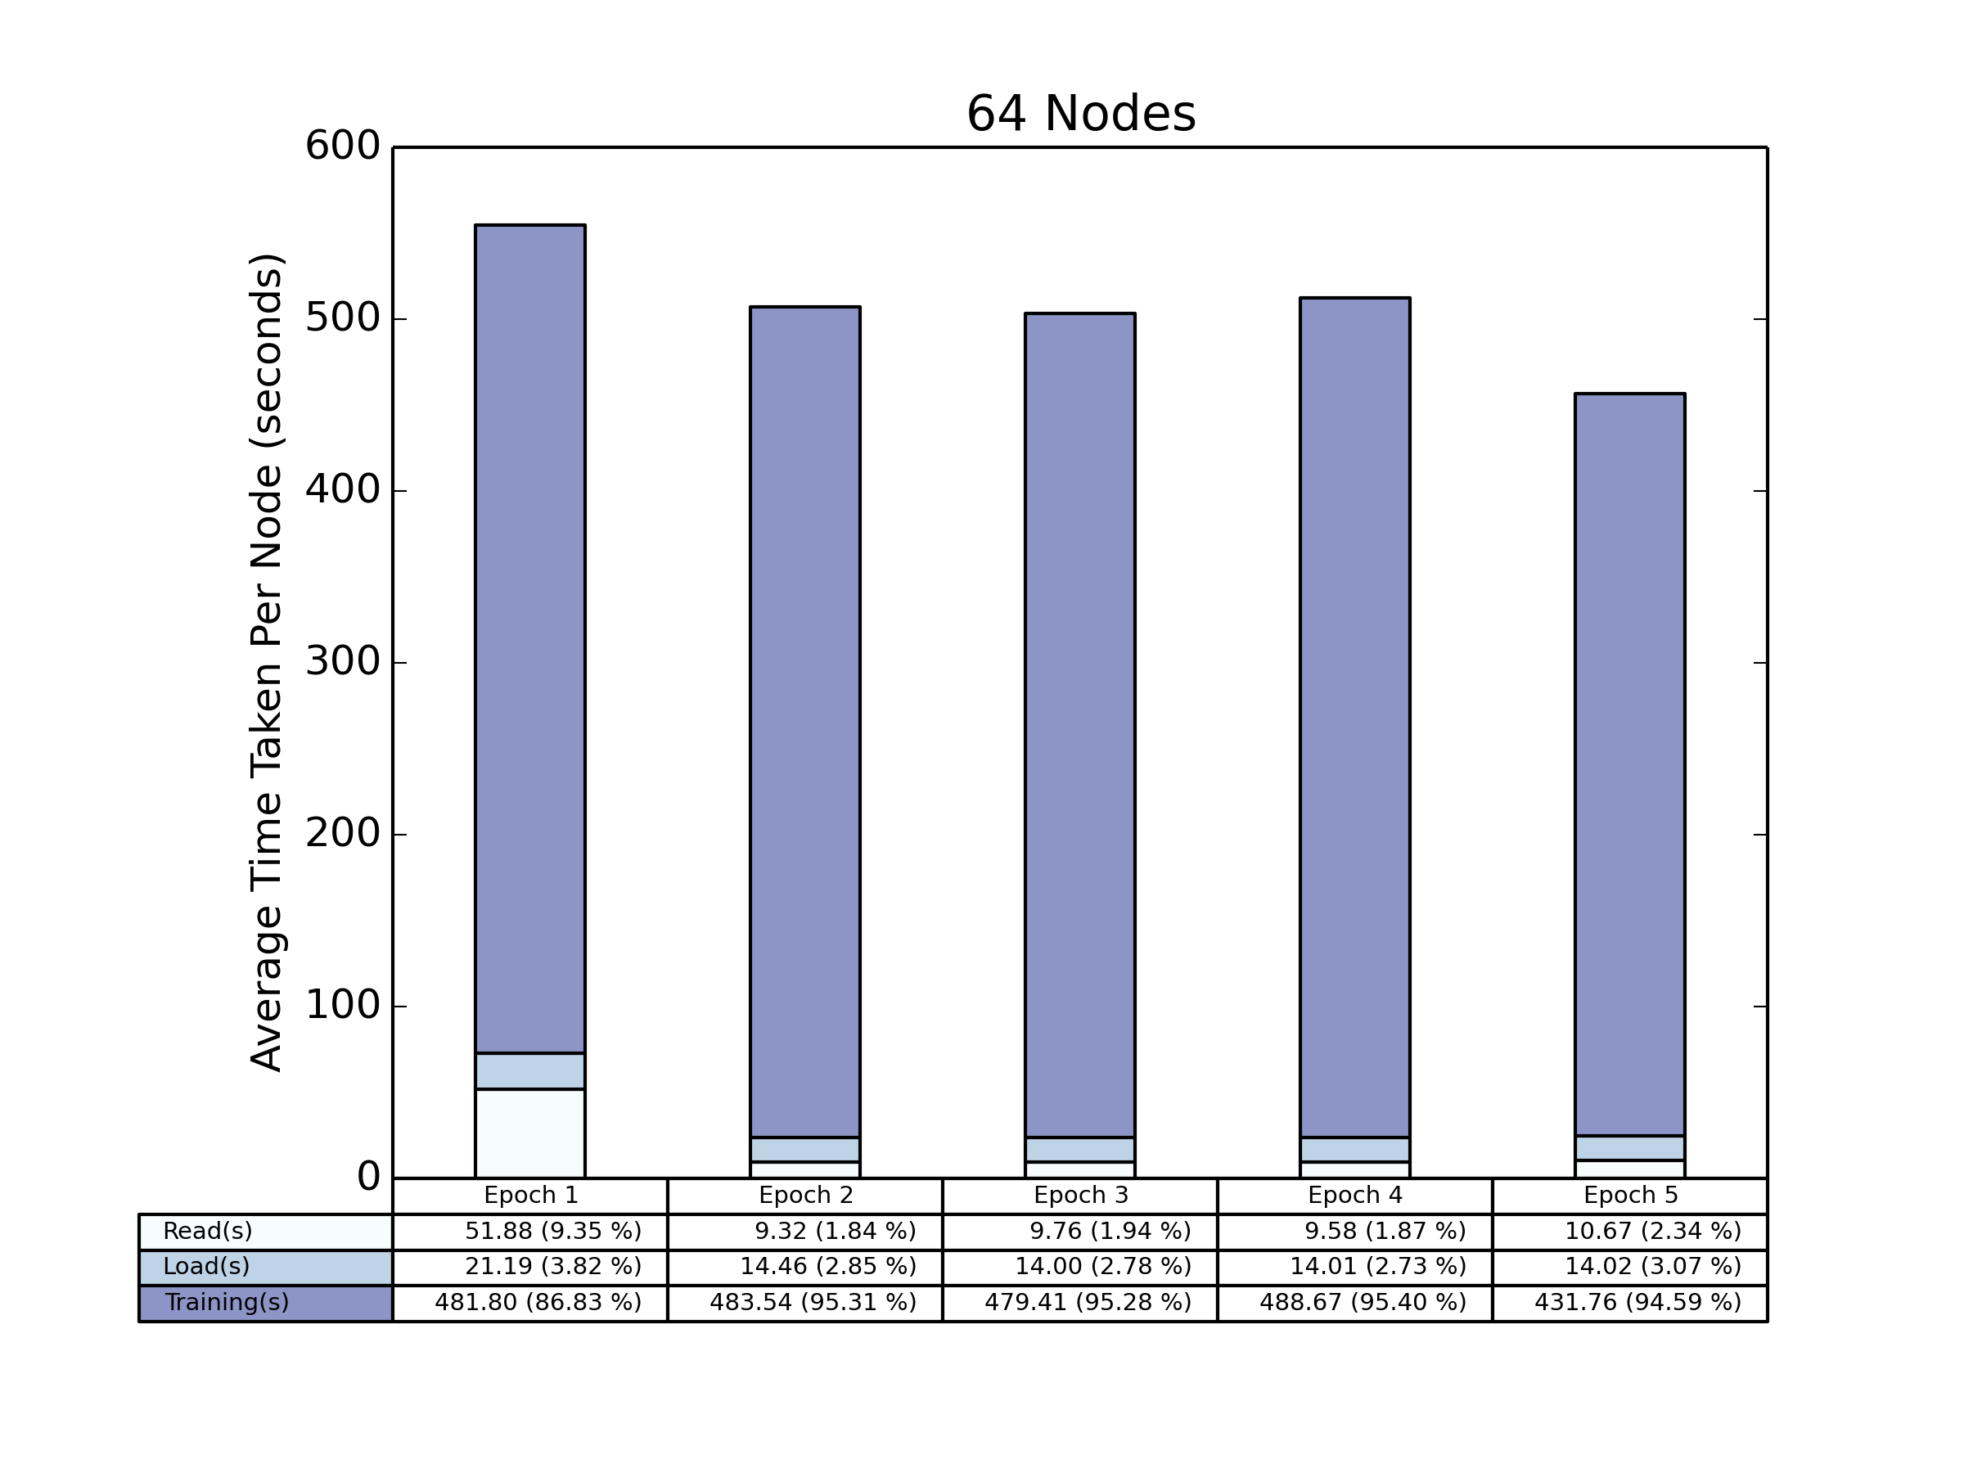
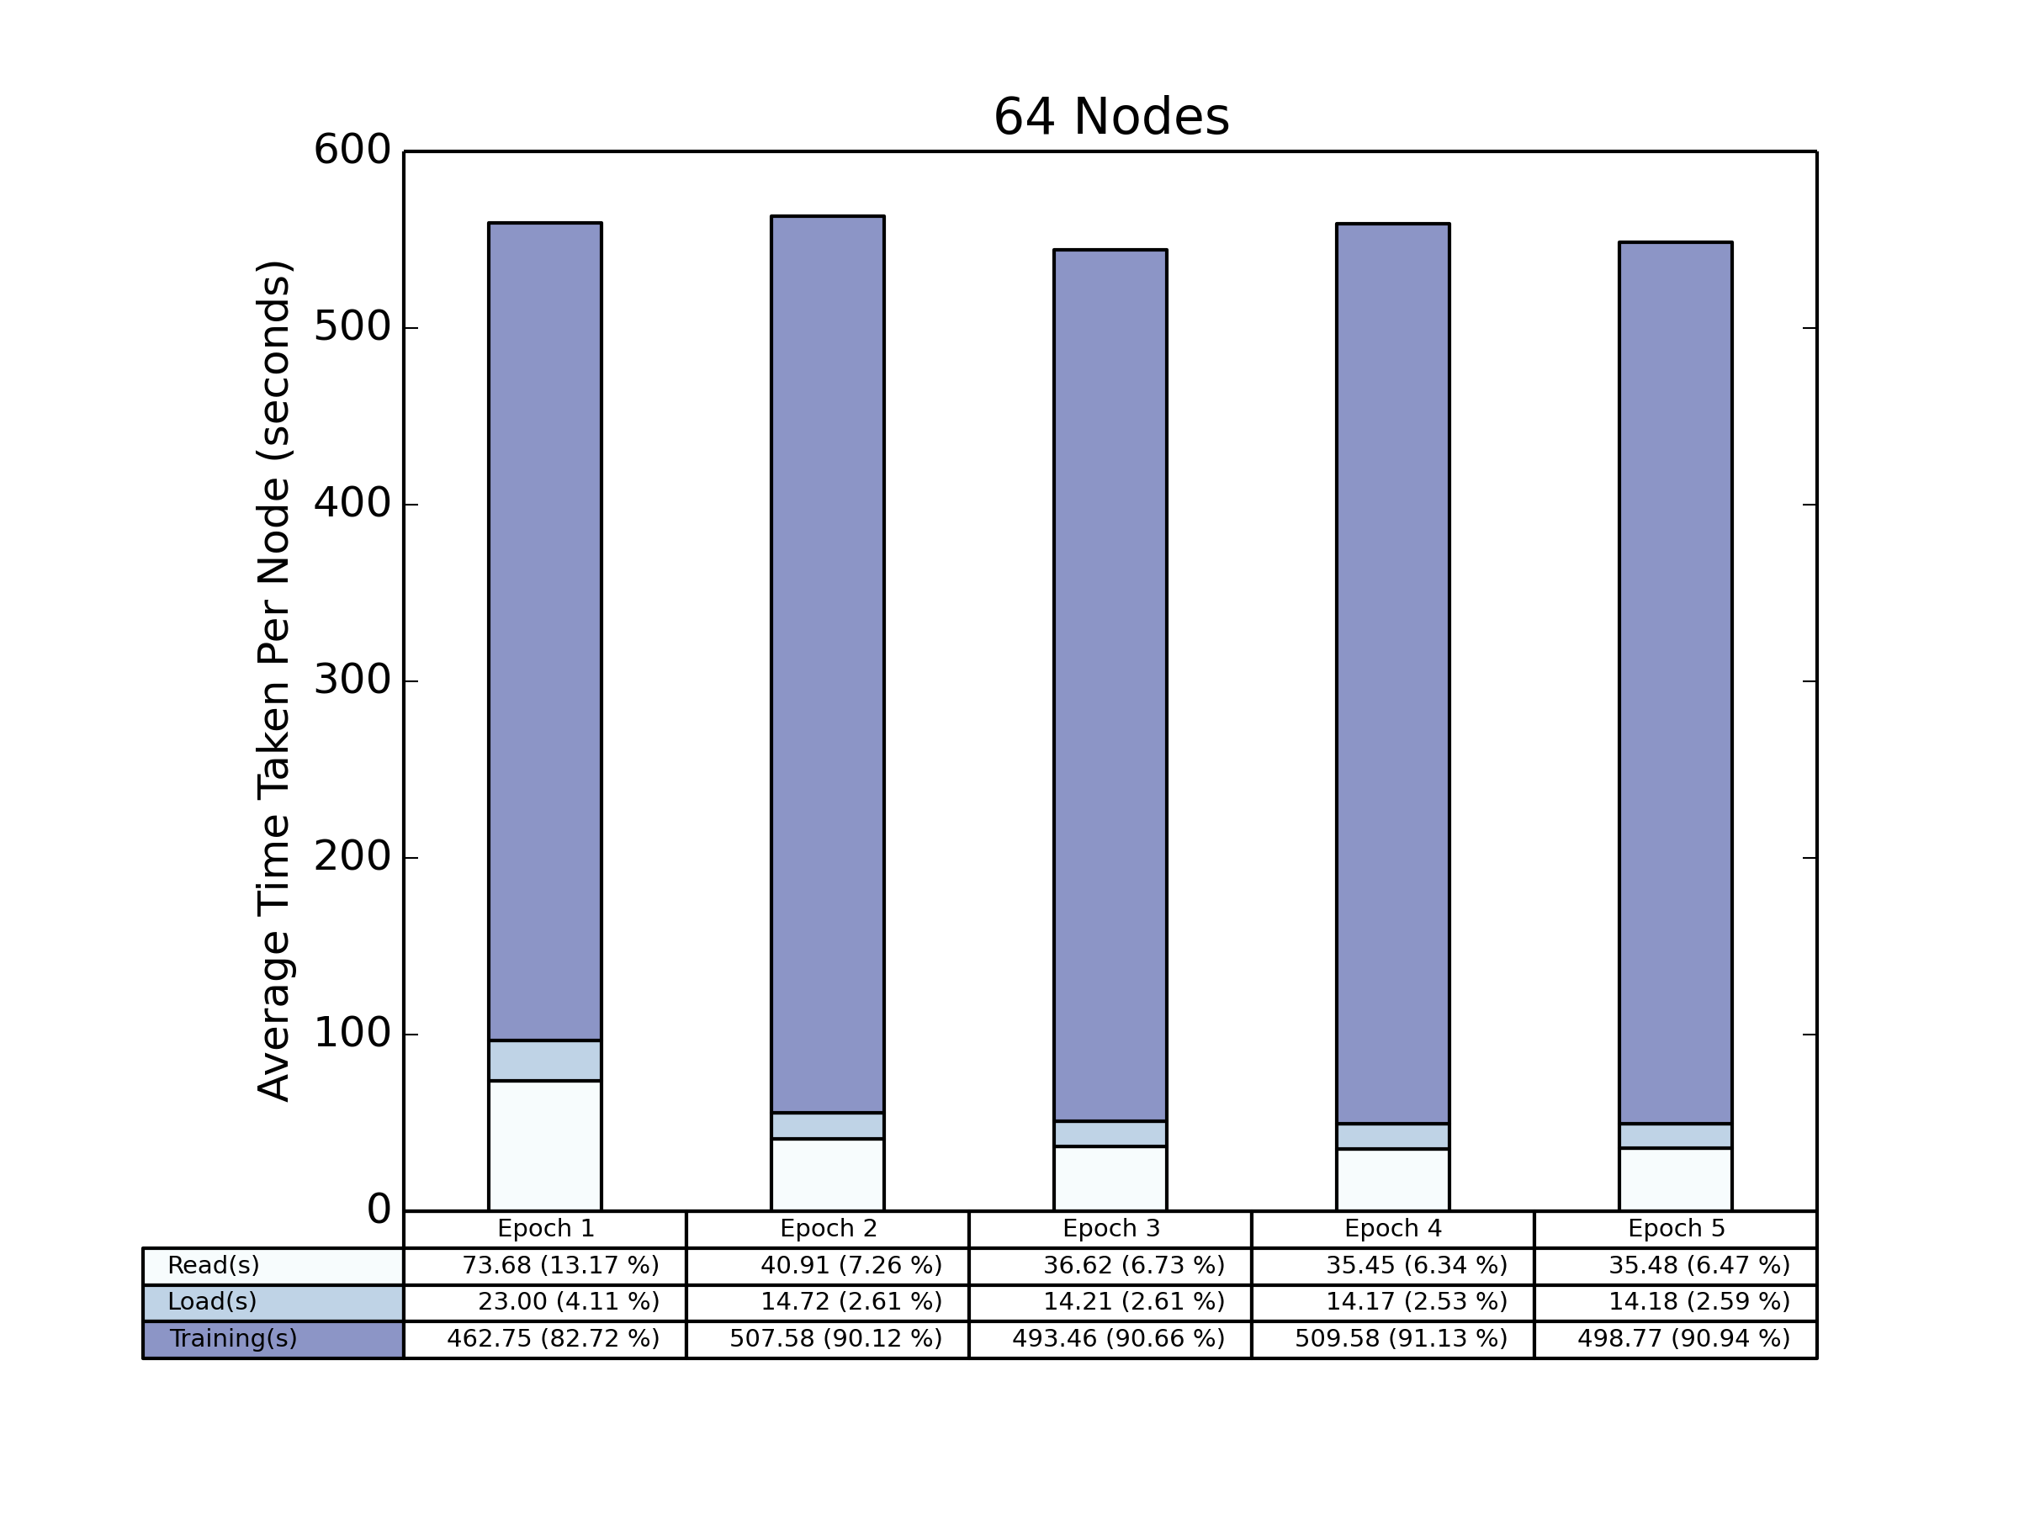
64 Nodes
Local Shuffle
Global Shuffle

Slide 5
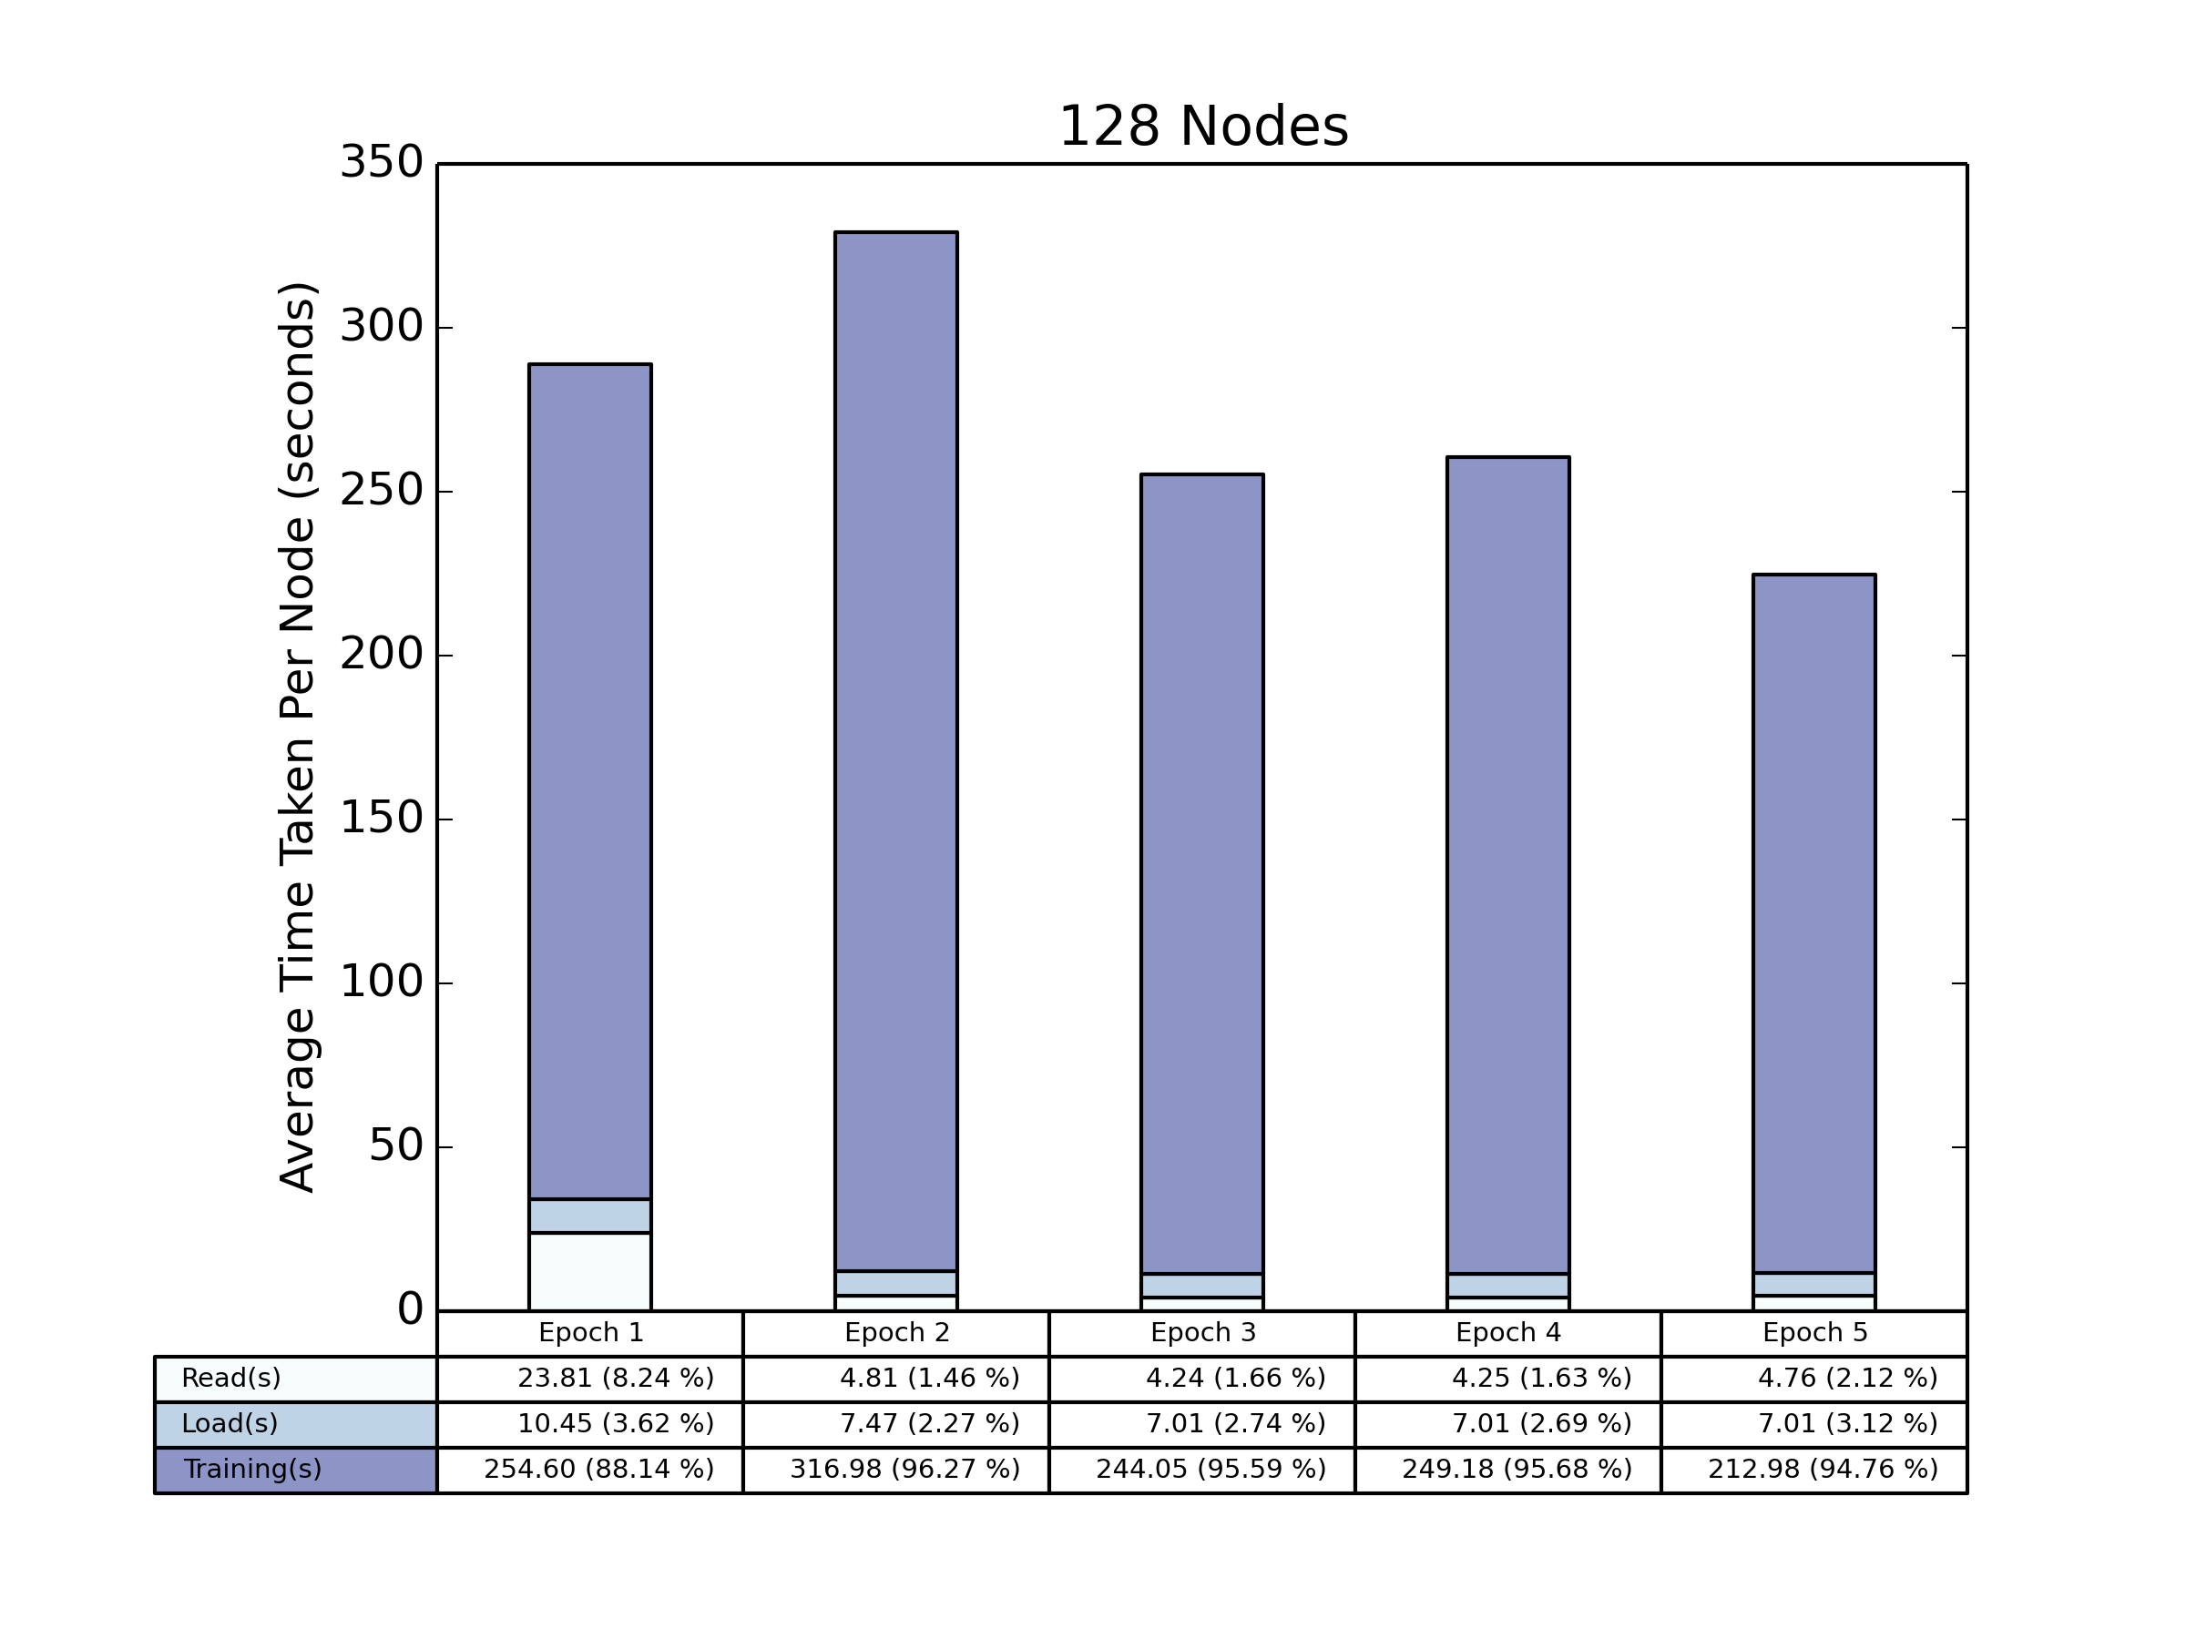
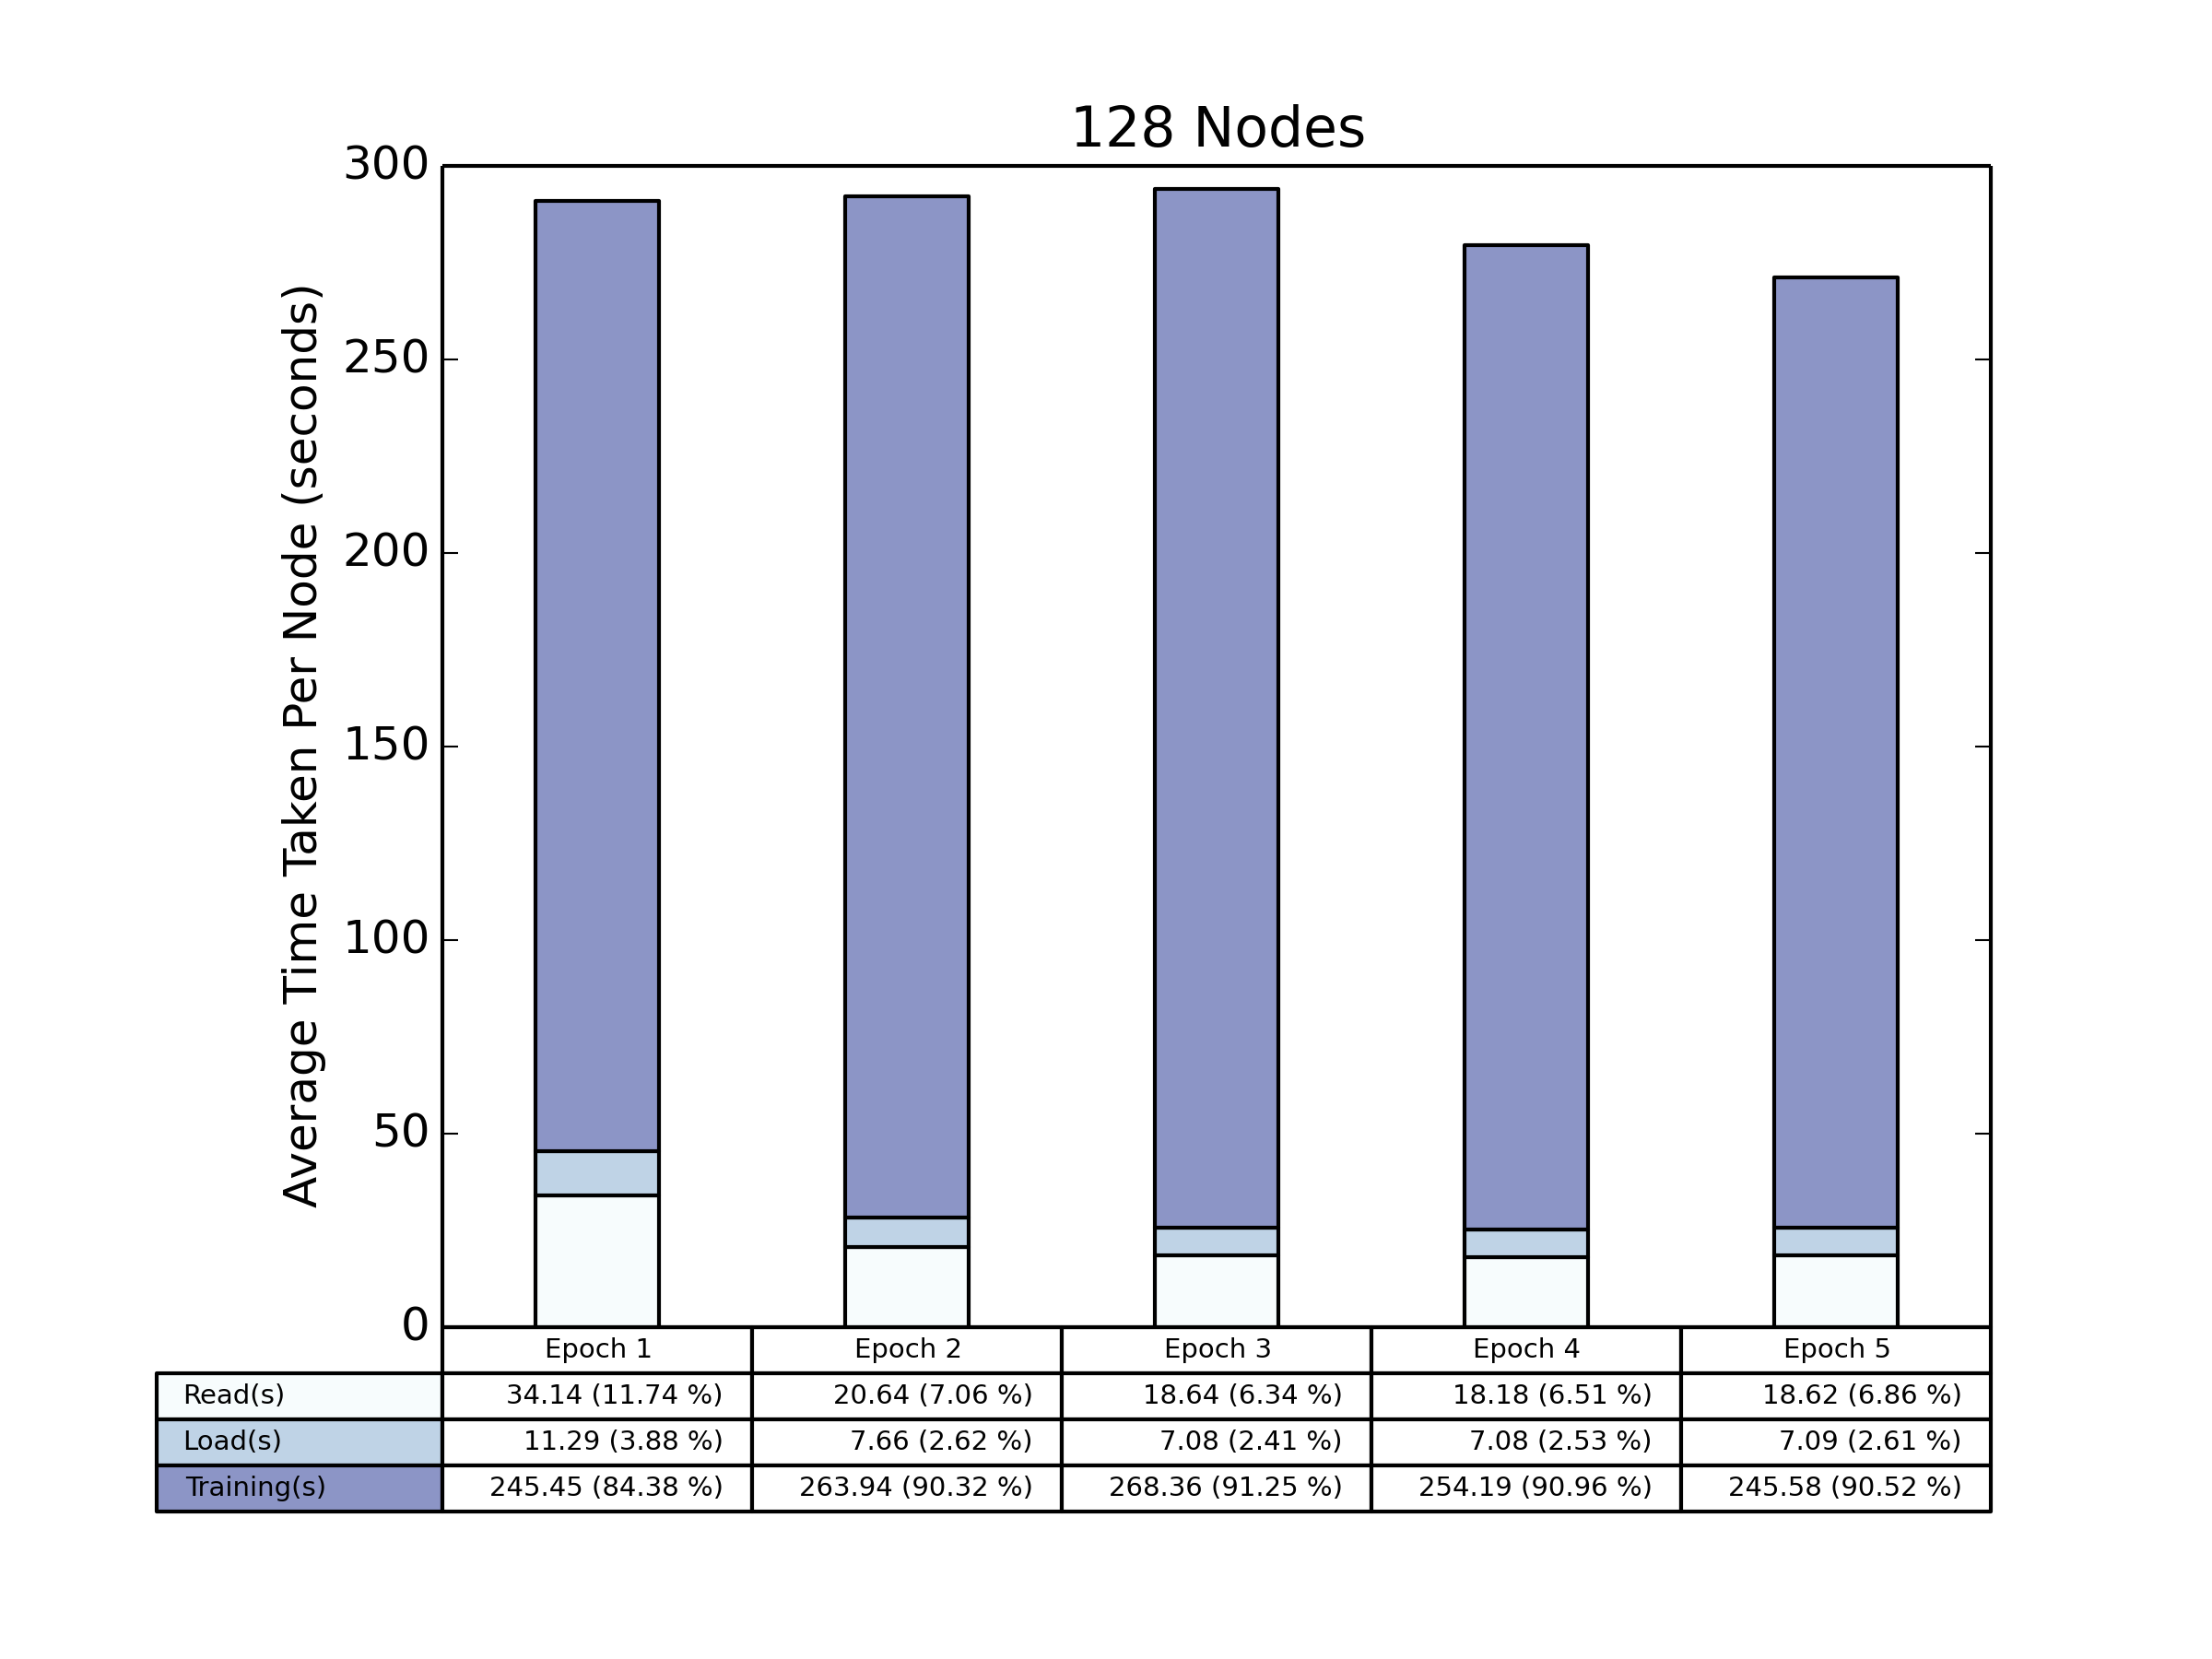
128 Nodes
Local Shuffle
Global Shuffle

Slide 6
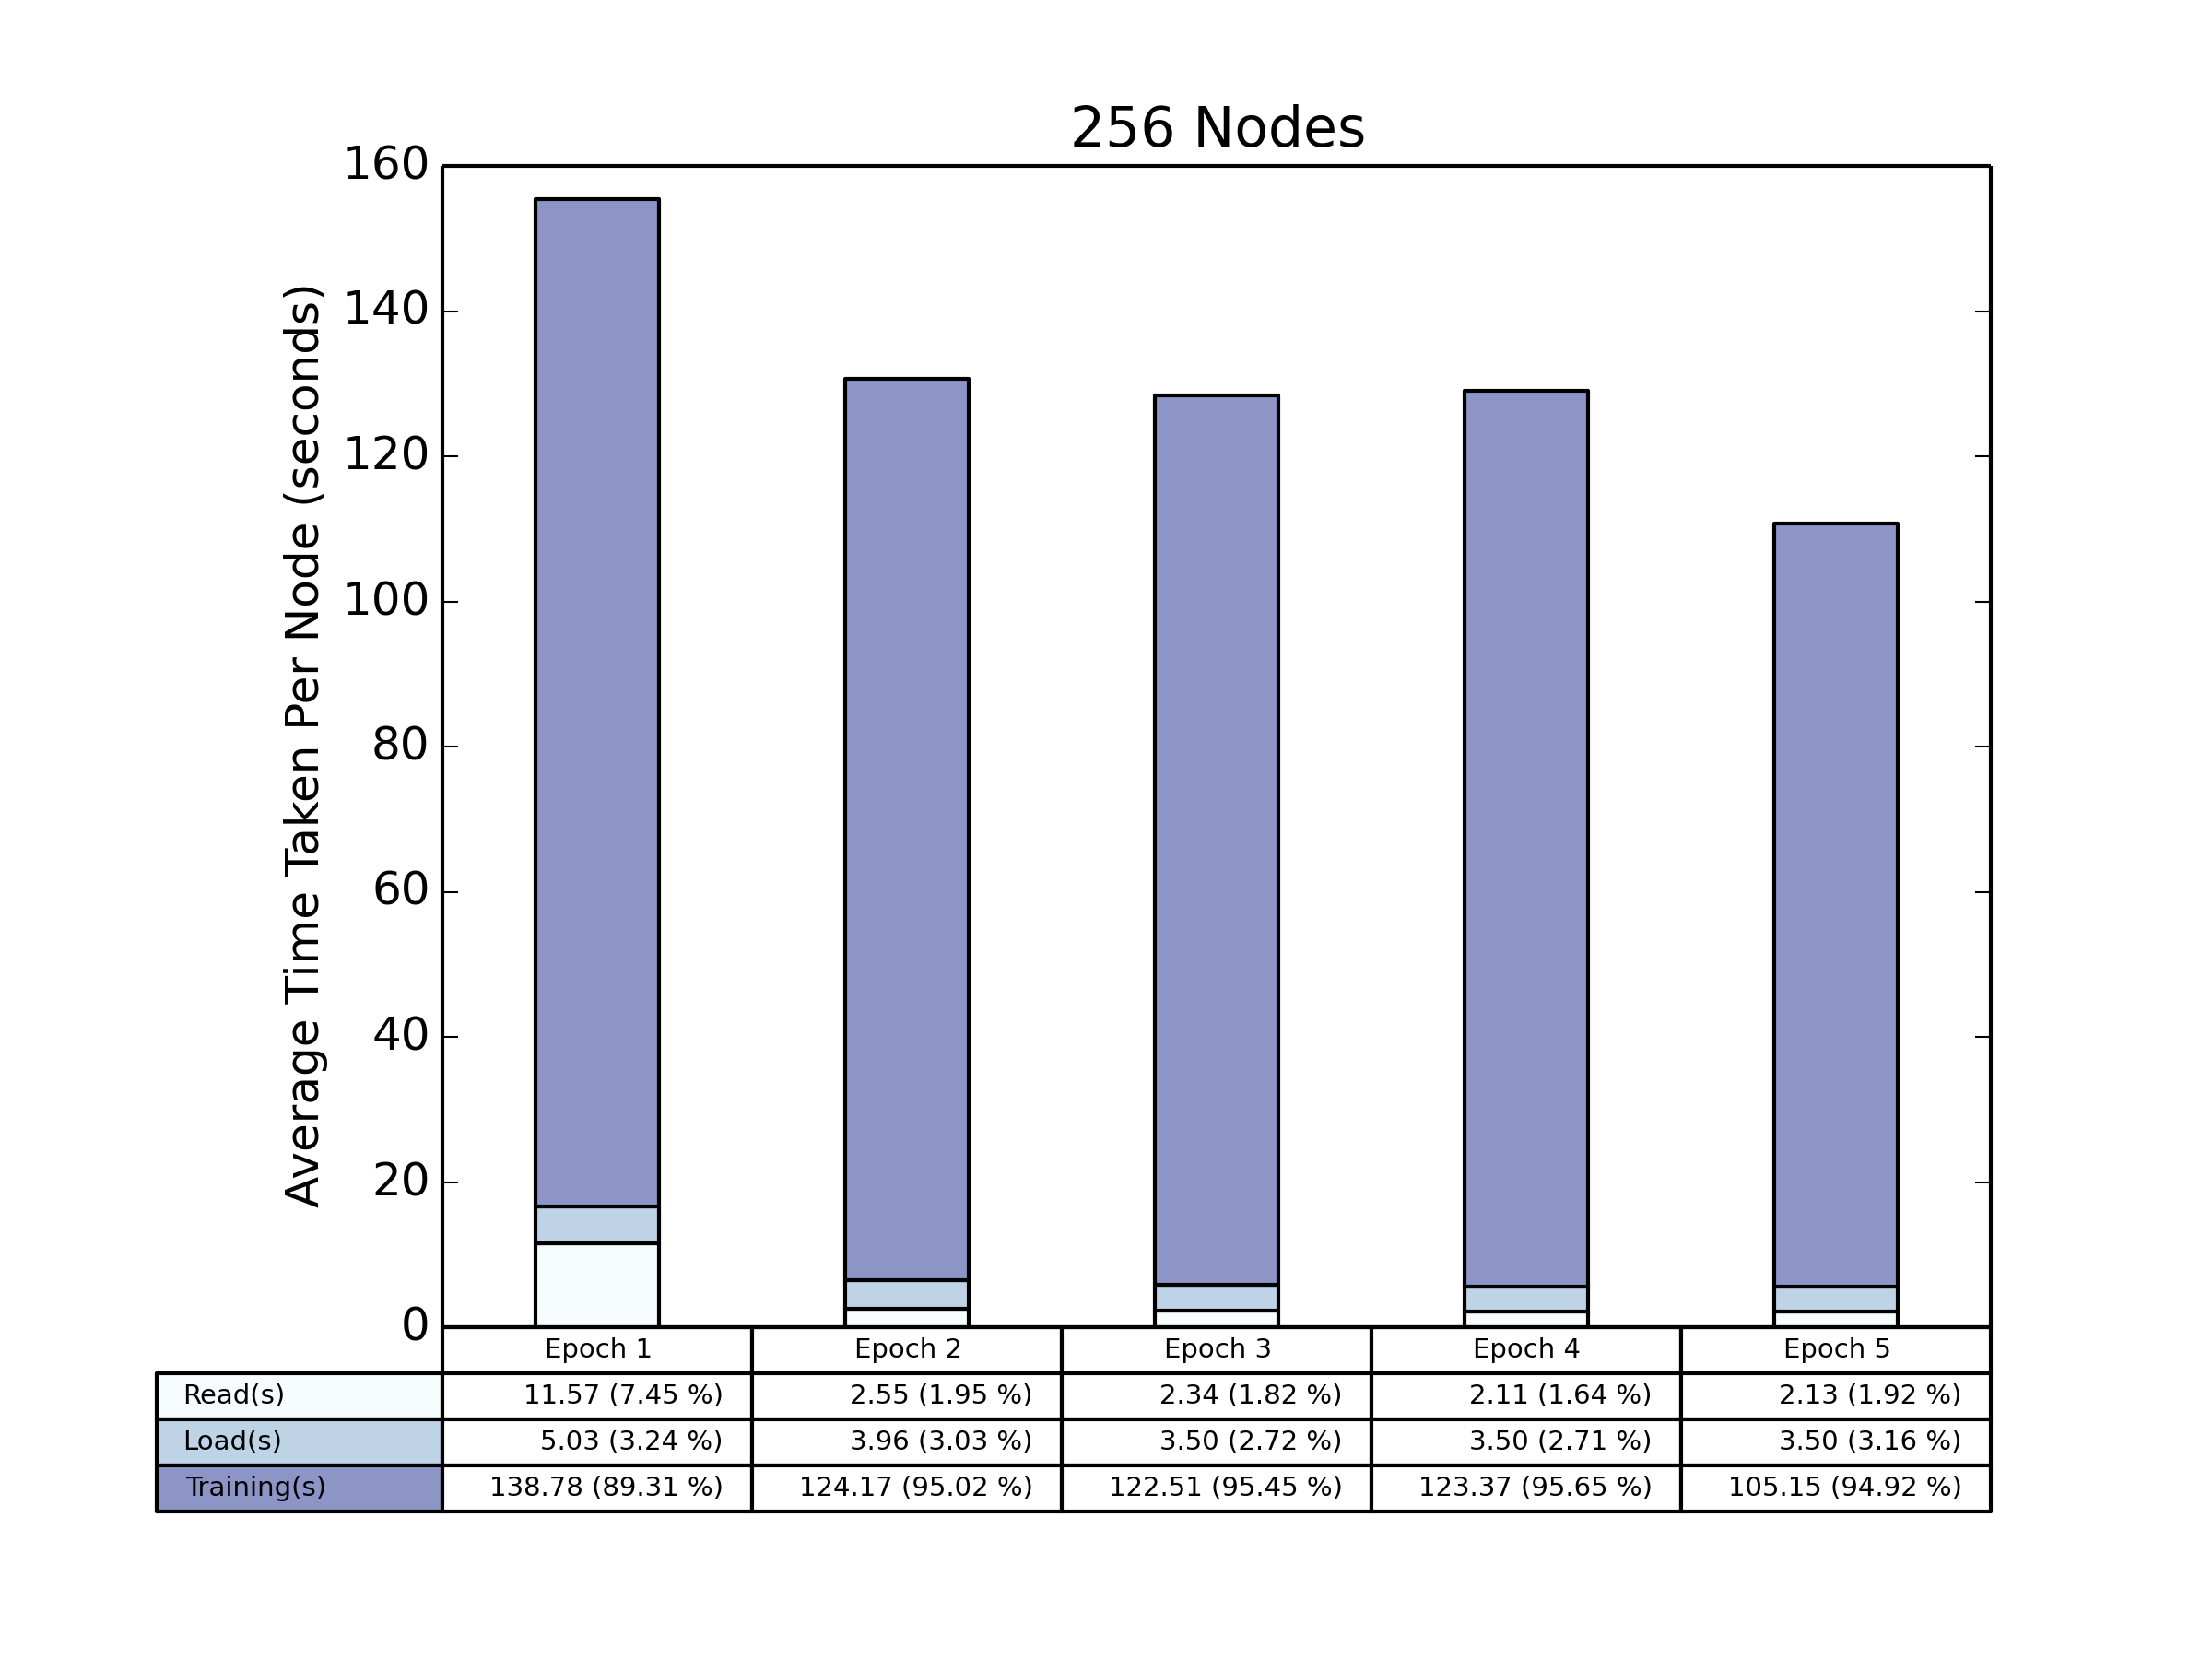
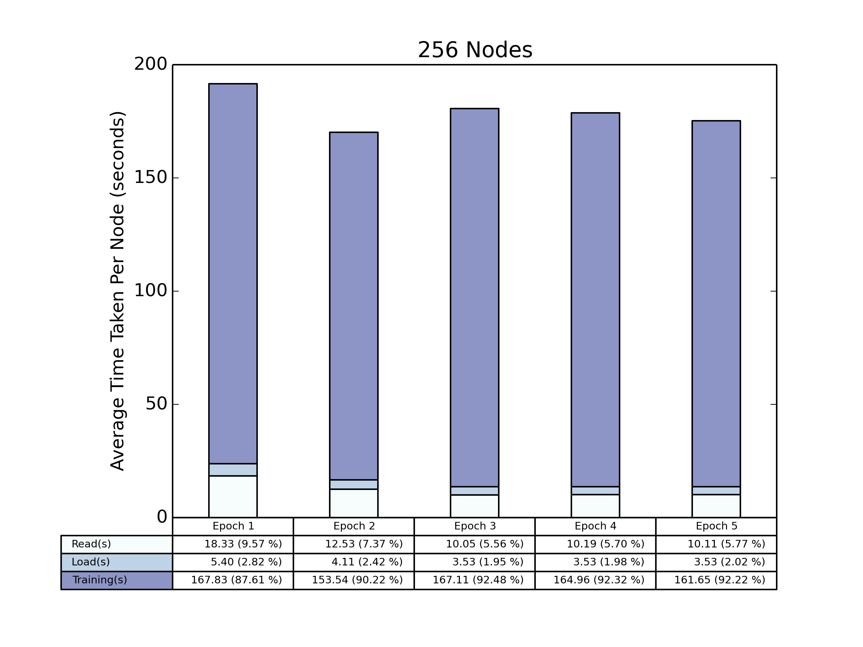
256 Nodes
Local Shuffle
Global Shuffle

Slide 7
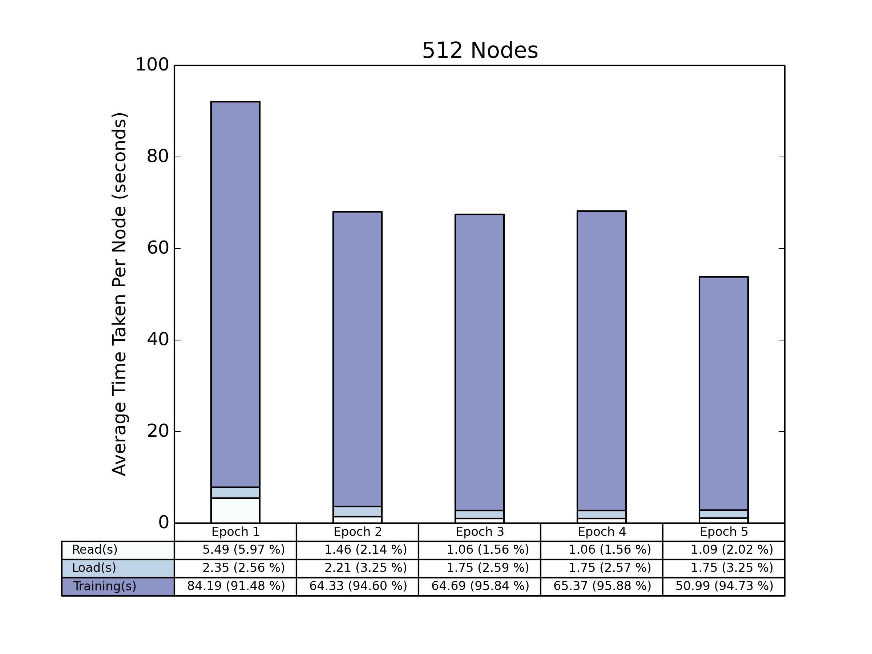
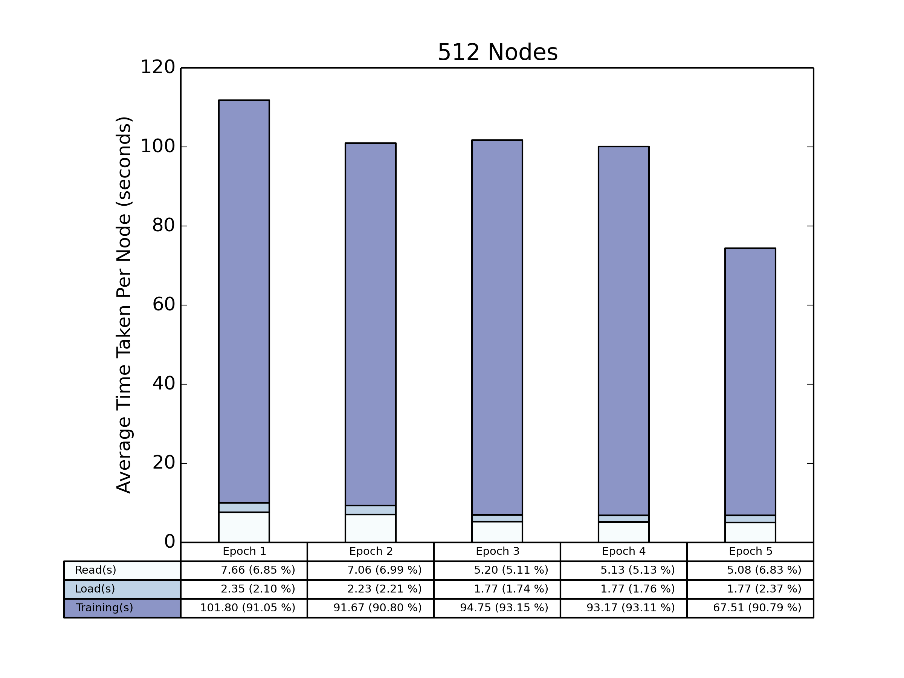
512 Nodes
Local Shuffle
Global Shuffle

Slide 8
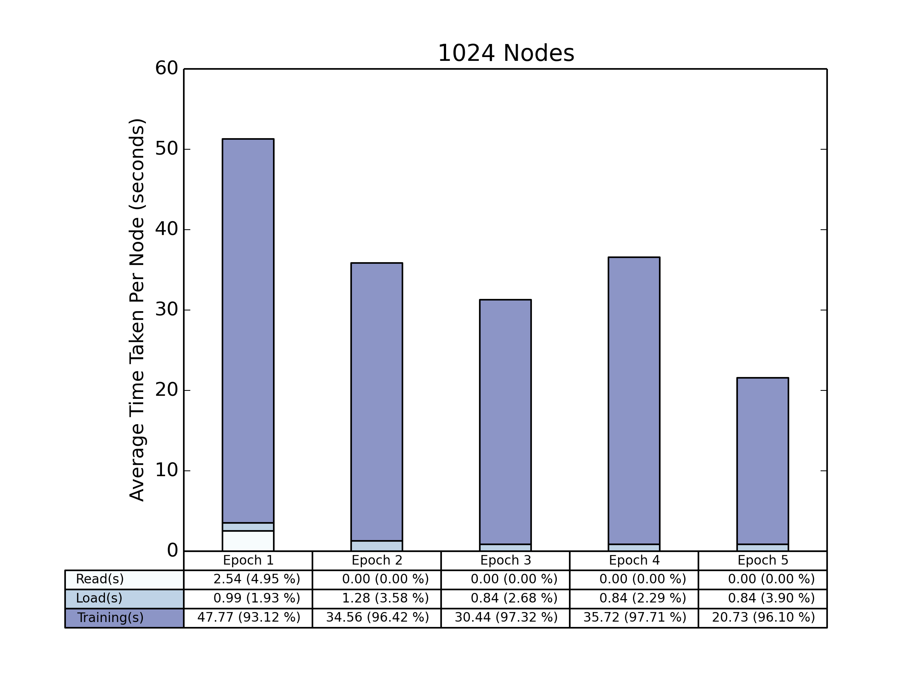

1024 Nodes
Local Shuffle
Global Shuffle

Slide 9
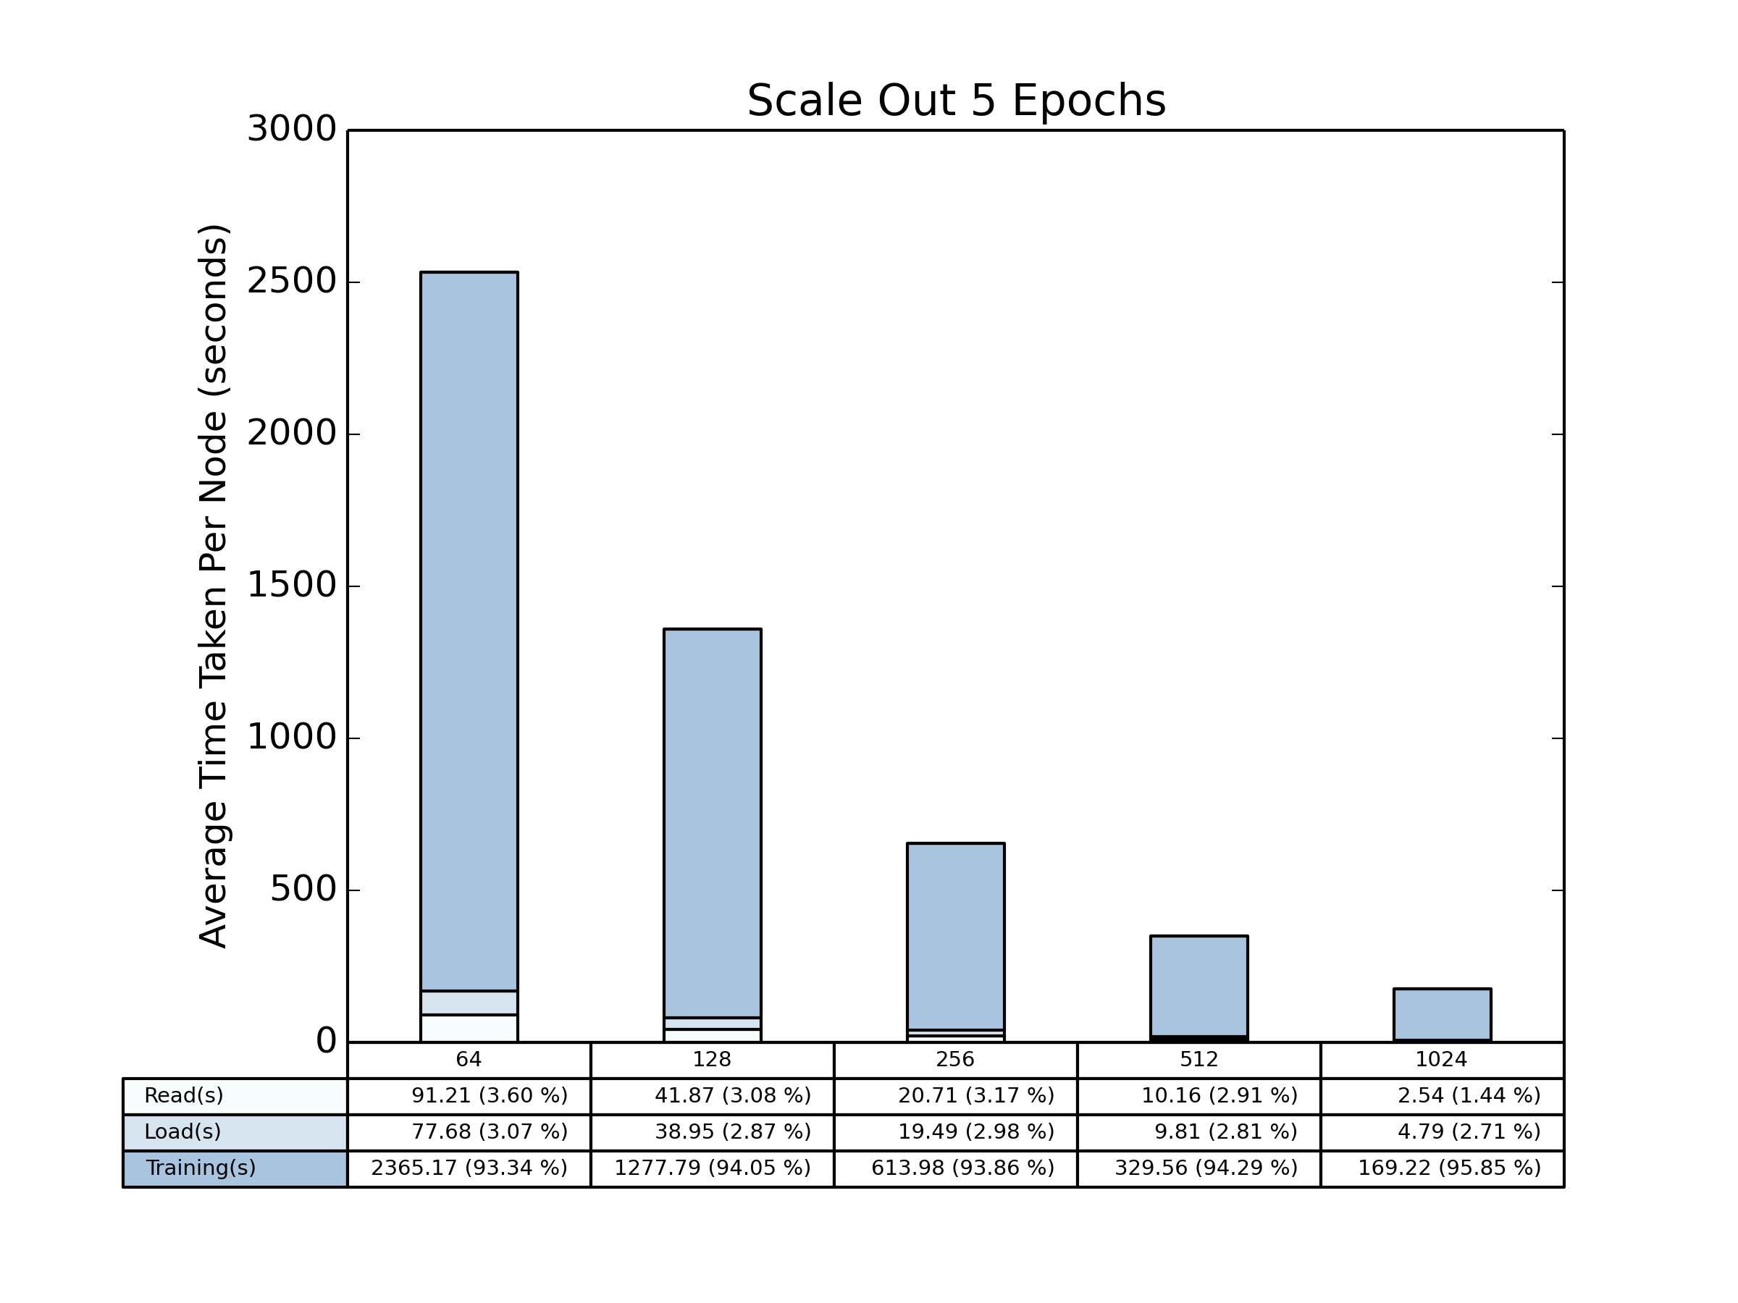
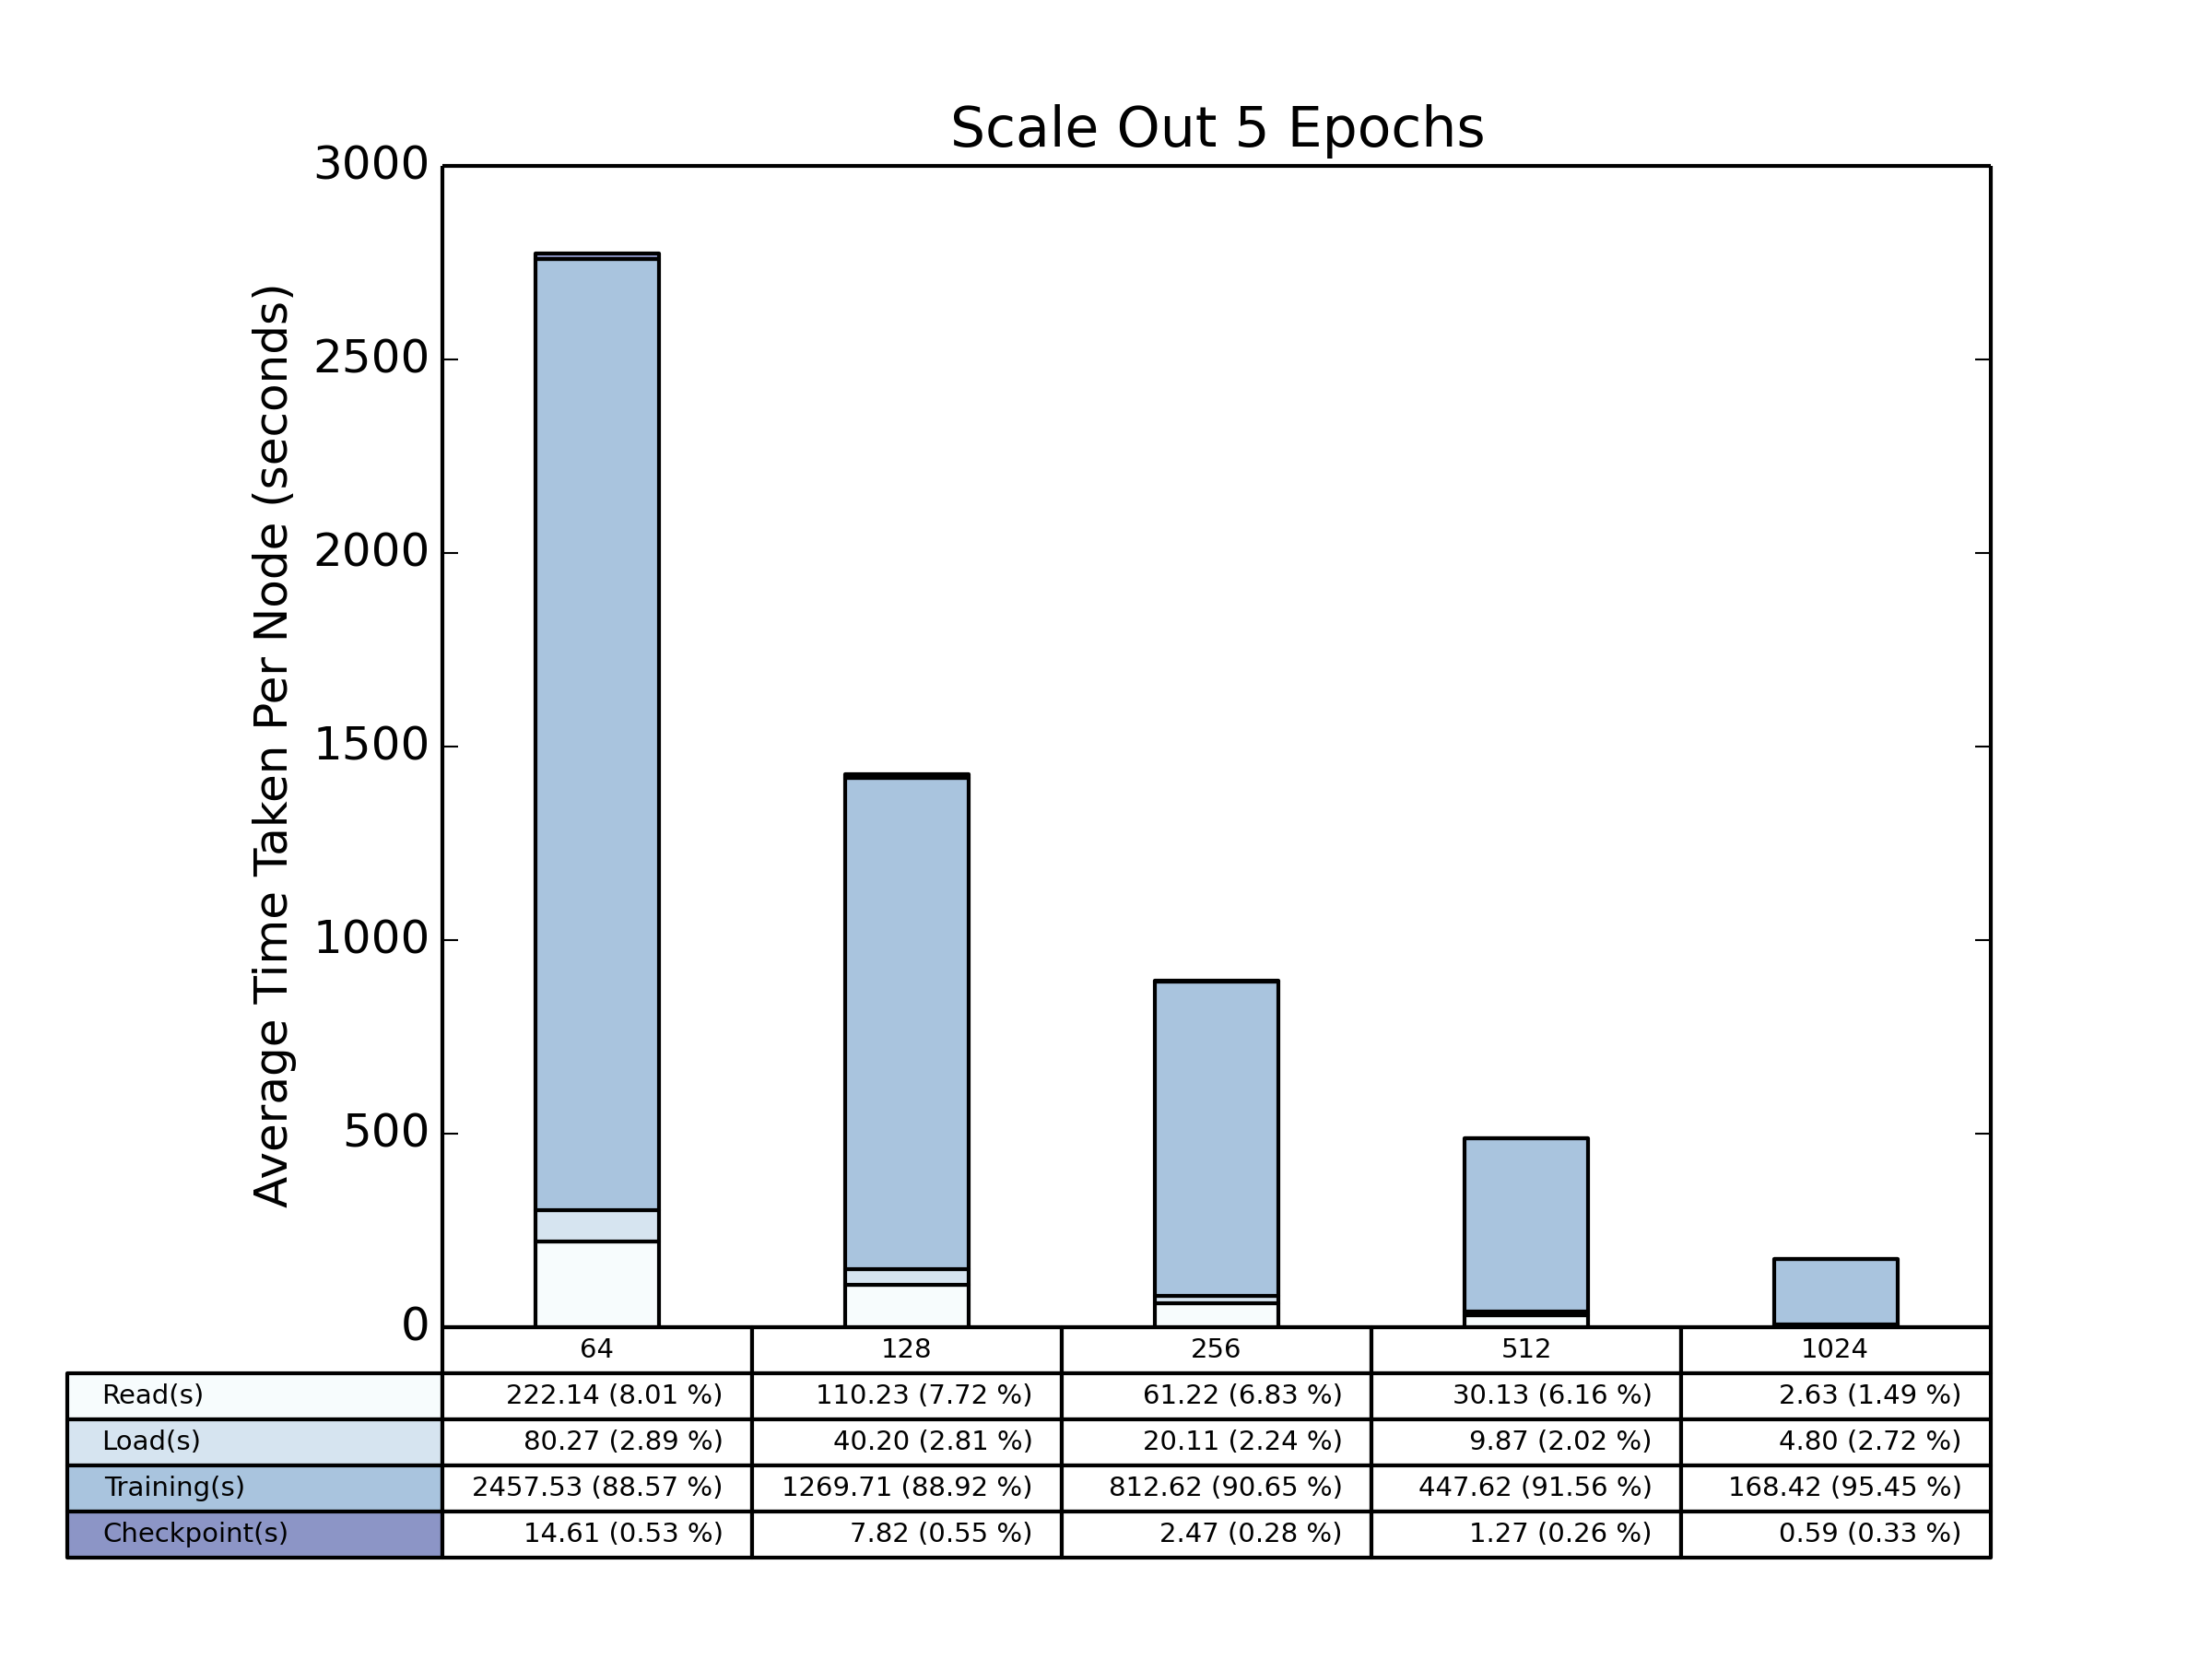
Total Time Scale Out
Local Shuffle
Global Shuffle

Slide 10
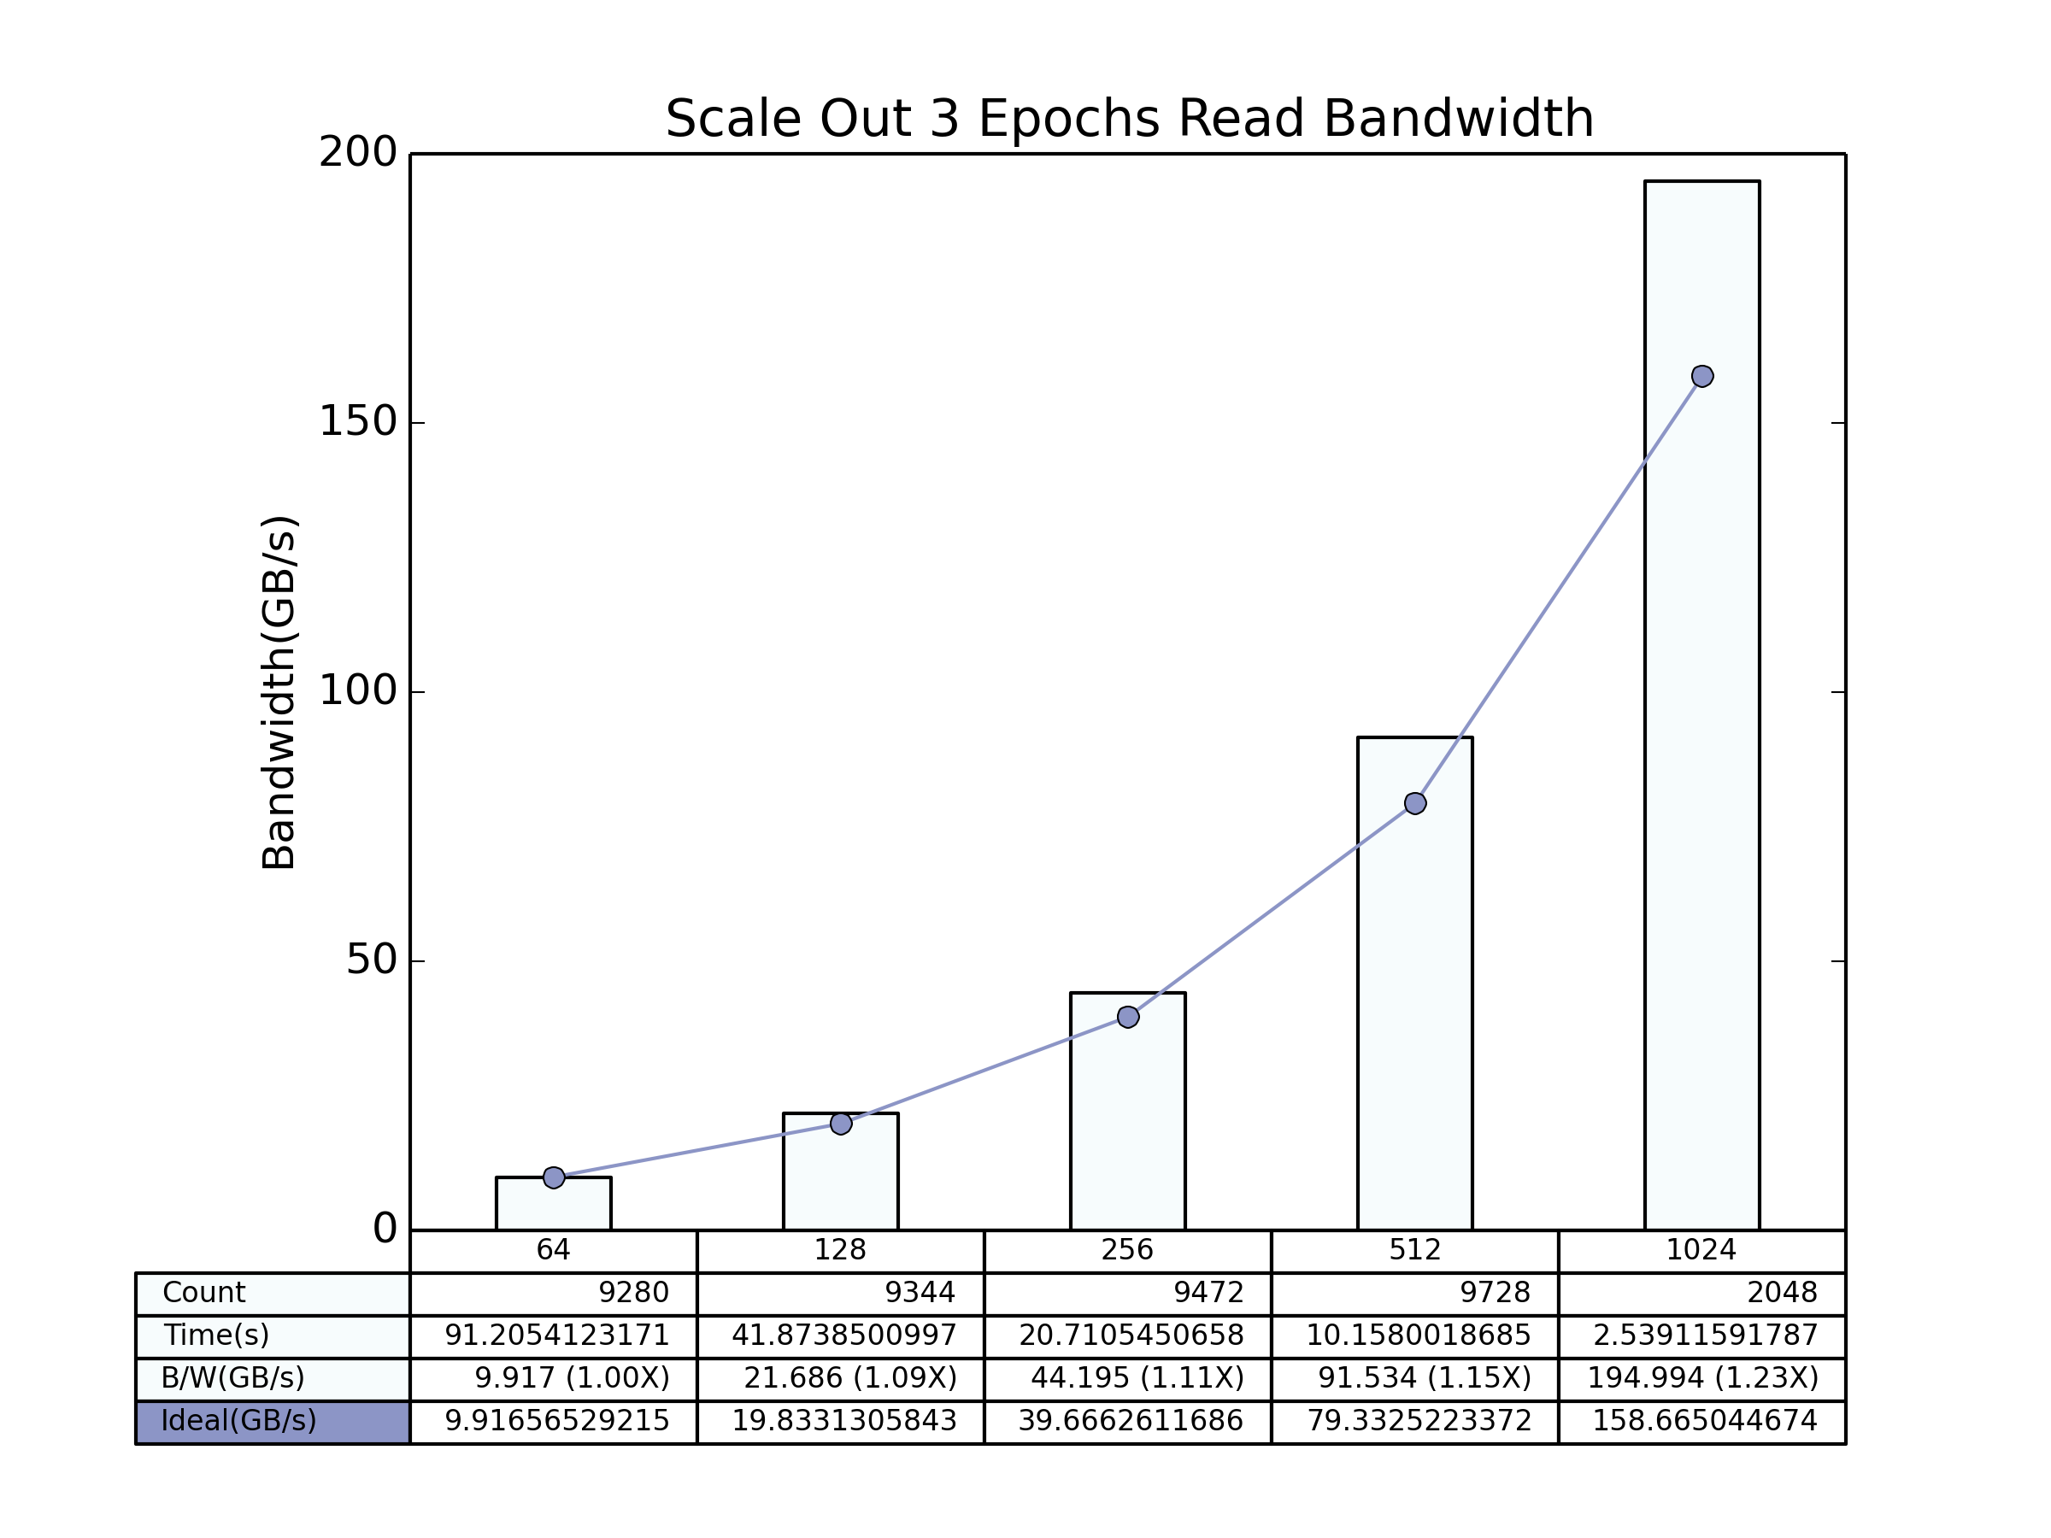
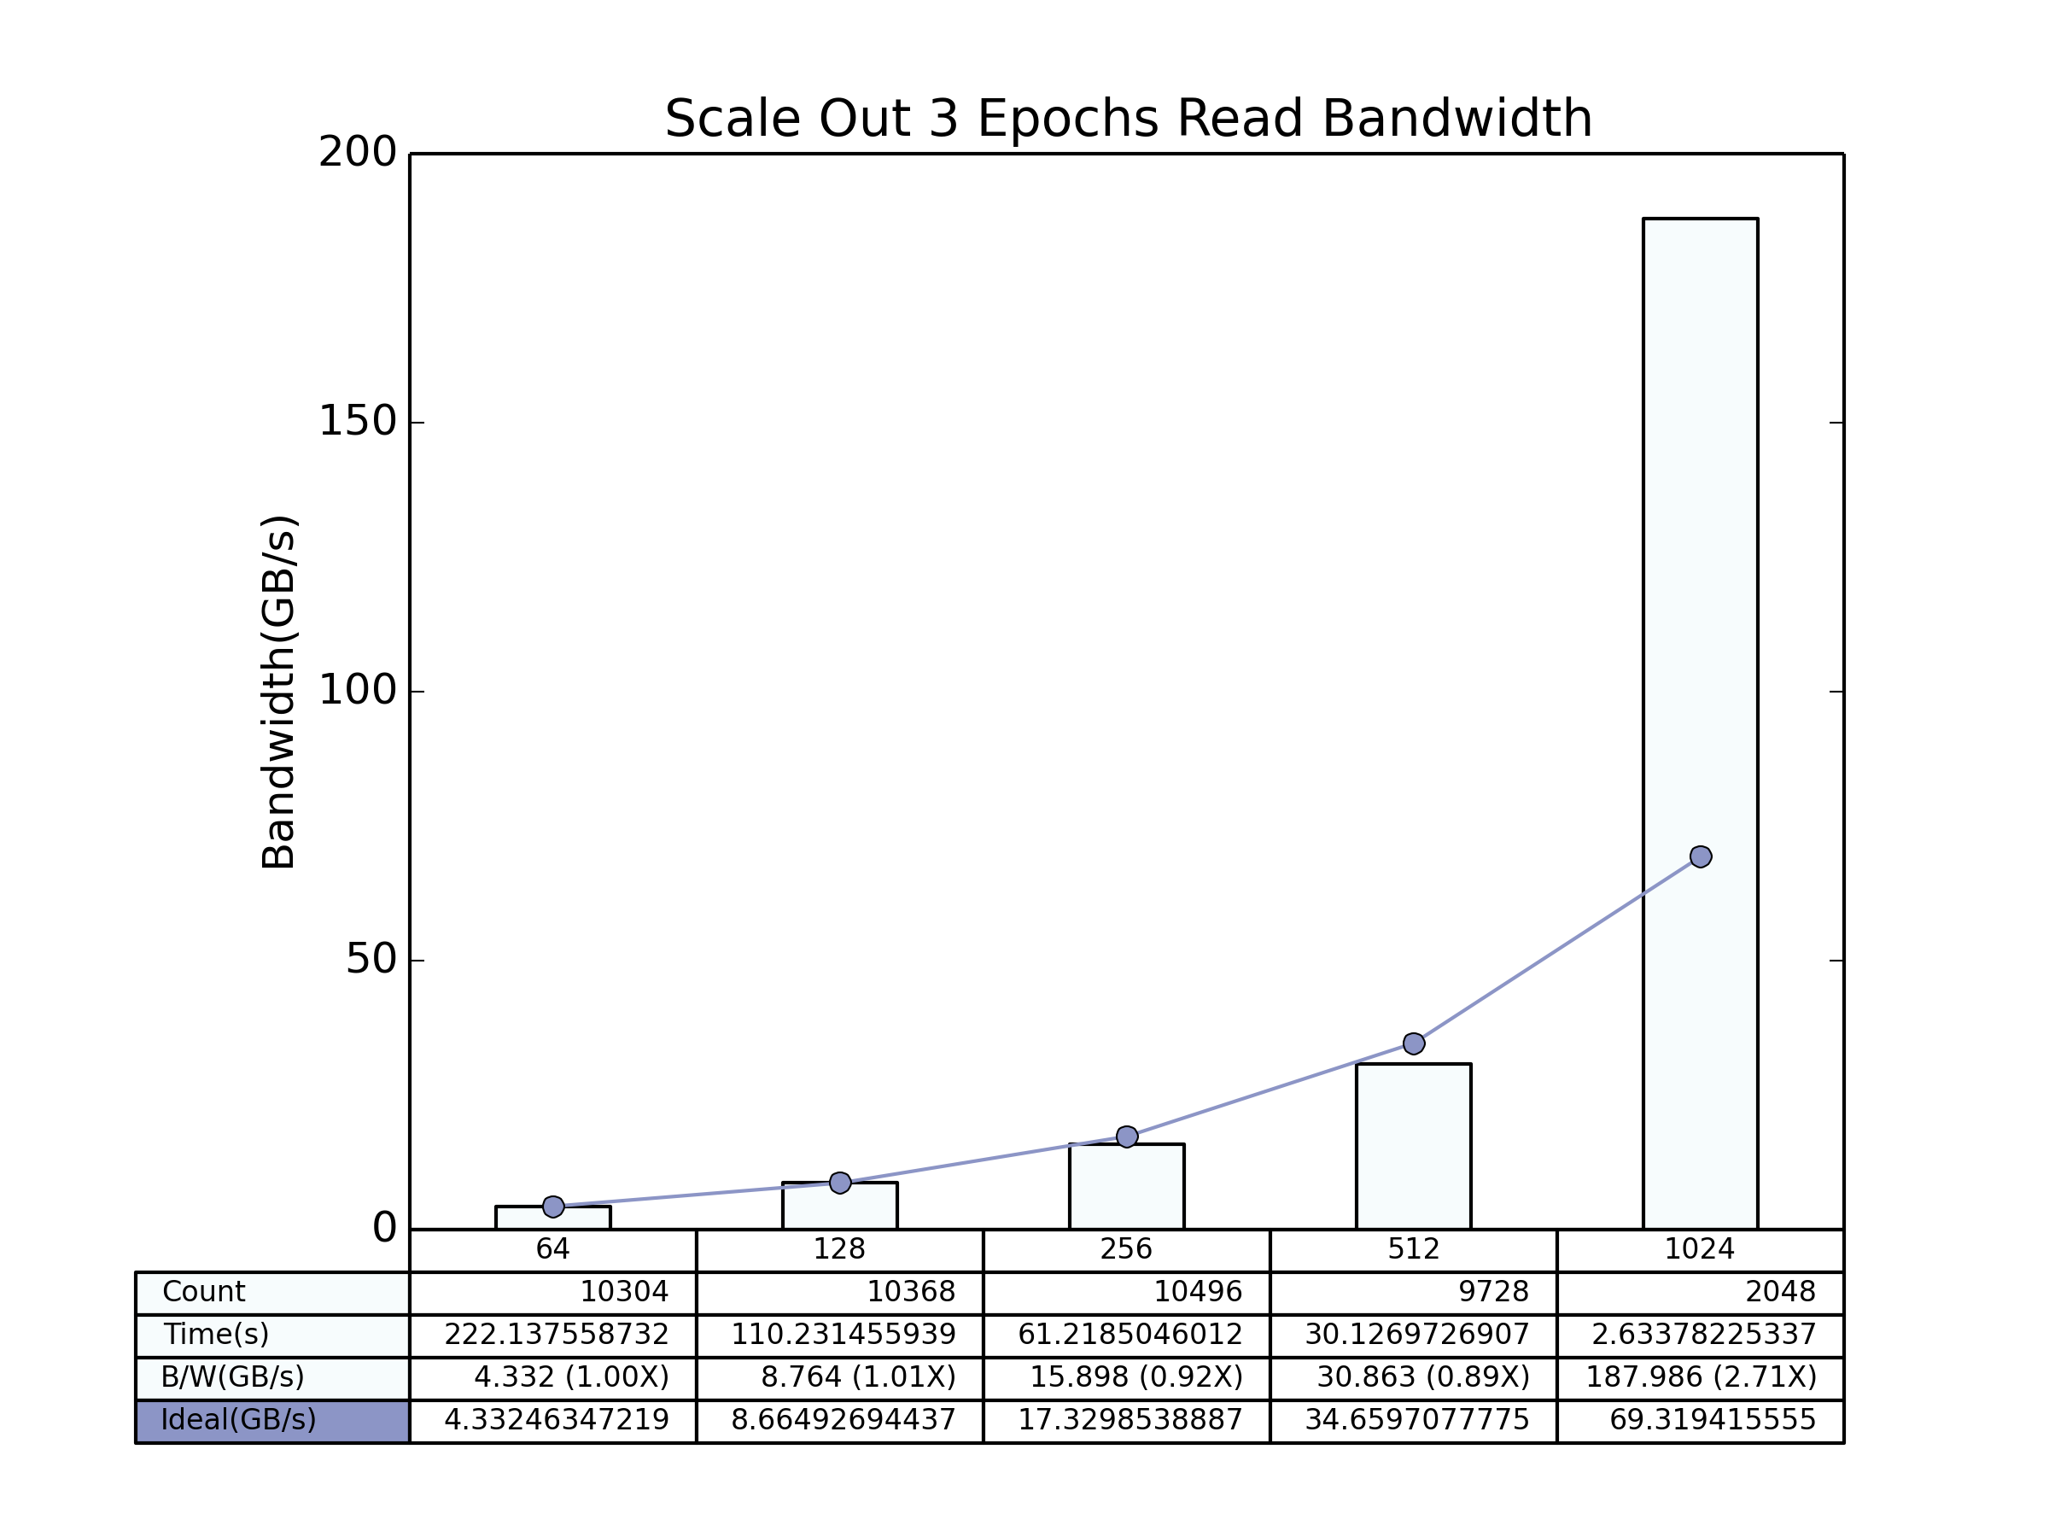
Read Bandwidth Scale Out
Local Shuffle
Global Shuffle

Slide 11
Outline
HEP Benchmark
Comparison Between Local and Global Shuffle
Climate Data Benchmark
Plots using Merged Interval Strategy
Playing with 64 Nodes Results
Future Exploration Scopes

Slide 12
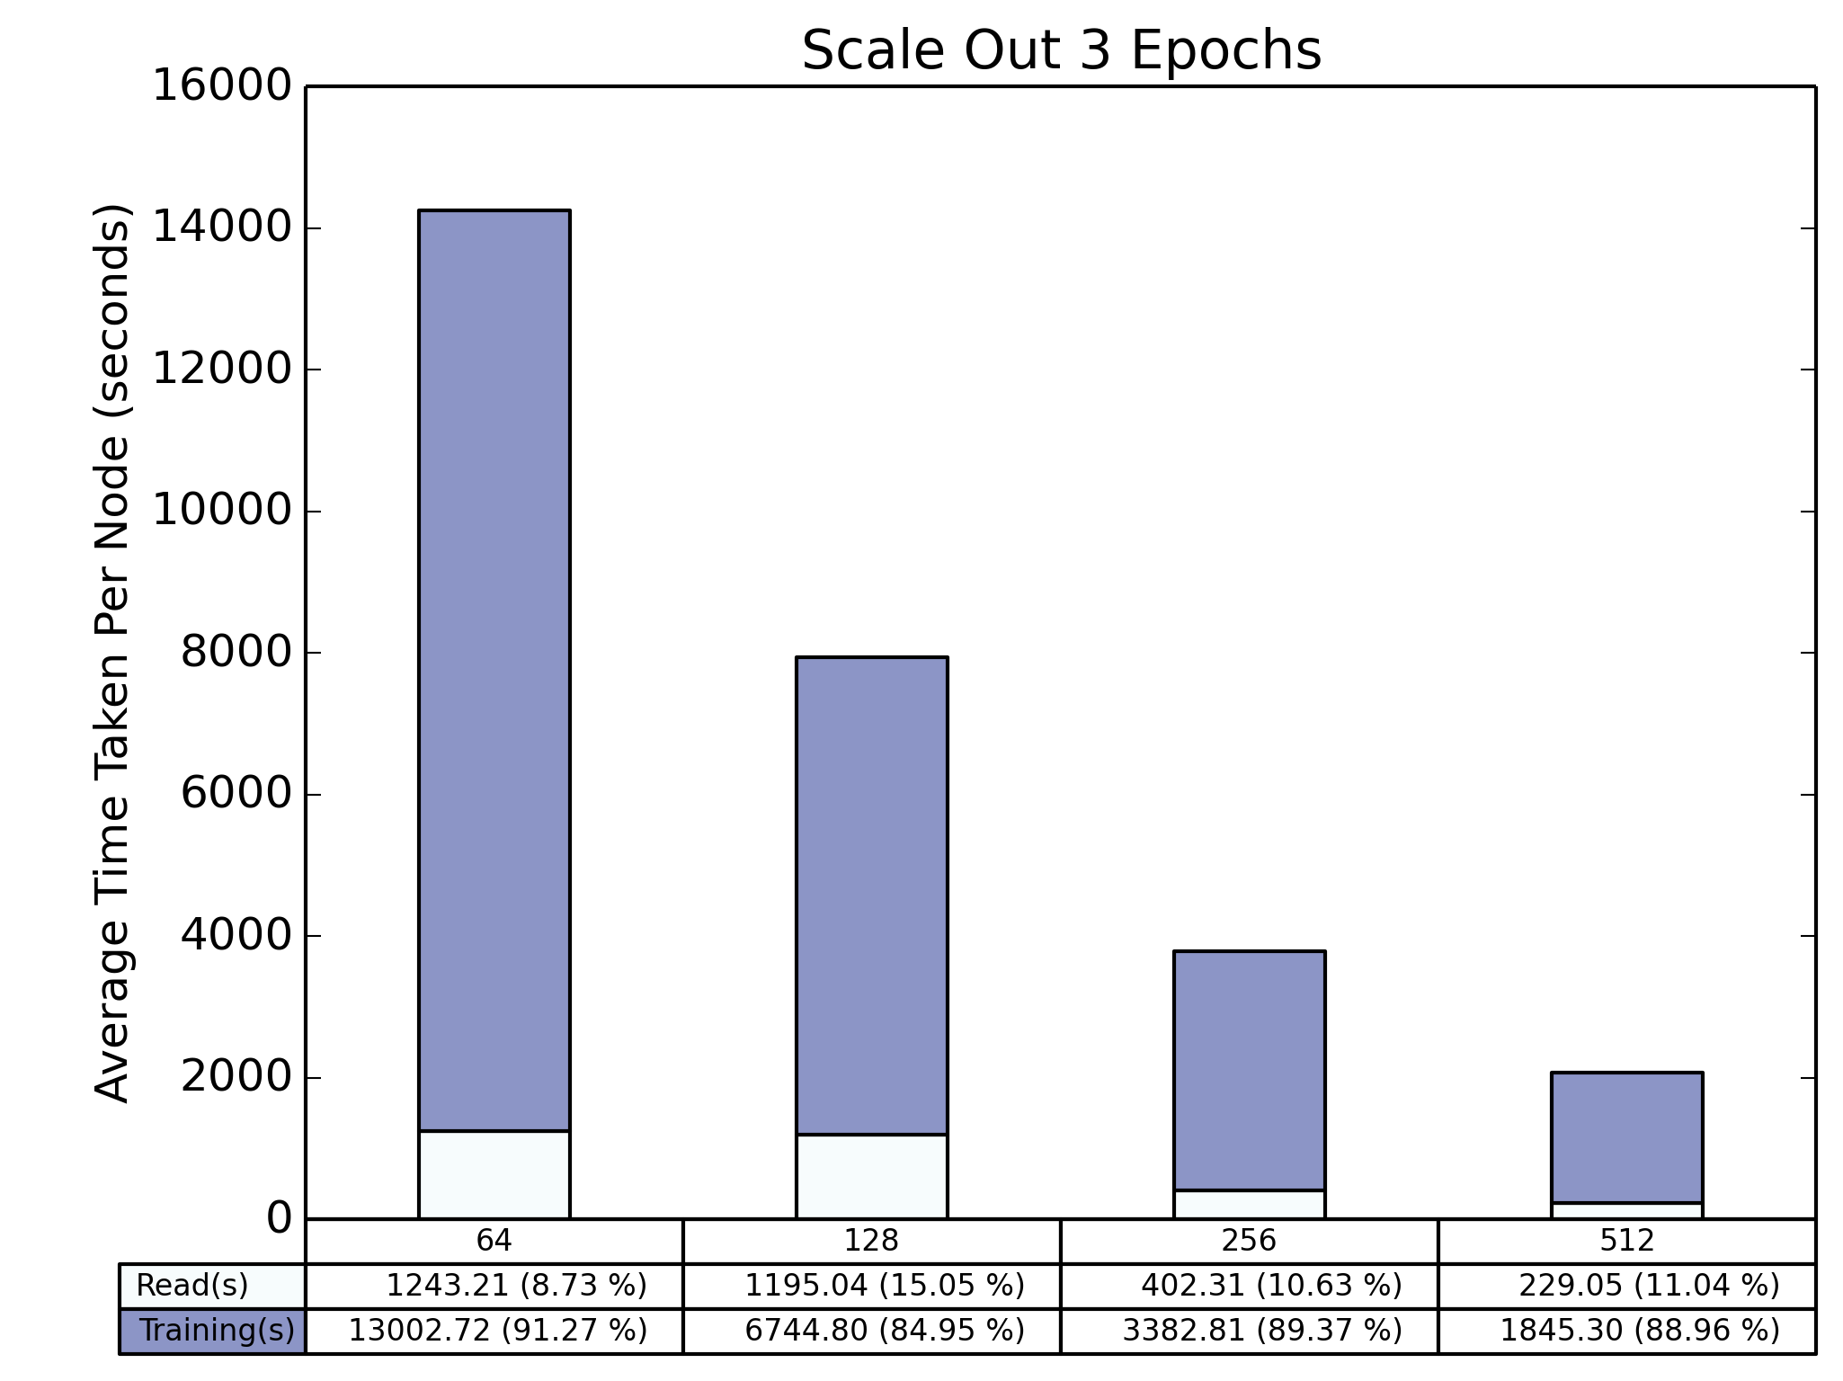
Total Time Scale Out

Slide 13
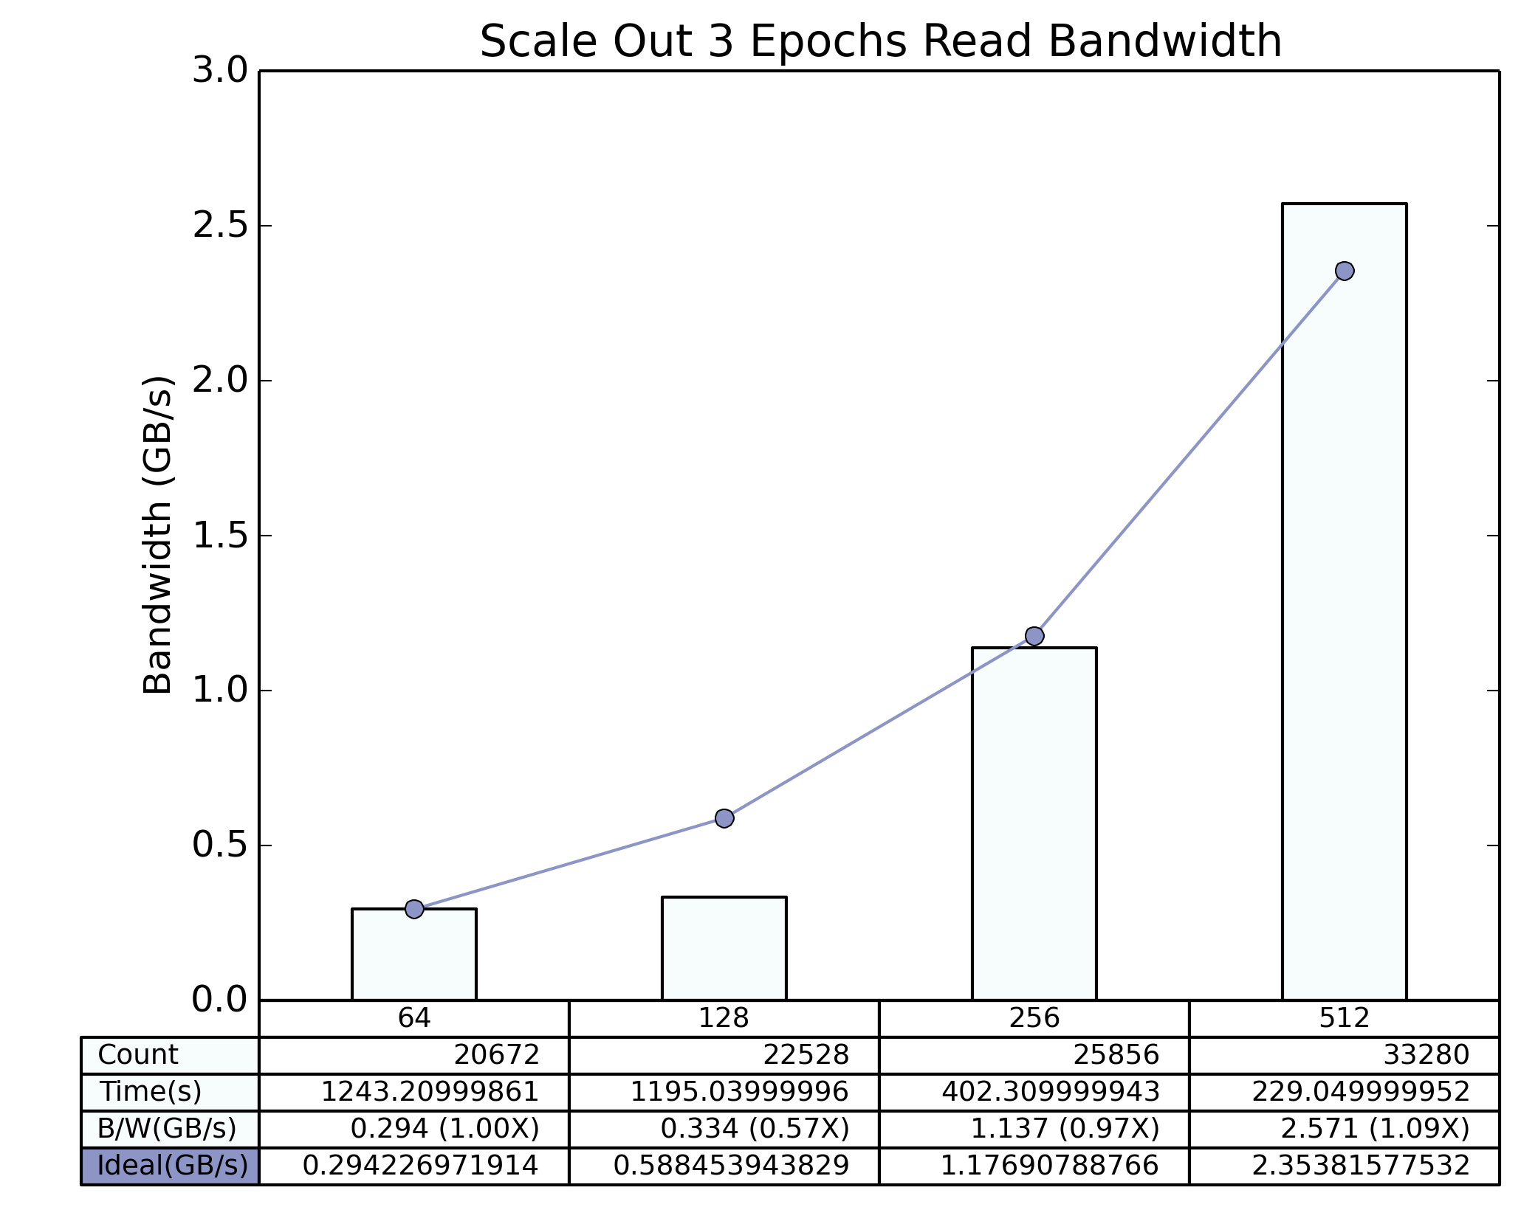
Read Bandwidth Scale Out

Slide 14
Outline
HEP Benchmark
Comparison Between Local and Global Shuffle
Climate Data Benchmark
Plots using Merged Interval Strategy
Playing with 64 Nodes Results
Future Exploration Scopes

Slide 15
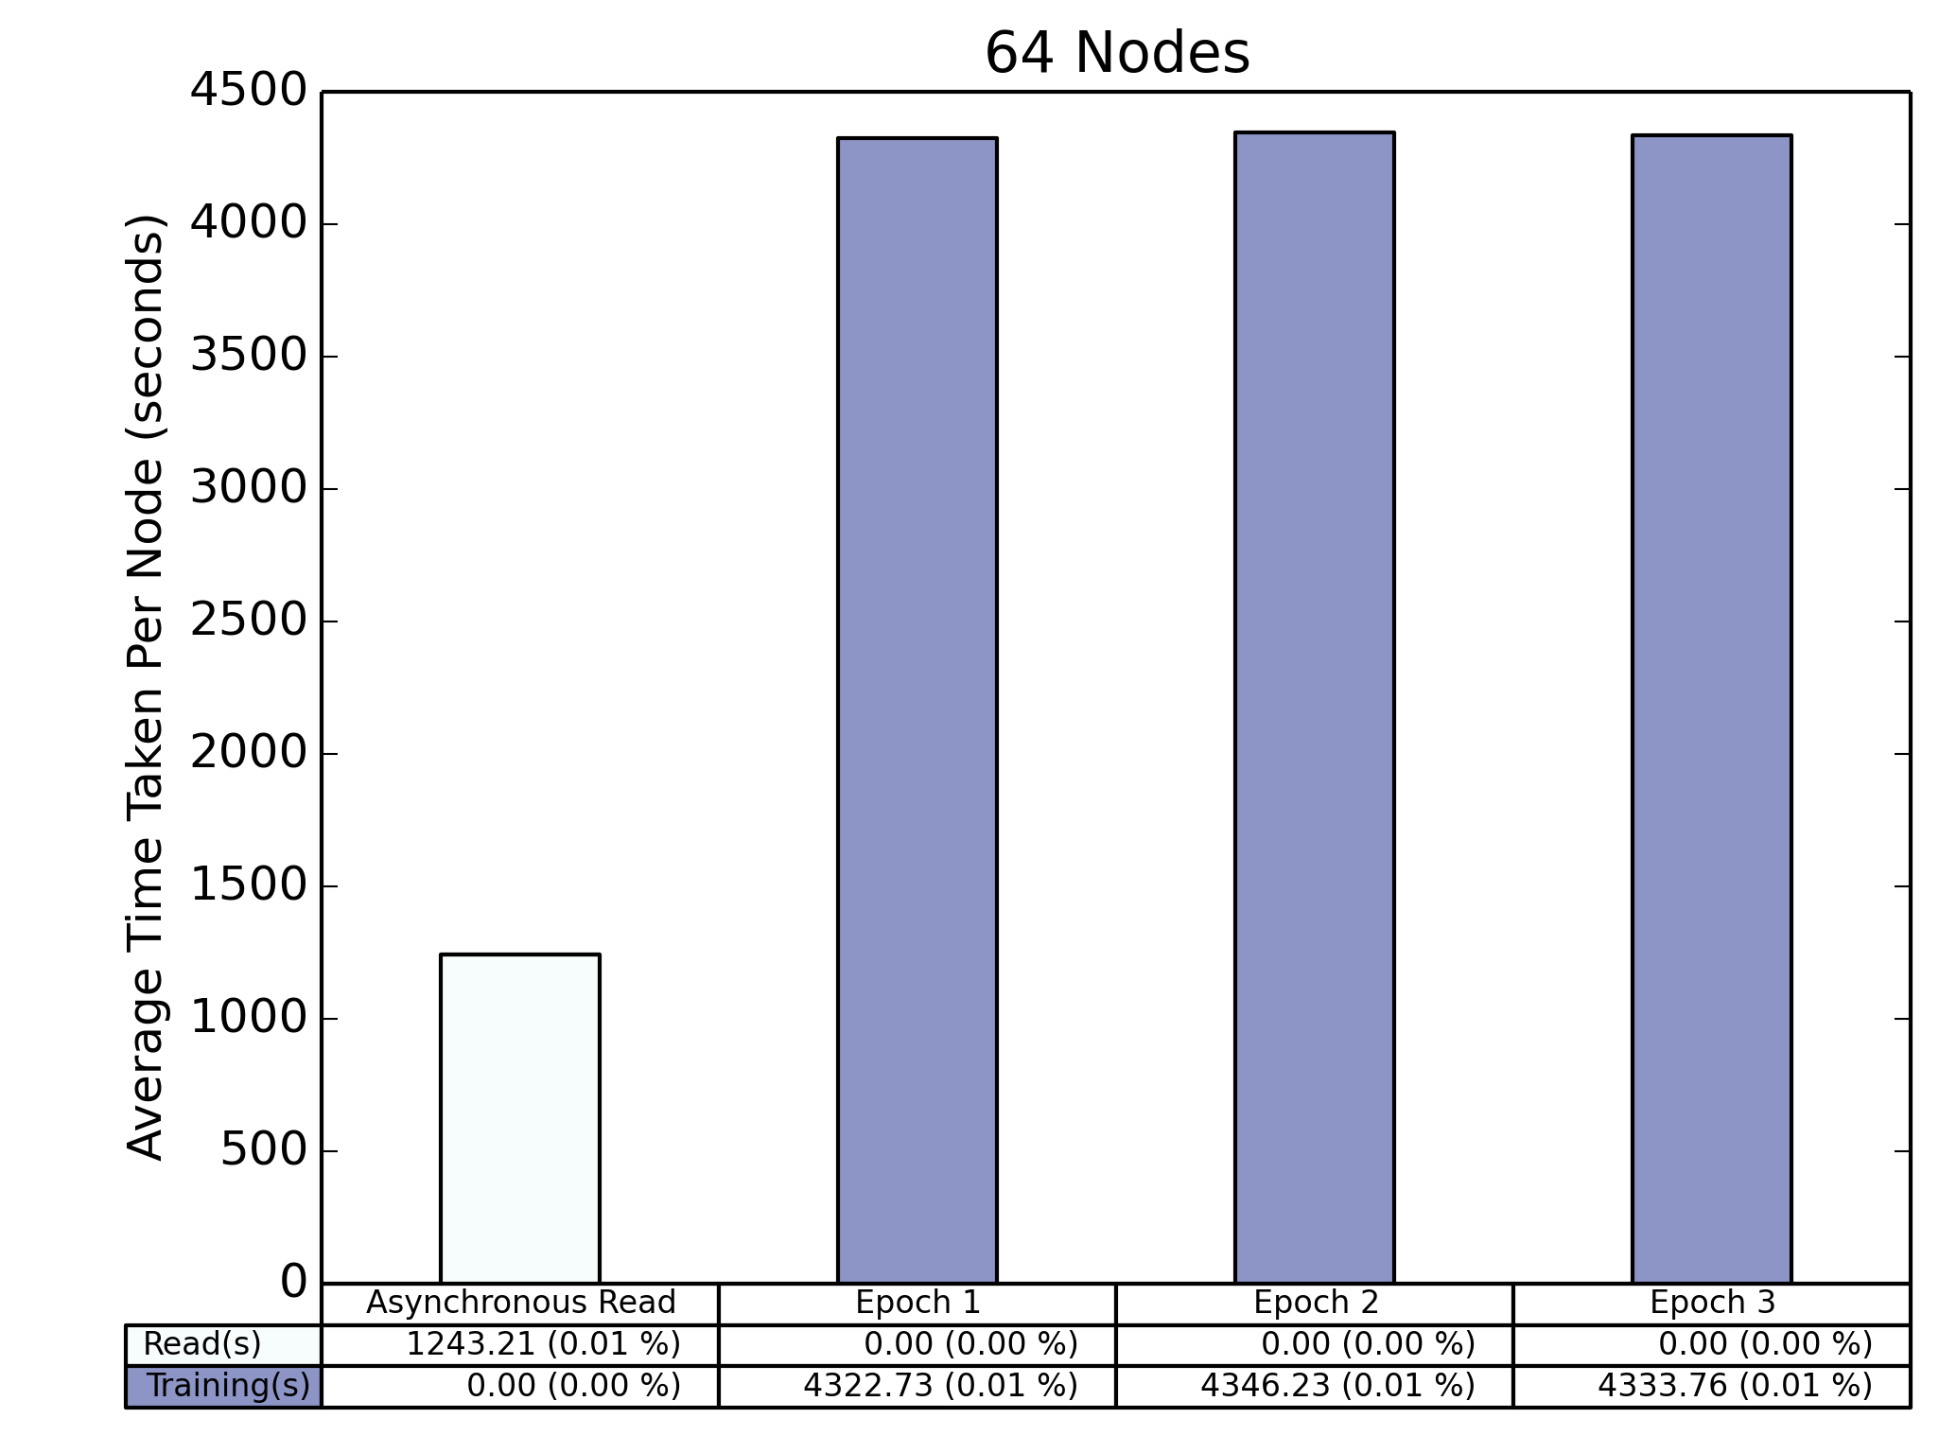
I/O + Training

Slide 16
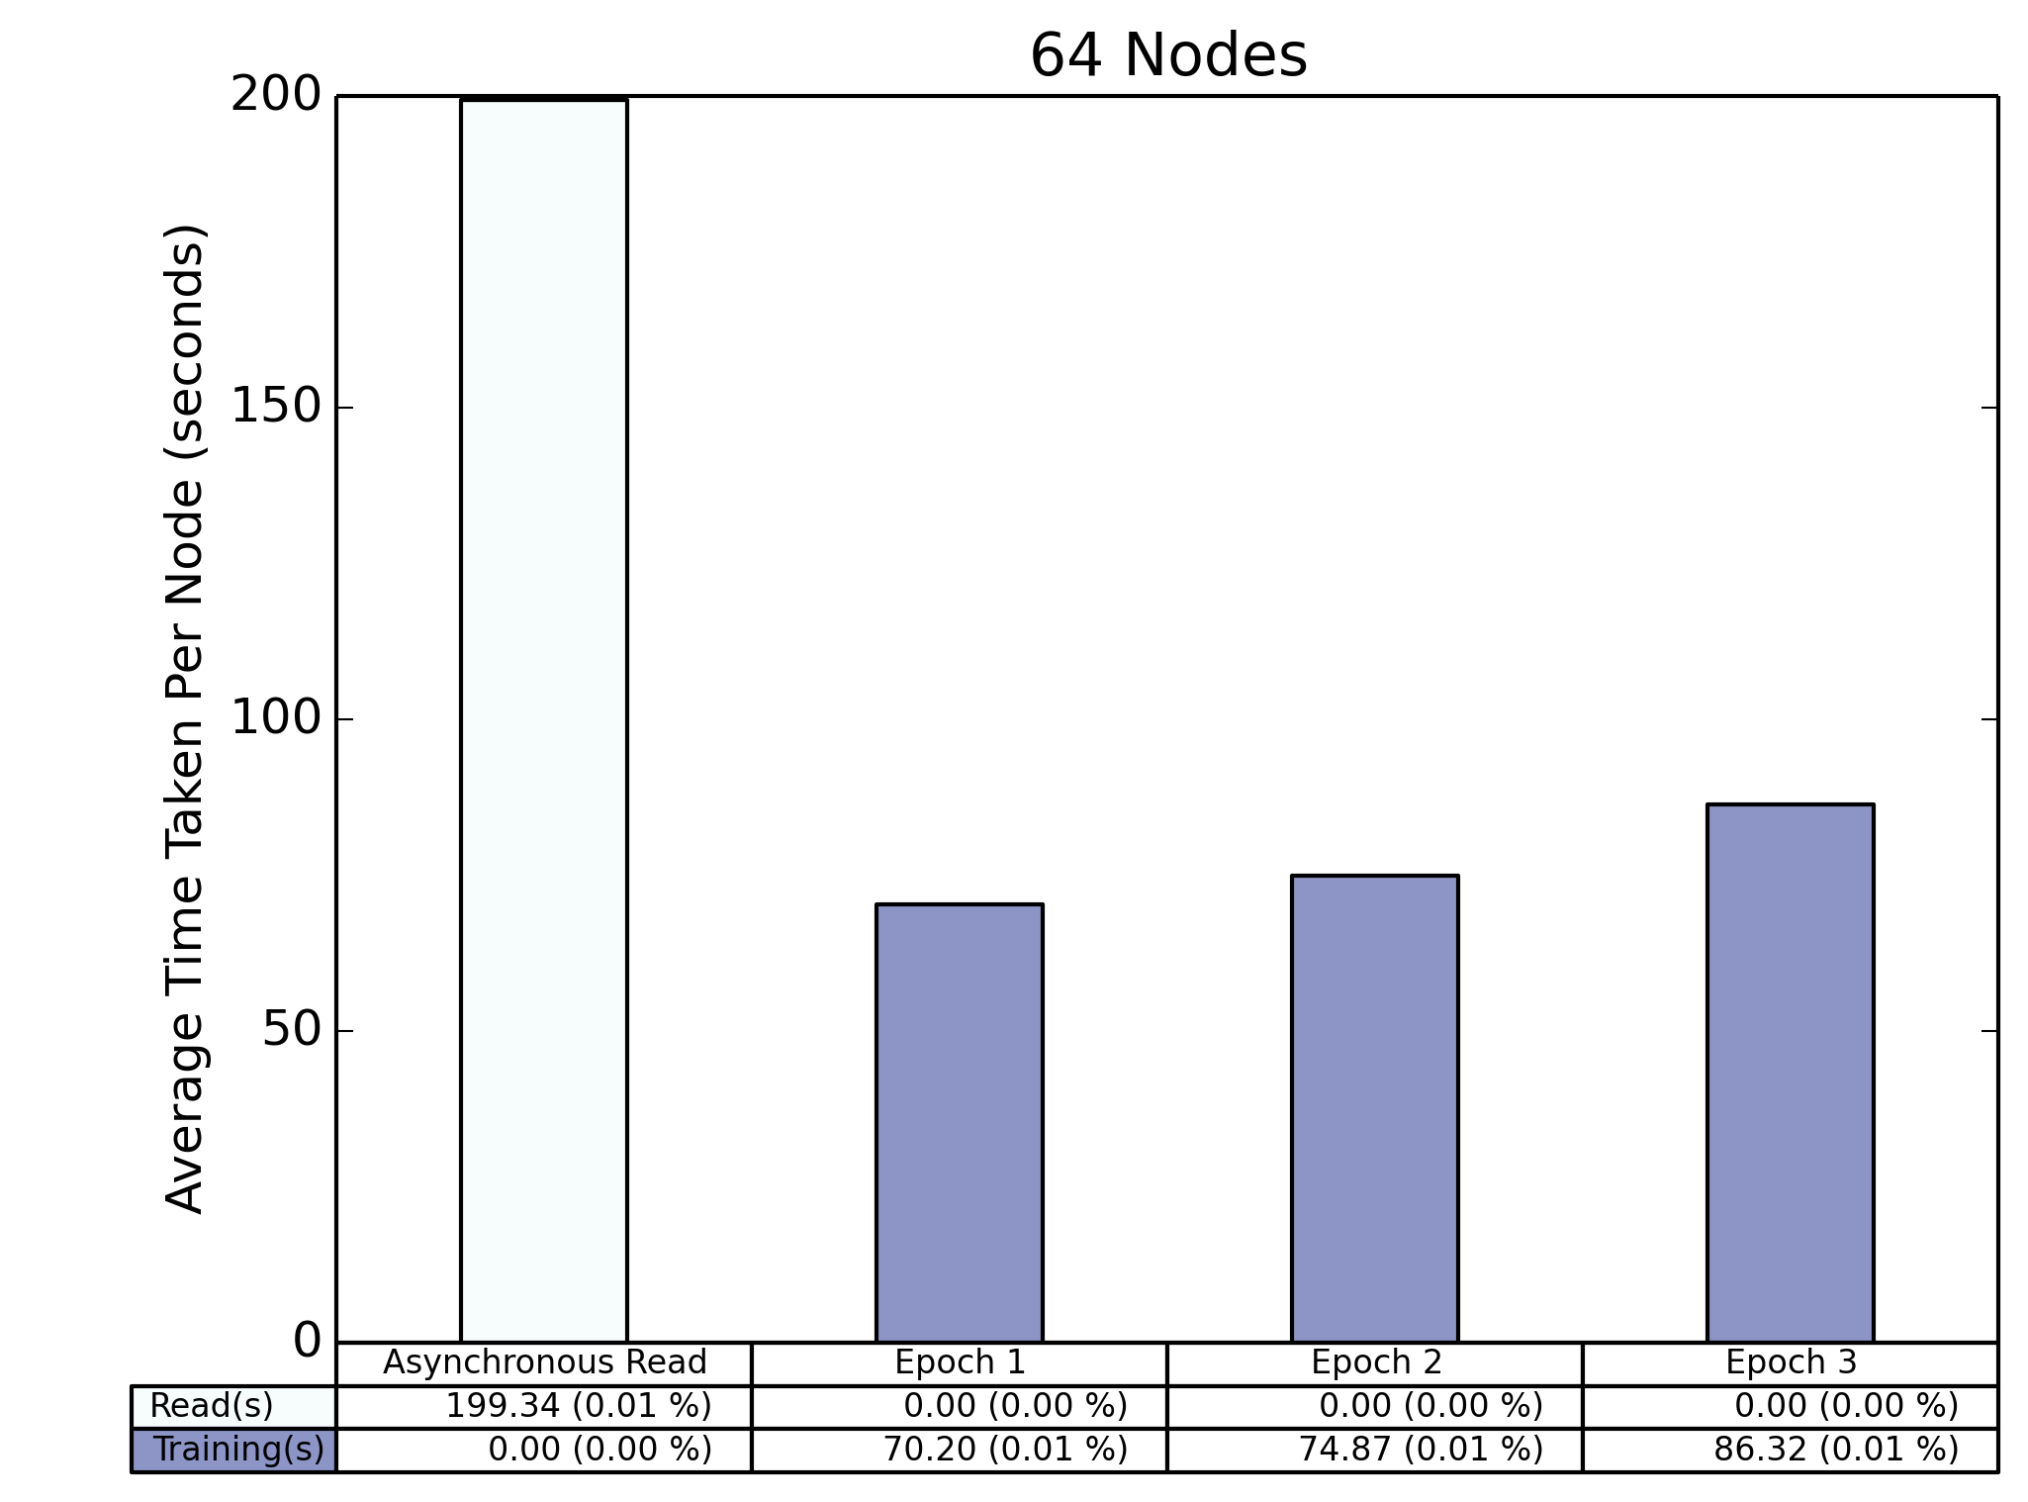
Disabled Training (I/O Only)

Slide 17
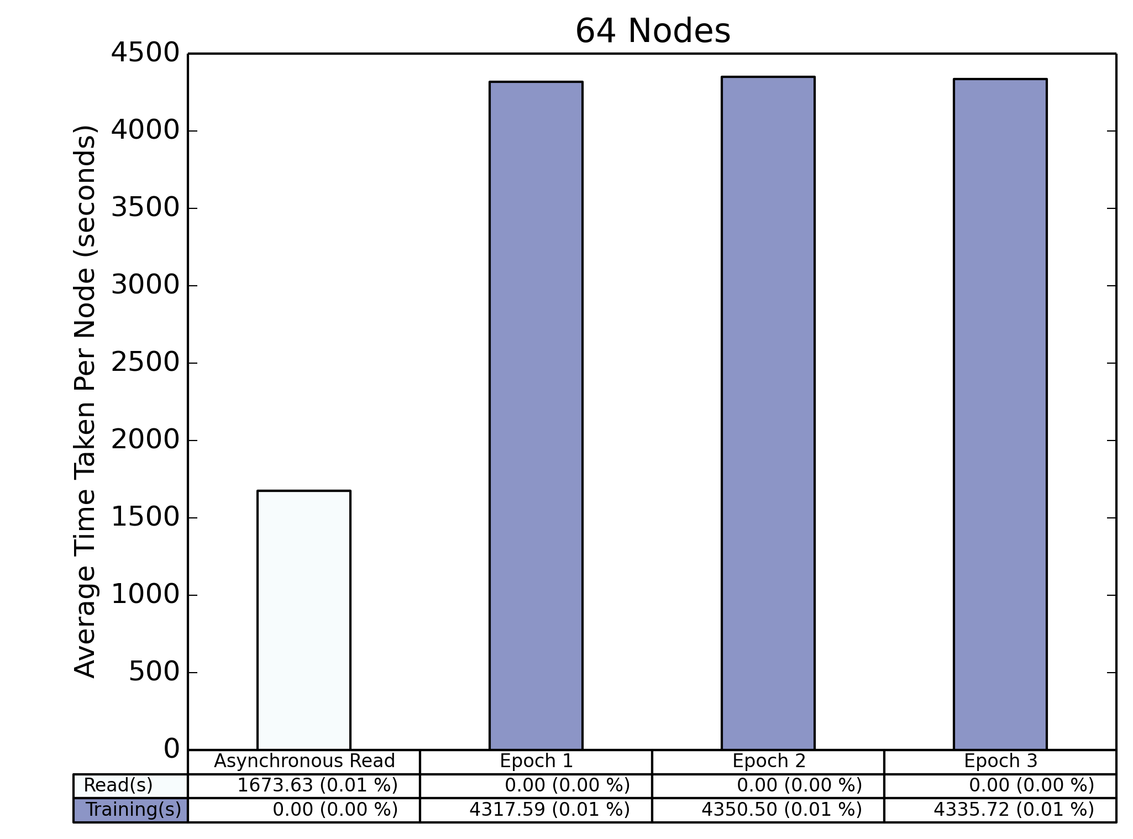
Metadata I/O Only

Slide 18
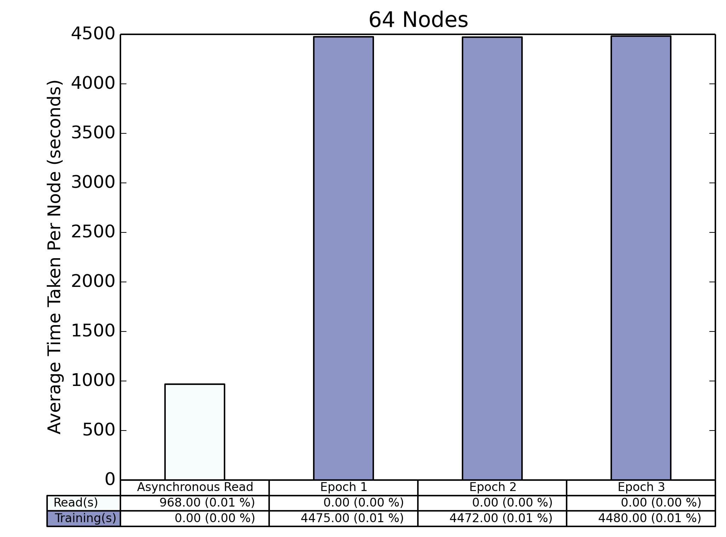
No I/O

Slide 19
Analyzing Raw Data
Climate - 64 nodes - Global Total Time
Training | Nodes | Inter op parallelism | Intra op parallelism | Dataset multi- processing pool size | Start Latency (s) | Average (s) | Max (s) | Min (s) | Read Count
No | 64 | 6 | 1 | 4 | 10 | 432 | 454 | 420 | 18816
No | 64 | 1 | 1 | 1 | 3 | 924 | 993 | 890 | 18816
Yes | 64 | 6 | 1 | 4 | 16 | 13906 | 13913 | 13895 | 20672
Yes (No I/O, No meta) | 64 | 6 | 1 | 4 | 30 | 14552 | 14517 | 14530 | N/A
 |  |  |  |  |  | IO (s) | Training (s) | Total (s) | Difference with Global (s)
 |  |  |  |  | According to merged interval method | 1243 | 13002 | 14245 | 339

Slide 20
Outline
HEP Benchmark
Comparison Between Local and Global Shuffle
Climate Data Benchmark
Plots using Merged Interval Strategy
Playing with 64 Nodes Results
Future Exploration Scopes

Slide 21
Future Exploration Scopes
To Understand Results from Single Node, Process and Thread Run (No Parallelism)
To Find Way to Log Thread Specific Information by TimeLogger?
To Explore TensorFlow Timeline – Already Started
To Study TensorBoard to See TensorFlow Graph
To Modify the Lustre Striping Pattern to Maximize Bandwidth
To Have a Look into the PyTorch Benchmark
To Try Running the Climate Data Tests Using Burst Buffer

