Slide 1
Fahim Tahmid Chowdhury Data Analytics & Service Group NERSC
Project Summary
August 16, 2018

Slide 2
Outline
Project Objectives
Benchmarks at NERSC
Experimental Results
Tasks In Progress
Plans for the Future

Slide 3
Outline
Project Objectives
Benchmarks at NERSC
Experimental Results
Tasks In Progress
Plans for the Future

Slide 4
Project Objectives
Scalable Deep Learning requires efficient I/O mechanism.
While Parallel I/O has been studied extensively for conventional HPC workloads, serious I/O bottlenecks are present in modern DL frameworks.
The goals of this project are
Exploring I/O patterns invoked through multiple DL applications running on HPC systems
Addressing bottlenecks caused by I/O in the training process
Developing optimization strategies to overcome the I/O bottlenecks.
Notes:
Demo from PyCharm

Slide 5
Outline
Project Objectives
Benchmarks at NERSC
Experimental Results
Tasks In Progress
Plans for the Future

Slide 6
HEPCNNB Overview
High Energy Physics Deep Learning Convolutional Neural Network Benchmark (HEPCNNB)
Uses a dataset of particle collisions generated by a fast Monte-Carlo generator named Delphes
Used to generate particle events that can be described by standard model physics and particle events with R-parity violating Supersymmetry
Can be expanded for multi-class classification or including regression on model parameters
Uses Horovod for Distributed TensorFlow
Notes:
Demo from PyCharm

Slide 7
HEPCNNB Input Pipeline
hep_classifier_tf_train_horovod.py
Networks/binary_classifier_tf.py
filelist, num_tasks, split_filelist, split_file etc.
Dataset
Dataset instance
next_batch()
if(split_file)
split file blocks (number of entries / tasks) among tasks
if(split_filelist)
split the files among tasks
load_next_file()

Slide 8
CDB Overview
Climate Data Benchmark (CDB)
Uses a huge dataset of climate data images
Used as an image recognition model to detect patterns for extreme weather
Uses Horovod for Distributed TensorFlow
Uses TensorFlow Dataset API and python’s multiprocessing package for input pipelining
Made of Tiramisu, a fully convolutional network for semantic segmentation
Notes:
Demo from PyCharm

Slide 9
CDB Input Pipeline
mascarpone-tiramisu-tf-singlefile.py
tiramisu_helpers.py
input_path, channels, weights etc.
h5_input_reader instance
Dataset
Dataset
h5_input_reader instance
h5_input_reader
next_element
create_dataset()
tf.data.Dataset.map
read()
data, label, weights etc.
multiprocessing.Pool
Re-initializable training and validation dataset iterators
h5_input_subprocess_reader()
apply

Slide 10
Outline
Project Objectives
Benchmarks at NERSC
Experimental Results
Tasks In Progress
Plans for the Future

Slide 11
Profiling Tools
Darshan can not profile I/O calls made without directly using MPI or POSIX
The benchmarks use h5py on HDF5-IO
Developed an in-house python profiling tool, i.e. TimeLogger class in utility_classes.time_logger package
Incorporated TimeLogger in the benchmarks and ran the benchmarks on Cori
Developed utility scripts to extract TimeLogger outputs and plot using matplotlib python package
Notes:
Demo from PyCharm

Slide 12
HEPCNNB Dataset
Lustre Directory for Data
/global/cscratch1/sd/ftc/deep_learning_data/hep_cnn/224x224/
1024 Training Files 408 MiB each
1024 Validation Files 54 MiB each
Each Node Reads (1024/num_of_nodes) Training Files and Validation Files if Files are Equally Split
If num_of_nodes = 64 and Files are Equally Split Each Epoch
Each Node Reads 16 Training Files
Roughly Each Node Reads 16 * 408 MiB = 6.375 GiB of Training Data
And Each Node Reads 16 * 54 MiB = 0.84375 GiB or 864 MiB of Validation Data
Notes:
Demo from PyCharm

Slide 13
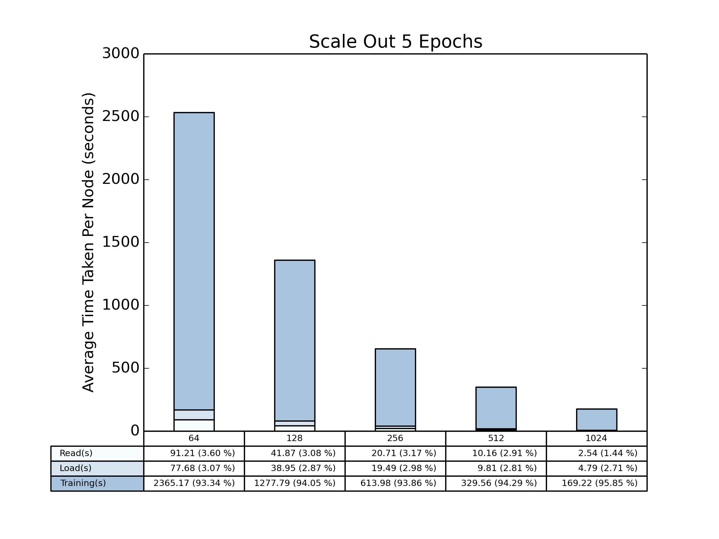
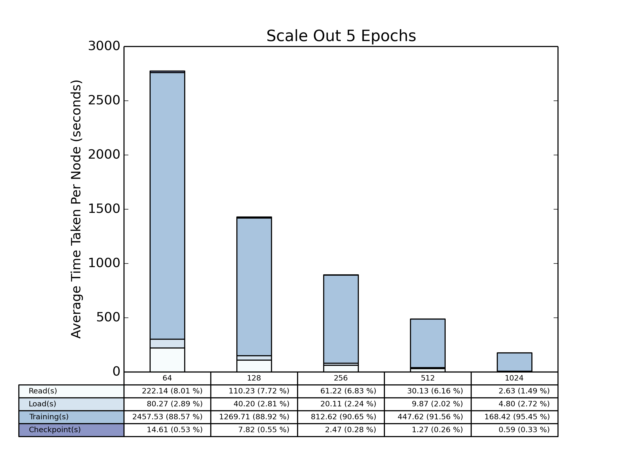
Total Time Scale Out (HEPCNNB)
Local Shuffle
Global Shuffle
Notes:
Details in 20180727

Slide 14
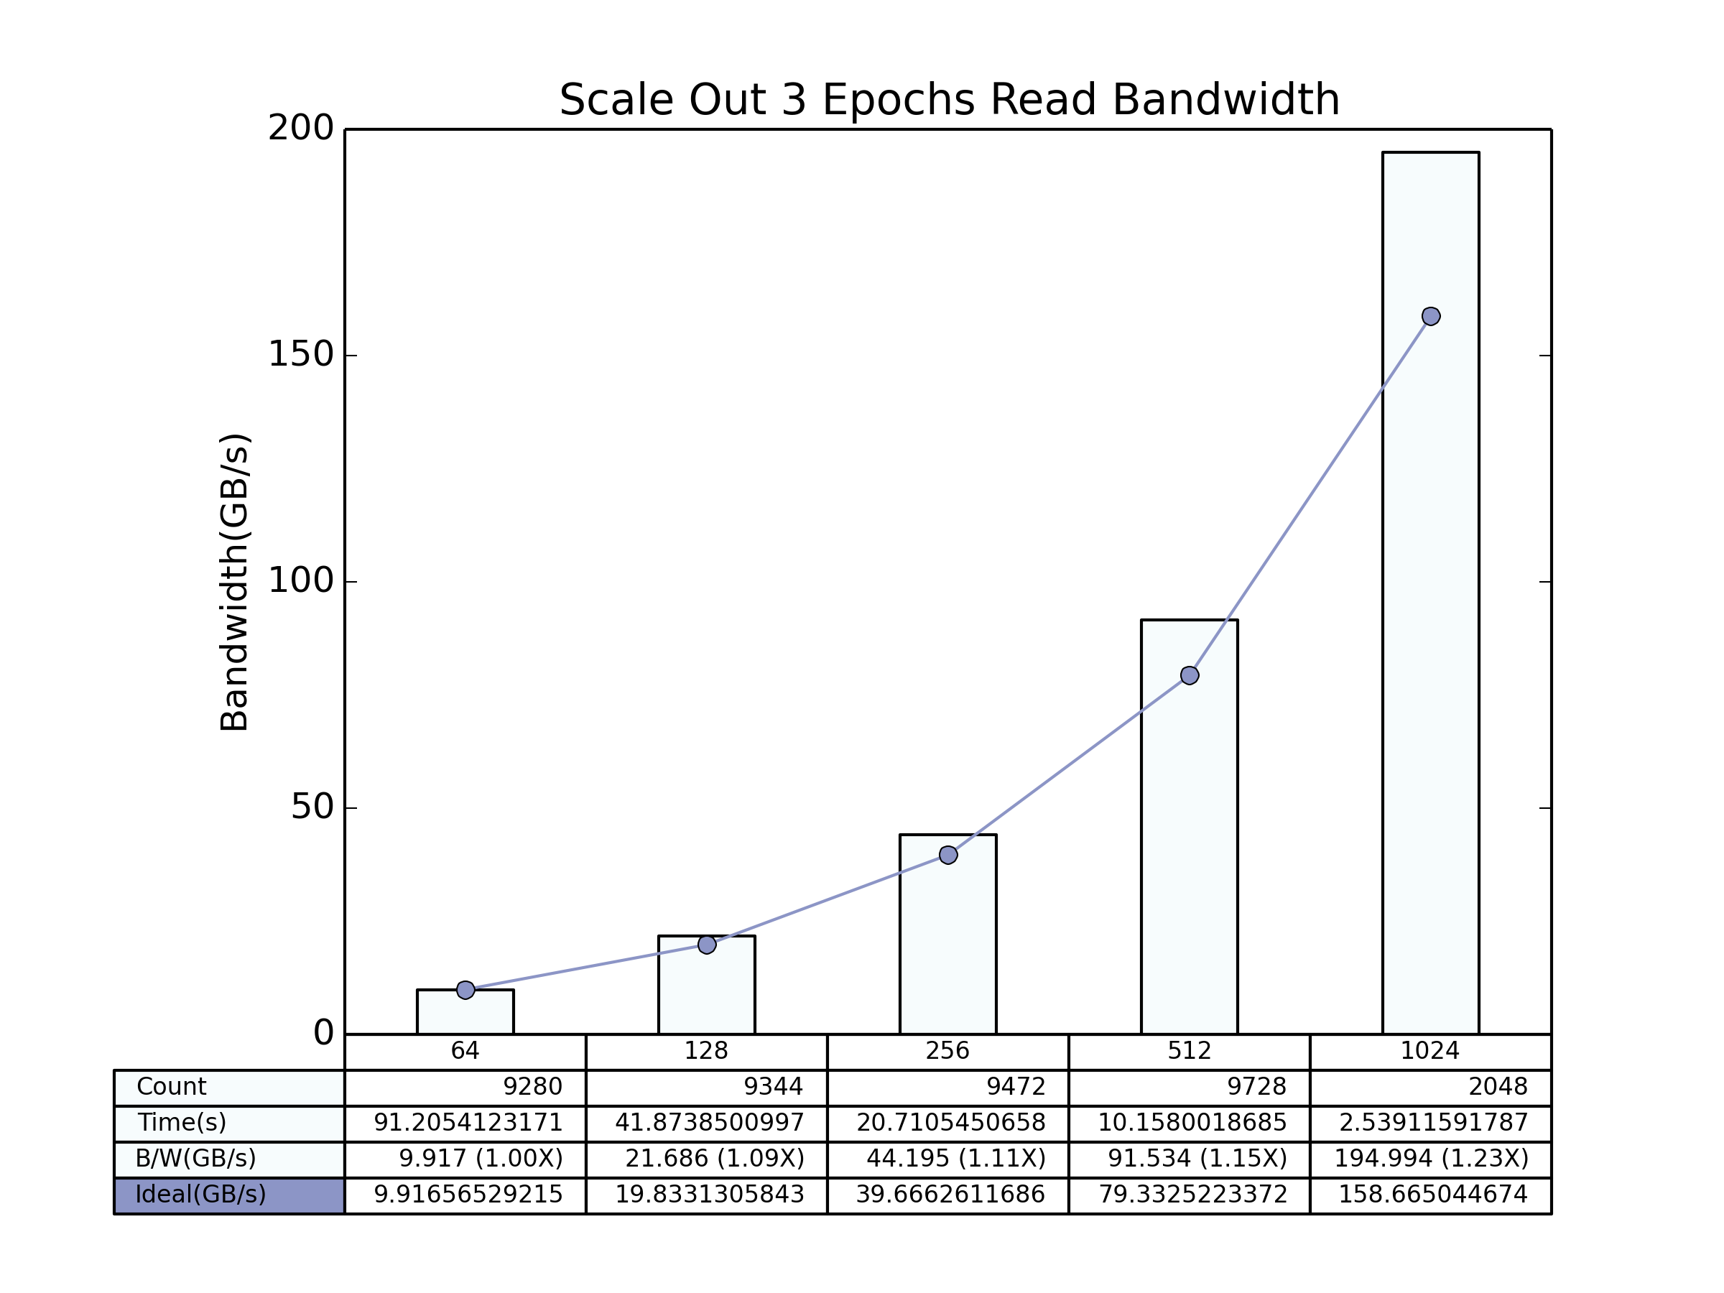
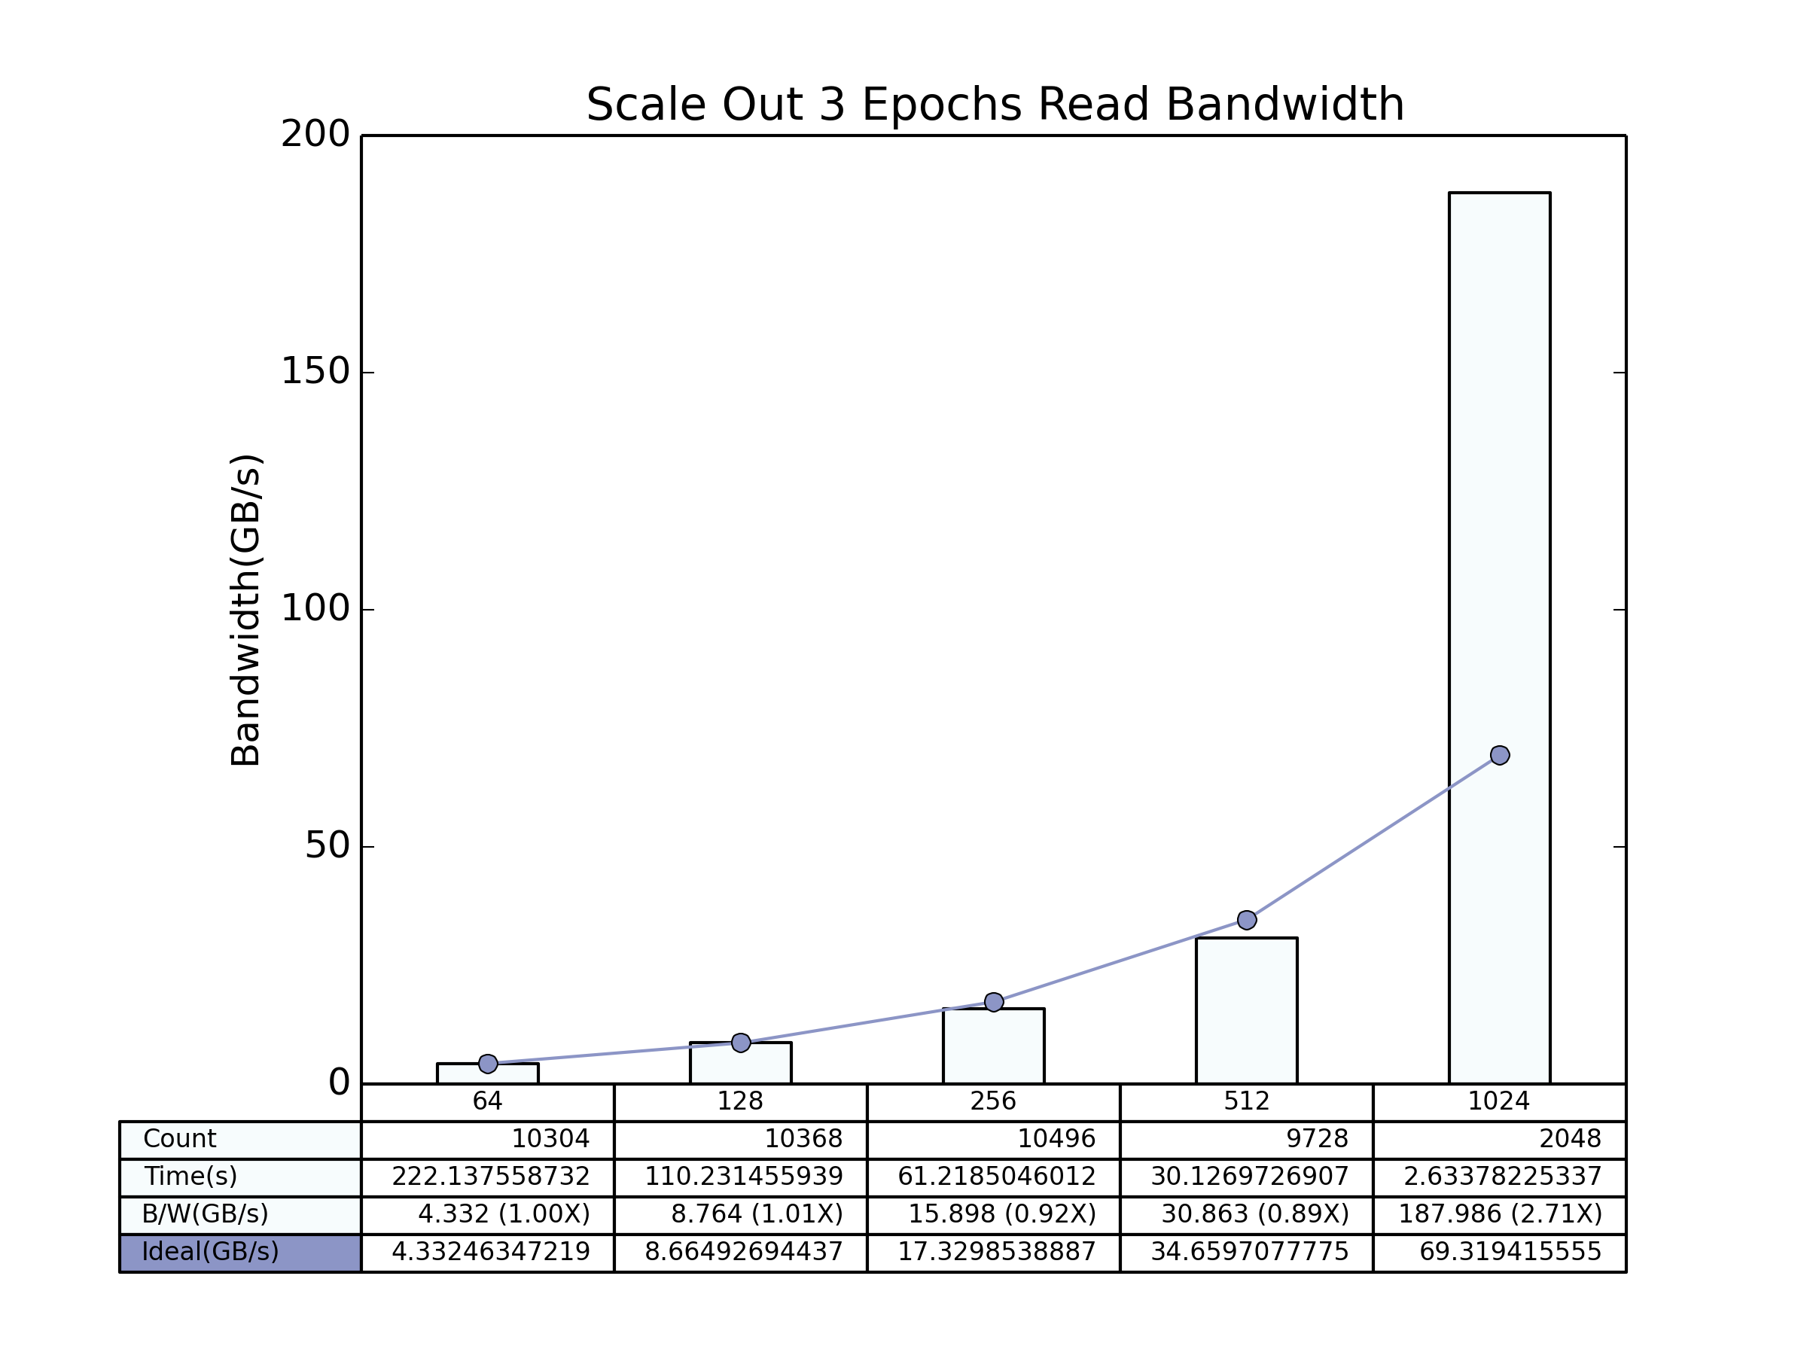
Read Bandwidth Scale Out (HEPCNNB)
Local Shuffle
Global Shuffle

Slide 15
CDB Dataset
Lustre Directory for Data
/global/cscratch1/sd/ftc/deep_learning_data/climate_deep_learn/
62738 Data Files 58 MiB each
1 Stats (Normalization) File 2.3 KiB
Files are shuffled
Training Files: first 80% = 50190
Validation Files: last 10% = 6273
data.shard is used to equally distribute the file list
If number of nodes is 64, each node reads 784 training files and 98 validation files
Notes:
10%

Slide 16
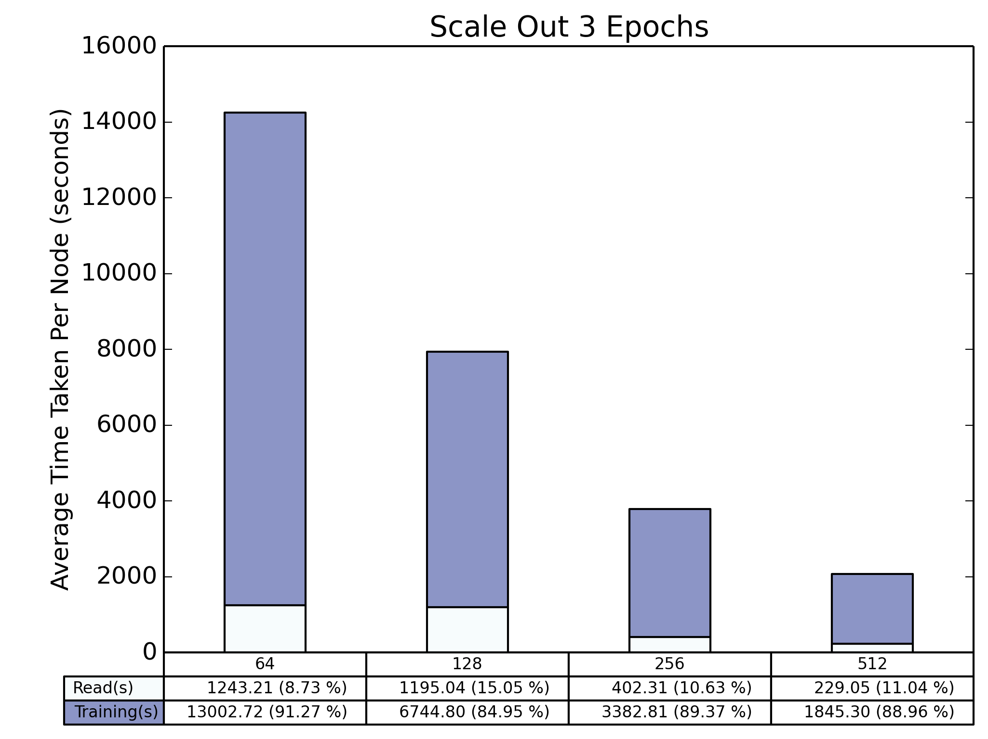
Total Time Scale Out (CDB)
Notes:
Details in 20180713

Slide 17
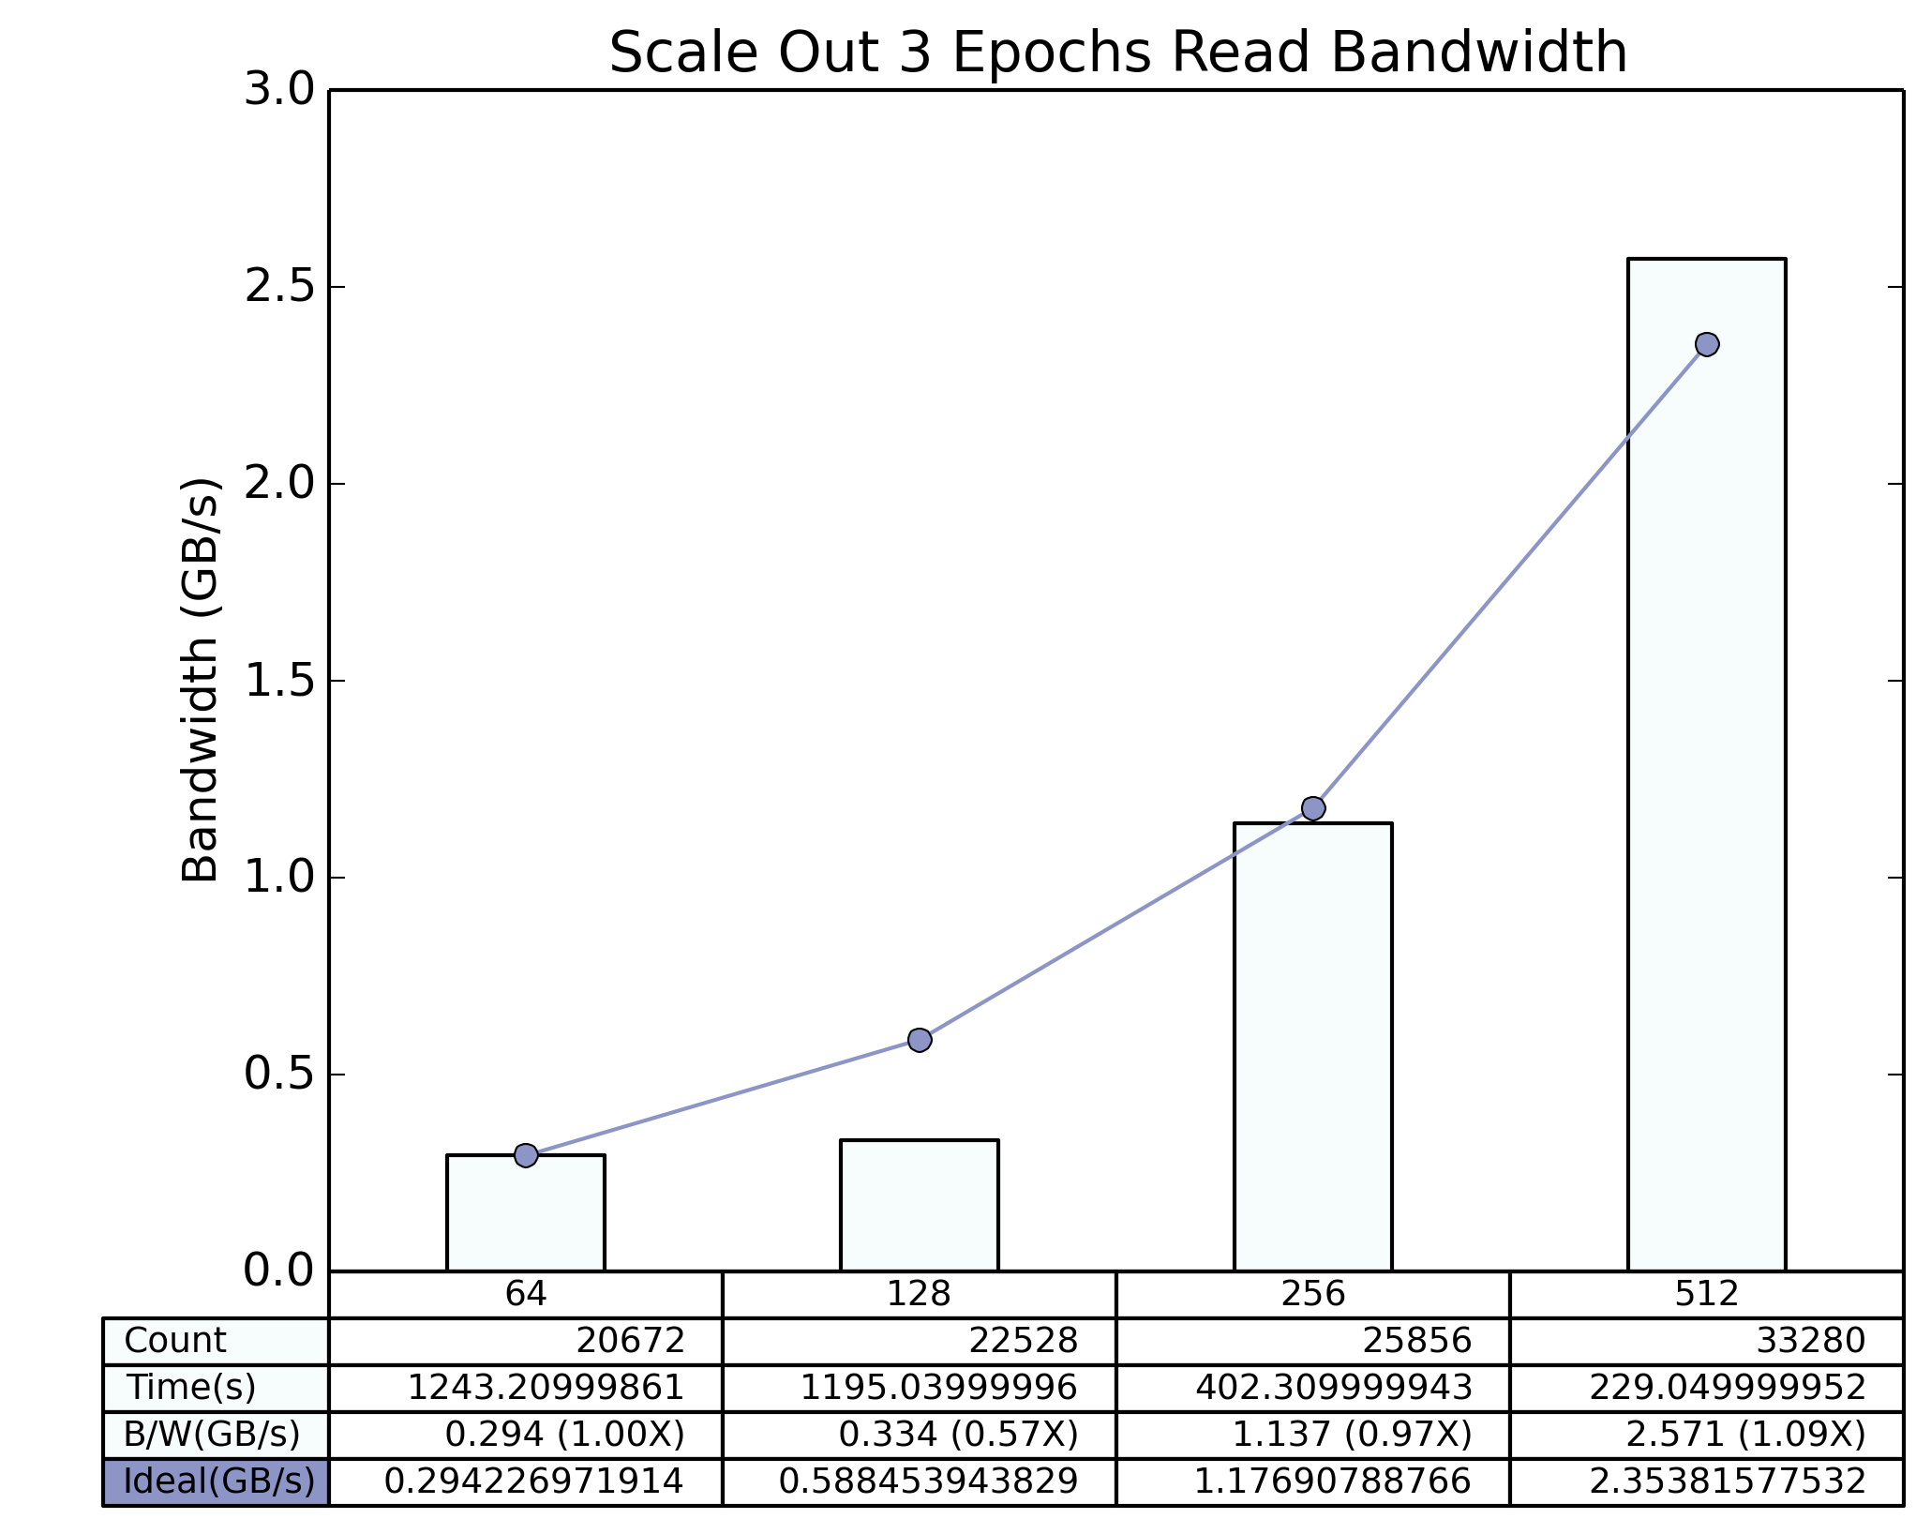
Read Bandwidth Scale Out (CDB)

Slide 18
Outline
Project Objectives
Benchmarks at NERSC
Experimental Results
Tasks In Progress
Plans for the Future
Notes:
https://github.com/NERSC/DL-Parallel-IO

Slide 19
Tasks In Progress
Digging deeper into Timeline generated metadata
Exploring the visualization tool developed at Google
Working on extracting thread specific information from TF Timeline output
Notes:
Show demo of the output from TensorFlow Metadata Visualizer tool by Hadi

Slide 20
Outline
Project Objectives
Benchmarks at NERSC
Experimental Results
Tasks In Progress
Plans for the Future

Slide 21
Plans for the Future
To understand the Timeline plots to get a clear view
To extend Google’s tool to combine the results from all the runs
To modify Google’s tool to segregate IO, Compute and Communication
To modify TensorFlow’s codebase if required
To add prefetching using TF Dataset API in HEPCNNB
To write a summary report on the project in IEEE format
To target a conference publication

