Slide 1
Fahim Tahmid Chowdhury Data Analytics & Service Group NERSC
Project Progress
July 13, 2018

Slide 2
Outline
HEP Benchmark
Time Breakdown and Bandwidth
Climate Data Benchmark
Data Format
Time Breakdown and Bandwidth
Future Exploration Scopes

Slide 3
Outline
HEP Benchmark
Time Breakdown and Bandwidth
Climate Data Benchmark
Data Format
Time Breakdown and Bandwidth
Future Exploration Scopes

Slide 4
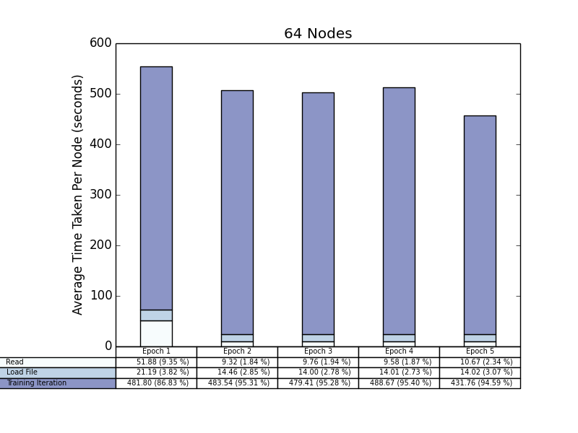
64 Nodes

Slide 5
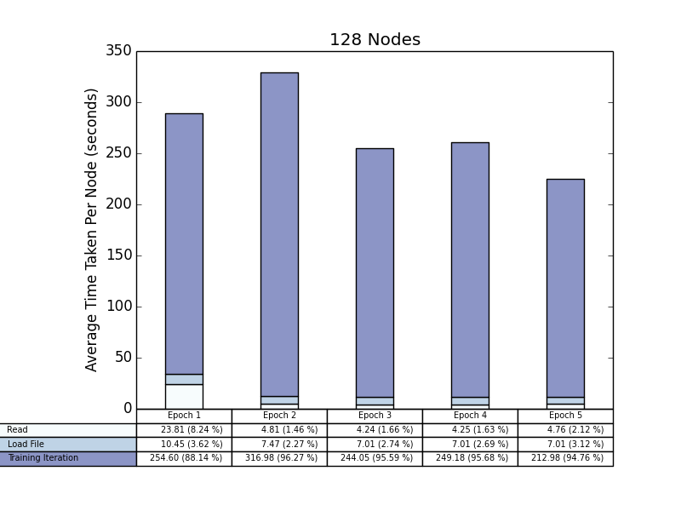
128 Nodes

Slide 6
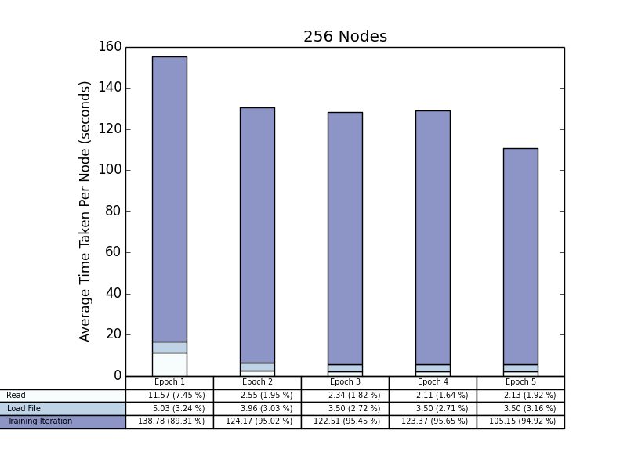
256 Nodes

Slide 7
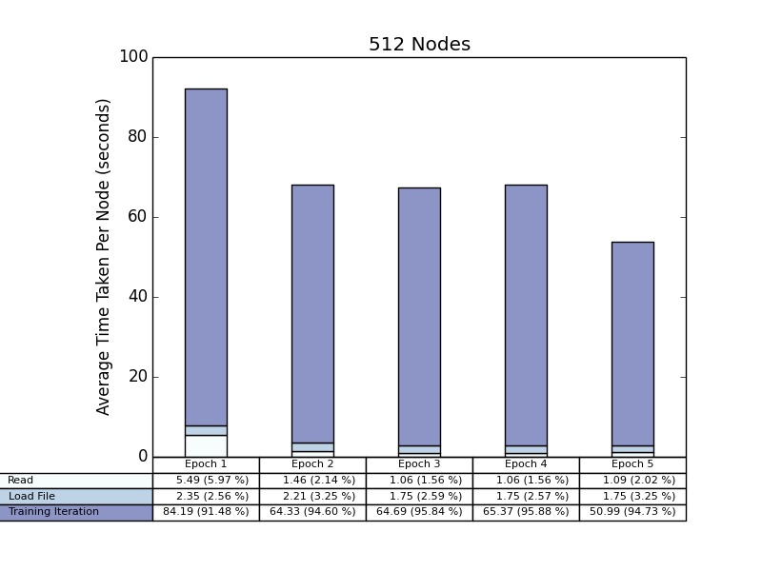
512 Nodes

Slide 8
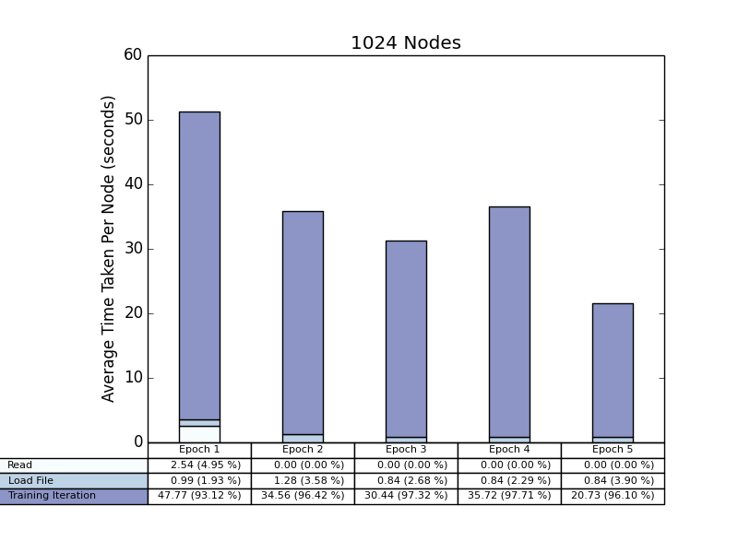
1024 Nodes

Slide 9
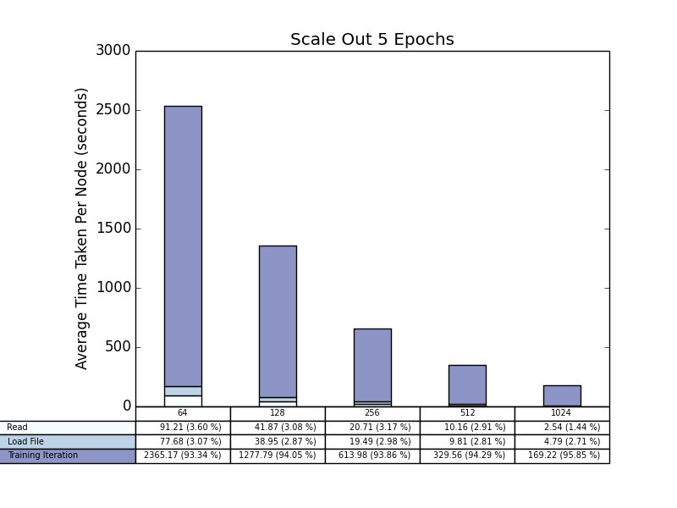
Total Time Scale Out
Notes:
Global Shuffle and See what happens
Random number generator instance with a new seed

Slide 10
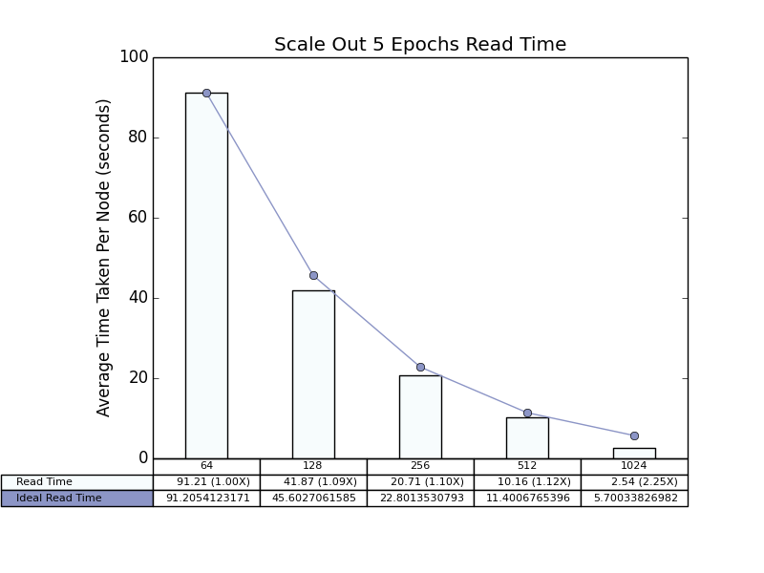
Read Time Scale Out

Slide 11
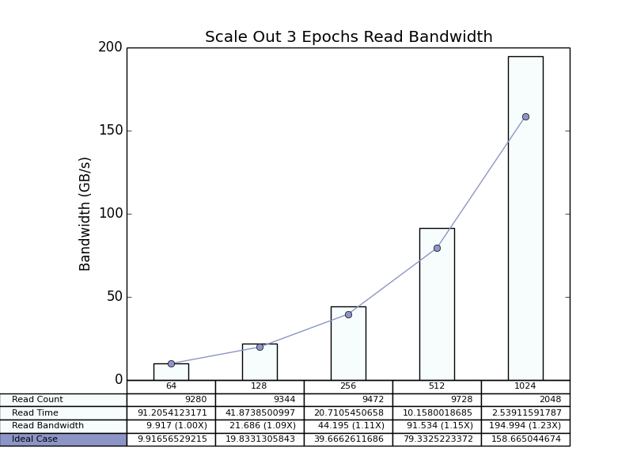
Read Bandwidth Scale Out
Notes:
Ideal case from 1 node

Slide 12
Outline
HEP Benchmark
Time Breakdown and Bandwidth
Climate Data Benchmark
Data Format
Time Breakdown and Bandwidth
Future Exploration Scopes

Slide 13
Dataset
Lustre Directory for Data
/global/cscratch1/sd/ftc/deep_learning_data/climate_deep_learn/
62738 Data Files 58 MiB each
1 Stats (Normalization) File 2.3 KiB
Files are shuffled
Training Files: first 80% = 50190
Validation Files: last 90% = 56464
data.shard is used to equally distribute the file list
If number of nodes is 64, each node reads 784 training files and 882 validation files
Notes:
10%

Slide 14
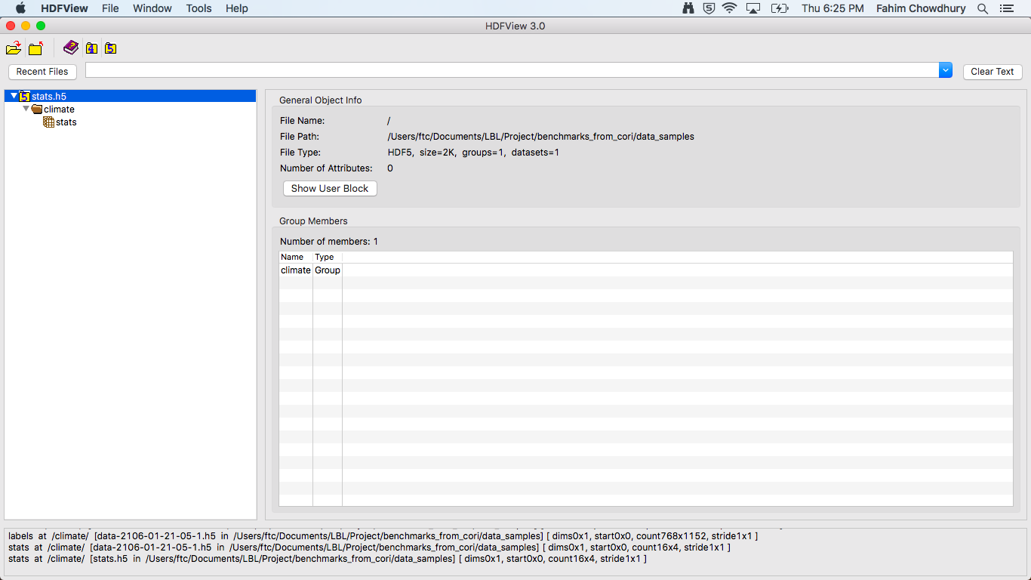
Normalization File (stats.h5)
Notes:
Demo from PyCharm

Slide 15
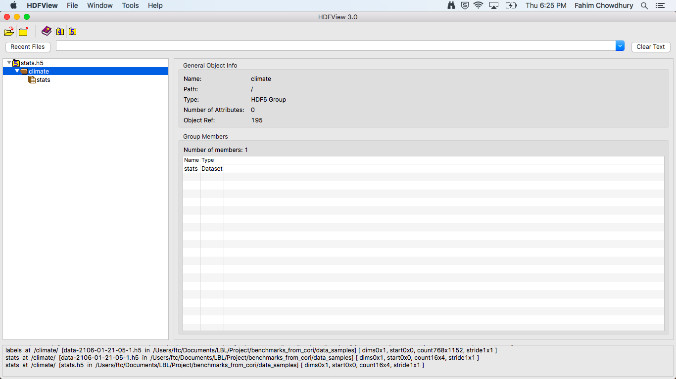
Normalization File (stats.h5)
Notes:
Demo from PyCharm

Slide 16
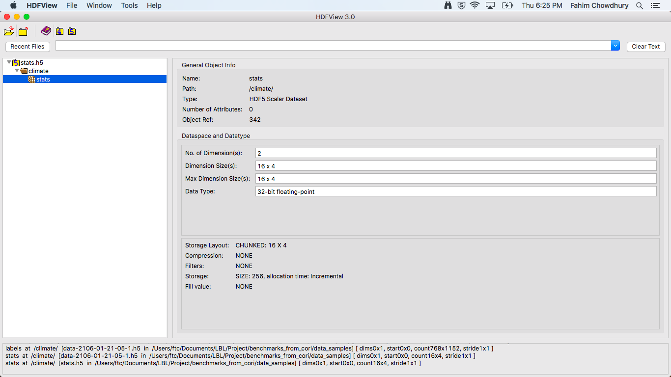
Normalization File (stats.h5)
Notes:
Demo from PyCharm

Slide 17
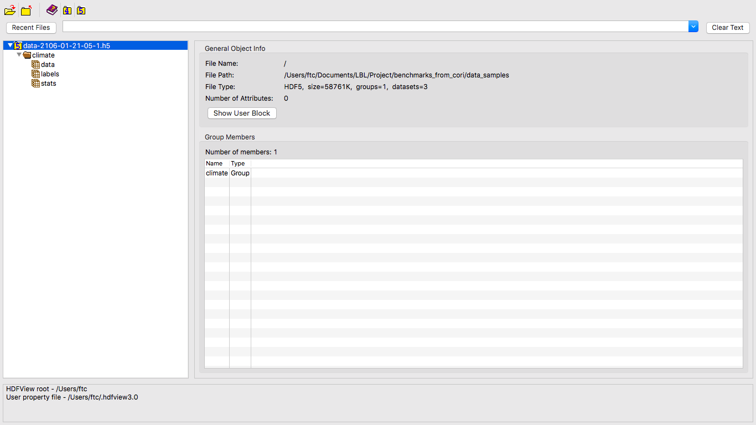
Training Data
Notes:
Demo from PyCharm

Slide 18
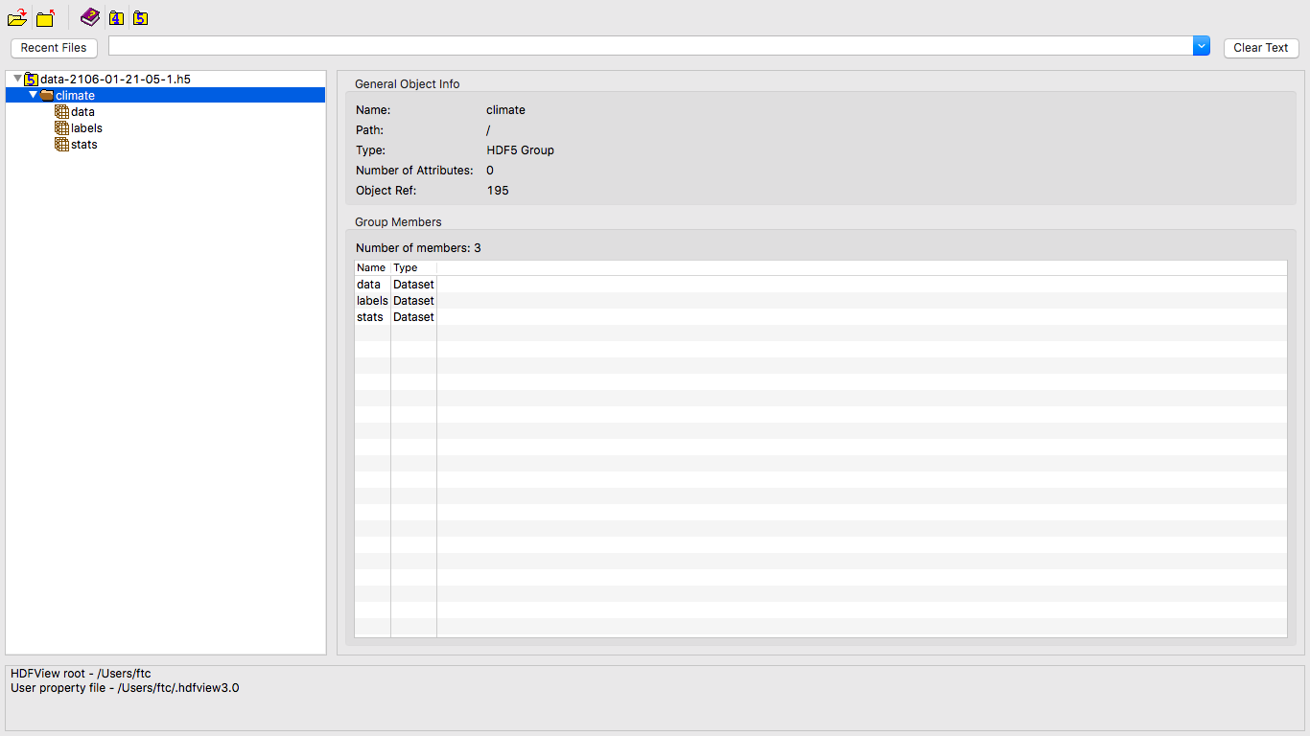
Training Data
Notes:
Demo from PyCharm

Slide 19
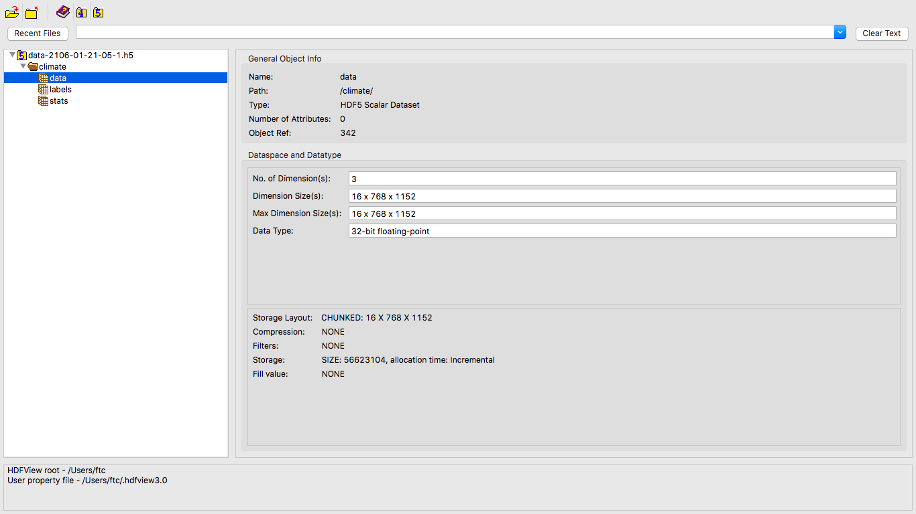
Training Data
Notes:
Demo from PyCharm

Slide 20
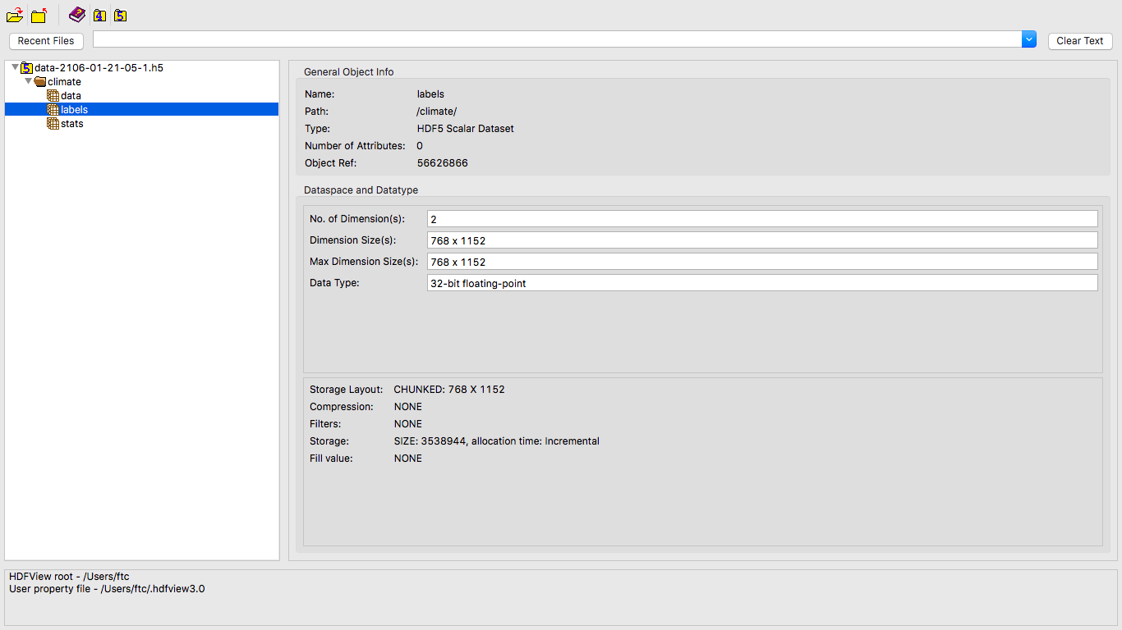
Training Data
Notes:
Demo from PyCharm

Slide 21
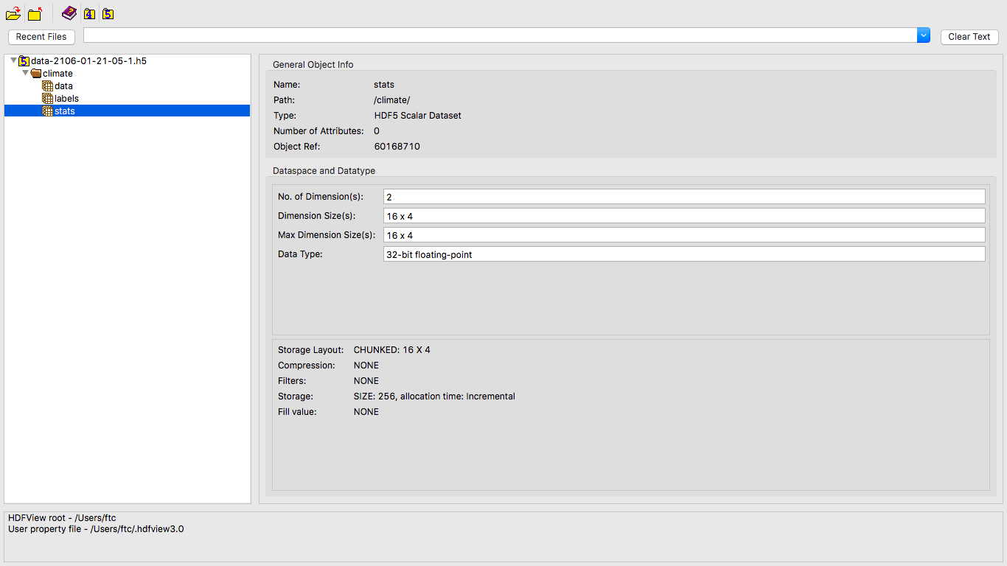
Training Data

Slide 22
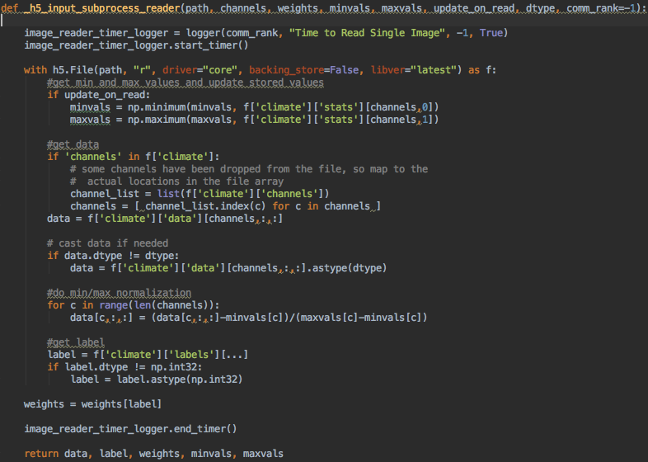
File Read Code Snippet

Slide 23
Dataset Detail
More Precisely
channels = [0,1,2,10]
climate -> stats = 4 x 2 x 32 / 8 B = 32 B
climate -> data = 4 x 768 x 1152 x 32 / 8 B = 14155776 B
climate -> labels = 768 x 1152 x 32 / 8 B = 3538944 B
Total data read in one sub process call = 17694752 B
4 parallel sub process calls per read call
4 parallel read calls per dataset.map call
Notes:
Compute overlapping intervals

Slide 24
Outline
HEP Benchmark
Time Breakdown and Bandwidth
Climate Data Benchmark
Data Format
Time Breakdown and Bandwidth
Future Exploration Scopes

Slide 25
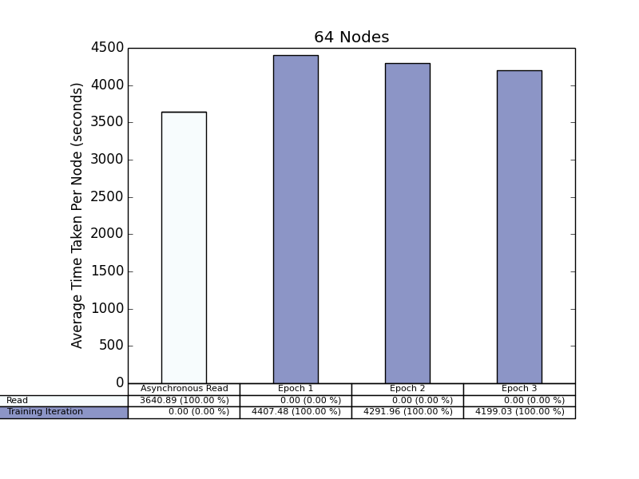
64 Nodes
Notes:
Calculate on Steps

Slide 26
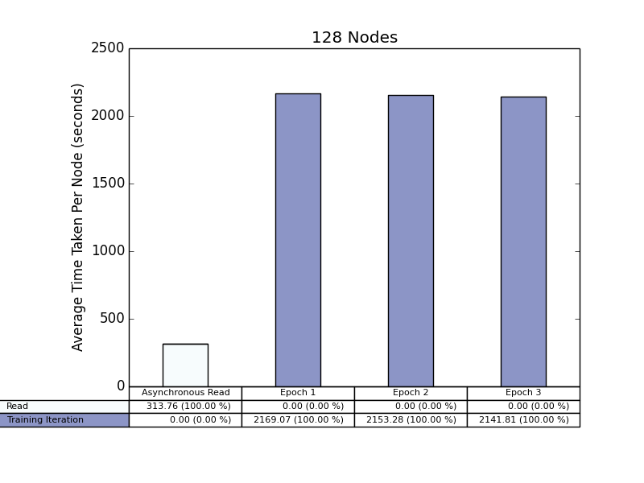
128 Nodes

Slide 27
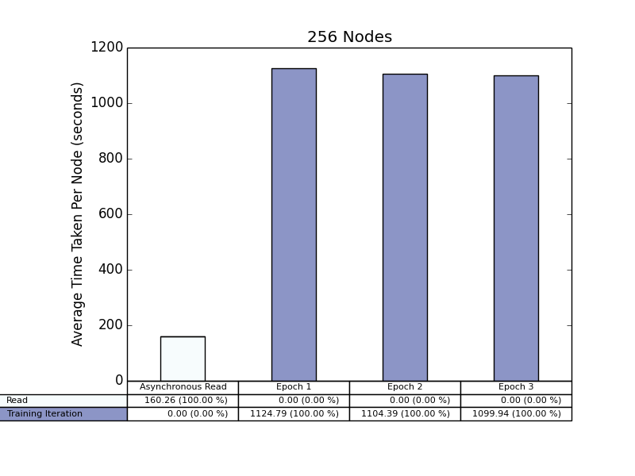
256 Nodes

Slide 28
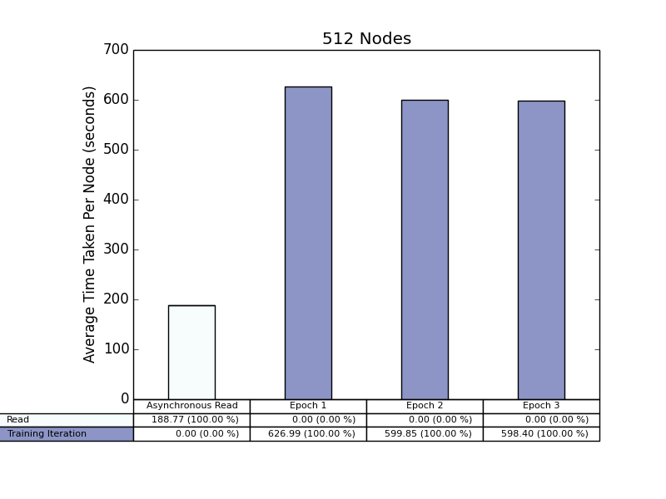
512 Nodes
Notes:
IO Only
Train Only on Random Data
Training Time per Step
IO Time per Step
Tensorflow Timeline

Slide 29
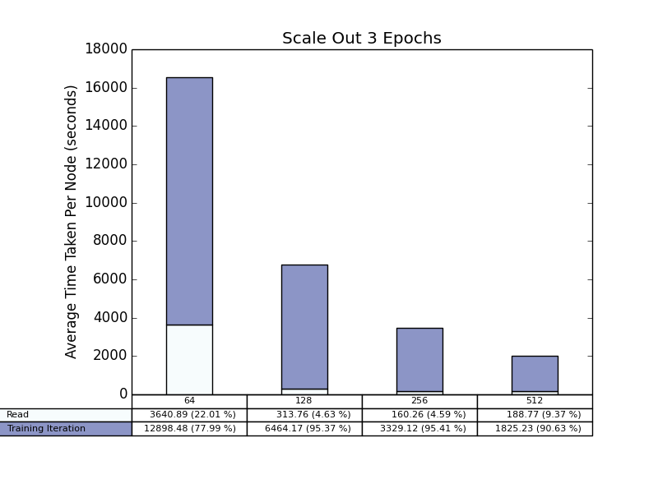
Total Time Scale Out

Slide 30
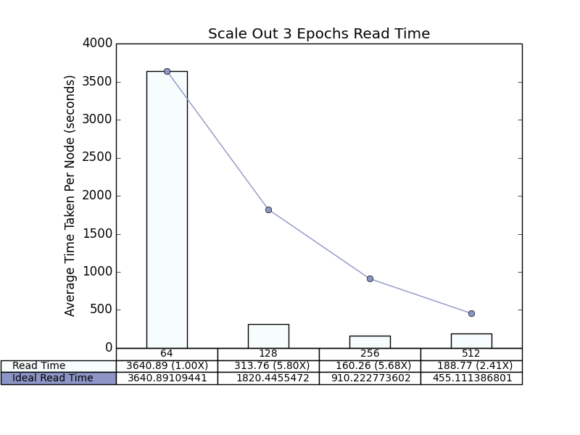
Read Time Scale Out

Slide 31
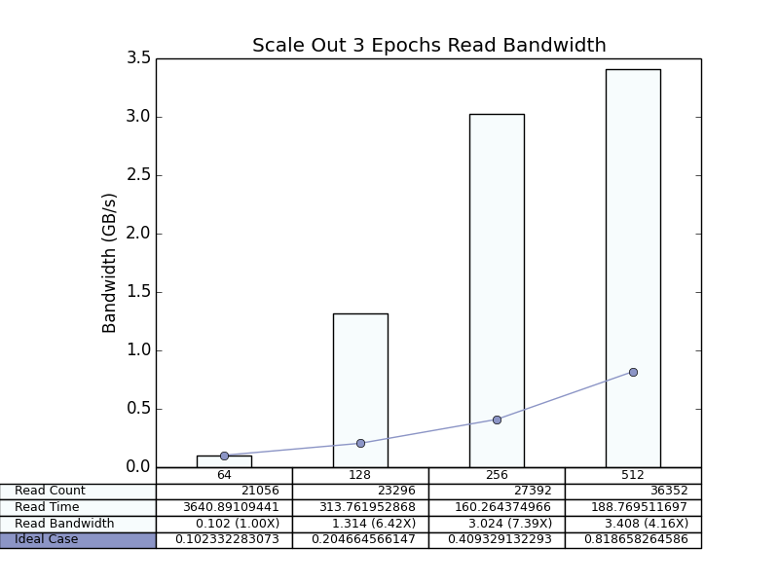
Read Bandwidth Scale Out

Slide 32
Outline
HEP Benchmark
Time Breakdown and Bandwidth
Climate Data Benchmark
Data Format
Time Breakdown and Bandwidth
Future Exploration Scopes

Slide 33
Future Exploration Scopes
Added Flag to Ignore Training
Can Try to Run the Tests with Training Disabled
Added Provision to Test Checkpointing by TimeLogger
Can Try to Run the Tests with this feature
Have to Perform Deeper Analysis on the Bandwidth for Parallel IO in Climate Data Benchmark
To Have a Look into the PyTorch Benchmark
To Try Running the Climate Data Tests Using Burst Buffer
Notes:
Run the stuffs IO + Training
Only Training with random data
See whether IO is hidden

