Slide 1
Fahim Tahmid Chowdhury Data Analytics & Service Group NERSC
Deep Learning I/O
Related Works
June 01, 2018
Notes:
Key ideas in the two papers Synergy Lab at Virginia Tech in collaboration with Argonne Lab.
Key points
LMDBIO – Improve Intra-node Performance by implementing Localized mmap technique to decrease the number of I/O calls and unnecessary context switches
LMDBIO-2.0 – Improve Internode communication by first serializing I/O using portable cursor and then implementing speculative parallelization to leverage the HPC infrastructure by Caffe’s LMDB

Slide 2
Outline
Impact of I/O in DL Applications
Analysis of I/O in Caffe
LMDBIO: Towards Scalable DL via I/O Analysis and Optimization
LMDBIO-2.0: Parallel I/O Optimization for Scalable DL
Notes:
Key points
LMDBIO – Improve Intra-node Performance by implementing Localized mmap technique to decrease the number of I/O calls and unnecessary context switches
LMDBIO-2.0 – Improve Internode communication by first serializing I/O using portable cursor and then implementing speculative parallelization to leverage the HPC infrastructure by Caffe’s LMDB

Slide 3
Outline
Impact of I/O in DL Applications
Analysis of I/O in Caffe
LMDBIO
LMDBIO-2.0
Notes:
Impact of DL in modern times:
Google’s AlphaGo to Tesla’s Autopilot to Baidu’s DeepSpeech for Speech Recognition
Key points
LMDBIO – Improve Intra-node Performance by implementing Localized mmap technique to decrease the number of I/O calls and unnecessary context switches
LMDBIO-2.0 – Improve Internode communication by first serializing I/O using portable cursor and then implementing speculative parallelization to leverage the HPC infrastructure by Caffe’s LMDB

Slide 4
Impact of IO in DL Applications
First Phase of Deep Learning is “Training”
Generating Effective DL Networks
One of the Targets in Research Community
Leveraging Supercomputing Systems for Faster Training
Problems
Computation Performance Improves, but I/O is a Major Bottleneck
How and Why I/O is a Major Bottleneck?
Notes:
Impact of DL in modern times:
Google’s AlphaGo to Tesla’s Autopilot to Baidu’s DeepSpeech for Speech Recognition

Slide 5
Outline
Impact of I/O in DL Applications
Analysis of I/O in Caffe
LMDBIO
LMDBIO-2.0

Slide 6
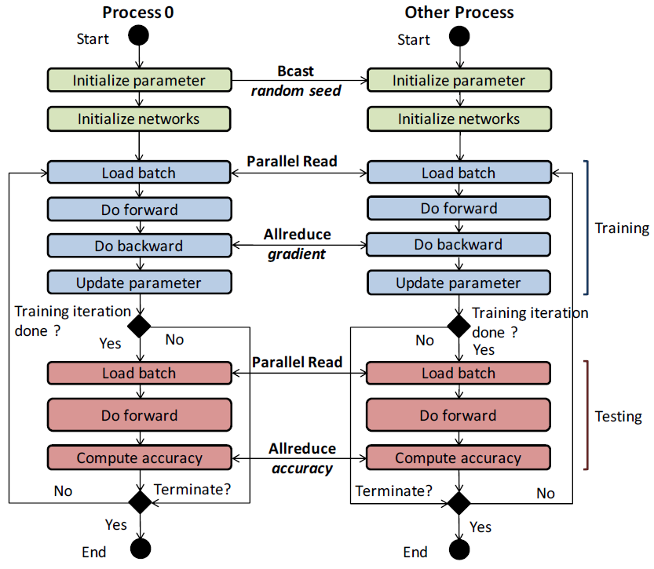
Caffe Workflow – Parallel Training
For each iteration, each worker reads a subset of batch from a DB
LMDB - Default and most used data reading option
Forward Training
Compute weighted sum of inputs in each layer of DNN
Calculate classification error in last layer
Backward Pass
Error is propagated back to calculate network’s parameter gradients
Accumulate gradients by each worker
Update parameters and test periodically
Do until desired accuracy found or maximum number of iteration reached

Slide 7
LMDB – Lightning Memory-mapped DB
The I/O Subsystem for Caffe
Allows Block-based I/O and Represents DB in B+ Tree Format
Relies on Memory-mapped I/O to Access Database
Uses mmap and Maps Dataset to Memory for Faster Parsing (Lightning?)
Highly Inefficient in Large-scale Systems
Unnecessary Context Switches for Unix Process Scheduling System
Increased Total Sleep Time for I/O when Page Fault Occurs
Imagine mmap Page Fault Scenario on a System with Thousands of Nodes
Notes:
Here block-based means, the records are kept in pages.

Slide 8
Experimental Platform
Argonne “Blues” Cluster
310 Nodes Connected via Infiniband Qlogic QDR
Each Node has 64 GB of Memory and 2 Sandy Bridge 2.6 GHz Pentium Xeon processors (16 cores, hyperthreading disabled)
110 TB of Cluster-wide Space Provided by GPFS and 15 GB of On-node Ramdisk
Datasets and Training
CIFAR10-Large (50 Million 3 KB Images + Metadata = 190 GB) Trained by AlexNet DNN Model
With batchsize 4096 through 1,024 Iterations Using 4 Million Images
Imagenet (1.2 Million 192 KB Images + Metadata = 240 GB) Trained by CaffeNet DNN Model
With batchsize 4096 through 32 Iterations Using 128 K Images
Notes:
Data was stored in LMDB format and the files were stored directly on a GPFS having 10 Network Shared Disk (NSD) servers.

Slide 9
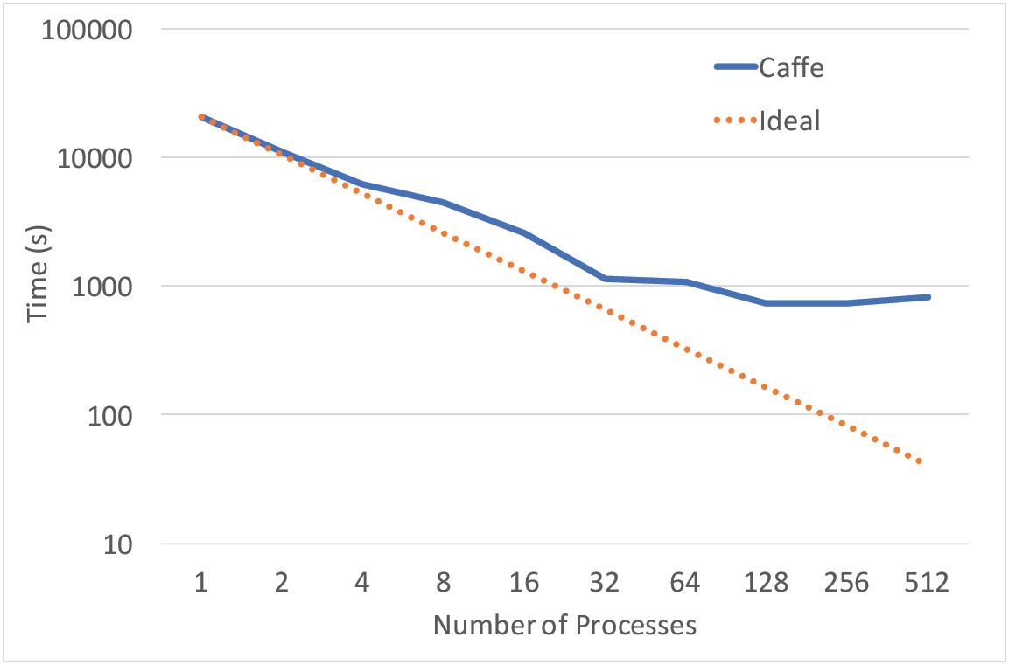
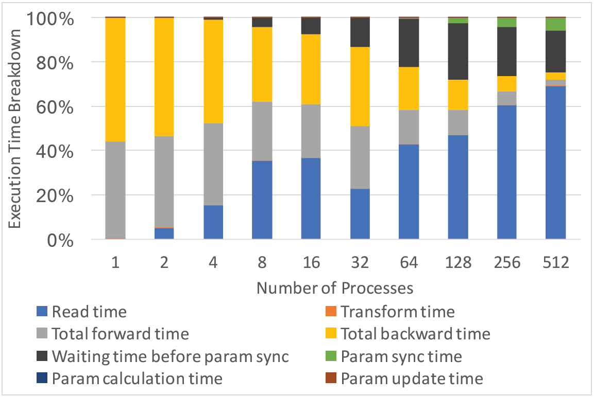
Caffe Scalability Analysis
For 512 Processes, Caffe is 20-fold Worse than Ideal Case
For 512 Processes, Read Time Takes 70% of Total Training Time
Notes:
Transform time - The time used in data sample transformation (e.g., InferBlobShape, Reshape)
// Use data_transformer in Data layer class to infer the expected blob shape from datum.
How do they measure the breakdown time?
They did not use any profiling tool. They added custom timers to the Caffe code. They used MPI_Wtime() to get the start time and end time of each component and calculate the elapsed time.

Slide 10
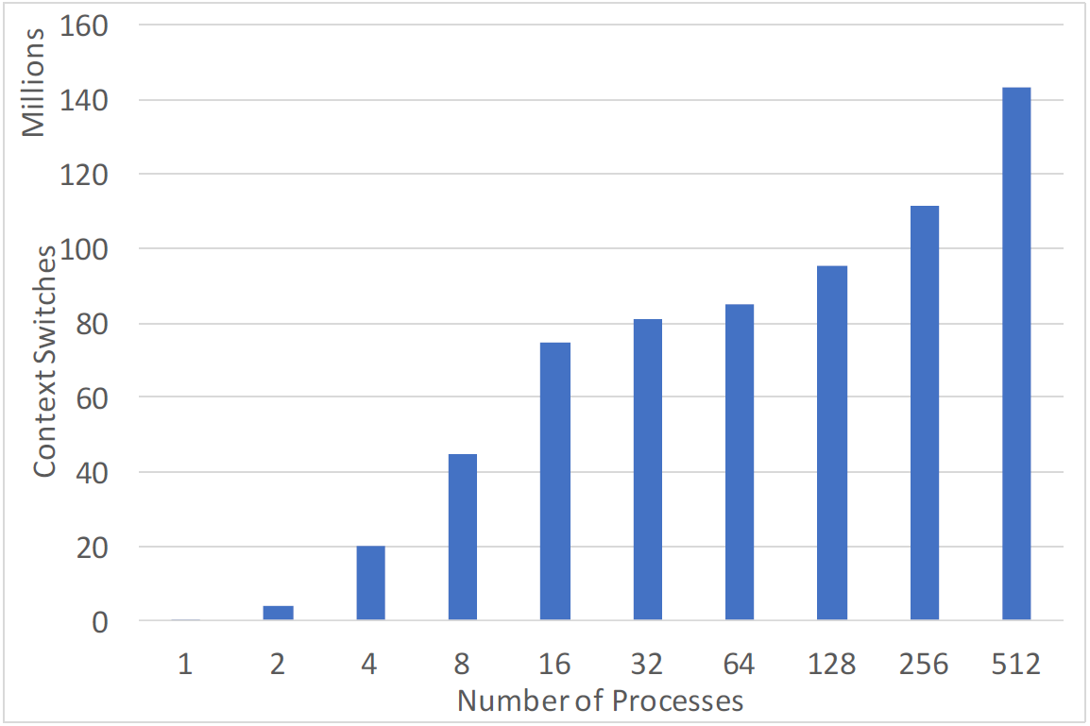
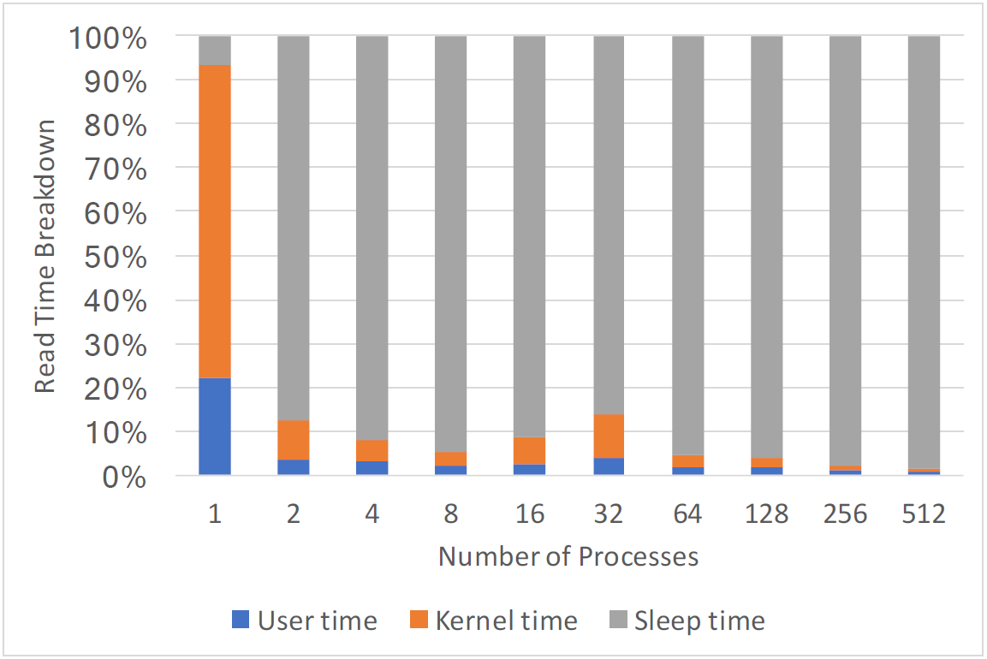
mmap Analysis
Context Switches Increases with the Increasing Number of Processes
For More Than 1 Process, Sleep Time is Approximately 90% of Overall Read Time
Notes:
How do they measure context switches?
They did not use any tool. They used the Linux system call "getrusage()” to get the number of context switches and the time. They manually inserted this system call into the Caffe code.

Slide 11
Outline
Impact of I/O in DL Applications
Analysis of I/O in Caffe
LMDBIO
LMDBIO-2.0

Slide 12
LMDBIO Overview
Caffe I/O Model (LMDB) has Lack of True Parallelism
Data Fetching is Independent for each Process
Unnecessary Data Reading and Discarding
All Processes Perform Data I/O – Unnecessary Context Switches
LMDBIO Leverages the Power of MPI-3 Shared Memory and LMDB Engine
LMDBIO Solves Some Problems in LMDB with Localized mmap Implementation
Notes:
More detail on what is being fetched?
Images kept in LMDB format in the GPFS are being fetched

Slide 13
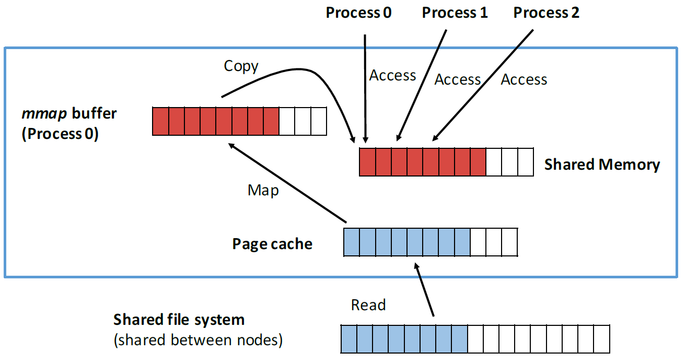
Localized mmap
Workflow of localized mmap
A single process on each node is chosen as the root process
Root process reads data from FS
Root process uses MPI-3 SHM to distribute data to other procs
All the processes access data from SHM
Advantages
mmap gets more sequential view of I/O
Minimizes inter-proc contention
Linux I/O handler gets only one process to wake up that is waiting for I/O and minimizes context switches
Notes:
Could not get idea to combine 15 and 17, hence kept separate

Slide 14
LMDBIO – More Detail
Initialization Phase
Assigns one reader per node
Each reader uses mmap through LMDB to map database in VAS
All processes per node allocate SHM buffer
Data Reading Phase
Each reader proc per node reads B/R* data samples from DB
Data read from FS to Page cache and mapped to VAS
Reader proc copies data to SHM
LMDBIO ensures the read is finished
All processes start reading from the SHM buffer
Each proc can access B/P* samples
* B = Batch Size
R = Number of Readers
P = Total Number of Processes
Notes:
How many storage nodes in the experimental platform?? Ask the author
10 GPFS Network Shared Disks
How are the images per reader chosen? Not clear yet
How many images per reader?
128 images
They did not use all 310 nodes in the experiments. They used from 1 node to 32 nodes. Each Blues node has 16 cores. The maximum number of reader processes was 32. So each process read 4096/32 = 128 images.

Slide 15
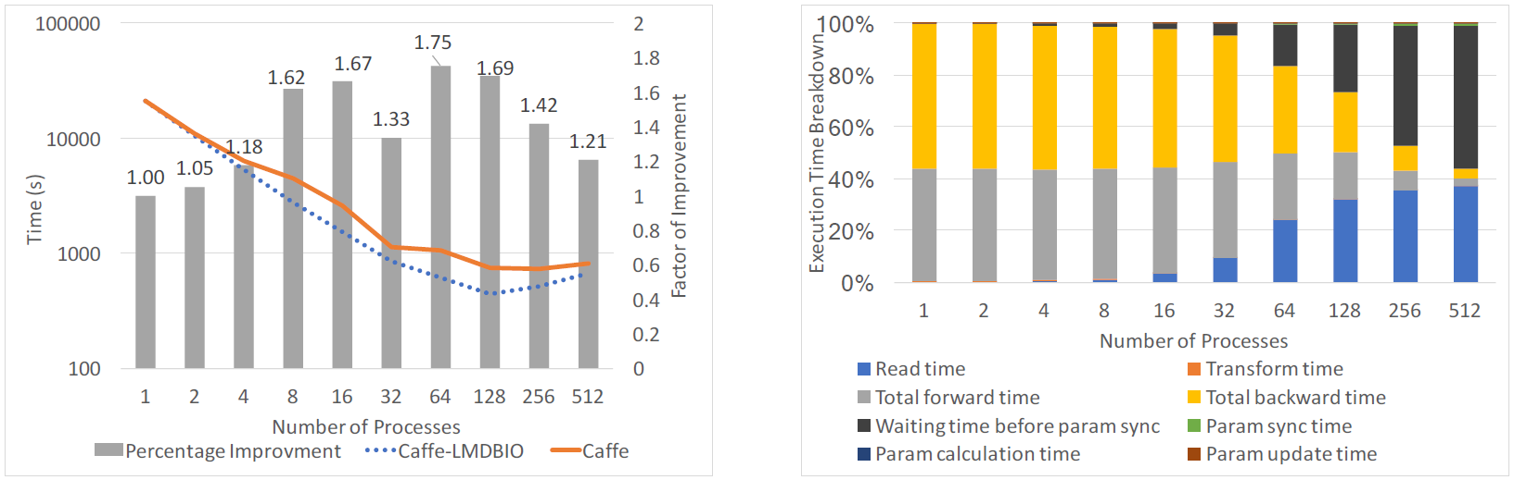
Performance Comparison – CIFAR10-Large
Caffe-LMDBIO Performs up to 1.75 Times Better Than Caffe
Read Time has Reduced from 70% to 30% of the Original Caffe Implementation

Slide 16
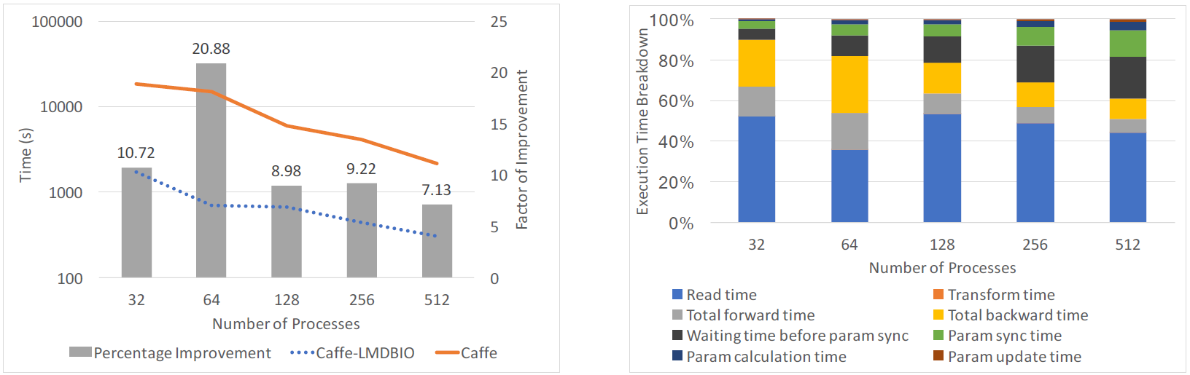
Performance Comparison – ImageNet
Caffe-LMDBIO Demonstrates up to 20 Times Improvement
ImageNet has Larger Images
Notes:
Read Jialin’s slide on Secret of slow I/O
Go through why larger images show more improvement -> probably because of larger I/O

Slide 17
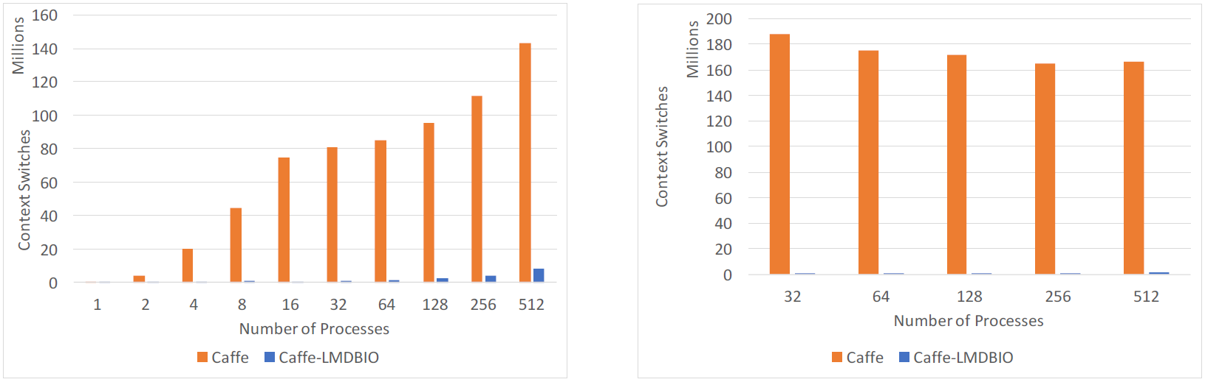
Context Switches Analysis
CIFAR10-Large
Up to 120-fold Less
ImageNet
Up to 700-fold Less

Slide 18
LMDBIO – Shortcomings
Serialized I/O
One Process Per Node Performs I/O
Minimizes Inter-process Contention, but Compromises Read Bandwidth of File System
Buffer Aliasing
Allocated Buffer Memory can Contain Pointers to Other Memory
Change in Buffer can Modify Other Memory Regions, which is Buffer Aliasing
Compiler Refrains Optimization in the Buffers that are Aliased
MPI-3 SHM Allocation Does Not Have Memory Buffer as Return Value Rather as Parameter
MPI-3 SHM Buffer Allocation cannot let the Compiler Know about No-Aliasing of the Allocation
TLB Misses
Malloc Buffer Page Size is 2 MB and SHM Buffer Page Size is 4 KB

Slide 19
Outline
Impact of I/O in DL Applications
Analysis of I/O in Caffe
LMDBIO
LMDBIO-2.0

Slide 20
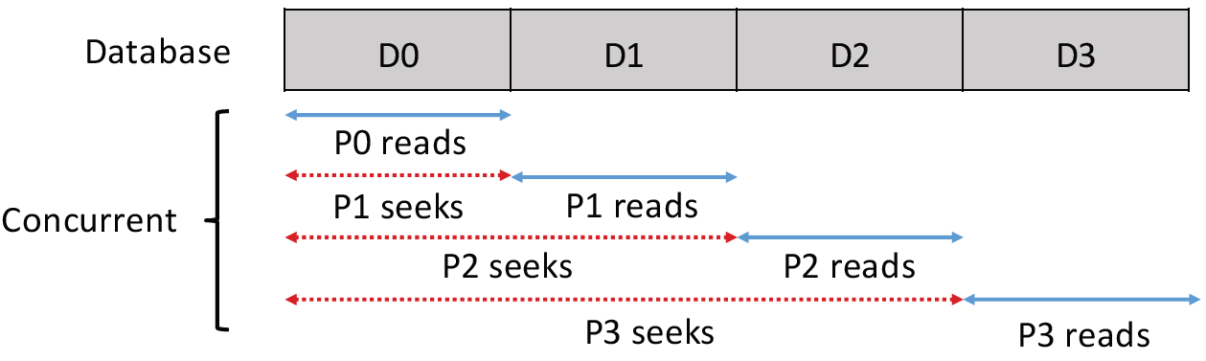
LMDBIO – Redundant Data Movement
LMDB seek operation
Start from root node
Traverse through every branch and leaf nodes
Reach node with target record
Parallel I/O can have random data access pattern!
P0 reads only D0
P1 has to seek through D0 to D1
P3 reads most extra data
In worst case, R x B bytes can be read by a process
R = Total number of readers
B = Size of an individual data portion
Notes:
LMDB seek, not traditional disk seek

Slide 21
LMDBIO-2.0 Overview
Primary Reason for Performance Loss in Caffe-LMDB and Caffe-LMDBIO
Redundant Data I/O by Different Processes
LMDBIO-2.0 Implements a Two-step Approach to Solve This Problem
Each Process Reads Only the Data It Needs to Process by Serializing I/O
Performance Loss for Serialization
Estimate What Data Pages Each Process Would Need and Perform Speculative Parallel I/O
Regain Most of the Lost Performance Caused by Serialization

Slide 22
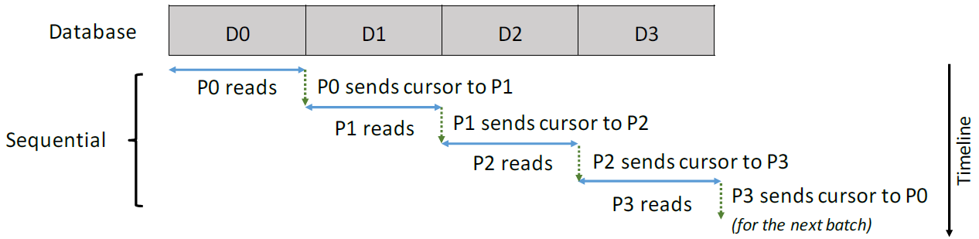
Serializing I/O Using Portable Cursor
Portable Cursor
Solution: Symmetric Address Space
How: All processes memory-maps the DB into same virtual address location
First process randomly picks a location
Tries to mmap the DB to the location
If successful, broadcasts to other procs
Each process tries to mmap to the same location
If all successful, we get a Symmetric Address Space
Else, try the method for few iterations
In 64-bit address space, it is possible in 1-2 tries
If any proc fails, go back to LMDBIO
Serializing I/O
Each process should read data that it needs
Each process reads data it needs to process
Passes cursor information to the next process
Cursor is not a simple structure
It has information represented as pointers
It makes sense only in local VAS of a process
How can it be made portable?
Notes:
Cursor, pointer structure of LMDB, contains information about Record index, Virtual address location, Parent branch node and Offset of page holding record

Slide 23
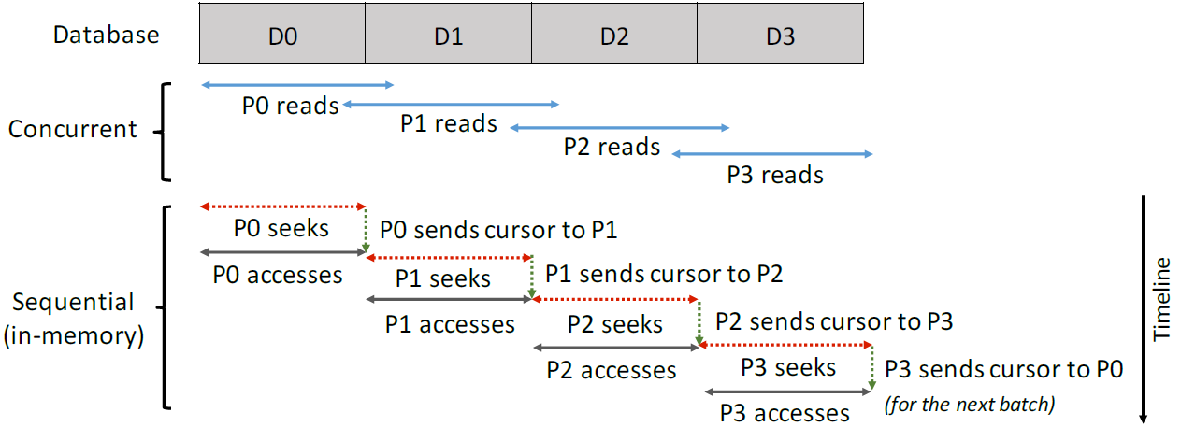
Speculative Parallel I/O
How to estimate what part of DB is needed to be fetched by a process?
Estimate required page by initial guess
Guess is based on number of pages used by first data sample
Guess is adjusted based on its accuracy in the previous iteration
After few iterations, the guess is expected to be fairly accurate
All processes fetch the estimated parts of data in parallel into memory
Sequentially seek and pass the starting location to corresponding processes
Most data should already be in memory
Finally, start the actual data processing
Serialization in data I/O is inefficient
Parallel file systems can be efficiently leveraged by parallel I/O
Solution: Speculatively perform parallel I/O
Notes:
How the guess is adjusted? Estimation algorithm? Ask the author
The correctness was measured by measuring the number of fault pages happened during database access. The measurement was done separately from the performance evaluation.

Slide 24
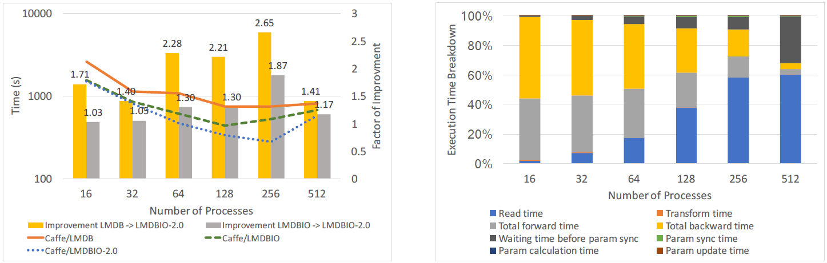
Performance Comparison – CIFAR10-Large
Caffe/LMDBIO-2.0 is 1.87-fold better than Caffe-LMDBIO; 2.65-fold better than Caffe/LMDB
Read time increases, but waiting time for processes decreases significantly

Slide 25
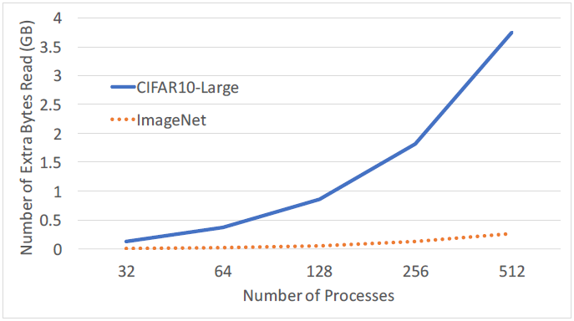
Analysis: Amount of Data Fetched
Observations
Number of extra bytes read increases with number of processes up to almost 4 GB
Increase in ImageNet is smaller than CIFAR10-Large
ImageNet 192 KB and CIFAR10-LARGE 3 KB sample size; more extra info read in CIFAR10-Large with header

Slide 26
Recap
Learnt about Caffe’s Data Access Pattern and LMDB’s Limitations
Discussed LMDBIO Implementation by Localized mmap Using MPI-3 SHM to Minimize Unnecessary Context Switches and Total Sleep Time
Studied LMDBIO-2.0 Implementation to Minimize Redundant Data I/O by Caffe/LMDB and Caffe/LMDBIO by Serializing I/O and Speculative Parallelization

Slide 27
Motivations and Take-aways
I Have Learnt How to Dissect a DL Framework Like Caffe and Find Out the Existing Problems and Establish Statements with Experimental Results.
I Believe We can Apply Similar Techniques in Case of Our Project, But We can Aim for a Different Framework Like TensorFlow or Torch.
I Think We can Handle the Experiments and Data More Smartly by Using Profiling Tools and Benchmarks.
I Believe, In Addition to Improvement in the Training Time, We can Look for Any Improvement Opportunity in the Later Stages of Deep Learning Like Forward Training and Backward Pass or Parameter Synchronization and Update.

Slide 28
References
[1] S. Pumma, M. Si, W. c. Feng and P. Balaji, "Towards Scalable Deep Learning via I/O Analysis and Optimization," 2017 IEEE 19th International Conference on High Performance Computing and Communications; IEEE 15th International Conference on Smart City; IEEE 3rd International Conference on Data Science and Systems (HPCC/SmartCity/DSS), Bangkok, 2017, pp. 223-230.
[2] S. Pumma, M. Si, W. c. Feng and P. Balaji. "Parallel I/O Optimizations for Scalable Deep Learning," 2017.

Slide 29
Thank You

Slide 30
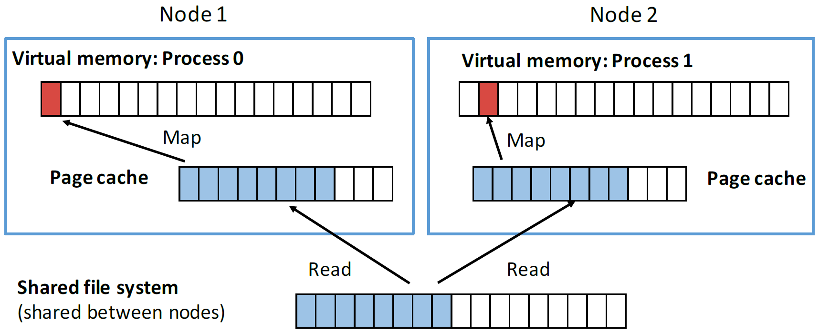
mmap Workflow
Components of mmap
File System (FS) – Local/Shared
Page Cache – Shared by procs
Virtual Address Space (VAS) – Private to a process (proc)
Workflow when mmap is called
Proc receives a VAS to map file
Proc can access file buffer freely
If a page is not mapped in VAS?
Page Fault!
Page-fault handler is invoked
Searches in page cache
Maps to VAS if found
If not found, issue I/O request
Process sleeps until I/O completion!
mmap is a Unix System Call
mmap exposes file layout from FS to VAS of a process
Instead of loading the whole file in memory, mmap loads segments of file at a page granularity
Beneficial for partial file accesses
Entire file is not accessed at once
File represents a complex database

Slide 31
CFS – Completely Fair Scheduler
Introduced in Linux Kernel 2.6
The Process with Least-used CPU Time is Chosen to Run First
Does Not Take the Process Queueing Order into Account
Guarantees Fairness between Processes
Maximizes CPU Utilization
When I/O Completion Interrupt is Invoked
CFS Awakes All the Chosen Processes
If Interrupt is not from the Proper Operation, the Processes Go to Sleep Again
Increases Unnecessary Context Switches and Total Sleep Time!

Slide 32
Detecting Collocated Process
How can Localized mmap Detect which Processes Reside on the Same Node?
LMDBIO Tries to Solve the Problem Using an MPI-3 Feature
Splits Global MPI Communicator to Multiple Local MPI Communicators
Uses MPI_Comm_split_type with MPI_COMM_TYPE_SHARED
Returns Group of Processes that can Create an SHM Buffer Together
Most of the Time it Returns Group of Processes from the Same Node
If Wrong Set of Processes is Returned, Performance is Compromised, but Workflow Does Not Fail

Slide 33
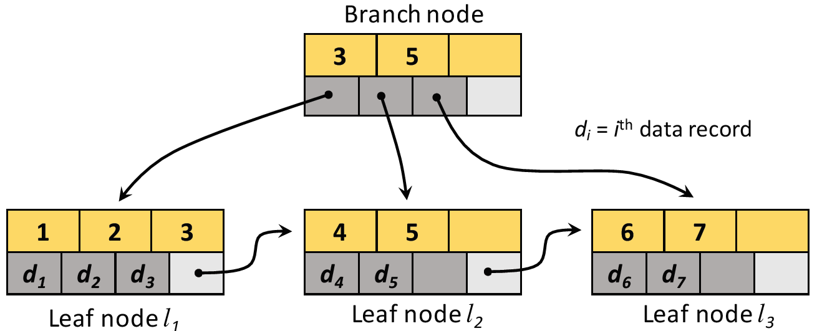
LMDB Revisited – Database Format
Metadata Pages
Store Information about DB
Branch Pages & Leaf Pages store Page Header and Records
Overflow Pages store the records that exceed leaf pages
Page Header (not in overflow page) stores type of each page, size of node, pointer to other nodes
Cursor, pointer structure of LMDB, contains information about
Record index
Virtual address location
Parent branch node
Offset of page holding record
Allows only sequential DB access!
Balanced n-way search trees
B+ Tree has two types of nodes
Branch nodes
Contain pointers to point n children nodes
Govern the number range of indices of its successors
Leaf nodes
Contain data and address to sibling nodes
Notes:
Why do caffe need faster search using LMDB with B+ Tree?

Slide 34
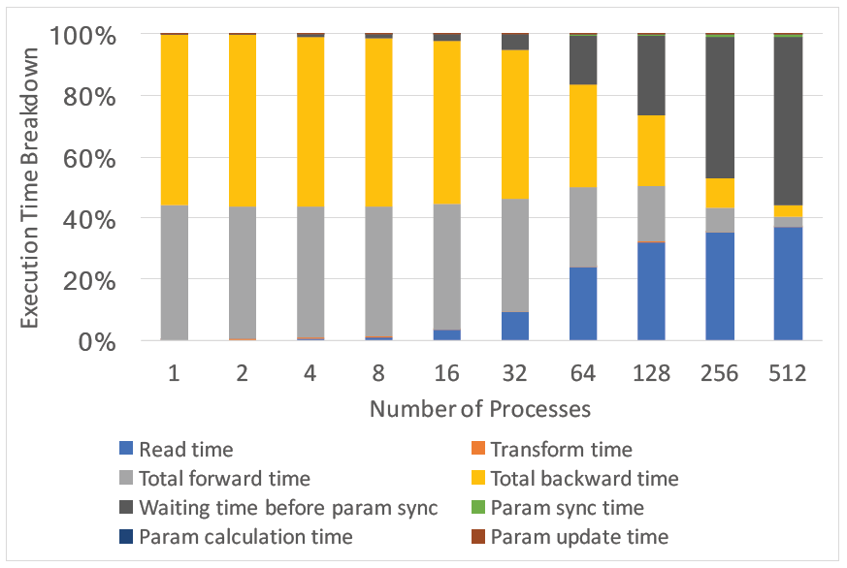
LMDBIO – Performance Analysis
For 512 processes
Read Time is 40% of Training Time
Waiting Time before parameter sync or Skew time between processes is almost 60% of total Training Time

Slide 35
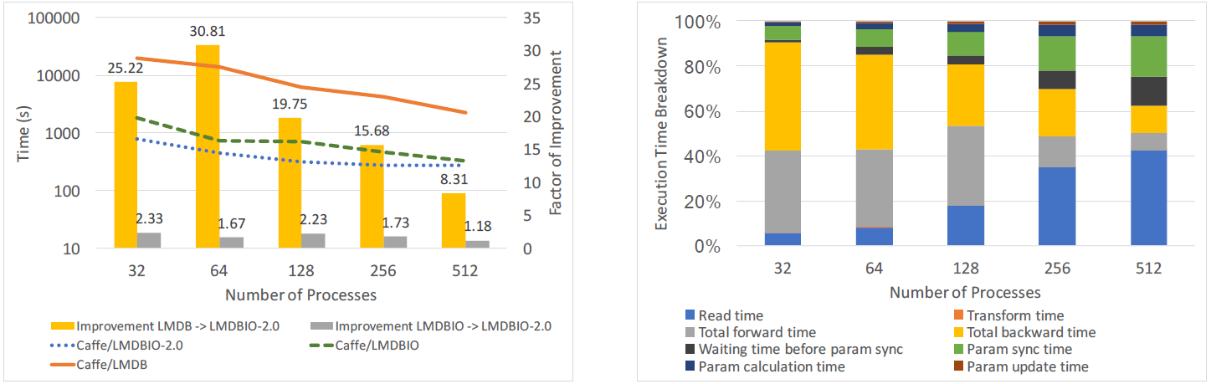
Performance Comparison – ImageNet LMDBIO-2.0
“Param Sync Time” – Time for parameter communication between processes increases
Because, CaffeNet DNN Model is larger than AlexNet
Notes:
Why param sync time is more for CaffeNet?

Slide 36
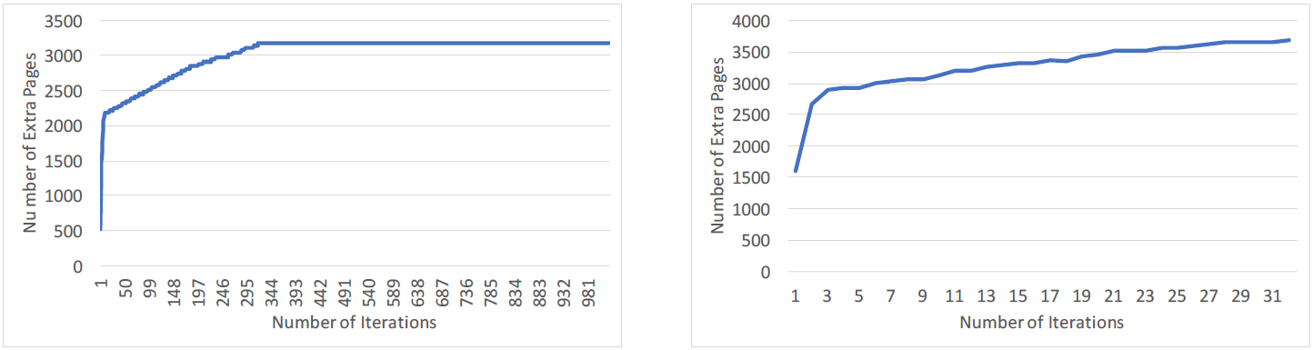
Analysis: Accuracy of Estimation LMDBIO-2.0
CIFAR10-Large
For 512 processes, number of extra pages stabilizes after some iterations
ImageNet
For 512 processes, number of extra pages stabilizes in even earlier iteration

Slide 37
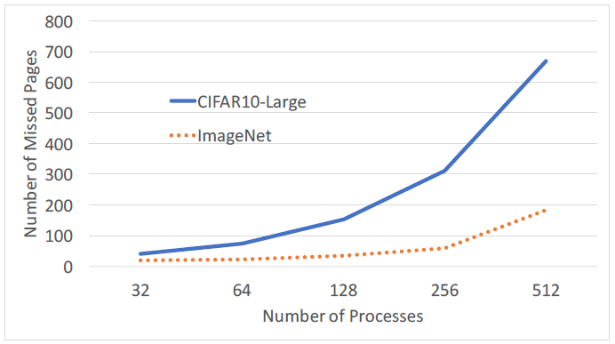
Analysis: Accuracy of Estimation LMDBIO-2.0
Number of missed pages increases with increasing number of processes
For 512 processes, number of missed pages is 700 for CIFAR10-Large and only 200 for ImageNet
Most of the missed pages happen in the first few iterations when LMDBIO-2.0 tries to converge the range of pages to fetch

Slide 38
Parallel I/O Optimizations for Scalable Deep Learning
Sarunya Pumma (sarunya@vt.edu), Min Si, Wu-chun Feng, and Pavan Balaji
12/16/2017

Slide 39
LMDBIO-DM: History Based Speculative Read (1/4)
Key idea of history based training: expanding boundaries of speculative read pages based on the min and max number of speculative pages read so far
The number of pages to read in the next iteration is in between the min and max pages
If every process reads n pages, the next page to read is the next n * r pages
n
n * (r – 1)
Next pages to read
n * r

Slide 40
LMDBIO-DM: History Based Speculative Read (2/4)
Key idea of history based training: expanding boundaries of speculative read pages based on the min and max number of speculative pages read so far
The number of pages to read in the next iteration is in between the min and max pages
If every process reads min pages, the next page to read is the next min * r pages
min
min * (r – 1)
Next pages to read
min * r

Slide 41
LMDBIO-DM: History Based Speculative Read (3/4)
Key idea of history based training: expanding boundaries of speculative read pages based on the min and max number of speculative pages read so far
The number of pages to read in the next iteration is in between the min and max pages
If every process reads min pages, the next page to read is the next min * r pages
min
min * (r – 1)
Next pages to read
min * r
Likewise if every process reads max pages
max
max * (r – 1)
Next pages to read
max* r

Slide 42
LMDBIO-DM: History Based Speculative Read (4/4)
Key idea of history based training: expanding boundaries of speculative read pages based on the min and max number of speculative pages read so far
The number of pages to read in the next iteration is in between the min and max pages
The new start page and end page to perform speculative I/O can be computed from the min and max pages
New start page
New end page

