Slide 1
Fahim Tahmid Chowdhury Data Analytics & Service Group NERSC
Deep Learning I/O
More Related Works
June 07, 2018
Notes:
Key Idea: Implementing a CUDA-Aware MPI Design by leveraging the explicit data movement operations using GPU buffers, maintaining parallel data reader threads for each processes and manage separate distributed queue, and incorporating collective operations patterns for data propagation and aggregation using MPI primitives like MPI_Bcast for data propagation and MPI_Reduce for gradient aggregation. Again, using multi-stage non-blocking collectives and proposing new gradient aggregation workflow design for maximal overlap of computation and communication.

Slide 2
Outline
Challenges and Requirements for Designing Scalable DL Frameworks
S-Caffe: Proposed Architecture and Co-designs
Performance Evaluation

Slide 3
Outline
Challenges and Requirements for Designing Scalable DL Frameworks
S-Caffe: Proposed Architecture and Co-designs
Performance Evaluation

Slide 4
Parallelization Strategies and Implementation Styles
Two Parallelization Approaches
Data Parallelization
Same model is replicated but fed with different parts of training data to different processing units
Model Parallelization
The parameters of the model is distributed and same data are fed to different processing units
Data-parallel Approach
Parameter-server approach – mostly used and not scalable; limited processing power and GPU mem
Each process sends the gradients to a master processor; master aggregates and sends to workers
Reduction-tree approach
Symmetric parallelization approach where all GPUs communicate using a tree-like pattern
Challenge: Implement data-parallel approach using symmetric SPMD-type solver
Notes:
Using master server for the aggregation makes the server processor as the bottleneck.
Using multiple servers as masters also adds overhead of the second layer of synchronization
Target: Implementing Data-parallel Approach using symmetric SPMD-style solvers where each GPU performs the same amount of work and the communication is performed in a collective fashion and before the start and end of each iteration

Slide 5
Distributed Address Space Design and Parallel Data Reading
HPC systems can have multiple (2-4) GPUs per node
Caffe has single address space system; single process can use multiple threads to leverage multiple GPUs
Caffe only makes intra-node scale-up possible
Caffe maintains training data in LMDB database
Caffe’s Data Reader thread brings data from storage to memory and shares the memory to the solvers or GPUs
Datasets are usually stored in PFS’s and storage nodes
Challenge: Design efficient parallel data reading mechanism

Slide 6
Exploiting Overlap of Computation and Communication
Caffe workflow has three main phases
Data propagation
Forward/backward passes
Gradient aggregation
Sequential nature of this workflow makes overlap of computation and communication impossible, so scalability is severely hindered
To-dos:
In-depth analysis of workflow and phases
Restructure coarse-grain phases to fine-grain ones
Leveraging new communication semantics

Slide 7
Designing DL-Aware Communication Runtimes
MPI communication protocol and runtimes
Can be CUDA-aware, but optimized for message sizes up to 4MB
In DL Frameworks, aggregation phase can require reduction on 256MB buffer
Challenge:
Design of new DL-Aware and GPU/CUDA-aware communication runtime and protocol
Can take advantage of GPU computing capabilities like GPUDirect RDMA (GDR) and InterProcess Communication (IPC)
Notes:
GPUDirect RDMA enables a direct path for data exchange between the GPU and a third-party peer device using standard features of PCI Express. Examples of third-party devices are: network interfaces, video acquisition devices, storage adapters.
IPC (Interprocess Communication) allows processes to share device pointers.

Slide 8
Outline
Challenges and Requirements for Designing Scalable DL Frameworks
S-Caffe: Proposed Architecture and Co-designs
Performance Evaluation

Slide 9
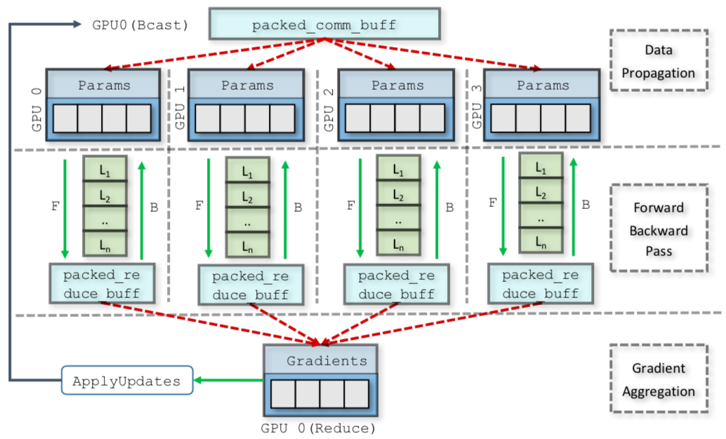
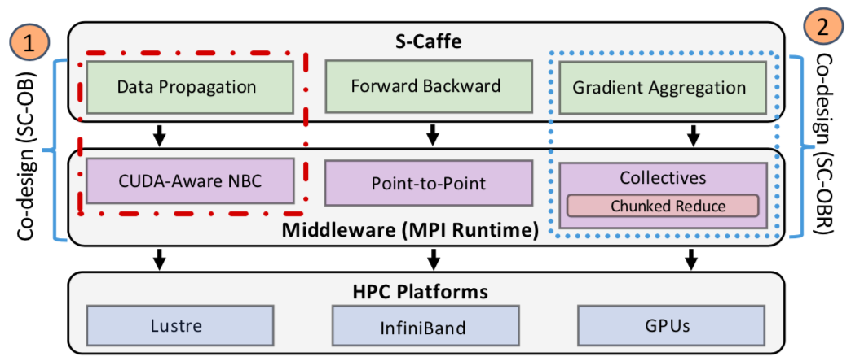
Caffe Architecture: Before-After
Before
After
Notes:
Net/Model: Holds important components of computation, communication, and I/O. e.g. AlexNet or GoogLeNet
Solver: Orchestrates the execution of different computation layers. Solver class is an interface that can be implemented by different solvers like Stochastic Gradient Descent (SGD) solver.
Layer: Abstractions for a defined set of computations on the data, e.g. Convolution, Pooling, and Data Layers.

Slide 10
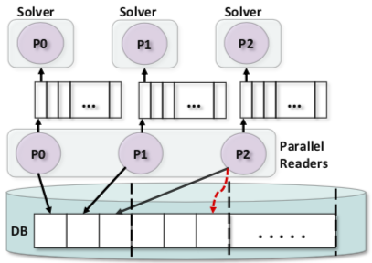
Basic CUDA-Aware MPI Design (SC-B)
Moved single address space to a distributed address space
Re-designed code to make threads share objects across heterogeneous CPU’s and GPU’s
Explicit Data Movement Operations
Identify minimum required data exchange
Use GPU-based buffers to communicate data across processes
Parallel Readers
Use parallel data reader threads and maintain separate distributed queues
Collective Operation Patterns for Data Propagation and Aggregation
Use MPI_Bcast for Forward Data Propagation
Use MPI_Reduce for Gradient Aggregation
Not efficient for larger scale
Notes:
Used ImageDataLayer of Caffe instead of LMDB. ImageDataLayer can access files in parallel. Kept the queues in Lustre. Faster than MPI communication.

Slide 11
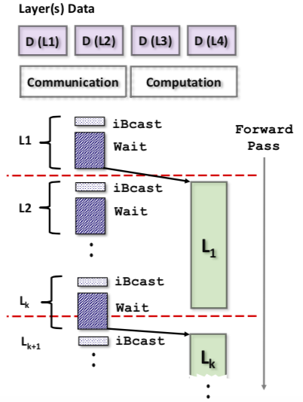
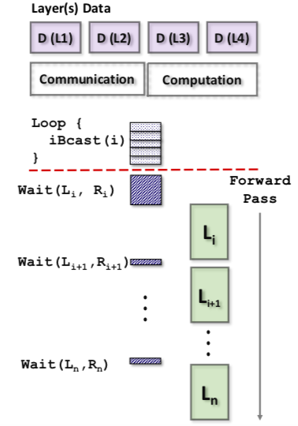
Multi-stage Non-blocking Collectives (SC-OB)
MPI_Ibcast: Non-blocking Collective
MPI_Wait: To complete
MPI_Wait blocks until the completion of the request
Naïve: Call MPI_Ibcast, then wait; Same as blocking
Call the Ibcast for all the layers
Call wait just before the computation of each layer
What about reduction during gradient aggregation?
Notes:
MPI_Ibcast: NBC (Non-Blocking Collective)
MPI_Wait
Use them intelligently

Slide 12
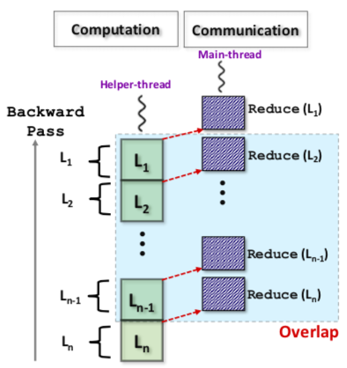
Helper Control Thread for Gradient Aggregation (SC-OBR)
Helper Thread
Responsible for invoking layers’ backward pass
Signals the main thread to invoke reduction
How to overlap computation and communication?
nth layer’s reduction needs nth layers computation to be completed
Synchronize main_thread and helper_thread using std::condition_variable
This design ensures the overlap of nth layer reduction with (n-1)th layer’s computation
Notes:
Used ImageDataLayer of Caffe instead of LMDB. ImageDataLayer can access files in parallel. Kept the queues in Lustre. Faster than MPI communication.

Slide 13
Outline
Challenges and Requirements for Designing Scalable DL Frameworks
S-Caffe: Proposed Architecture and Co-designs
Performance Evaluation

Slide 14
Experimental Platform
Cluster A
12 nodes (2 CPUs, 8 K-80 GPUs (2 CUDA devices for eache GPU))
InfiniBand Connect-IB dual-port network card (HCAs)
Cluster B
20 nodes (1 K-80 GPU)
InfiniBand EDR HCAs
Datasets and Training
CIFAR10-Large and ImageNet Trained by AlexNet and GoogLeNet DNN Model
With different batchsizes (e.g. 1024, 2048, 8192 etc.) through 1000 Iterations
Notes:
Clusters in Swiss National Supercomputing Center

Slide 15
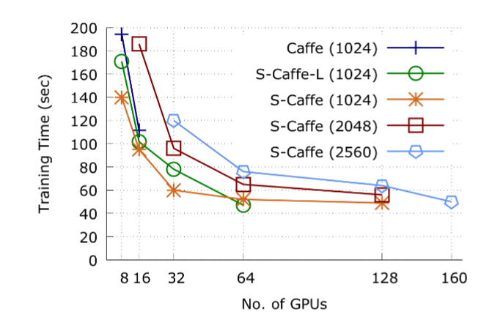
Scalability Evaluation: GoogLeNet and ImageNet
Performed on Cluster A
S-Caffe can perform better up to 160 GPUs in comparison to Caffe up to 16 GPUs
S-Caffe-L: Used LMDB instead of ImageDataLayer
It ran out of memory when 64 GPU’s with 1024 batchsize
Speedups of 3.3x over 16 GPUs and 2.5x over 32 GPUs for GoogLeNet training with 128 and 160 GPUs
Notes:
Ask the author about the experimental setup details

Slide 16
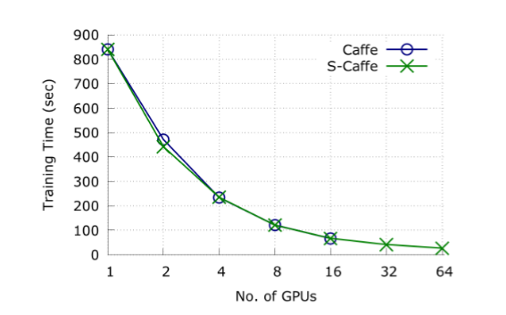
Scalability Evaluation: GoogLeNet and CIFAR10-Large
Performed on Cluster A
1000 iterations with batchsize of 8,192
CIFAR10 is compute sensitive and perform small-scale communication
32x faster over single GPU-training

Slide 17
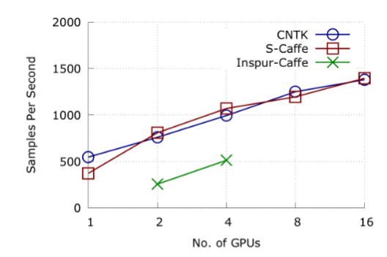
Performance Comparison: AlexNet and CIFAR10
Performed on Cluster B
Not much information about the Dataset, Batchsize and Iterations
Microsoft CNTK: MPI-based framework
Inspur-Caffe: MPI-based parameter-server implementation
Both S-Caffe and Inspur-Caffe used LMDB
CNTK used default reading mechanism

Slide 18
References
[1] Awan, Ammar Ahmad & Hamidouche, Khaled & Hashmi, Jahanzeb & Panda, D.K.. (2017). S-Caffe: Co-designing MPI Runtimes and Caffe for Scalable Deep Learning on Modern GPU Clusters. ACM SIGPLAN Notices. 52. 193-205. 10.1145/3018743.3018769.

