Slide 1




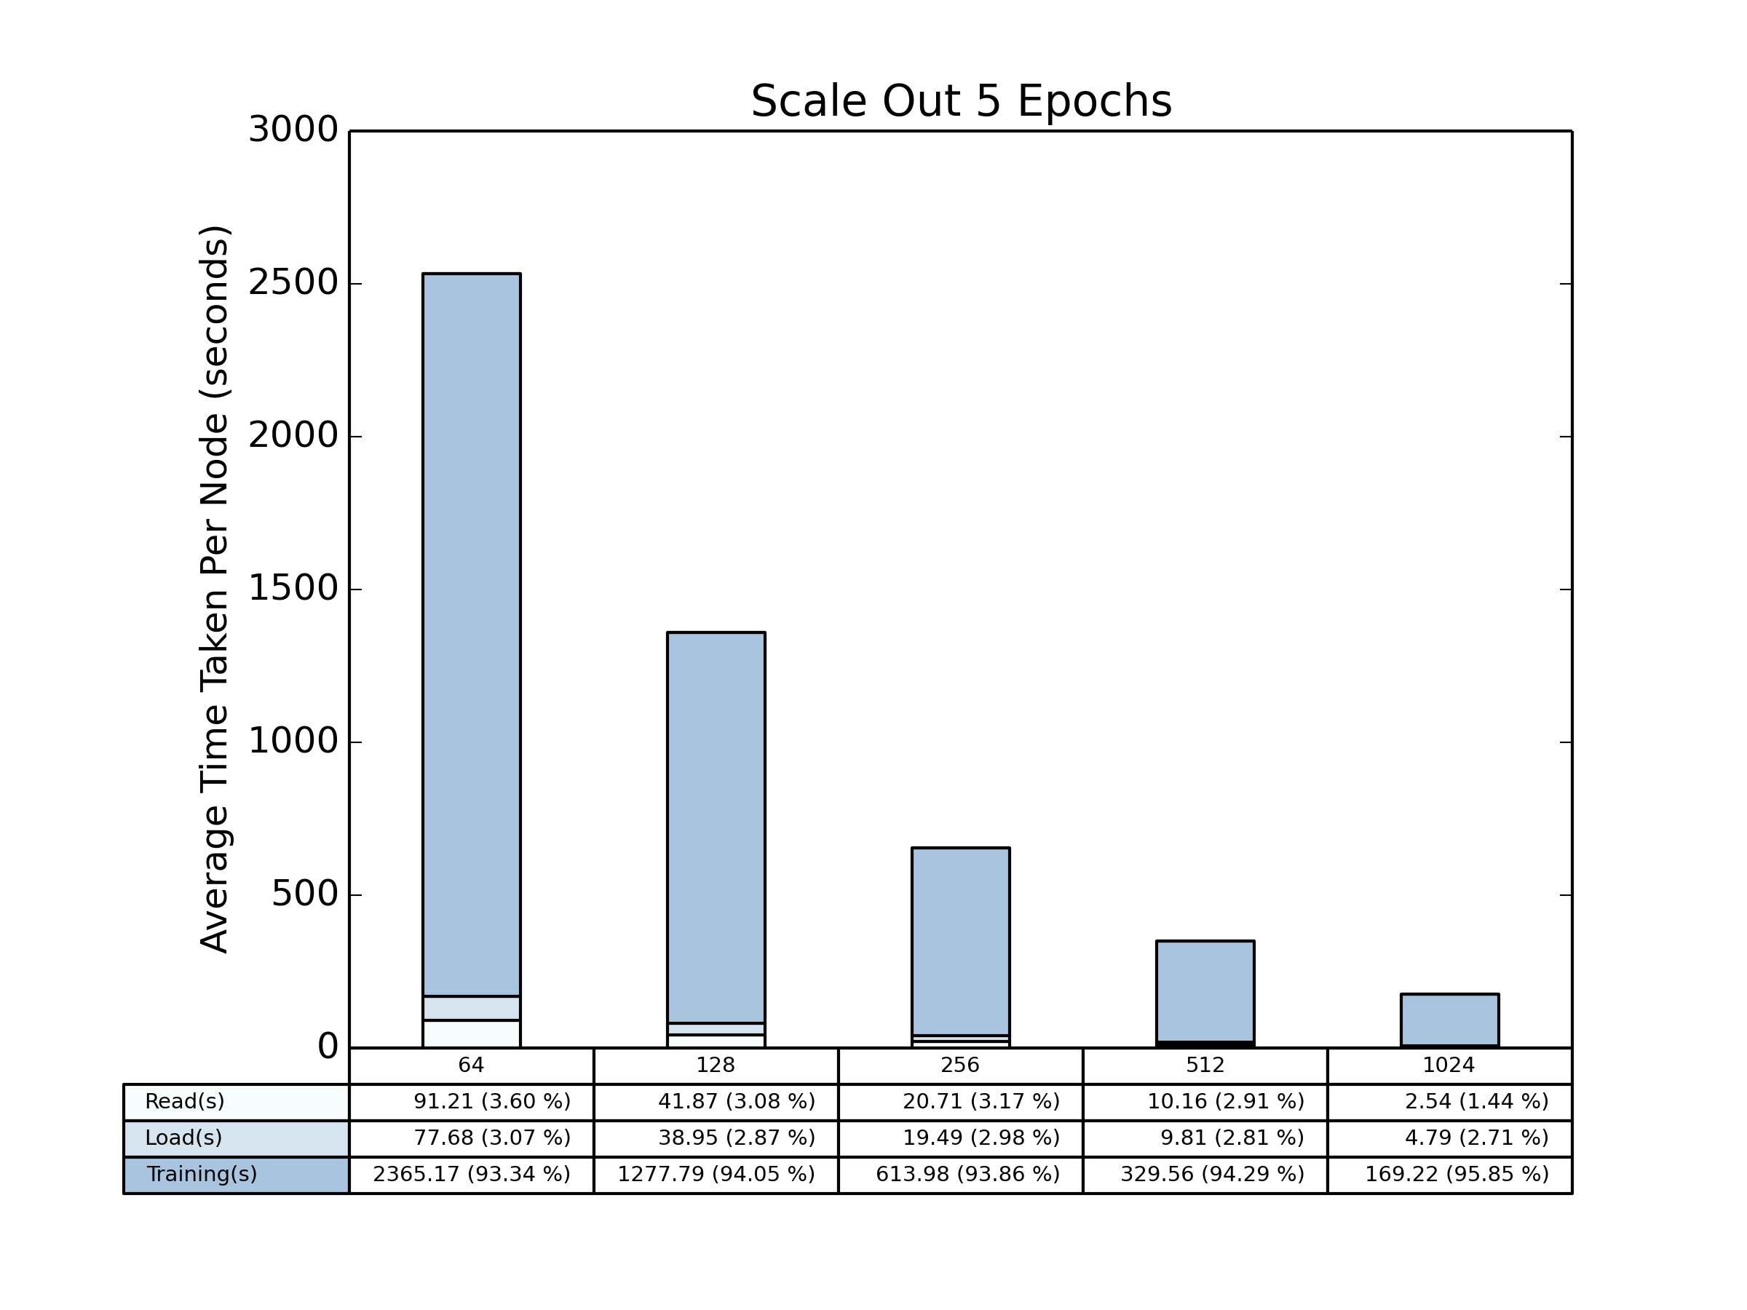
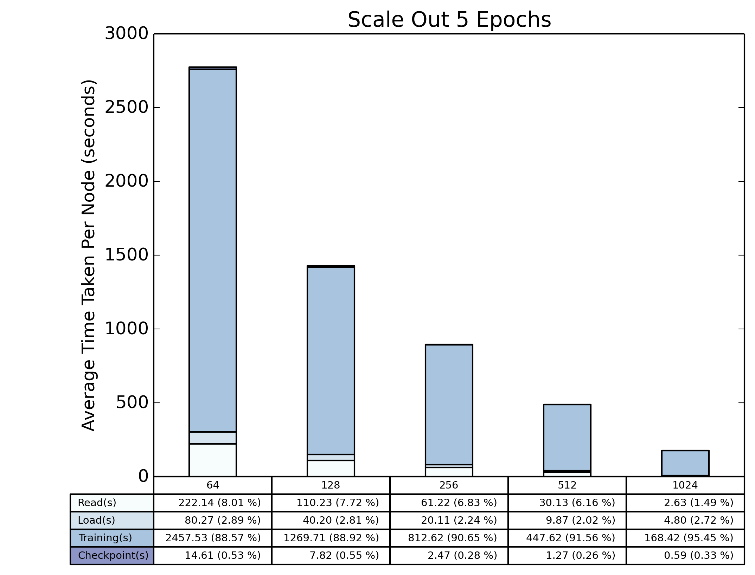
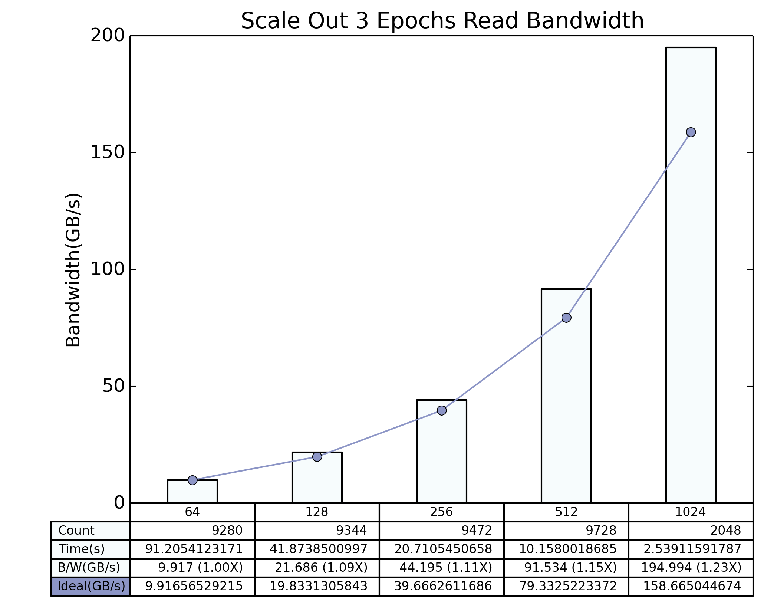
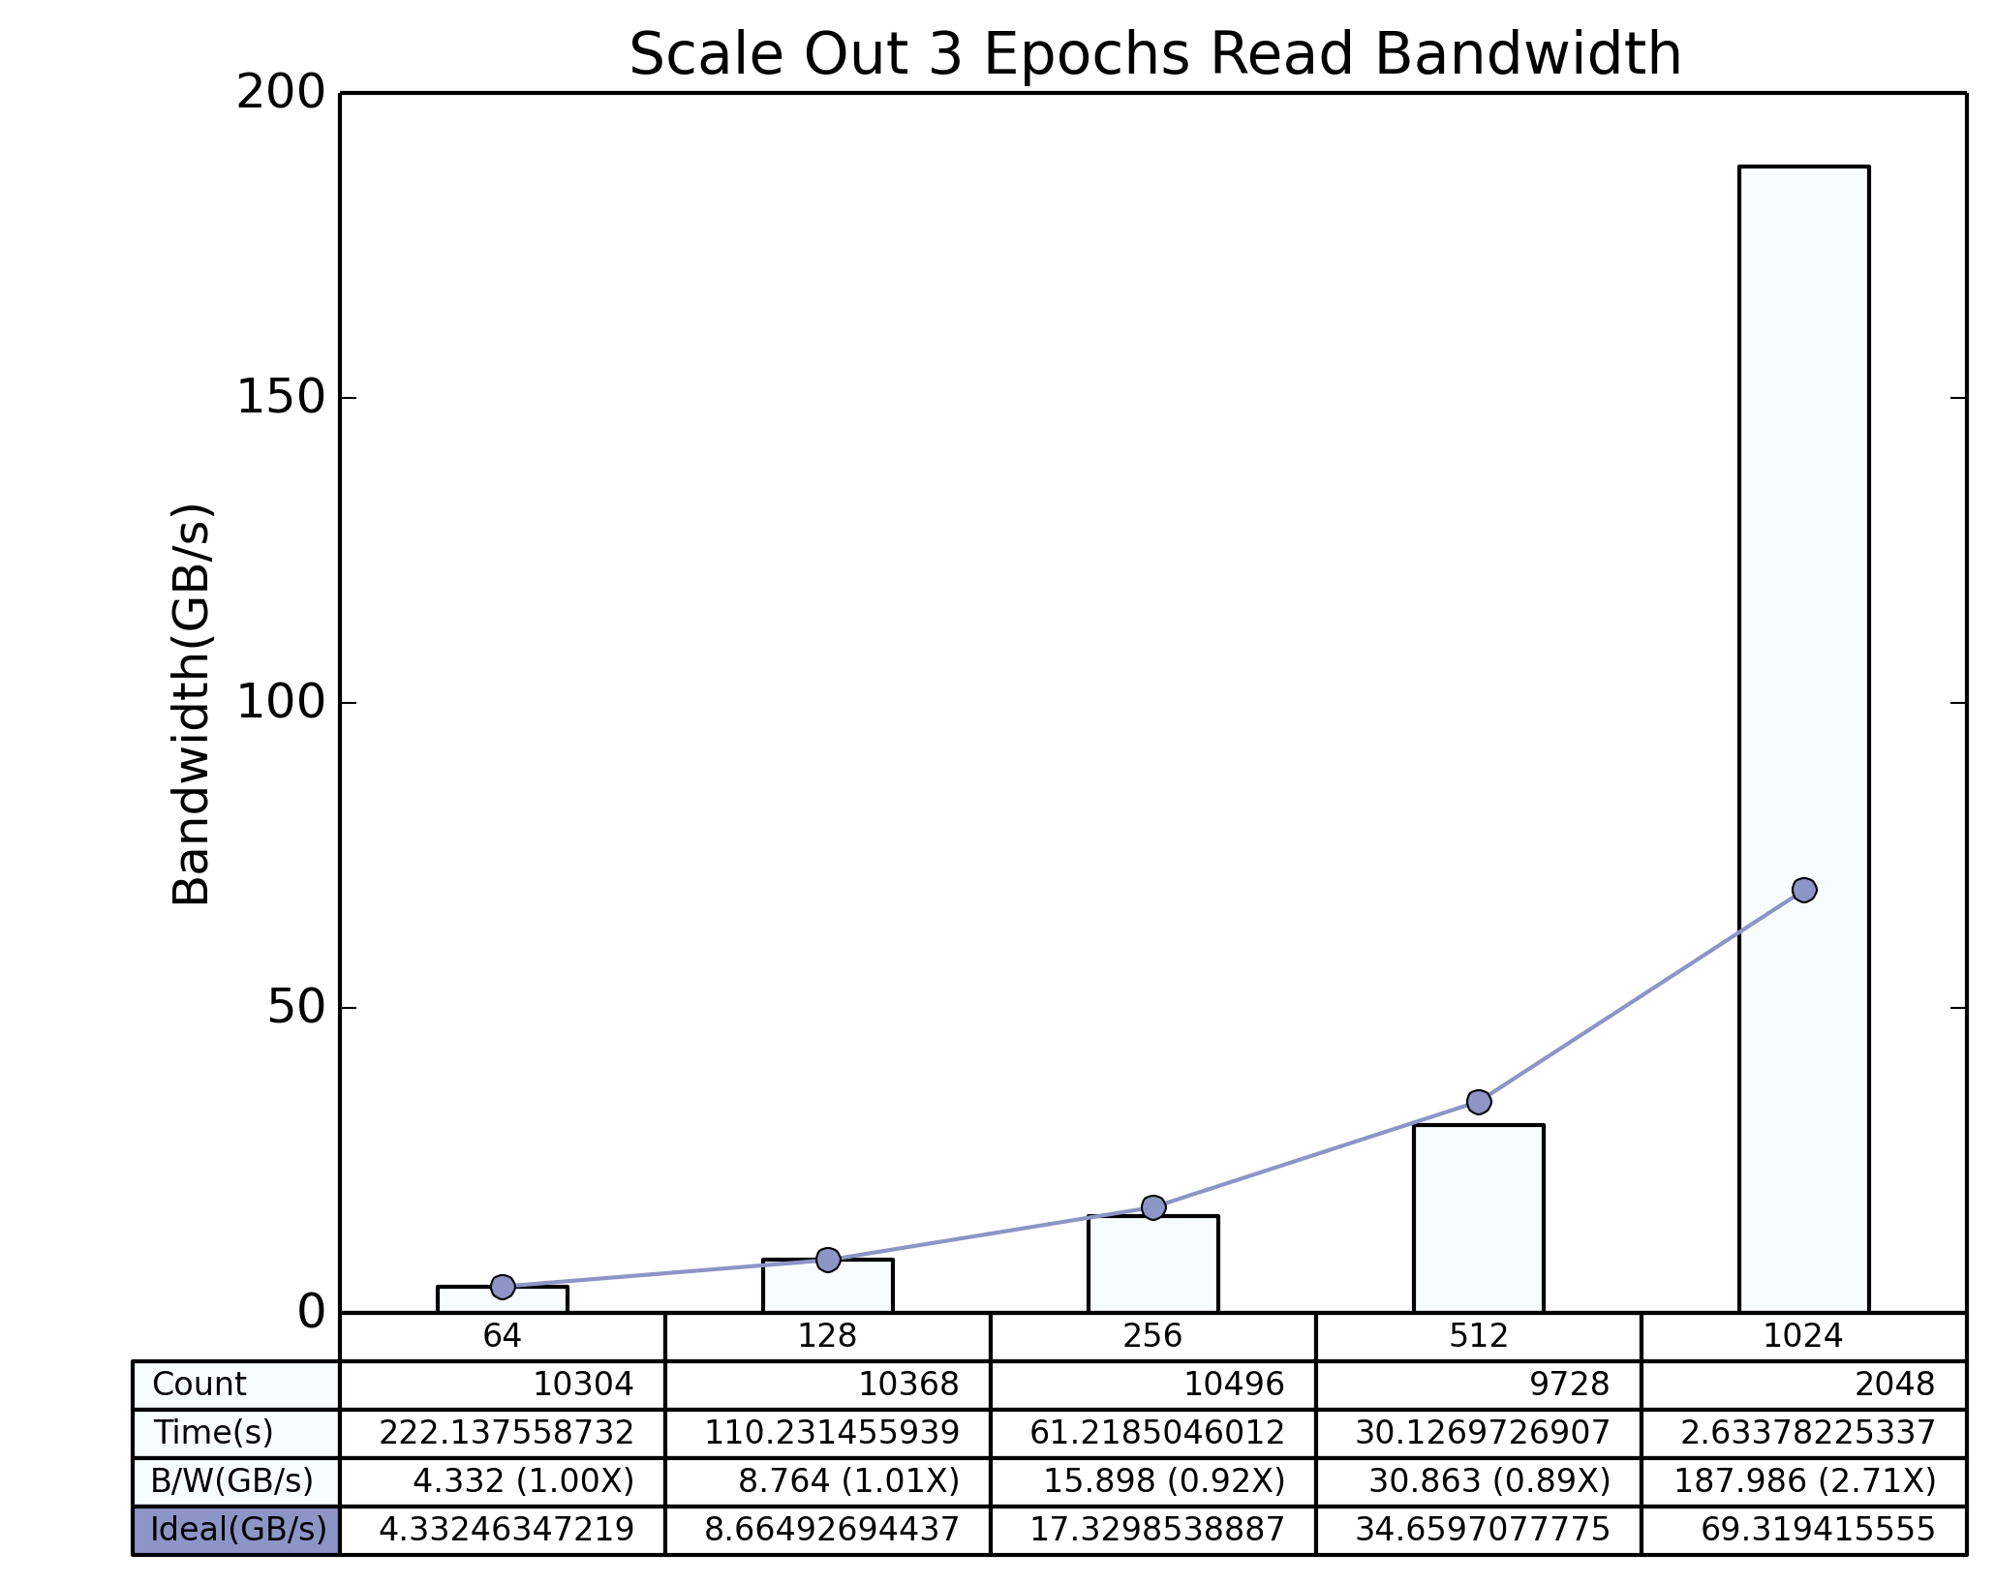
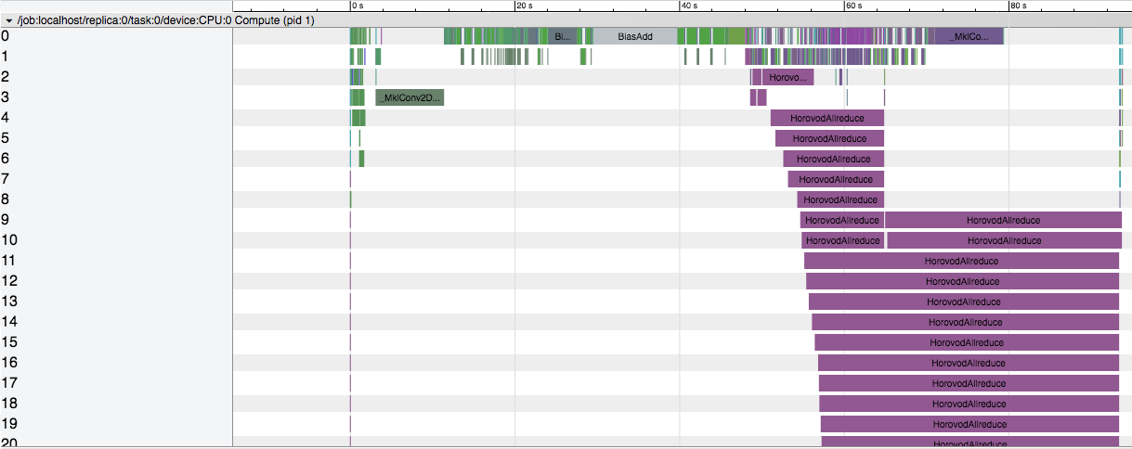
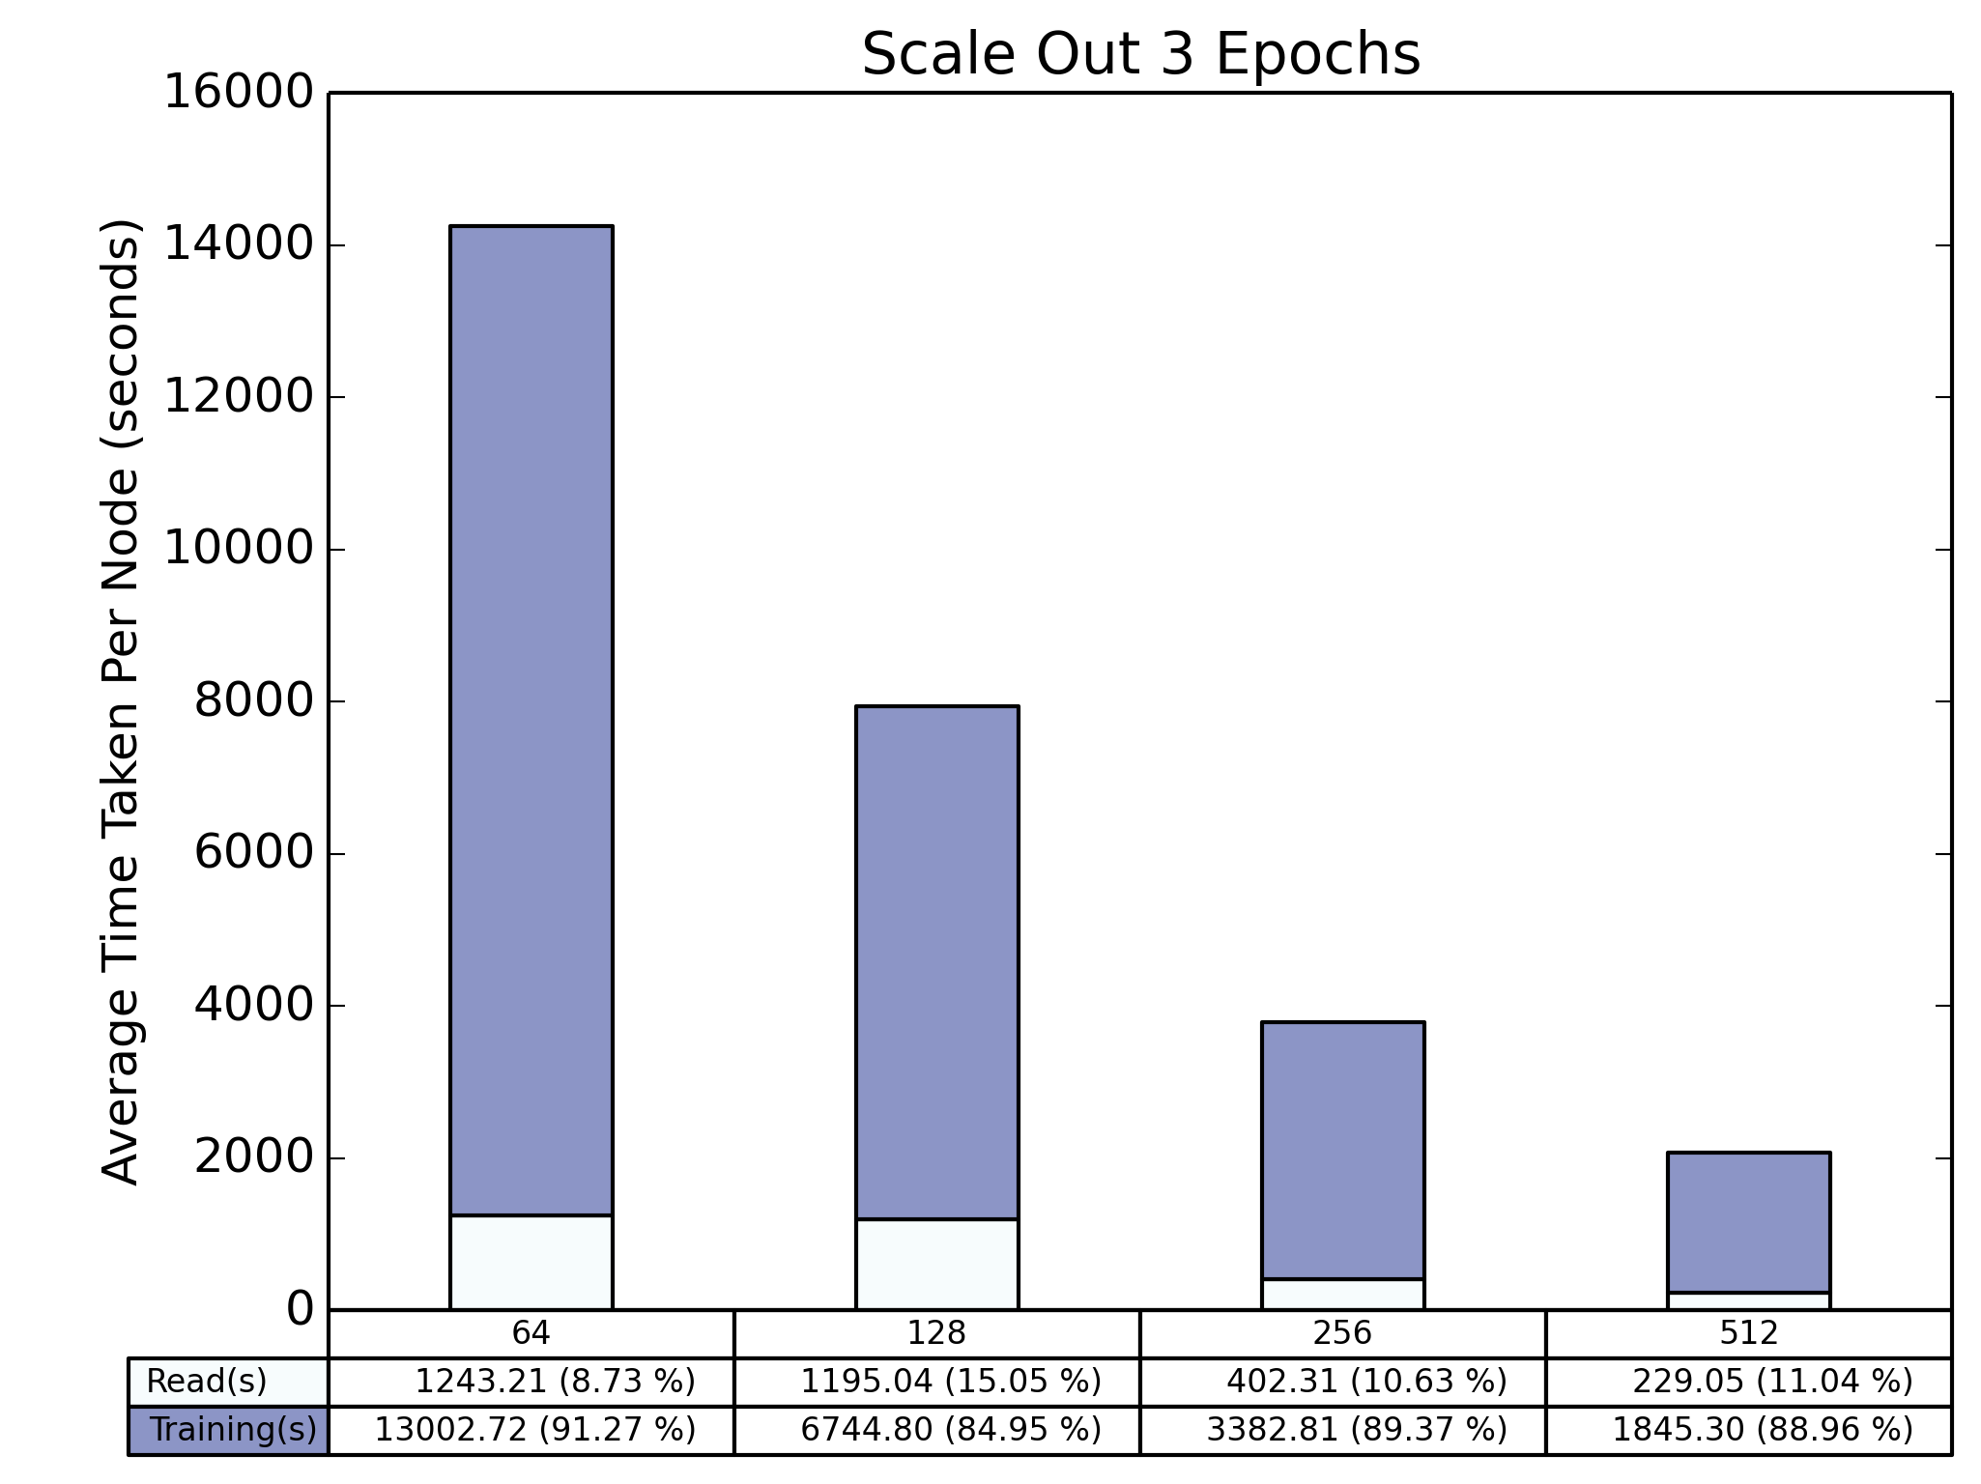
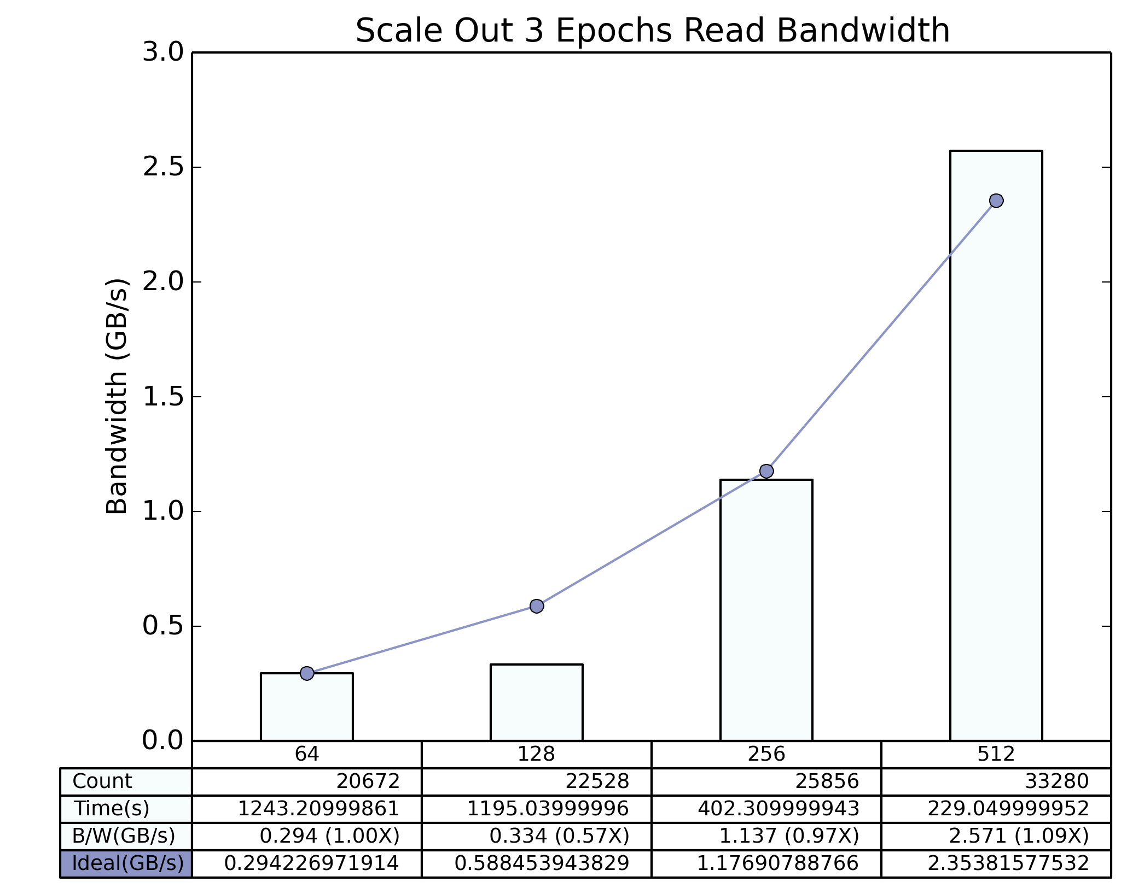
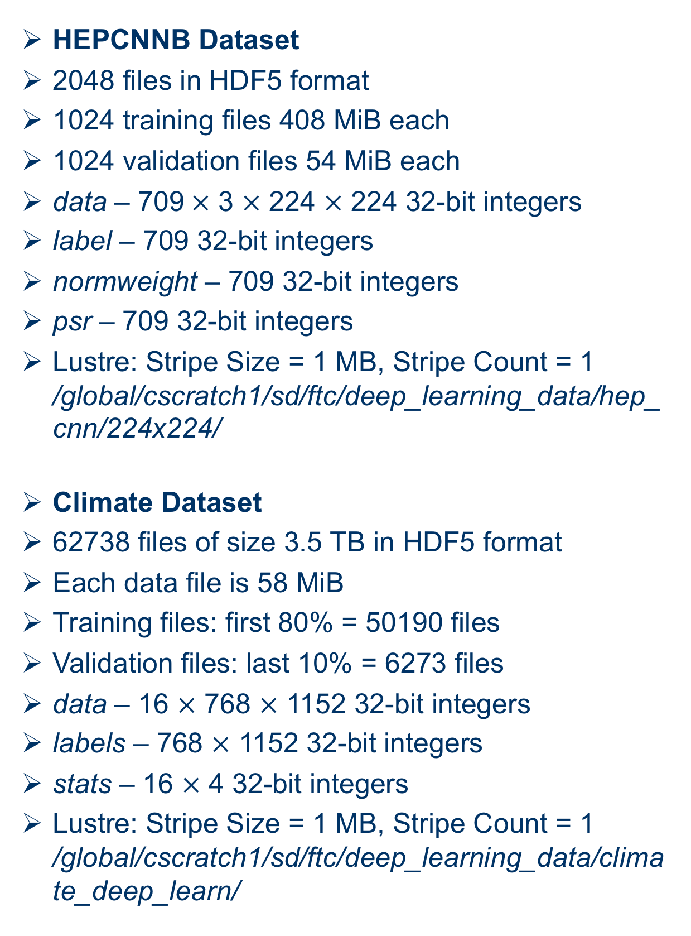
Analyzing Scalable Data Pipeline in Distributed Deep Learning
Fahim Chowdhury¹, Jialin Liu², Quincey Koziol², Thorsten Kurth², Steven Farrell², Suren Byna³,
and Prabhat²
¹ Department of Computer Science, Florida State University, Tallahassee, FL
² NERSC, Lawrence Berkeley National Laboratory, Berkeley, CA
³ Scientific Data Management Research Group, CRD, Lawrence Berkeley National Laboratory, Berkeley, CA
Overview
Data Pipelines in Benchmarks
Technology
Deep Learning (DL) is applied to solve problems in the industry. e.g. Google’s AlphaGo, Tesla’s Autopilot, Baidu’s DeepSpeech etc.
DL techniques are rigorously applied in the analysis and research on different fields of science such as High Energy Physics, Atmospheric Science etc.
DL applications need to train themselves by using a large amount of data to gain the best accuracy and require Supercomputing systems to run in an effective manner.
Scalable DL requires efficient I/O mechanism.
While Parallel I/O has been studied extensively for conventional HPC workloads, serious I/O bottlenecks are present in modern DL frameworks.
The goal of this project is to explore I/O patterns invoked through multiple DL applications running on HPC systems and develop optimization strategies to overcome the I/O bottlenecks.
HEPCNNB Input Pipeline
Climate Data Benchmark Input Pipeline
hep_classifier_tf_train_horovod.py
filelist, num_tasks, split_filelist, split_file etc.
Networks/binary_classifier_tf.py
mascarpone-tiramisu-tf-singlefile.py
input_path, channels, weights etc.
tiramisu_helpers.py
Dataset instance
Dataset
Dataset
h5_input_reader instance
Dataset
h5_input_reader instance
h5_input_reader
next_batch()
next_element
create_dataset()
tf.data.Dataset.map
read()
if(split_file)
split file blocks (number of entries / tasks) among tasks
load_next_file()
if(split_filelist)
split the files among tasks
Re-initializable training and validation dataset iterators
data, label, weights etc.
h5_input_subprocess_reader()
multiprocessing.Pool
Tools and Instrumentation
apply
Darshan can not profile I/O calls made without directly using MPI or POSIX
The benchmarks use h5py on HDF5-IO
Developed an in-house python profiling tool, i.e. TimeLogger class in utility_classes.time_logger package
TimeLogger can log node number, epoch number, start time, end time, duration, process id and current thread of any code snippet
Incorporated TimeLogger in the benchmarks
Ran the benchmarks on Cori
Developed utility scripts to extract TimeLogger outputs and plot using matplotlib python package
Explored TensorFlow’s Timeline
Looking into using TensorBoard
I/O Analysis of High Energy Physics Benchmark
Benchmarks at NERSC
Local Shuffle
Global Shuffle
High Energy Physics Deep Learning Convolutional Neural Network Benchmark (HEPCNNB)
Uses a dataset of particle collisions generated by a fast Monte-Carlo generator named Delphes
Used to generate particle events that can be described by standard model physics and particle events with R-parity violating Supersymmetry
Can be expanded for multi-class classification or including regression on model parameters
Uses Horovod for Distributed TensorFlow
Climate Data Benchmark
Uses a huge dataset of climate data images
Used as a image recognition model
Can be used to detect patterns for extreme weather
Uses Horovod for Distributed TensorFlow
Uses TensorFlow Dataset API and python’s multiprocessing package for input pipelining
Made of Tiramisu, a fully convolutional network for semantic segmentation
Future Scopes
To leverage TensorFlow Timeline for more detail and accurate profiling
To explore TensorBoard for generating session graphs
To try TAU for I/O profiling
To profile I/O and training executions per thread
To add optimization techniques like prefetching in HEPCNNB
To utilize Burst Buffer for I/O optimization
Training Datasets
HEPCNNB Dataset
2048 files in HDF5 format
1024 training files 408 MiB each
1024 validation files 54 MiB each
data – 709$×$ 3 $×$ 224 $×$ 224 32-bit integers
label – 709 32-bit integers
normweight – 709 32-bit integers
psr – 709 32-bit integers
Lustre: Stripe Size = 1 MB, Stripe Count = 1 /global/cscratch1/sd/ftc/deep_learning_data/hep_cnn/224x224/
Climate Dataset
62738 files of size 3.5 TB in HDF5 format
Each data file is 58 MiB
Training files: first 80% = 50190 files
Validation files: last 10% = 6273 files
data – 16 $×$ 768 $×$ 1152 32-bit integers
labels – 768 $×$ 1152 32-bit integers
stats – 16 $×$ 4 32-bit integers
Lustre: Stripe Size = 1 MB, Stripe Count = 1 /global/cscratch1/sd/ftc/deep_learning_data/climate_deep_learn/
I/O takes more time when Global Shuffling is introduced
I/O bottleneck becomes severe with increasing number of epochs
Global Shuffling affects I/O even if the dataset is small
I/O Analysis of Climate Data Benchmark
Conclusion
DL applications are indispensable for science and industry
Distributed DL at scale on Supercomputing clusters needs careful analysis of I/O
Performing careful profiling of I/O is necessary to innovate optimization techniques
An optimized cross-framework I/O strategy is necessary to speed up training process
Acknowledgement
The percentage of I/O in the training process is more when dataset is larger
The I/O percentage increases with the number of nodes
Training benefits more from the scaling than I/O
This research used resources of the National Energy Research Scientific Computing Center (NERSC), a U.S. Department of Energy Office of Science User Facility operated under Contract No. DE-AC02-05CH11231.
Github link: https://github.com/NERSC/DL-Parallel-IO
Contact Information
Email: ftc@lbl.gov; fchowdhu@cs.fsu.edu;
Phone: 786-406-2617
Website: https://fahimcsebuet.github.io/website/

