Slide 1
Fahim Tahmid Chowdhury Data Analytics & Service Group NERSC
NERSC-TF Sync Backup
August 03, 2018

Slide 2
HEPCNNB Dataset
Lustre Directory for Data
/global/cscratch1/sd/ftc/deep_learning_data/hep_cnn/224x224/
1024 Training Files 408 MiB each
1024 Validation Files 54 MiB each
Each Node Reads (1024/num_of_nodes) Training Files and Validation Files if Files are Equally Split
If num_of_nodes = 64 and Files are Equally Split Each Epoch
Each Node Reads 16 Training Files
Roughly Each Node Reads 16 * 408 MiB = 6.375 GiB of Training Data
And Each Node Reads 16 * 54 MiB = 0.84375 GiB or 864 MiB of Validation Data
Notes:
Demo from PyCharm

Slide 3
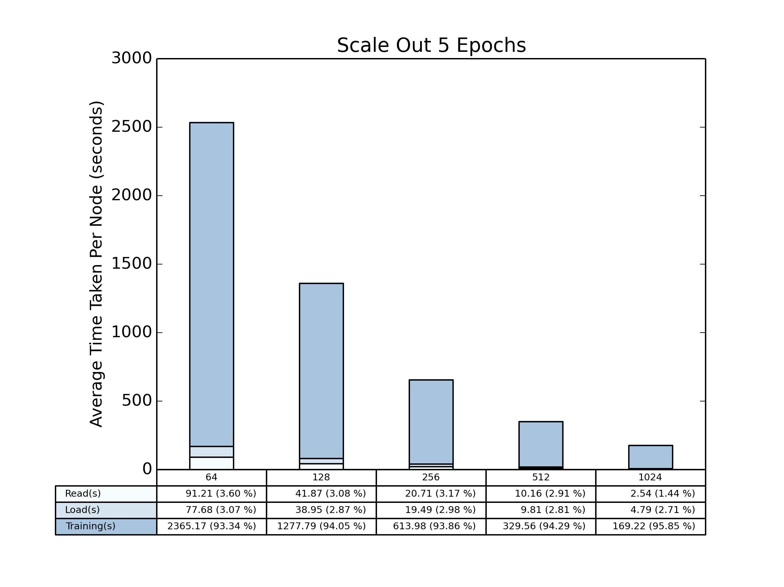
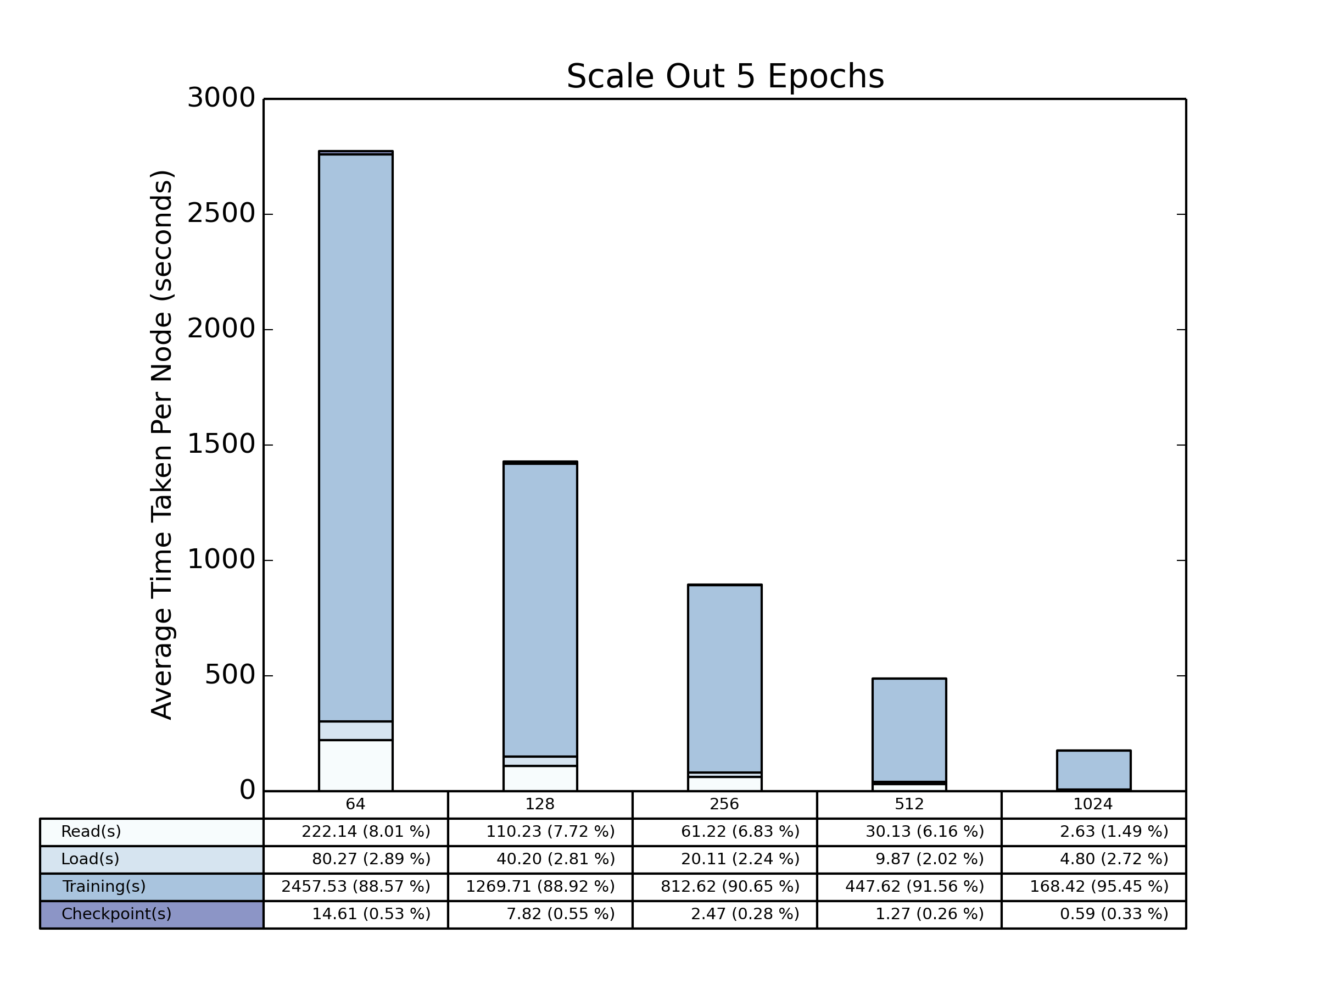
Total Time Scale Out (HEPCNNB)
Local Shuffle
Global Shuffle

Slide 4
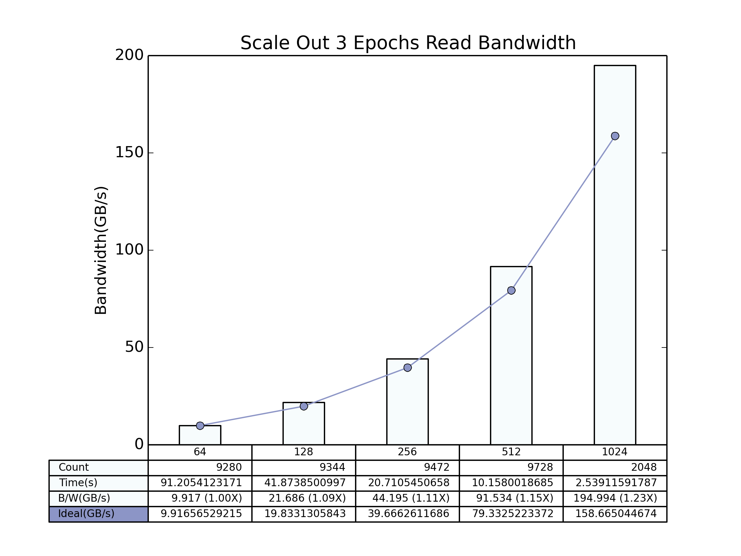
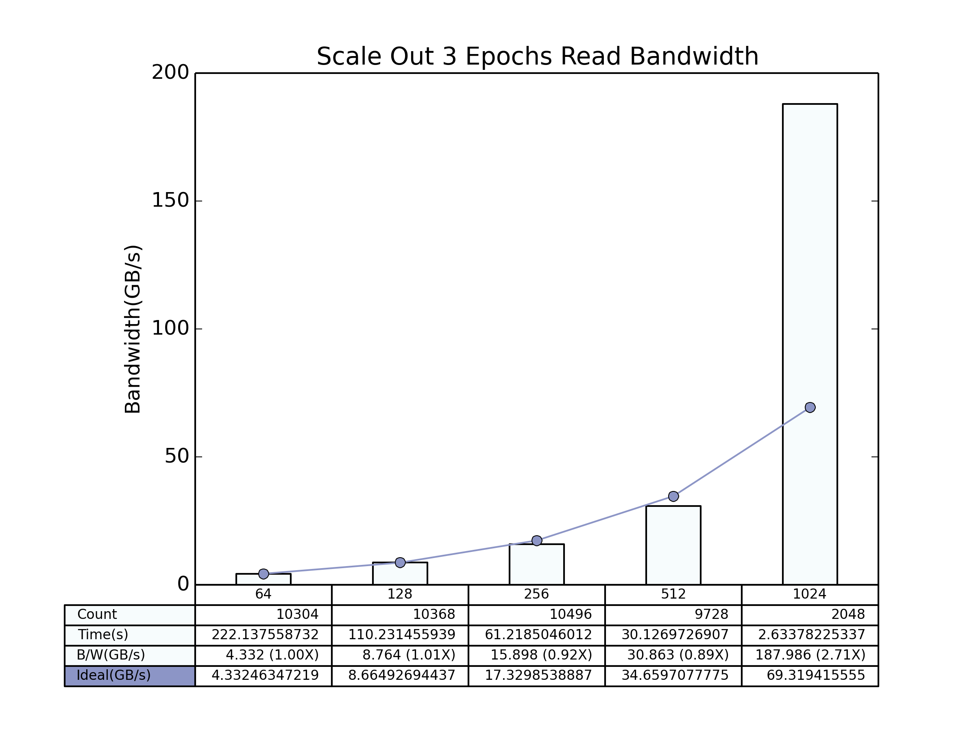
Read Bandwidth Scale Out (HEPCNNB)
Local Shuffle
Global Shuffle

Slide 5
CDB Dataset
Lustre Directory for Data
/global/cscratch1/sd/ftc/deep_learning_data/climate_deep_learn/
62738 Data Files 58 MiB each
1 Stats (Normalization) File 2.3 KiB
Files are shuffled
Training Files: first 80% = 50190
Validation Files: last 10% = 6273
data.shard is used to equally distribute the file list
If number of nodes is 64, each node reads 784 training files and 98 validation files
Notes:
10%

Slide 6
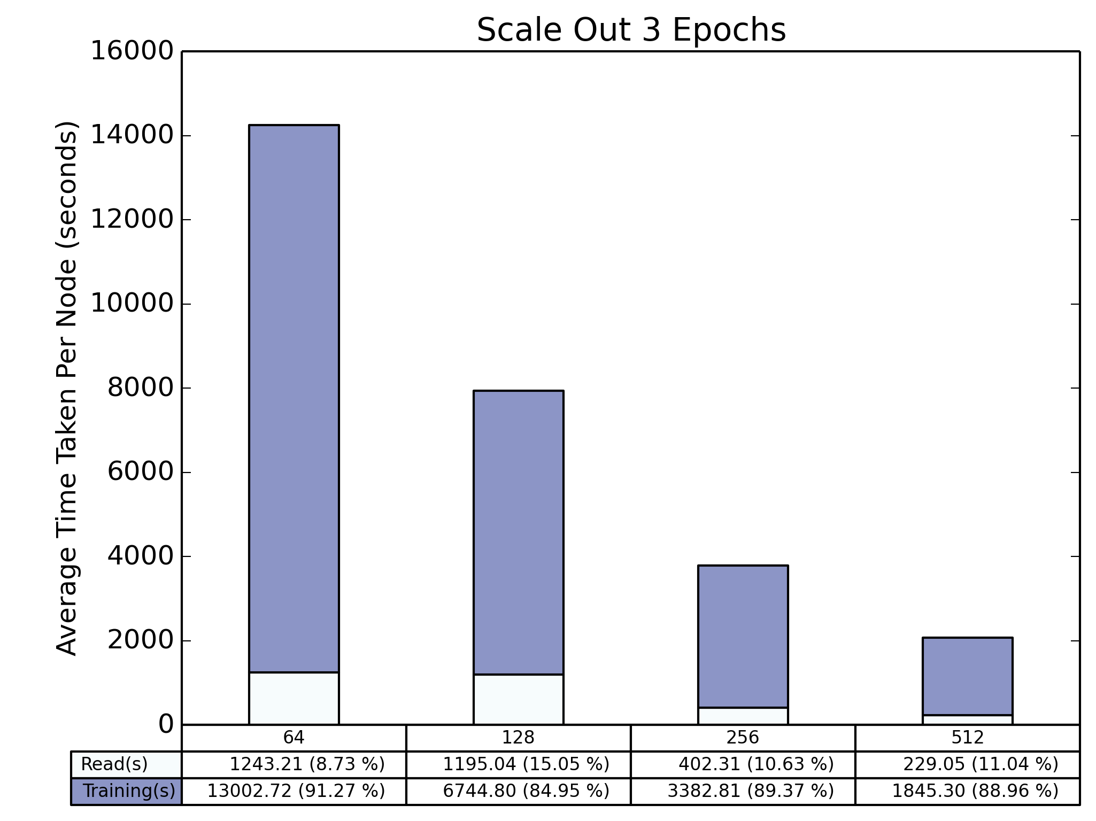
Total Time Scale Out (CDB)

Slide 7
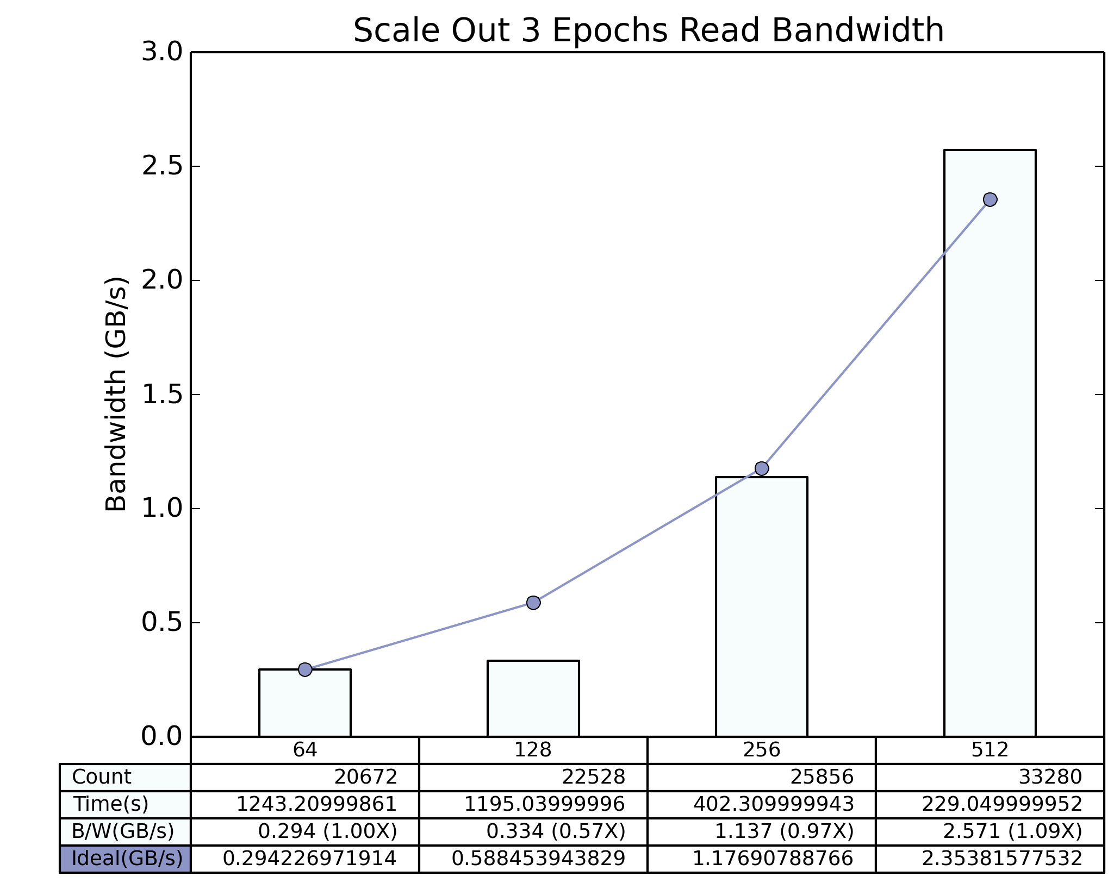
Read Bandwidth Scale Out (CDB)

Slide 8
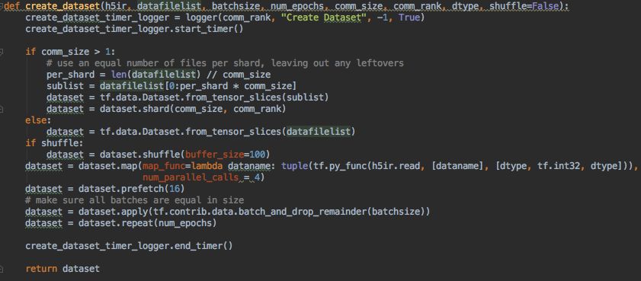
CDB Dataset Creation

Slide 9
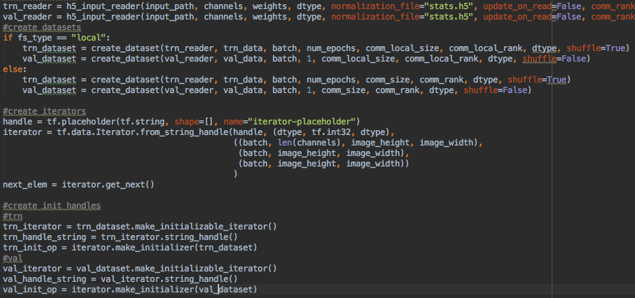
CDB Iterator Initialization

Slide 10
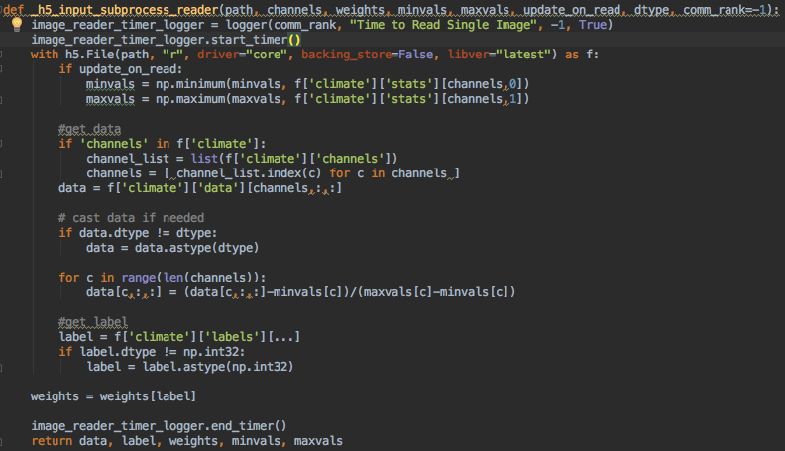
Reader Subprocess

