Slide 1
Fahim Tahmid Chowdhury Data Analytics & Service Group NERSC
Project Progress
June 29, 2018

Slide 2
Outline
Instrumentation – TimeLogger – Demo
HEP Benchmark
Data Format
Time Breakdown
Future Exploration Scopes

Slide 3
Outline
Instrumentation – TimeLogger – Demo
HEP Benchmark
Data Format
Time Breakdown
Future Exploration Scopes

Slide 4
Time Logger
Tried Darshan on both Climate Data and HEP Benchmark
None of them were tracked by Darshan
Implemented Time Logger
from utility_classes.time_logger import TimeLogger as logger
Implemented a utility script to extract the logs and write on a CSV file
Demo
Notes:
Demo from PyCharm
- Recompile Horovod and link it with IPM

Slide 5
Outline
Instrumentation – TimeLogger – Demo
HEP Benchmark
Data Format
Time Breakdown
Future Exploration Scopes

Slide 6
Dataset
Lustre Directory for Data
/global/cscratch1/sd/ftc/deep_learning_data/hep_cnn/224x224/
1024 Training Files 408 MiB each
1024 Validation Files 54 MiB each
Each Node Reads (1024/num_of_nodes) Training Files and Validation Files if Files are Equally Split
If num_of_nodes = 64 and Files are Equally Split Each Epoch
Each Node Reads 16 Training Files
Roughly Each Node Reads 16 * 408 MiB = 6.375 GiB of Training Data
And Each Node Reads 16 * 54 MiB = 0.84375 GiB or 864 MiB of Validation Data
Notes:
Demo from PyCharm

Slide 7
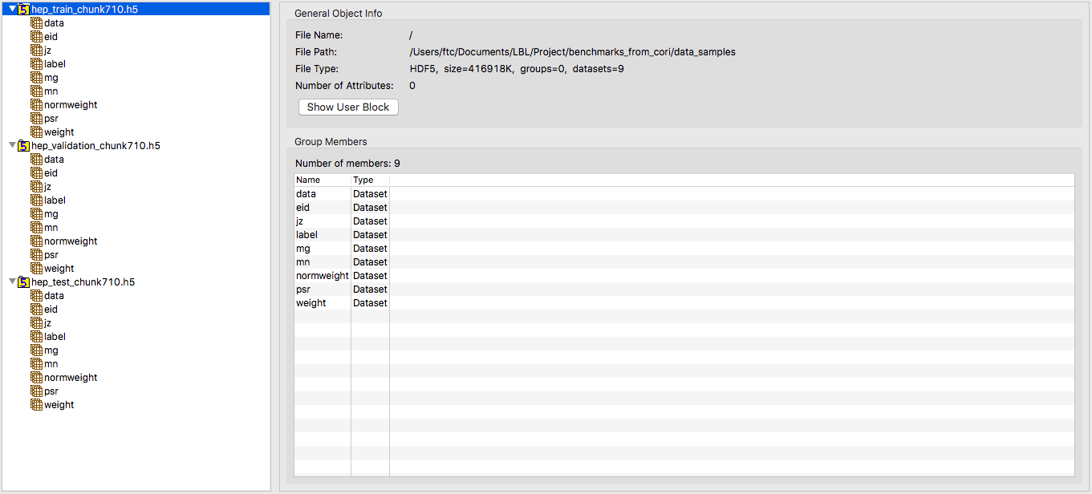
Training Data
Notes:
Demo from PyCharm

Slide 8
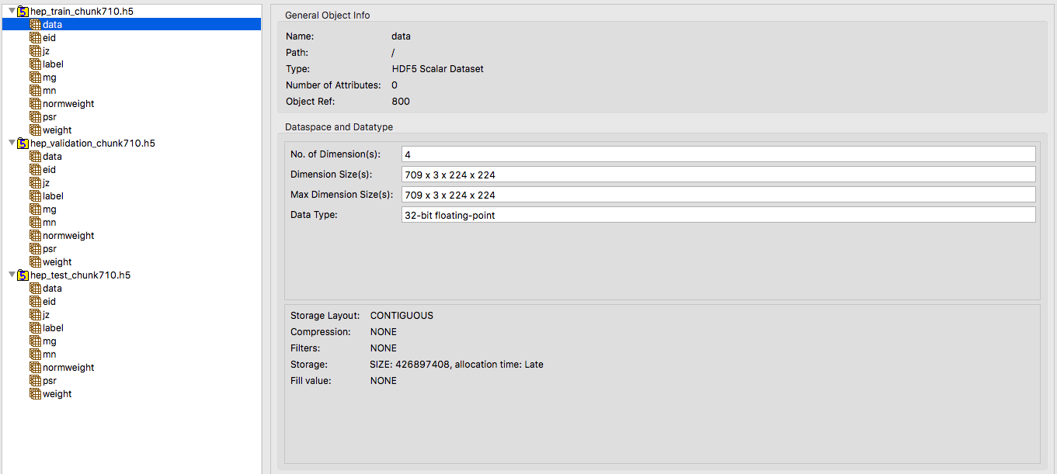
Training Data
Notes:
Demo from PyCharm

Slide 9
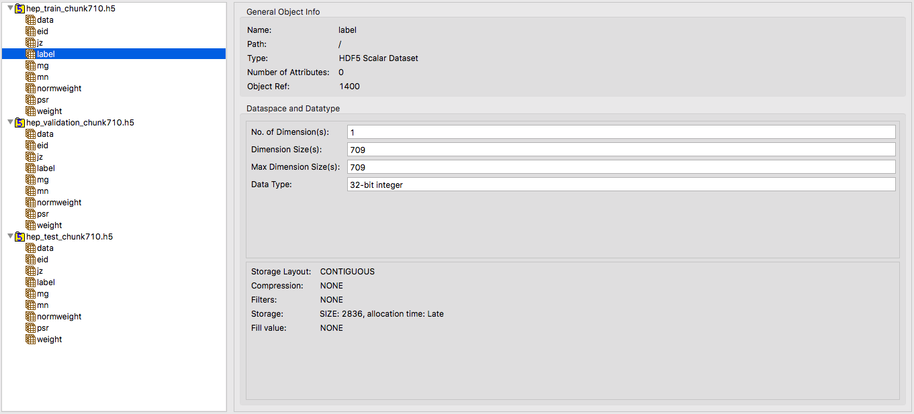
Training Data
Notes:
Demo from PyCharm

Slide 10
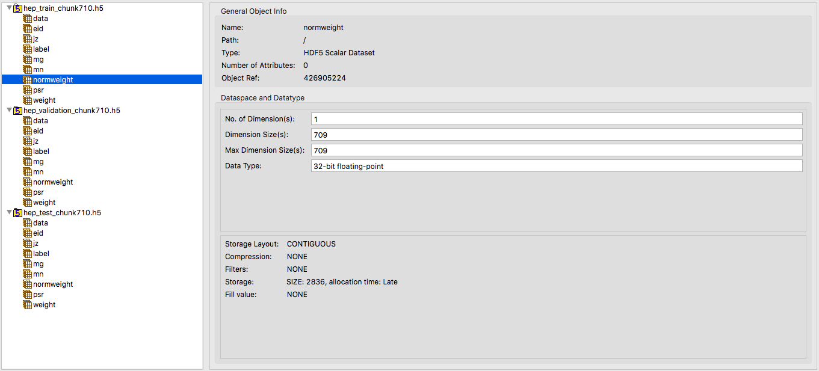
Training Data
Notes:
Demo from PyCharm

Slide 11
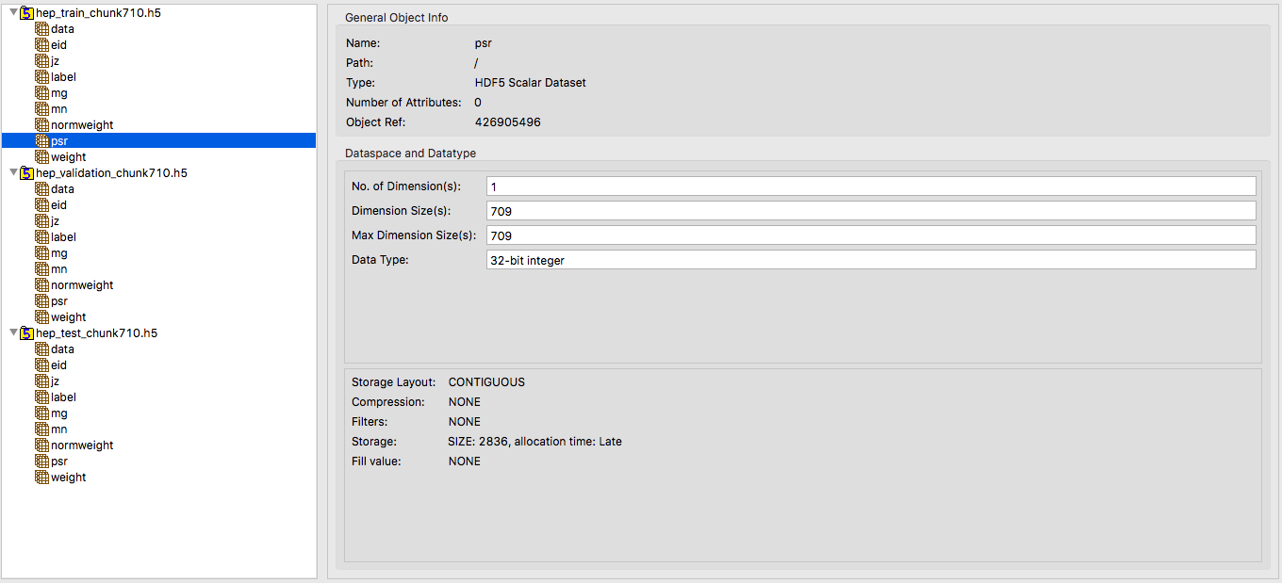
Training Data
Notes:
Demo from PyCharm

Slide 12
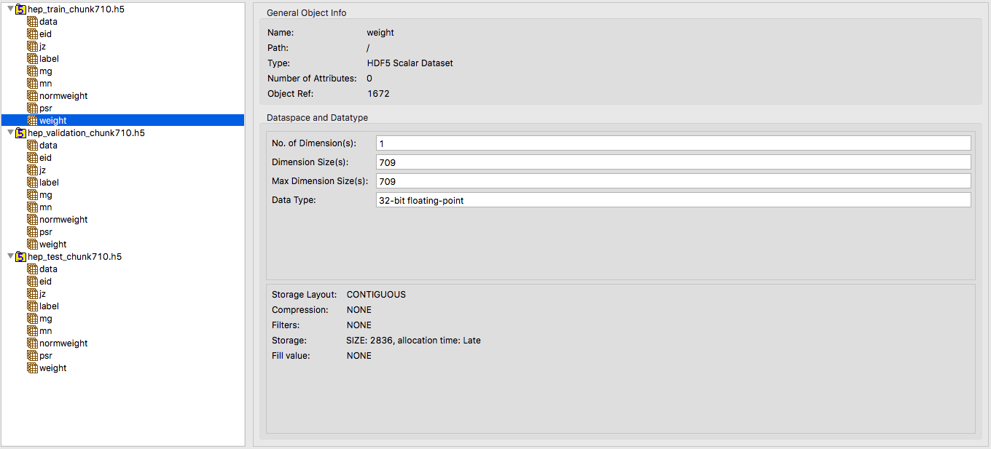
Training Data
Notes:
Demo from PyCharm

Slide 13
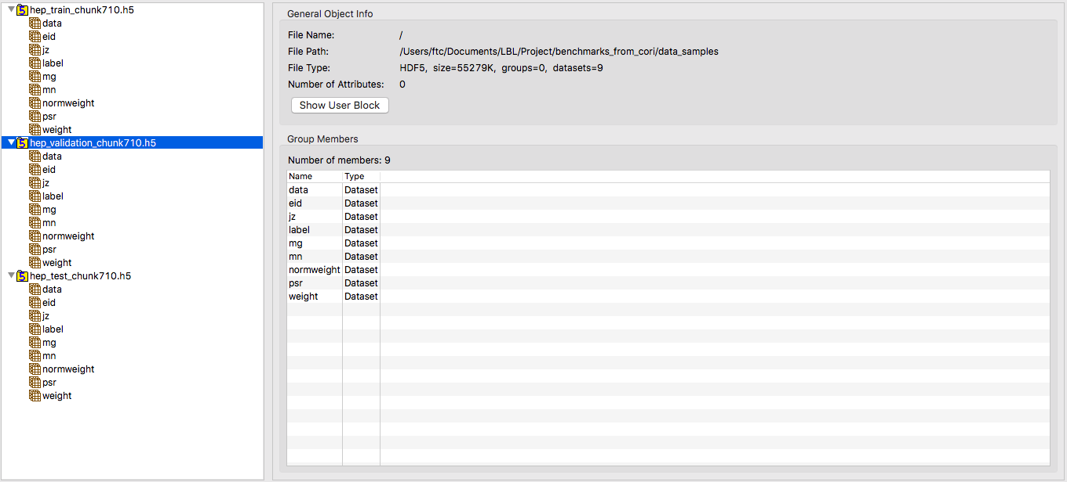
Validation Data
Notes:
Demo from PyCharm

Slide 14
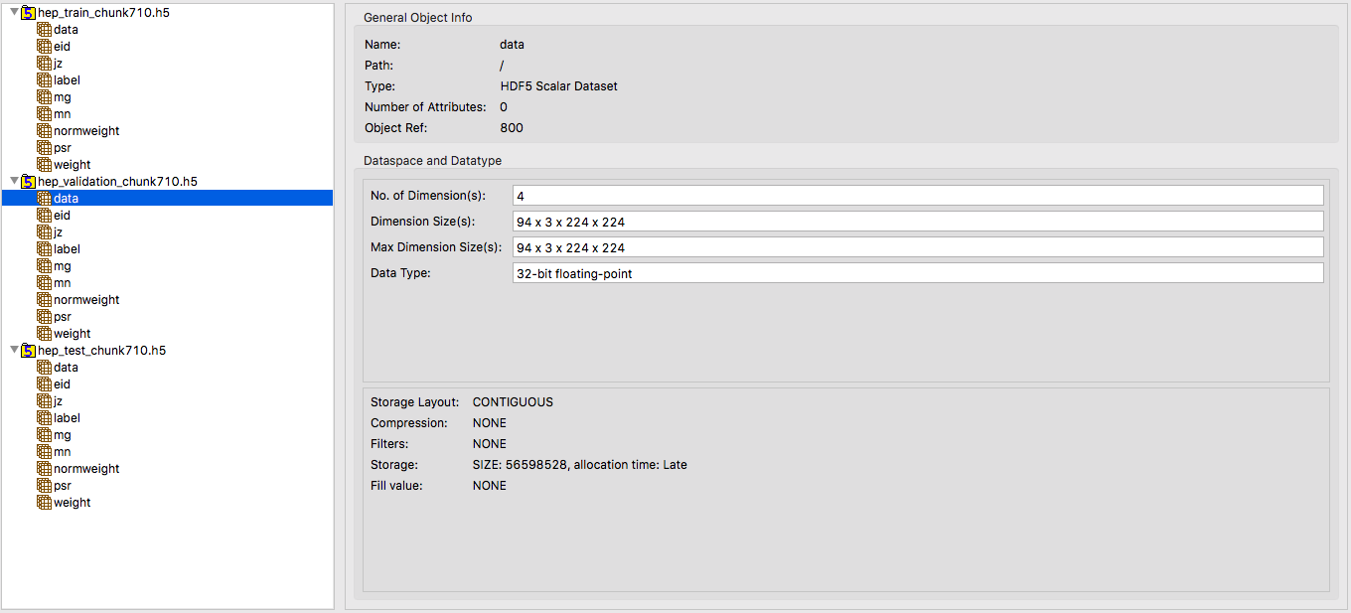
Validation Data
Notes:
Demo from PyCharm

Slide 15
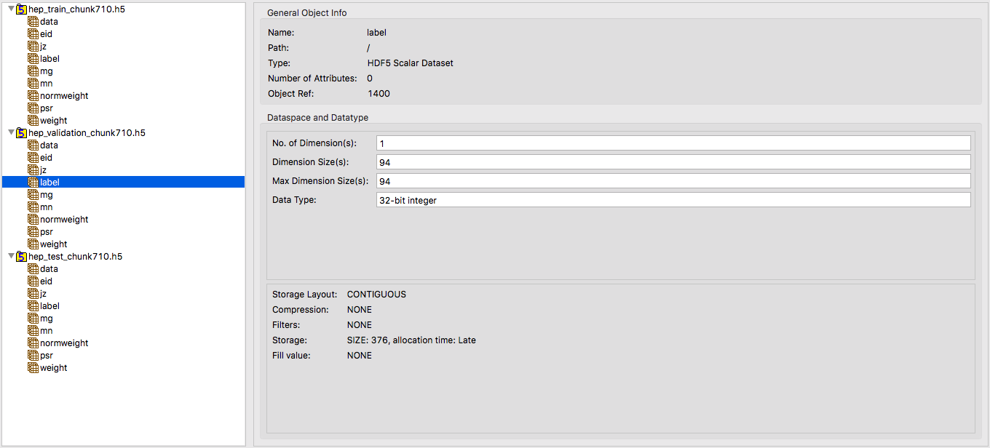
Validation Data
Notes:
Demo from PyCharm

Slide 16
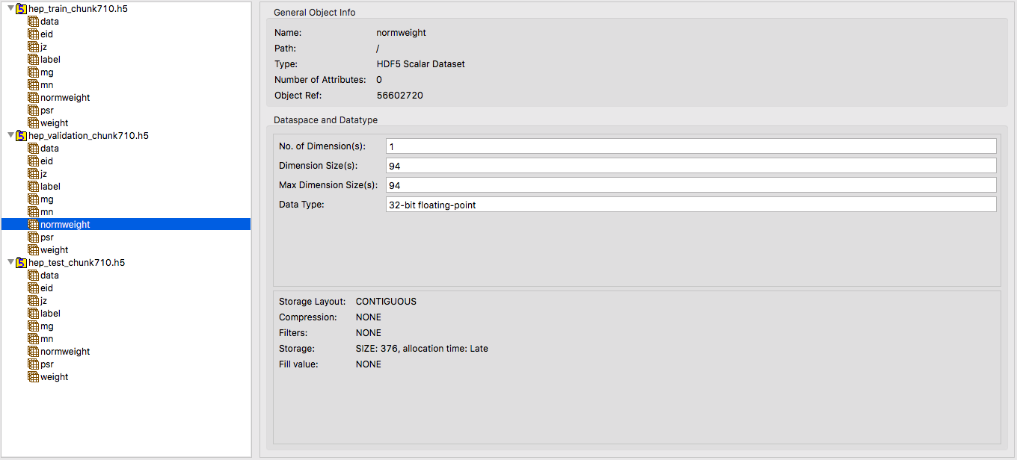
Validation Data
Notes:
Demo from PyCharm

Slide 17
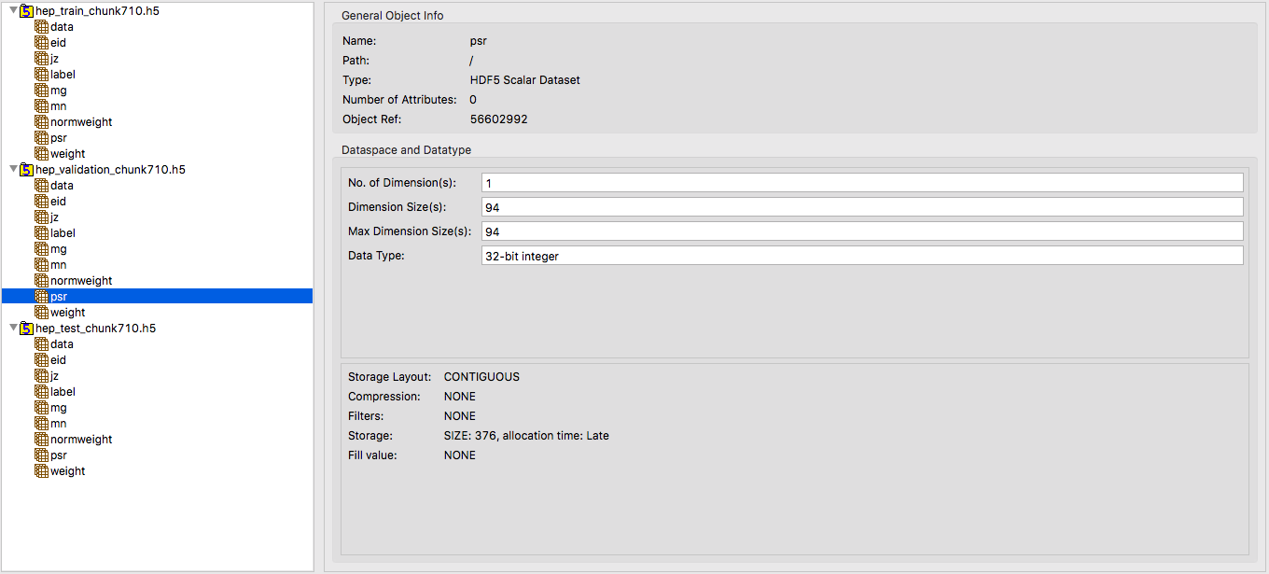
Validation Data
Notes:
Demo from PyCharm

Slide 18
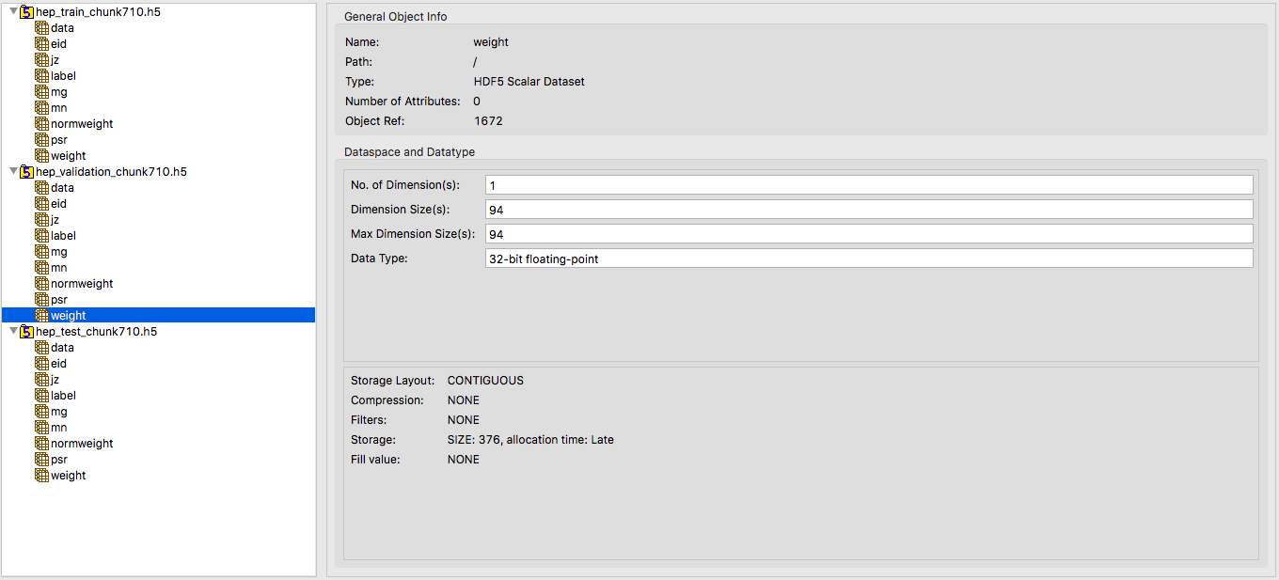
Validation Data
Notes:
Demo from PyCharm

Slide 19
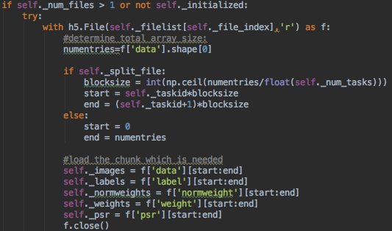
File Read Code Snippet

Slide 20
Dataset Detail
More Precisely
If num_of_nodes = 64 and Files are Split Equally
Each Node Reads 16 Training Files and 16 Validation Files
Each Node Reads
16 * (426897408 + 2836 * 4) B = 6.361 GiB Training Data
Each Node Reads
16 * (56598528 + 376 * 4) B = 0.84341 GiB or 863.65 MiB Validation Data
Notes:
Demo from PyCharm

Slide 21
Outline
Instrumentation – TimeLogger – Demo
HEP Benchmark
Data Format
Time Breakdown
Future Exploration Scopes

Slide 22
64 Nodes
Notes:
Error Bars
Std Deviation
Global Shuffling?
Initialize a new seed and use that for randomization

Slide 23
128 Nodes

Slide 24
256 Nodes
Notes:
The Percentage of IO time in the total training time

Slide 25
512 Nodes

Slide 26
1024 Nodes

Slide 27
Total Time Scale Out
Notes:
Scaling plot for IO only with Ideal Scaling
Bandwidth from the time and data

Slide 28
Total Time Scale Out
Notes:
Scaling plot for IO only with Ideal Scaling
Bandwidth from the time and data

Slide 29
Total Time Scale Out
Notes:
Scaling plot for IO only with Ideal Scaling
Bandwidth from the time and data

Slide 30
64 Nodes

Slide 31
128 Nodes

Slide 32
256 Nodes

Slide 33
512 Nodes

Slide 34
1024 Nodes

Slide 35
Total Read Count Scale Out

Slide 36
Outline
Instrumentation – TimeLogger – Demo
HEP Benchmark
Data Format
Time Breakdown
Future Exploration Scopes

Slide 37
Future Exploration Scopes
Profile IO Calls
Number of Calls and Size
Profile Bandwidth
Generate Breakdown Plots for Climate Data Benchmark
Should We Check the Caching Effect in Lustre?
Should We Try Using GPFS or Other PFS?
Add Flag to Ignore Training Time
Explore TAU for Tracking IO and Cross-check If It Works
Notes:
Accumulate in-memory later
Now independent log file
Take caching out by randomization and then use Burst Buffer
TAU event based sampling; call $ tau_exec – pds?
TAU IO options
Use TensorBoard? – Might get errors.
If writing down random self-defined time stamps
Tensorflow Timeline (json files)
Use Tau-2.27

