Slide 1


Slide 2
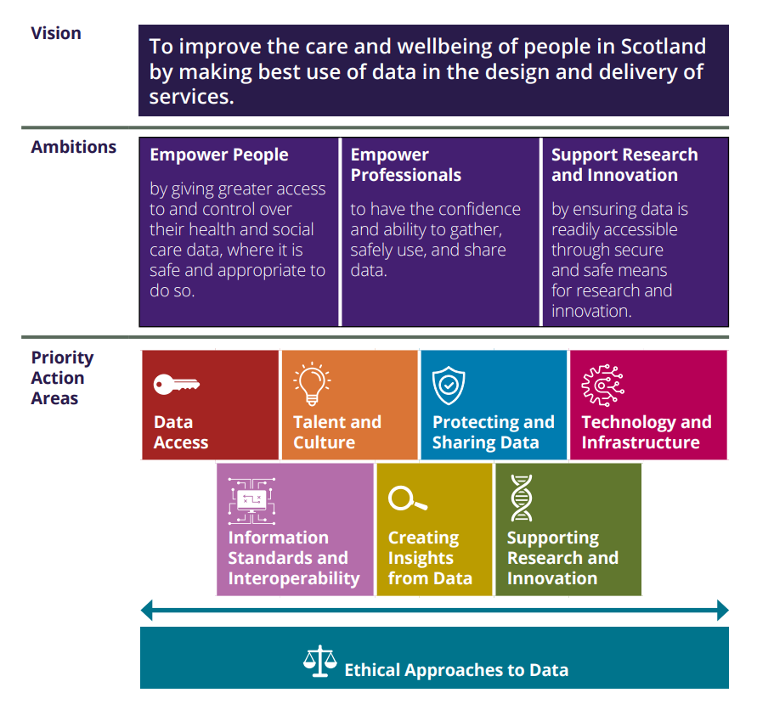
Overall structure

Slide 3
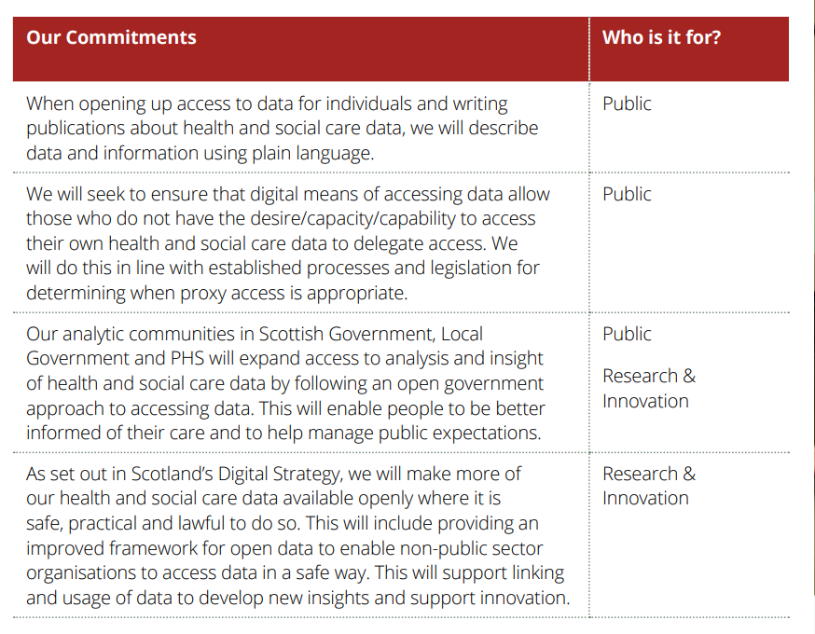
Data access

Slide 4
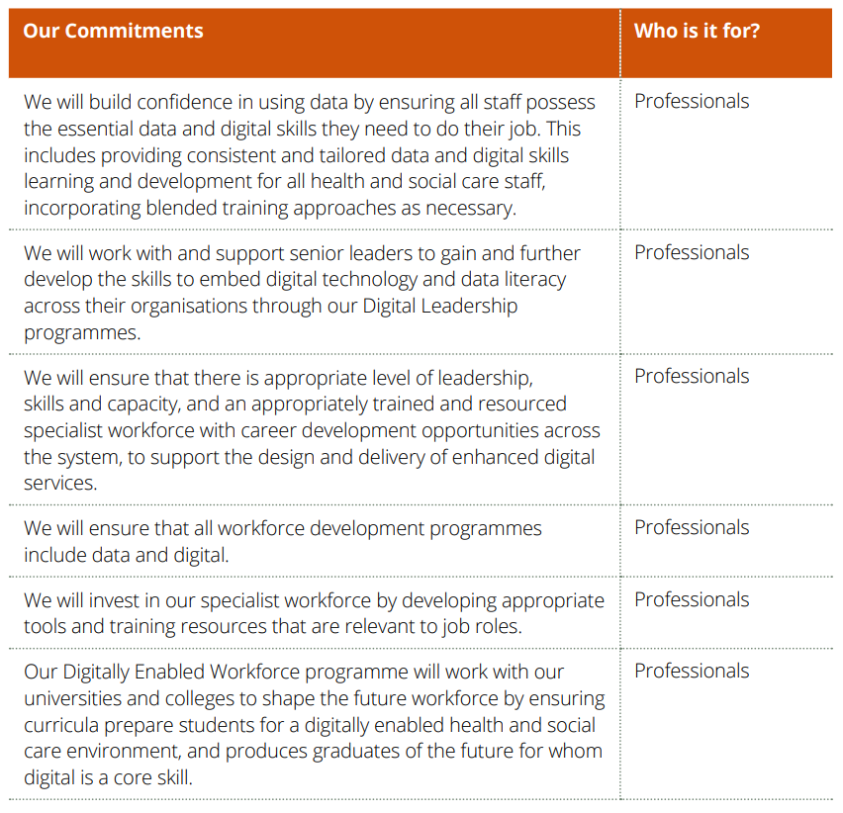
Talent and culture

Slide 5
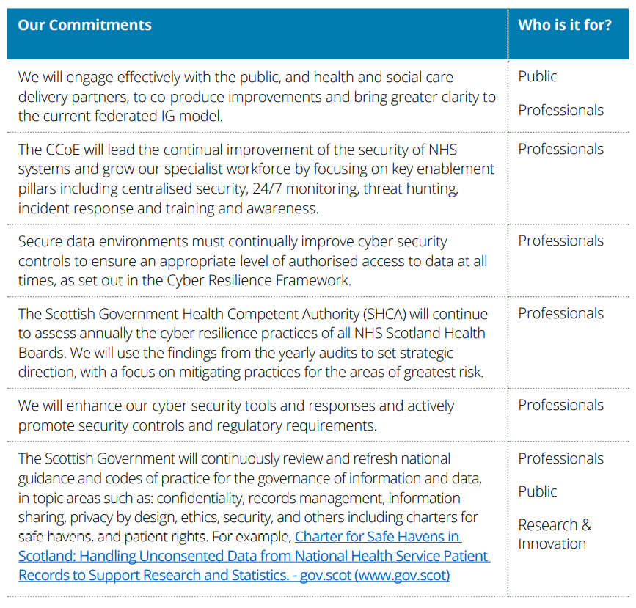
Protecting and sharing data

Slide 6
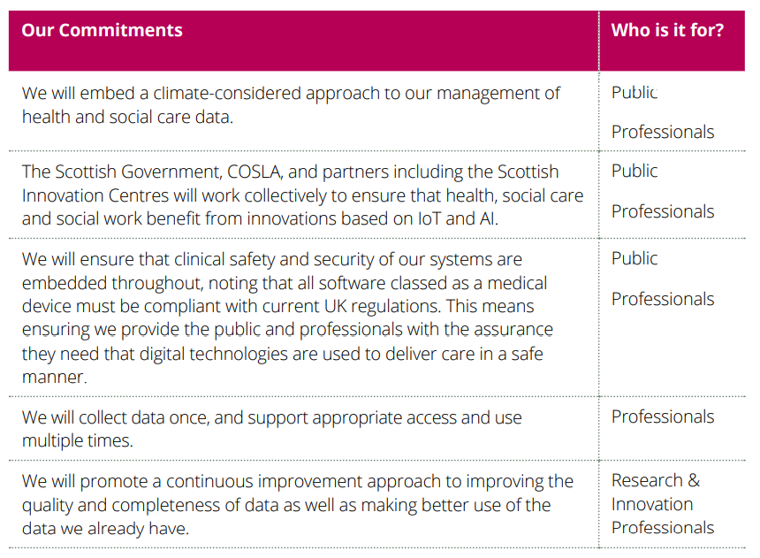
Technology and infrastructure

Slide 7
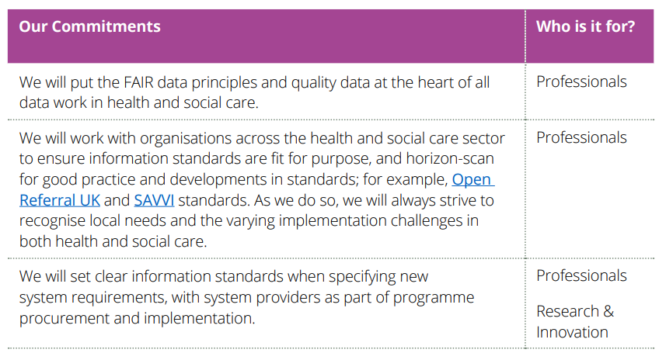
Information standards and interoperability

Slide 8
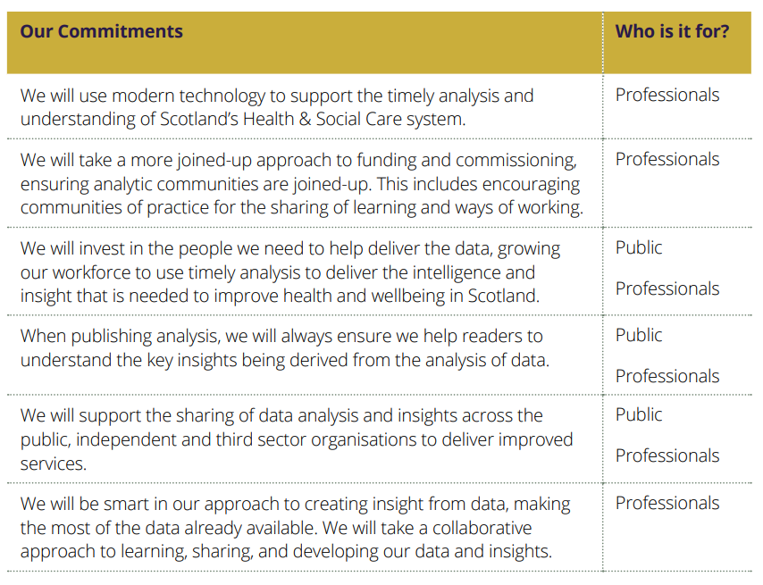
Creating insights from data

Slide 9
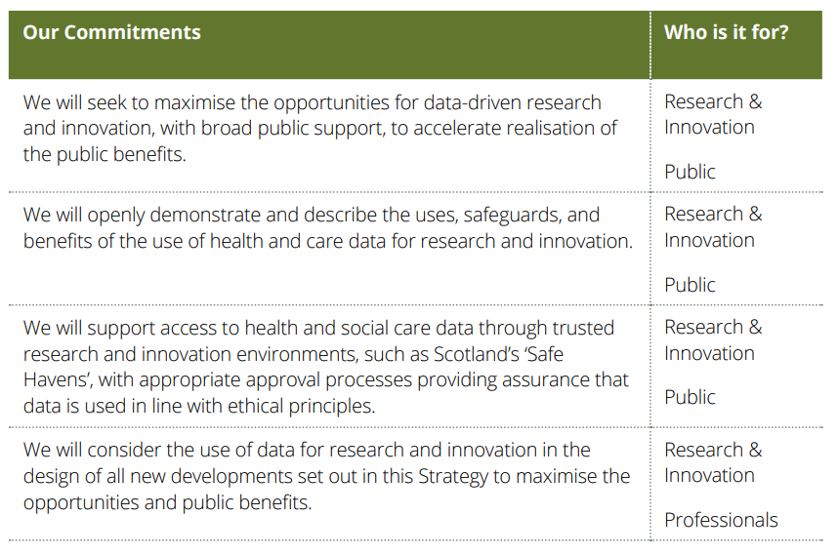
Supporting research and innovation

Slide 10

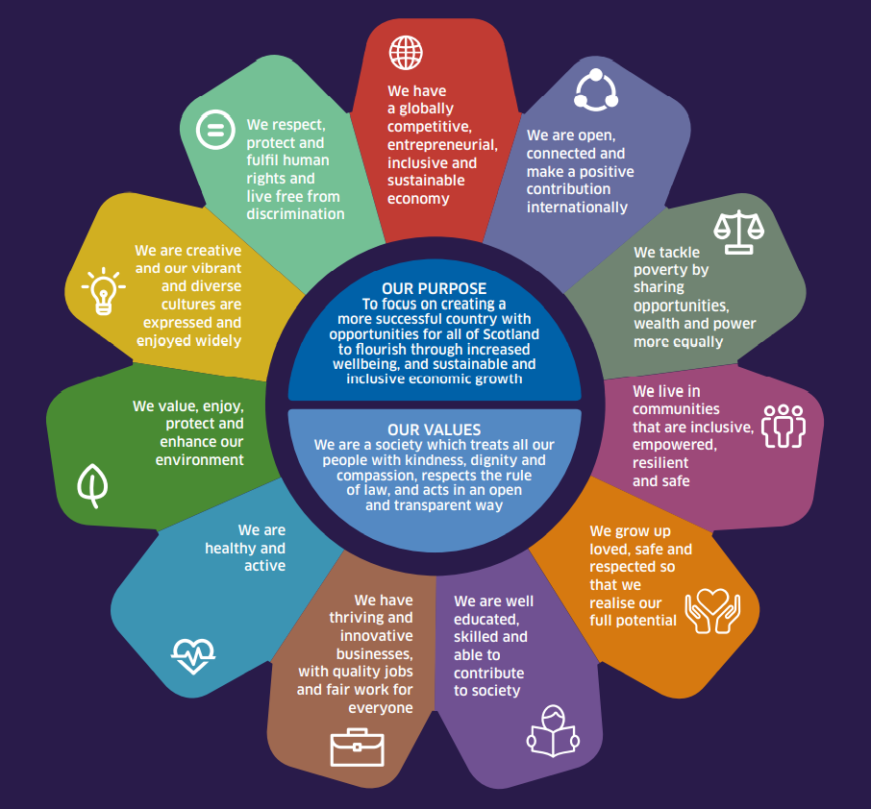

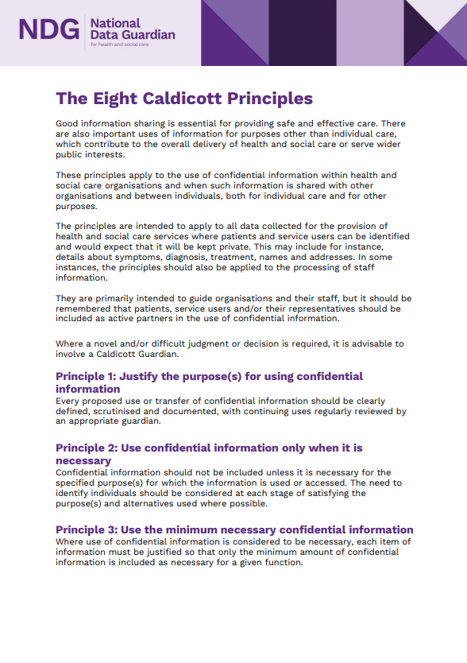
Ethical Approaches to Data
Beneficial
Responsible
Accountable
Insightful
Inclusive
Necessary
Observant
Widely participatory

