Slide 1
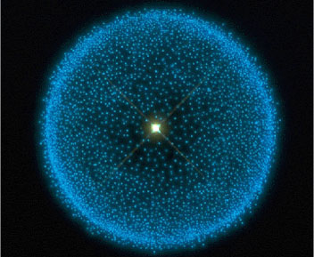

Releasing ontologies in multiple formats using the OBO Ontology Release (Oort)
Carlo Torniai

Slide 2
Content
Release process
What does it mean to release an ontology?
Suggestions, recommendations, and tools
Example

Slide 3
Releasing an ontology
Make a version of the ontology available that:
Is “complete” enough for people to use
Is available in different formats
OWL
OBO
Has a resolvable IRI
Is pre-reasoned (classified) -> you are releasing the inferred hierarchy
Is a landmark referencable unit of work

Slide 4
Releases and PURLS
Example:
In your browser go and check:
http://purl.obolibrary.org/obo/obi.owl
You will see that you are redirected to:
http://obi.svn.sourceforge.net/svnroot/obi/releases/2012-07-01/merged/merged-obi-comments.owl
Before you first release the “stable” purl, you can point to your current working file in your trunk in SVN

Slide 5
Releases and PURLS (2)
Normally, a stable PURL is used to redirect to the latest released version of an ontology
Another best practice is to use version IRIs that resolve to particular releases.
http://purl.obolibrary.org/obo/obi/2012-07-01/obi.owl and http://purl.obolibrary.org/obo/obi.owl resolve to the same ontology
If you instead try http://purl.obolibrary.org/obo/obi/2012-03-29/obi.owl you will get the previous OBI release

Slide 6
What to do before release?
Ensure that your ontology has the terms and the properties you need
NOTE: There is no such thing as a “finished” or “perfect” ontology)
Ensure that it is consistent (e.g. the reasoner isn’t throwing errors)
Ensure that it is properly annotated
A very minimum set of annotations for each term and property would contain:
Textual definition
Term editor
Definition source
Label

Slide 7
What to do before a release? (cont’d)
Update all external referenced terms
If it’s the first release, it is a good practice to have at least two people external to your group review your ontology
After the first release
Make sure to have release notes that summarize the changes form the previous version
Make sure to keep obsoleted terms, with comments

Slide 8
Updating external referenced terms
It can be a long process, especially if you are importing from several sources
What needs to be checked:
If the imported terms still exist in the source ontology
Update any annotation to the terms
If axioms are imported, check if there are any changes in the source ontology that make your source ontology inconsistent.
For some of our projects such as eagle-i, Reagent Ontology (ReO), and CARO, we have developed simple Python scripts that do the above checking using OntoFox

Slide 9
Steps for release
Have your ontology with the proper terms and annotations (for your own terms) updated
Check consistency
Update external referenced terms
Make required changed upon syncing external terms
Move classes, update/change axioms, import different classes form other source ontologies, check consistency again

Slide 10
Steps for release (cont’d)
5) Merge files
6) Use OBORelease Manager to generate the released files
7) Update PURLs
8) Make sure that the version IRI (or remark in OBO) is updated to the version number or date
9) Submit to repositories such Bioportal / Ontobee

Slide 11
How to get a PURL
You can register as a user at
http://purl.obolibrary.org/docs/index.html
Send a request to
obo-discuss@lists.sourceforge.net
You may need a domain (ID space like ERO, GO, PCO) or your ontology can simply live under another domain

Slide 12
How to update a PURL (cont’d)
Let’s say you’ve set up a purl for your ontology and you are an admin for that purl
http://purl.obolibrary.org/obo/ero.owl
You will have to do the following things upon release :
Change the purl to point to the latest release version of the ontology
Create a new purl for the versionIRI

Slide 13
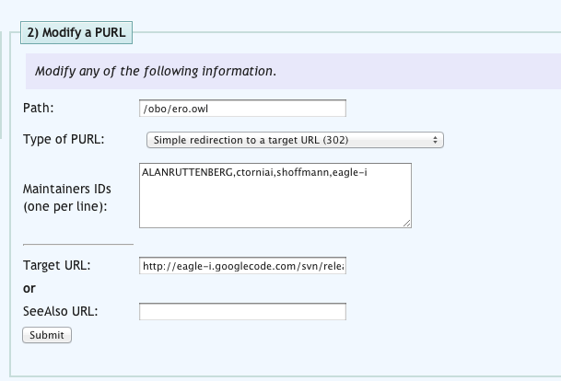
How to update a PURL (cont’d)
Here the PURL to the main ontology is redirected to the latest release in google code

Slide 14
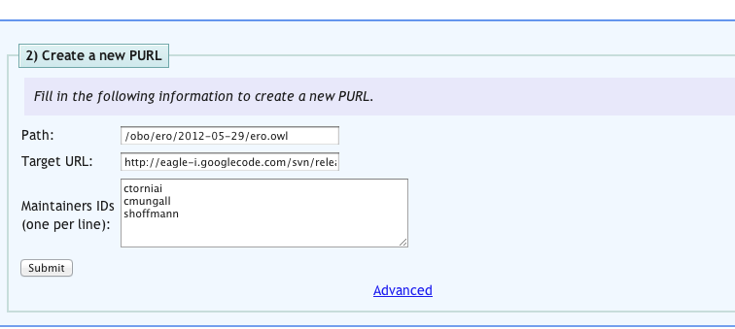
How to update a PURL (cont’d)
Create the redirect for the version IRI
Pointing to the actual file in the SVN
http://eagle-i.googlecode.com/svn/releases/2012-05-29/ero.owl

Slide 15
Release Pipeline
Requirements:
Facilitate editing, maintenance, and release of the ontology even by non-technical people
Reuse available tools
Automate maintenance and release as much as possible

Slide 16
Release Pipeline (cont’d)
Decisions:
Use OntoFox (http://ontofox.hegroup.org/) as an implementation of the MIREOT principle
Use the OBO Ontology Release Tool (Oort) to manage releases.
Define a specific organization for the files containing external referenced entities

Slide 17
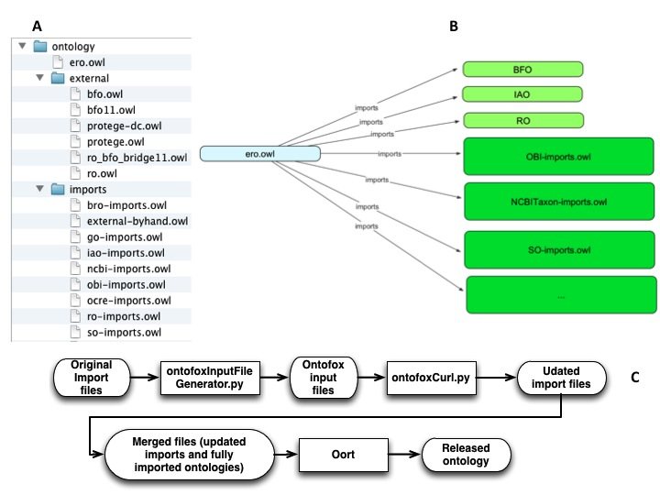
Release pipeline
Notes:
Add picture and simple explain what it does

Slide 18
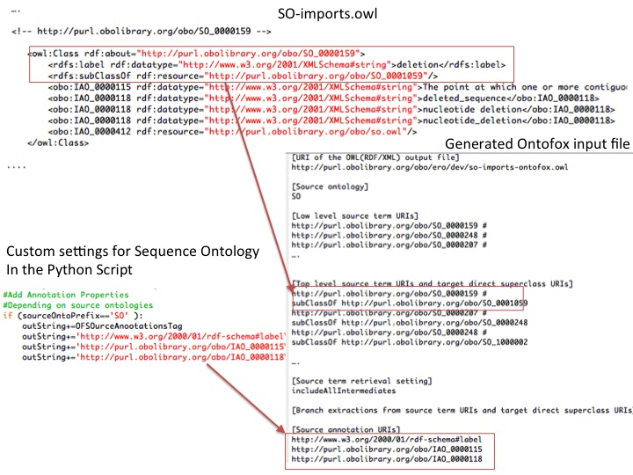
Release pipeline

Slide 19
Example using Oort
Tutorial at
https://code.google.com/p/nescent-anatomy-course/source/browse/trunk/material_for_course/fri/tutorial/tutorial_ontology_release.doc

