Slide 1



Looking up ontology terms with Ontobee
Carlo Torniai

Slide 2
What is Ontobee?
A web server aimed to facilitate ontology visualization, query, and development
Ontobee provides a user-friendly web interface for displaying the details and its hierarchy of a specific ontology term

Slide 3
Ontobee vs Bioportal
Ontobee has a smaller set of Ontologies
Ontobee follows the principles of Semantic Web more closely
Updated more frequently

Slide 4
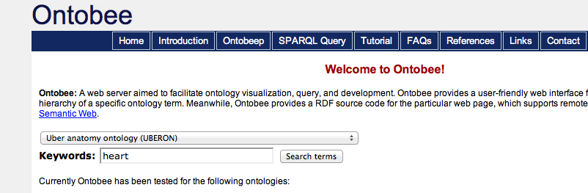
Hands on
http://www.ontobee.org/index.php
Search for heart in Uberon

Slide 5
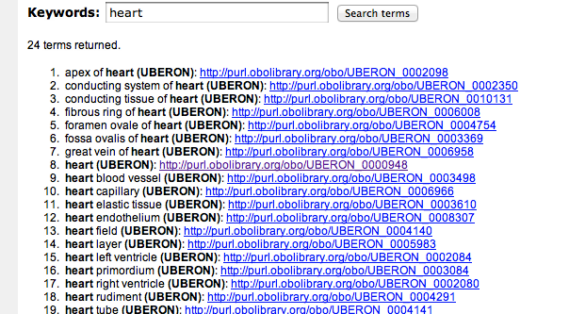
Results

Slide 6
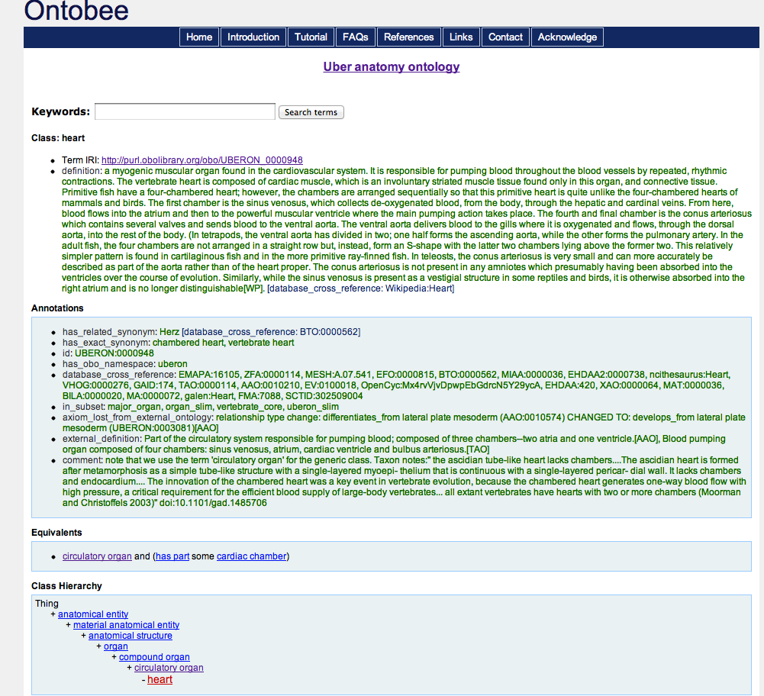
Inspect Results

