Slide 1

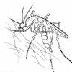
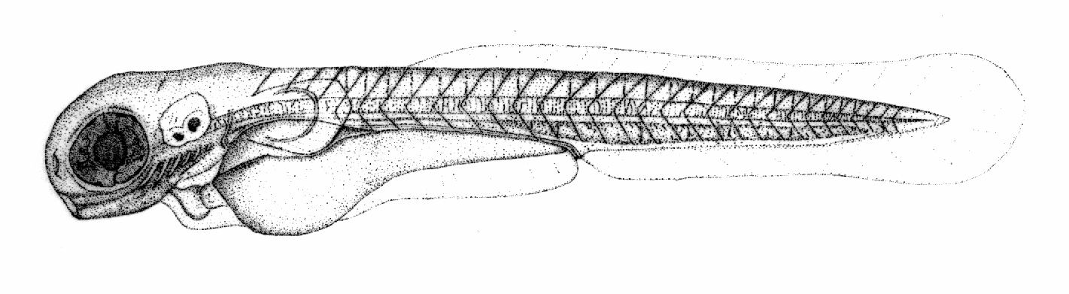

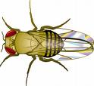


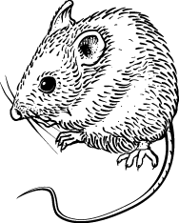
Developing anatomy ontologies in the context of others
Melissa Haendel, Chris Mungall, Carlo Torniai, Matt Yoder

Slide 2
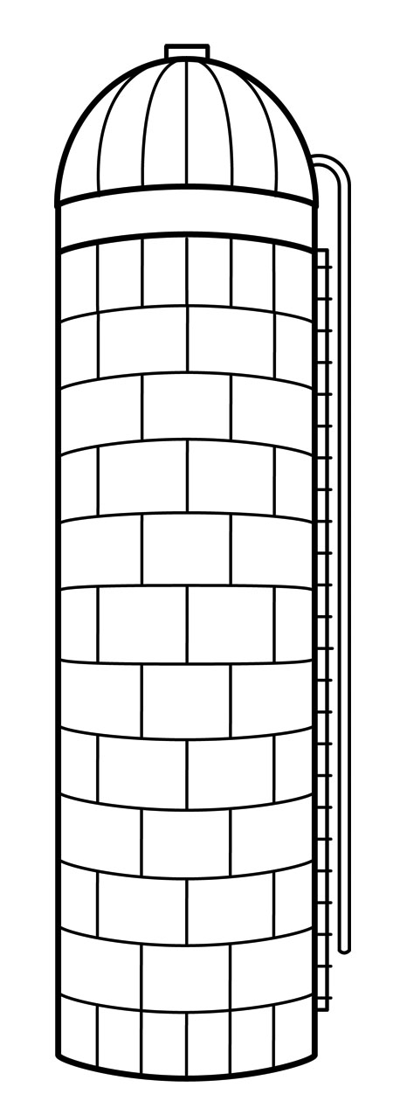
The problem: Data Silos
is_a (SubClassOf)
part_of
GO
develops_from
FMA
surrounded_by
EHDAA2
multicellular organismal process
pharyngeal region
organ system
solid organ
respiratory gaseous exchange
respiratory primordium
lung bud
respiratory system
parenchymatous organ
respiratory system process
lung
MA
Lower respiratory tract
lobular organ
thoracic cavity
organ system
MPO
abnormal respiratory system morphology
thoracic cavity organ
respiratory system
pleural sac
lung
abnormal lung morphology
lung
abnormal pulmonary acinus morphology
pulmonary acinus
abnormal pulmonary alveolus morphology
lung
alveolus
alveolar sac
Notes:
Add circles around lungs

Slide 3
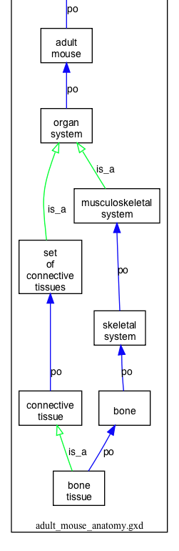
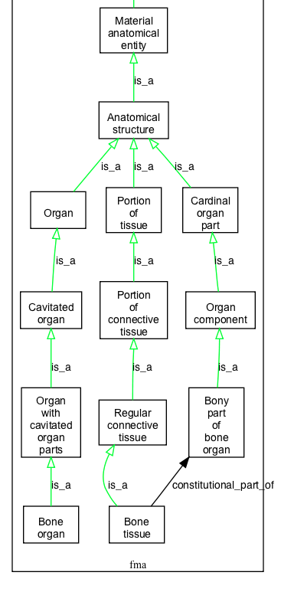
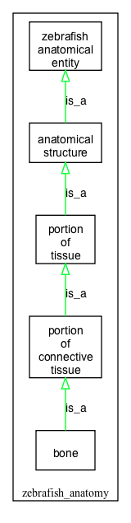
Ontology alignment
Differences in bone and bone tissue representation

Slide 4
How to synchronize anatomy ontologies
Three approaches:
“mapping”
Xref strategy
imports/MIREOT

Slide 5
There are issues with mappings
Class A | Class B | In Bioportal? | Useful?
FMA extensor retinaculum of wrist | MA retina | Yes | No
FMA portion of blood | MA blood | No | Yes
ZFA Macula | MA macula | Yes | No
ZFA aortic arch | MA arch of aorta | Yes | Dubious
ZFA hypophysis | MA pitiuitary | No | Yes
FMA tibia | FBbt tibia | Yes | No
FMA colon | GAZ Colón, Panama | Yes | No
PATO male | Chebi maleate 2(-) | Yes | No

Slide 6
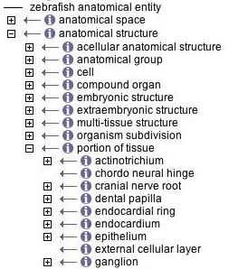


Zebrafish terms are is_a subtypes of teleost terms
Reconciliation and linking between TAO and ZFA
Zebrafish Anatomy
Teleost Anatomy Ontology
is_a
Logic implemented via Xrefs- difficult to keep synchronized
Notes:
Example of synch by xref. Basically, approach is manual and very easy to get out of synch.

Slide 7
OBO relations between ontologies
treat-xrefs-as-equivalent: CARO
treat-xrefs-as-equivalent: GO
treat-xrefs-as-equivalent: VSAO
treat-xrefs-as-is_a: VHOG
treat-xrefs-as-reverse-genus-differentia: MA part_of NCBITaxon:10088
These are some assertions in UBERON, and relate the Xrefs in Uberon to classes in other ontologies using specificied semantics. This allows merging of ontologies in taxonomically appropriate ways

Slide 8
Zebrafish terms are is_a subtypes of teleost terms
Reconciliation and linking between TAO and ZFA
Zebrafish Anatomy
Teleost Anatomy Ontology
X
is_a
Logic implemented via Xrefs- difficult to keep synchronized
Notes:
Example of synch by xref. Basically, approach is manual and very easy to get out of synch.

Slide 9
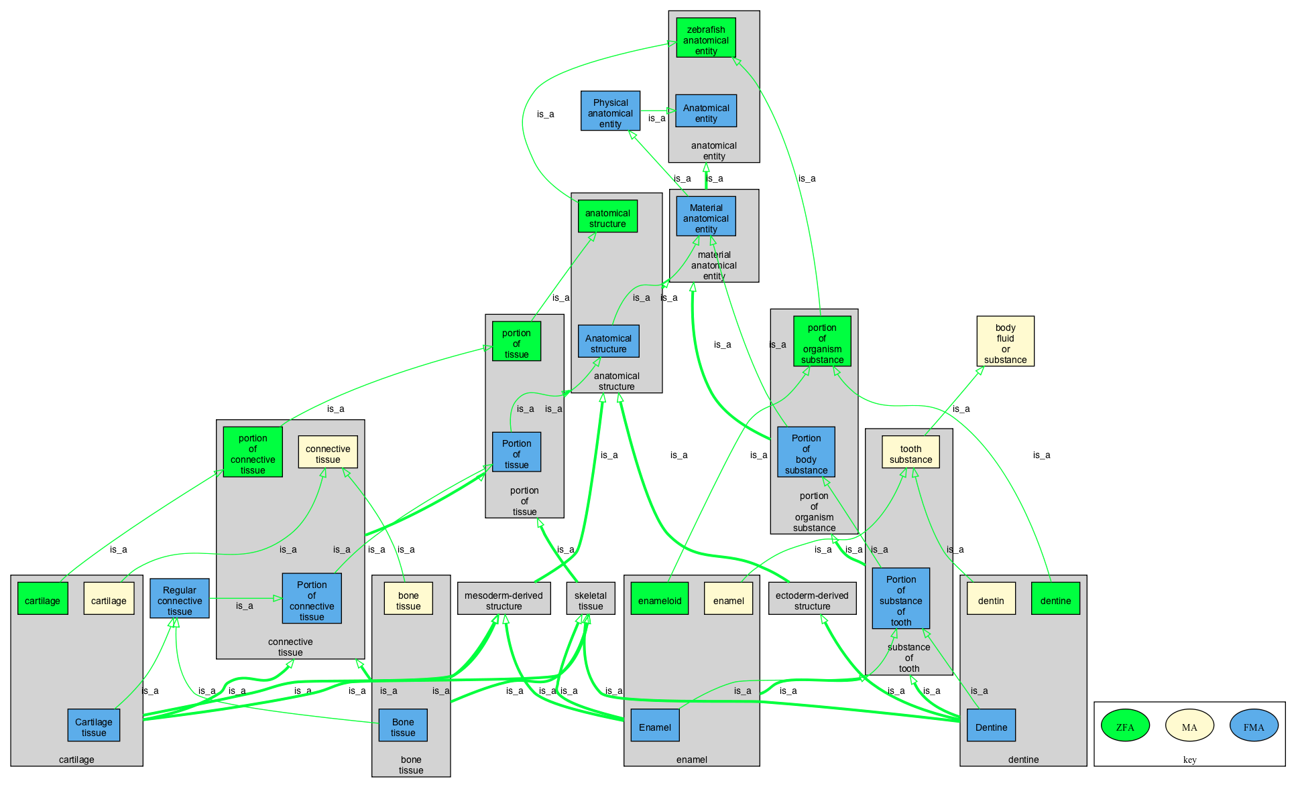
Ontology alignment
Using Uberon for alignment facilitates identification of missing classes

Slide 10
Uberon classes connect to other ontologies via a variety of relations
is_a (SubClassOf)
anatomical structure
part_of
develops_from
capable_of
endoderm
is_a (taxon equivalent)
only_in_taxon
organ part
foregut
swim bladder
organ
endoderm of forgut
NCBITaxon:
Actinopterygii
respiration organ
Uberon
classes
respiratory primordium
GO: respiratory gaseous exchange
pulmonary acinus
alveolus
lung
lung primordium
NCBITaxon: Mammalia
alveolus of lung
alveolar sac
lung bud
FMA: pulmonary alveolus
FMA:lung
MA:lung alveolus
MA:lung
EHDAA:
lung bud
Notes:
uberon-combined-mammal.owl - shows you what you get with the bridge axioms

Slide 11
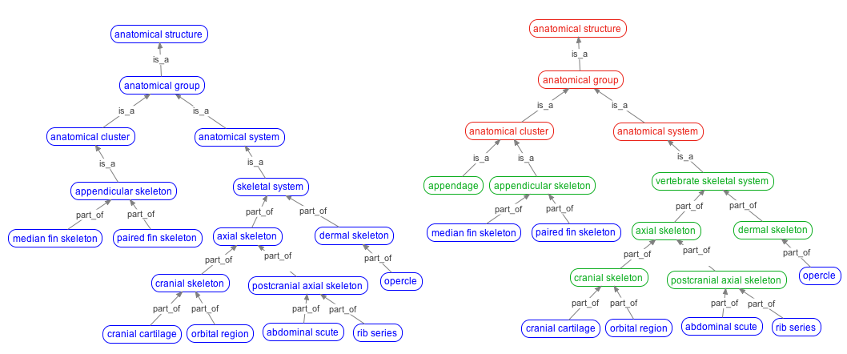
Synchronization by import across ontologies
CARO
VSAO
Present TAO
Modularized ontology
One can import a whole ontology or just portions of another ontology
MIREOT: Minimum information to reference an external ontology term
Notes:
\

Slide 12
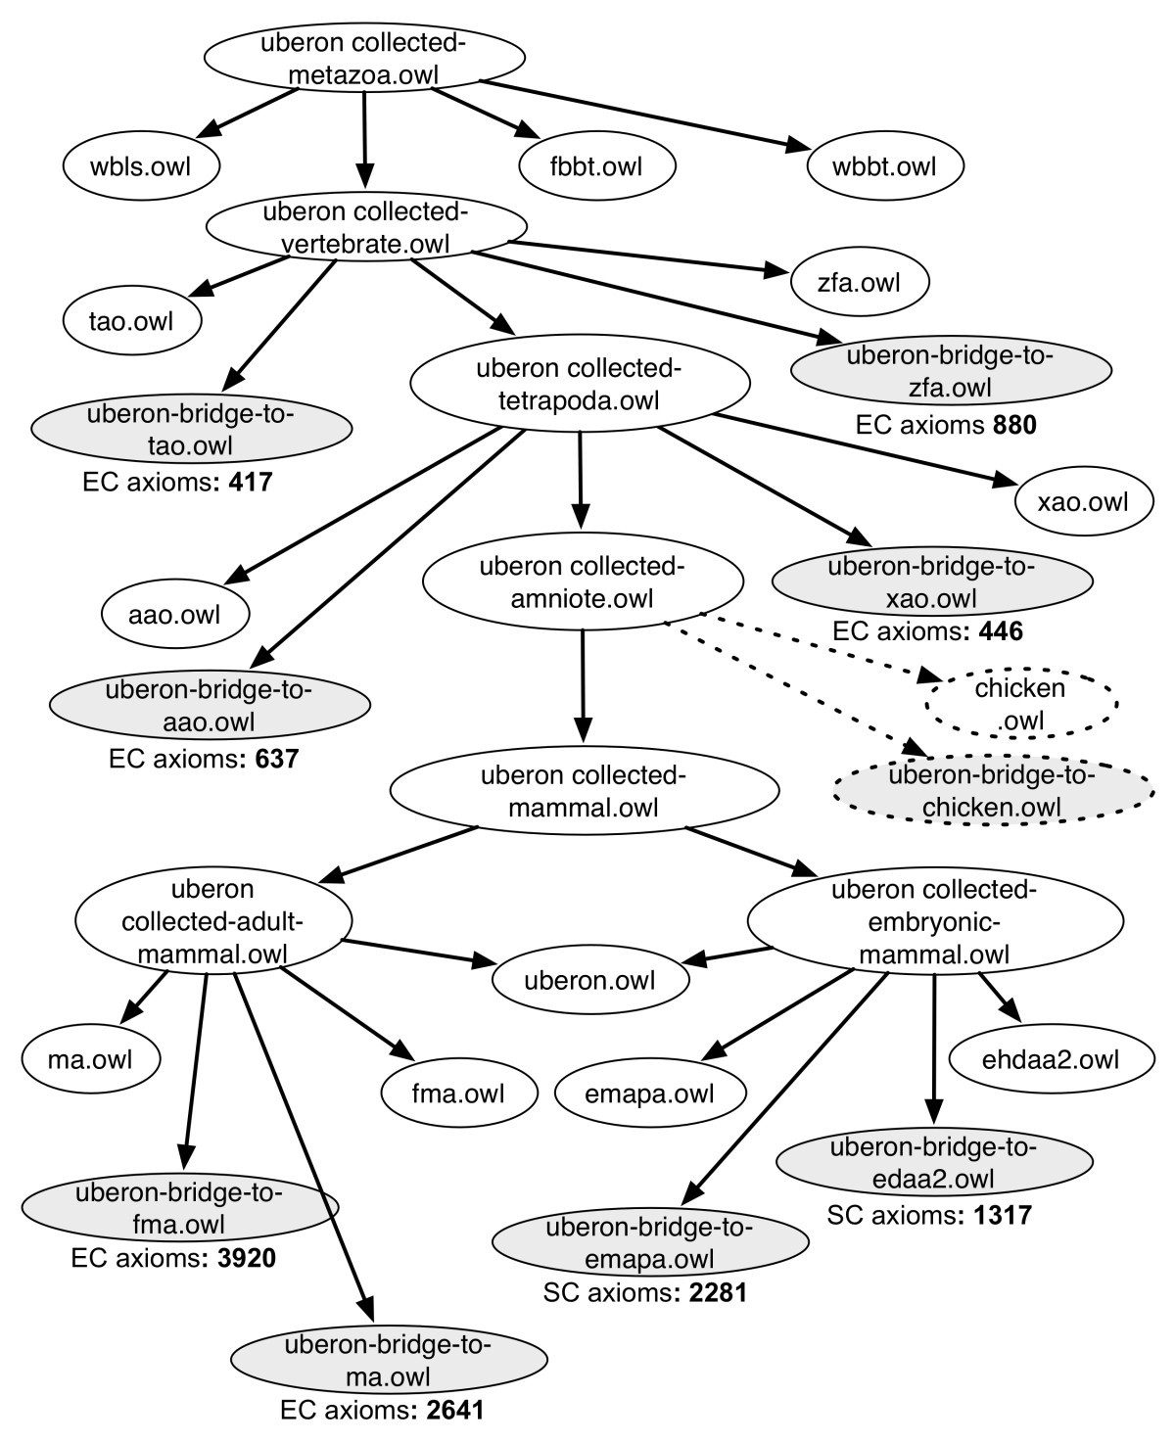
Notes:
Uberon.owl import chain

Slide 13
Leveraging an integrated set of ontologies
cross-ontology
link (sample)
caro / uberon/all
import
cell
tissue
metazoa
nervous system
gut
gonad
appendage
skeleton
circulatory system
gland
mesoderm
respiratory
airway
larva
muscle
tissue
skeletal
tissue
mollusca
arthropoda
vertebrata
trachea
bone
mantle
mushroom body
limb
fin
vertebra
tibia
shell
cuticle
vertebral
column
foot
antenna
mesonephros
parietal
bone
cephalopod
drosophila
teleost
amphibia
mammalia
tentacle
neuron types XYZ
weberian ossicle
tibiafibula
mammary gland
brachial lobe
zebrafish
mouse
human
NO pons

Slide 14
Proposed model moving forward
Maintain series of ontologies at different taxonomic levels
- euk, plant, metazoan, vertebrate, mollusc, arthropod, insect, mammal, human, drosophila
Each ontology imports/MIREOTs relevant subset of ontology “above” it
- this is recursive
Subtypes are only introduced as needed
Work together on commonalities at appropriate level above your ontology

Slide 15
Modularizing ontologies – We need:
To get the imports working well
To have distributed social responsibility assigned
Design patterns to ensure we are all doing the same thing
To check for consistency and errors across multiple ontologies using reasoners to get correct results for all users
-These ontologies are supposed to be orthogonal but aren’t always
Visualization tools that can aid non-ontology experts in identifying errors across multiple ontologies

Slide 16
Modularizing ontologies
Identify key points of integration between ontologies
Invest energy in understanding what is out there, i.e. seek to import and reuse, rather than “aligning” later
Modularize based on domain or taxon
Let the reasoner help do the work
Work together to distribute work

Slide 17
Idealized protocol for new AOs
Collect draft list of classes, build design documents
Subdivide into anatomical domains, taxonomic levels, and/or differentiating characteristics
Request new classes from existing AOs, stub in in your own ontology, make annotations to this effect (e.g. include tracker IDs)
Import pre-reasoned subset from other ontologies
Build your ontology

Slide 18
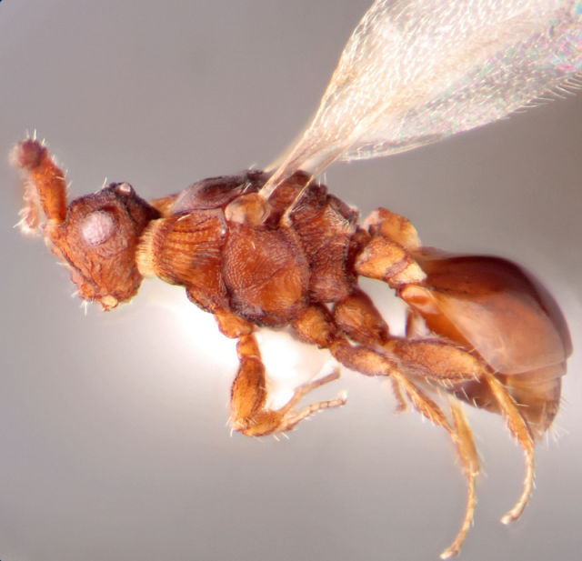
More about using ontologies together-post-composition
RO/BFO
RO/BFO
(seta and 'is bearer of' some White) and (part_of some head)
HAO
PATO
HAO

Slide 19
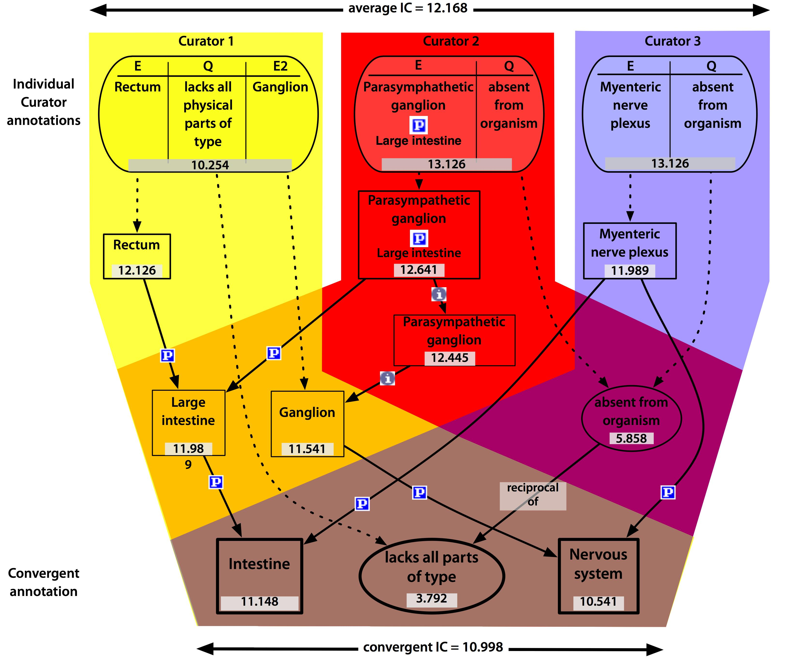
Ontologies can help reconcile annotation inconsistencies

