Slide 1
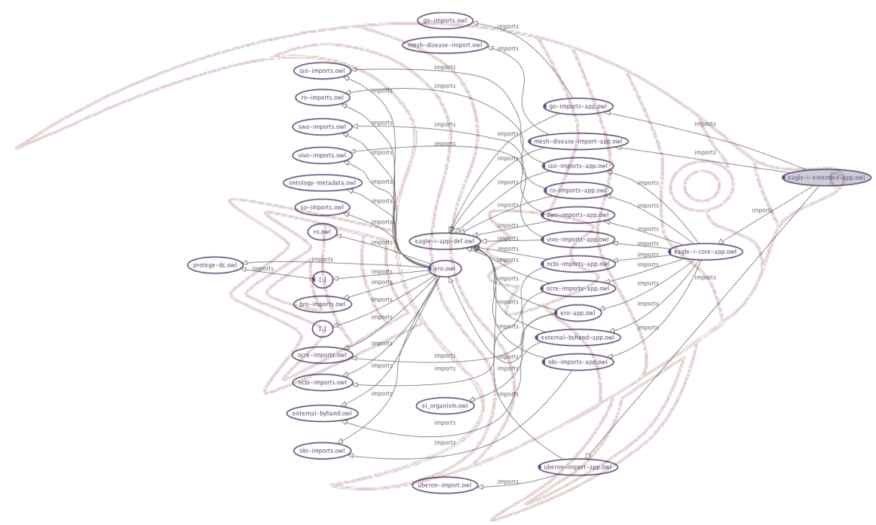

Imports, MIREOT, OntoFox
Contributors: Carlo Torniai, Melanie Courtot, Chris Mungall, Allen Xiang

Slide 2
Content
Owl Imports
Imports in Protégé
Ontology libraries and catalog files
MIREOT
OntoFox
Examples
Exercise

Slide 3
Importing ontologies
There is the need to reuse other existing OWL ontologies (as you’ve already seen) these ontologies can be:
On the web
In local files

Slide 4
Importing ontologies
Need to keep updated versions of imported ontologies
Need ensure consistency for your developed ontologies
In general, it’s always better to work with local files (and just in case, have a local SVN repository to sync with current versions of other ontologies)

Slide 5
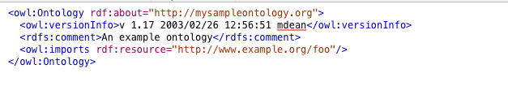
owl:imports
Ontology header
Notes:
Add caro2.owl header in here

Slide 6
owl:imports
owl:imports statement references another OWL ontology containing definitions, whose meaning is considered to be part of the meaning of the importing ontology
Each reference consists of a IRI specifying the location of the ontology that is to be imported
Syntactically, owl:imports is a property with the class owl:Ontology as its domain and range
The import statement is located in the ontology header
The owl:imports statements are transitive, that is, if ontology A imports B, and B imports C, then A imports both B and C.

Slide 7
Dealing with imports in Protégé
Tutorial document:
/thur/tutorials/imports_tutorial.doc
Install OWLviz plugin (if not installed already)
Review imports graph
Understanding imports in Protégé
Ontology libraries and Catalog file

Slide 8
Reuse of ontologies: challenge of imports
Large overhead - using large ontologies, such as NCBI Taxonomy or Foundational Model of Anatomy (FMA)
True Alignment - Ontologies constructed using a different design or those not using BFO as upper-level ontology cannot be fully integrated
Fluid development - Resources are always under development

Slide 9
Possible solutions
Generate your own terms and reference other terms
Generate and import a module of an ontologies: a complete subsets of entities and axioms
Import the whole resources

Slide 10
Create our own terms
One can create our own terms and reference others
Adding an annotation referencing the external ontology
But this duplicates efforts, creates redundancy, doesn’t comply with orthogonality principle from OBO Foundry, making data integration more difficult
OBI: cell
CL: cell
OBI: cancer
NCI: cancer

Slide 11
Import modules
A module is a subset of the external ontology, containing classes and axioms, allowing “original” reasoning
But it is a problem to create/ get the modules
Your small little Onto
Cell
Ontology

Slide 12
Full import
We can import whole resources
only if full axiomatic interoperability (the holy grail of the ontology community)
Large ontologies have huge overhead: current limitations in editing tools and reasoners
!
FMA
Your small
Little Onto

Slide 13
Idea: Import only classes that are needed
Pro: We get around the problems of the other methods
Con: one may loose complete inference

Slide 14
MIREOT
Minimal Information to Reference External Ontology Terms
Formal approach
Implementations

Slide 15
Define the minimal information we need
IRI of the class
IRI of the source ontology
Superclass in the recipient ontology
=> this minimal set allows us to unambiguously identify a term

Slide 16
Additional information
We may want to capture:
Label
Definition
Other annotations: adding “human-readable” information
SuperClasses: for example, NCBI taxonomy
…

Slide 17
Implementation
Strategy:
Figure out how to automate as much as possible..
Because if you edit owl….
How to make it as easy as possible to enter, and maintain
One (widely used) MIREOT implementation: OntoFox

Slide 18
OntoFox
OntoFox is a is a web-based system to support ontology reuse by applyingthe MIREOT principle
Access it at: http://ontofox.hegroup.org/
Notes:
Brief overview of the service

Slide 19
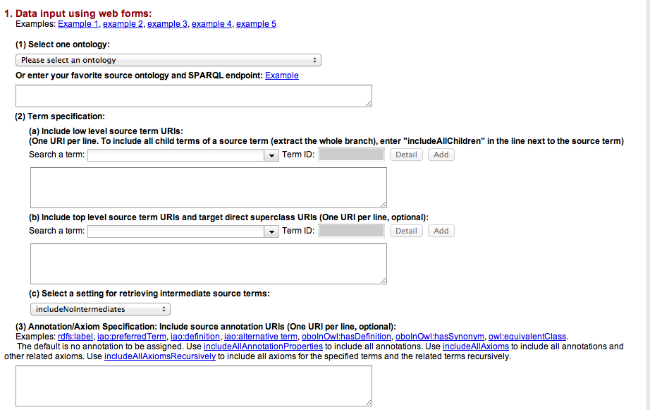
OntoFox tour

Slide 20
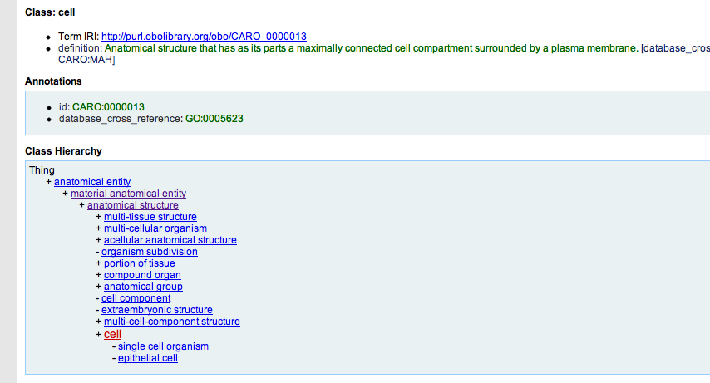
Example
Let’s look for the Caro term ‘cell’ in Ontobee

Slide 21
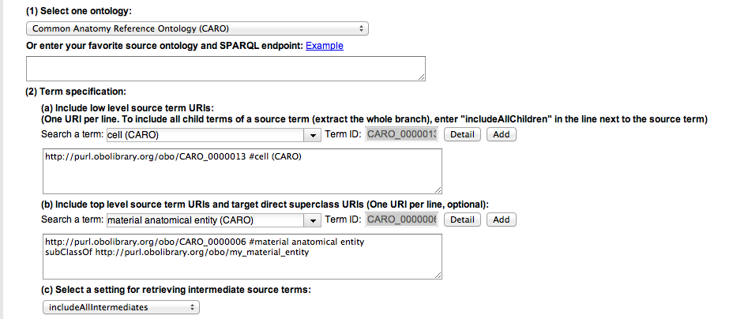

Example
http://purl.obolibrary.org/obo/my_material_entity
IS A CLASS IN YOUR TARGET ONTOLOGY i.e.
THE ONTOLOGY THAT IS GOING TO IMPORT THIS FILE

Slide 22
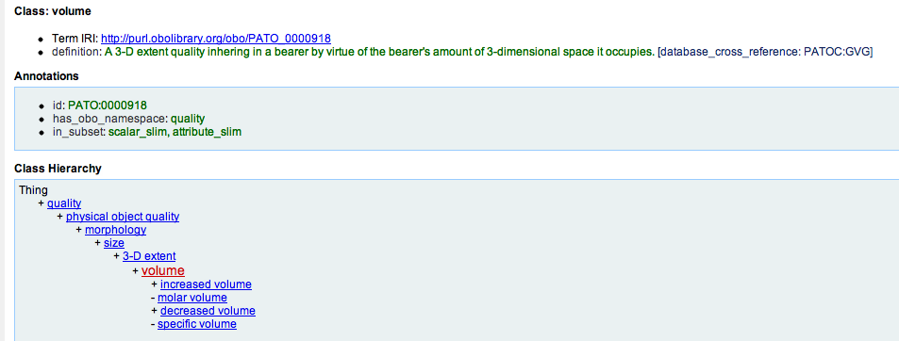
Example
Let’s look for the PATO term ‘volume’ in Ontobee
What do you think I would get as result?

Slide 23
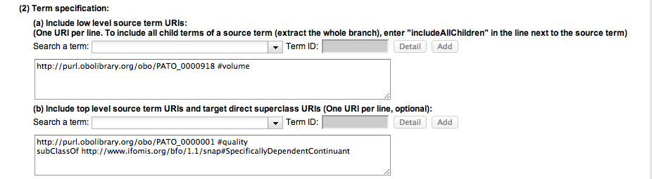
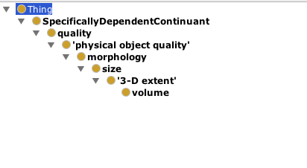
Example
http://www.ifomis.org/bfo/1.1/snap#SpecificallyDependentContinuant
IS A CLASS IN YOUR TARGET ONTOLOGY i.e.
THE ONTOLOGY THAT IS GOING TO IMPORT THIS FILE

Slide 24
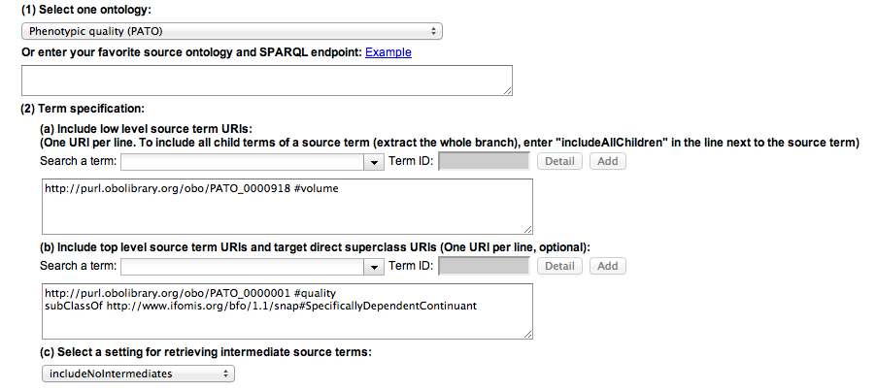
Example
What should I get with this settings?

Slide 25

Example

Slide 26
OntoFox Tutorial
Go on the tutorial file:
material_for_course/thur/tutorials/ontofox_tutorial.docx
Notes:
Missing this link (you probably already know this)

Slide 27
References
MIREOT:
http://obi-ontology.org/page/MIREOT

Slide 28
Backup

Slide 29
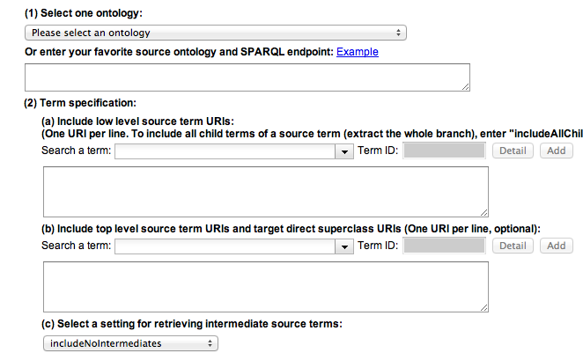
Select Ontology
The source ontology you want to retrieve the term(s) from

Slide 30

Term specification: intermediate terms
(c) Setting for retrieving intermediate source terms: Three options are available for retrieving intermediate terms:
(a) includeNoIntermediates: no intermediate source terms are retrieved
(b) includeComputedIntermediates: Computed intermediate source terms include those intermediate terms that are the closest ancestors of more than one low level source terms. Those intermediate terms that have only one parent term and one child term each are removed. This setting provides an option to get less intermediate ontology terms then that with the setting ‘includeAllIntermediates" and still fulfills many users’ requirement.
(c) includeAllIntermediates: All intermediate source terms are retrieved.

Slide 31
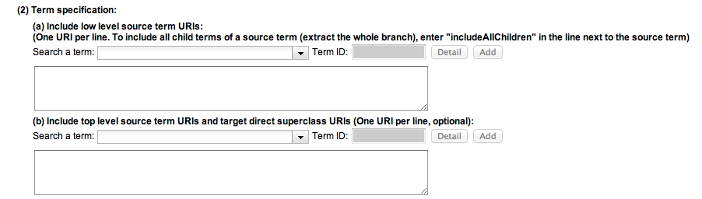
Term specification
(a) Low level source term URIs: The URIs of low level terms from source ontologies.
(b) Top level source term URIs and target direct superclass URIs: The URIs of top level terms from source ontologies and their direct superclass URIs from a target ontology (i.e., the ontology that will import the terms from the source ontologies). The top level source term URI can be the same as the low level source term URI

Slide 32
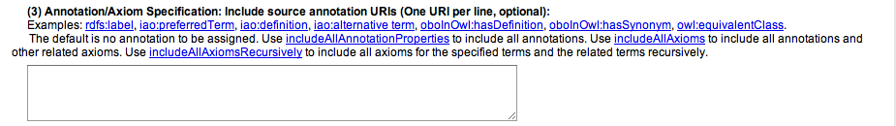
Annotation/Axioms Specification
includeAllAnnotationProperties": By default, if no annotation URI is assigned, no annotations associated with a specific ontology term will be fetched. To include all possible annotations, you can put "includeAllAnnotationProperties” on one line, and all the annotations associated with a specific ontology term will be fetched.
"includeAllAxioms": To include all possible annotations and related axioms for a specified term(s), you can put "includeAllAxioms"on one line, and all the axioms associated with a specific ontology term(s) will be fetched.
"includeAllAxiomsRecursively": To include all possible annotations and related axioms for a specified term(s) and its associated terms recursively, you can enter "includeAllAxiomsRecursively"on one line. Note: "includeNoIntermediates" and "includeComputedIntermediates" have higher priority and will override "includeAllAxiomsRecursively".

