Slide 1
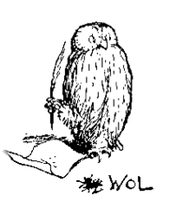

An Introduction to OWL
Contributors: Carlo Torniai, Matthew Horridge Chris Mungall, David Osumi-Sutherland

Slide 2
What is OWL?
Web Ontology Language (OWL) is a language for writing Ontologies for the Web
OWL 2 is the current version of OWL and a W3C recommendation as of October 2009
The previous version of OWL (OWL 1) was a W3C recommendation in 2004
An overview of the language can be found at: http://www.w3.org/TR/owl2-overview/

Slide 3
I use OBO, why should I care about OWL?
OWL 2 has a large and growing ecosystem of developers
Using OWL ontologies in Protégé 4 you can use fast reasoners to:
Query your ontology more effectively
Quickly find mistakes
Automate classification
Non-lossy round tripping from OBO to OWL and back is now easy
Most of the anatomy ontologies are moving towards OWL/Protégé
Notes:
That’s why we are spanding basically all today in this OWL intro and Protégé tutorial

Slide 4
Owl 2 Basics
OWL 2 is based on well known concepts and results for description logics (DLs)
Like DLs, OWL 2 is a language for representing knowledge about things, group of things, and relations between things
(there is “thing” again!)

Slide 5
Owl 2 Basics (cont’d)
The things or objects about which knowledge is represented (e.g. Melissa, Matt, England) are called individuals (aka instances)
Group of things (e.g., female) are called classes
Relations between things (e.g. siblings) are called properties (aka relations, relationship)
Individuals, classes and properties are called entities
How do we reference entities ?
Internationalized Resource Identifier (IRI)
Notes:
We will come bak to this later

Slide 6
IRI, URI, URL
Internationalized Resource Identifier (IRI)
Uniform Resource Identifier (URI)
Uniform Resource Locator (URL)

Slide 7
URI, URLs and URNs
A uniform resource identifier (URI) is a string of characters used to identify a name or a resource
URIs can be classified as locators (URLs), as names (URNs), or as both
A uniform resource name (URN) functions like a person's name, while a uniform resource locator (URL) resembles that person's street address
Notes:
URIs can be classified as locators (URLs), as names (URNs), or as both. A uniform resource name (URN) functions like a person's name, while a uniform resource locator (URL) resembles that person's street address. In other words: the URN defines an item's identity, while the URL provides a method for finding it.

Slide 8
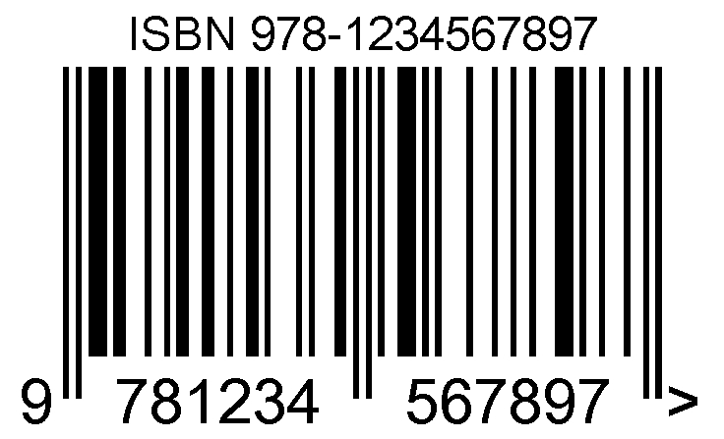


URI and URN
URN
URI
.ISBN 0-486-27557-4
file:///home/username/RomeoAndJuliet.pdf
Specific edition of Romeo and Juliette
Notes:
The ISBN system for uniquely identifying books provides a typical example of the use of URNs. ISBN 0-486-27557-4 (urn:isbn:0-486-27557-4) cites, unambiguously, a specific edition of Shakespeare's play Romeo and Juliet. To gain access to this object and read the book, one needs its location: a URL address. A typical URL for this book on a Unix-like operating system would be a file path such as file:///home/username/RomeoAndJuliet.pdf, identifying the electronic book saved in a file on a local hard disk. So URNs and URLs have complementary purposes.

Slide 9
URL
A URL is a URI that, in addition to identifying a network-homed resource, specifies the means of acting upon or obtaining the representation
Notes:
For reference se: http://en.wikipedia.org/wiki/Uniform_resource_identifier
http://www.wikipedia.org/ is a URI that identifies a resource (Wikipedia's home page) and implies that a representation of that resource (such as the home page's current HTML code, as encoded characters) is obtainable via HTTP from a network host named www.wikipedia.org.

Slide 10

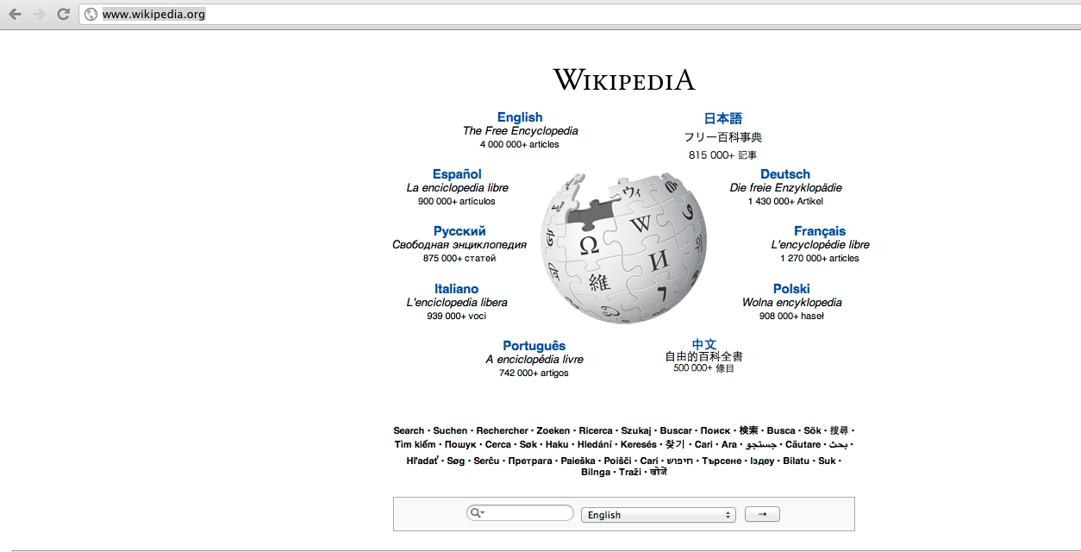

URL
Internet
www.wikipedia.org
host
URI
http://www.wikipedia.org/
identifies
hosted at
Resource
Accessed
thorugh HTTP
http://www.wikipedia.org/ is a URI that identifies a resource (Wikipedia's home page) and implies that a representation of that resource (such as the home page's current HTML code, as encoded characters) is obtainable via HTTP from a network host named www.wikipedia.org.
Notes:
For reference se: http://en.wikipedia.org/wiki/Uniform_resource_identifier

Slide 11
IRI
Internationalized Resource Identifier (IRI) is a generalization of the Uniform Resource Identifier (URI)
While URIs are limited to a subset of the ASCII character set, IRIs may contain characters from the Universal Character Set (Unicode/ISO 10646), including Chinese or Japanese kanji, Korean, Cyrillic characters, and so forth. It is defined by RFC 3987.
Notes:
See for reference http://en.wikipedia.org/wiki/Internationalized_Resource_Identifier

Slide 12
OWL document
Each ontology is associated with an ontology document which physically contains the ontology stored in a particular way ( e.g. a text file using one of the syntaxes available)
An ontology document should be accessible through an IRI

Slide 13
OWL Syntaxes
There are a variety of syntaxes for persisting, sharing and editing OWL ontologies
Functional OWL Syntax
RDF based Syntaxes
RDF/XML
Turtle
OWL/XML
Manchester Syntax
Notes:
Good Reference material: http://ontogenesis.knowledgeblog.org/88

Slide 14
RDF Based Syntaxes: RDF/XML
RDF = Resource Description Framework –based upon idea of making statements about in the form of subject-predicate-object expressions known as triples
This syntax provides an XML representation of an RDF graph
RDF/XML is very verbose
Not easy to be read
Most of the ontologies are exchanged and made available through RDF/XML
We will use RDF/XML in some of the exercises and in the remainder of the slides

Slide 15
Example
Let’s use this class as an example to explore the different OWL syntaxes:
teacher is equivalent to a person who teaches some course
Teaches_
some_
course
Person
Teacher

Slide 16
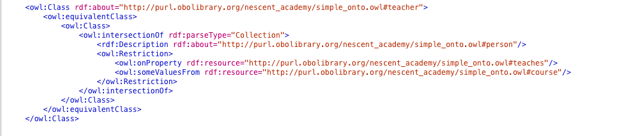
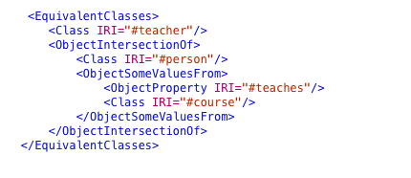
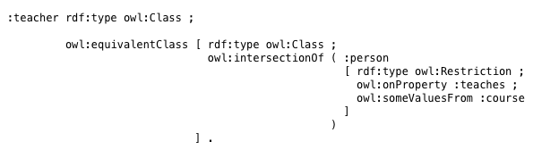
Different syntaxes
Functional Syntax
RDF/XML
OWL/XML
Turtle

Slide 17

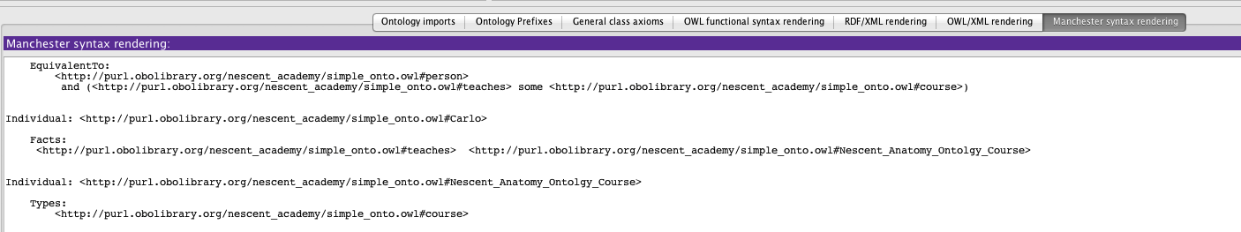
Different syntaxes (cont’d)
Manchester Syntax
You can visualize different syntax in Protégé using predefined Views
Notes:
There are owl files in the directory of course material for Wednesday with the example used here:

Slide 18
We now know about OWL syntax, but what is the actual content of an OWL ontology?
An OWL 2 ontology is a formal description of a domain of interest
OWL 2 ontologies consist of the following different syntactic categories
Entities, such as classes, properties, and individuals. They form the primitive terms of an ontology and constitute the basic elements of an ontology
Axioms are statements that are asserted to be true in the domain being described. For example, using a subclass axiom, one can state that the class student is a subclass of the class person

Slide 19
Ontology document (Anatomy of an OWL file)
An ontology document is composed by the following parts:
Namespace declaration
Ontology Header
The actual “body” of the ontology containing Entities and Axioms
RDF/XML syntax will be used in the examples
<rdf:RDF
….
>
NS declaration
<owl:Ontology>
….
header
</owl:Ontology>
Ontology Document
<owl:Class>
….
</owl:Class>
body
</rdf:RDF>
Notes:
Here show a protégé file thing

Slide 20
About XML Namespaces
XML namespaces are used for providing uniquely named elements and attributes in an XML document. They are defined in a W3C recommendation
An XML instance may contain element or attribute names from more than one XML vocabulary
If each vocabulary is given a namespace, the ambiguity between identically named elements or attributes can be resolved
Notes:
Reference http://en.wikipedia.org/wiki/XML_namespace

Slide 21
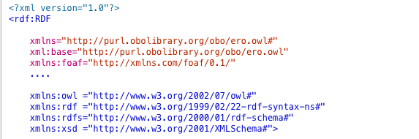

Namespace declaration
Before we can use a set of terms, we need a precise indication of what specific vocabularies are being used
A standard initial component of an ontology includes a set of XML namespace declarations enclosed in an opening rdf:RDF tag.
These provide a means to unambiguously interpret identifiers and make the rest of the ontology presentation much more readable
A typical OWL ontology begins with a namespace declaration similar to the one above

Slide 22
Namespace declaration (cont’d)
The first two declarations identify the namespace associated with this ontology
The first makes it the default namespace, stating that unprefixed qualified names refers to the current ontology
The second identifies identifies the base URI for this document (explained later)
Notes:
The first two declarations identify the namespace associated with this ontology.
The first makes it the default namespace, stating that unprefixed qualified names refer to the current ontology.
The second identifies identifies the base URI for this document (explained later).
The fourth namespace declaration says that in this document, elements prefixed with owl: should be understood as referring to things drawn from the namespace called http://www.w3.org/2002/07/owl#.
This is a conventional OWL declaration, used to introduce the OWL vocabulary.
OWL depends on constructs defined by RDF, RDFS, and XML Schema datatypes.
In this document, the rdf: prefix refers to things drawn from the namespace called http://www.w3.org/1999/02/22-rdf-syntax-ns#.
The next two namespace declarations make similar statements about the RDF Schema (rdfs:) and XML Schema datatype (xsd:) namespaces.

Slide 23
Namespace declaration (cont’d)
The third namespace declaration says that in this document, elements prefixed with owl: should be understood as referring to things drawn from the namespace called http://www.w3.org/2002/07/owl#
<owl:Class> -> <http://www.w3.org/2002/07/owl#Class>
<owl:ObjectProperty> -> <http://www.w3.org/2002/07/owl#ObjectProperty>
<Class> -> <http://purl.obolibrary.org/obo/ero.owl#Class>

Slide 24
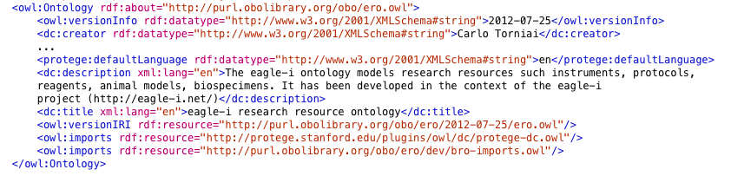
Ontology Header
A document describing an ontology typically contains information about the ontology itself
An ontology is a resource itself , so it may be described using properties from the OWL and other namespaces
The block included within the <owl:Ontology> tag is commonly called the ontology header and is typically found near the beginning of the RDF/XML document following the Namespace declarations

Slide 25
Ontology Header (cont’d)
The first line states that what is contained within the <owl:Ontology> tag describes the current ontology
More precisely, it states that the IRI http://purl.obolibrary.org/obo/ero.owl identifies an instance of the class owl:Ontology
In case rdf:about is left blank the base URI defined using an xml:base attribute in the <rdf:RDF> element at the beginning of the document will be used (see previous slides)

Slide 26
Ontology Header (cont’d)
<owl:versionInfo> is an annotation that contains information about the version of the ontology. Usually is the date of release.

Slide 27
Ontology Header (cont’d)
<dc:creator> identifies the authors of the ontology

Slide 28
Ontology Header (cont’d)
<dc:description> contains a description of the ontology
<dc:title> contains a title of the ontology

Slide 29
Ontology Header (cont’d)
<owl:versionIRI> identifies the IRI from which to get this ontology version
Note that the IRI contains the date as per the content of versionInfo
We will be discussing more about ontology versionIRI on Friday when talking about on ontology release process

Slide 30
Ontology Header (cont’d)
<owl:imports> identifies the IRI of external ontologies to be imported
We will be discussing more about imports tomorrow

Slide 31
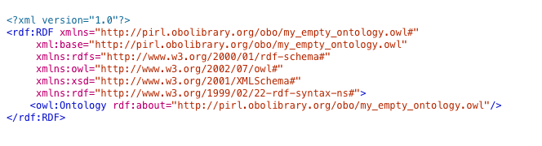
Ontology Header (cont’d)
Ontology metadata are optional
When creating an ontology from scratch (in Protégé) the only thing you will see is the Ontology IRI and the namespace declaration:
You can add annotations to an ontology the same way you add them to any other Entity or Axiom

Slide 32
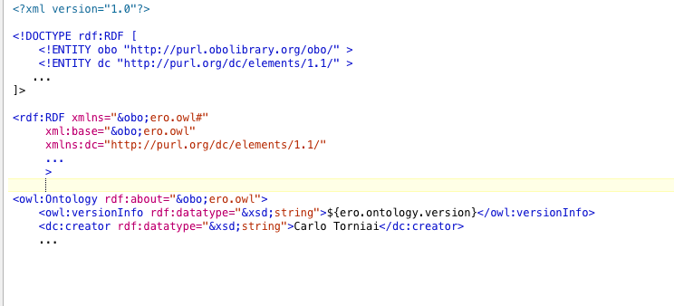
Compact format using XML entities
As an aid to writing lengthy URLs it can often be useful to provide a set of entity definitions in a document type declaration (DOCTYPE) that precedes the ontology definitions
Those definitions can be used later in the namespace declaration , in the ontology header and in the body of the document

Slide 33
Recap
OWL 2 is a language for representing knowledge about things (individuals), group of things (classes), and relations between things (properties)
Individuals, classes and properties are called entities

Slide 34


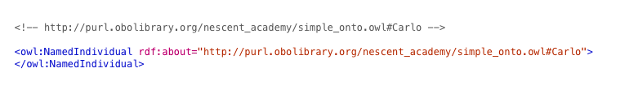
Individuals
Carlo
Individuals represent objects in the domain in which we are interested
Notes:
Note that because of the open world assumption in OWL two individuals with the same name are not necessarily the same unless specified.
In OWL, it must be explicitly stated that individuals are the same as each other, or different to each other — otherwise they might be the same as each other, or they might be different to each other.

Slide 35
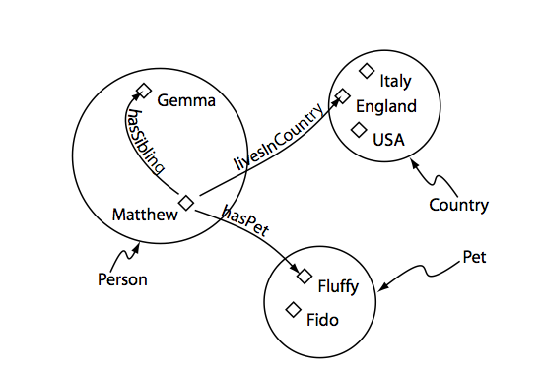

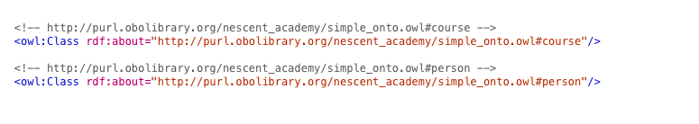
Classes and Subclasses
Nescent
anatomy course
teaches
Carlo
Course
OWL classes are interpreted as sets that contain individuals
They are described using formal descriptions that precisely state the requirements for membership of the class
For example, the class Course would contain all the individuals that are in our domain of interest

Slide 36
Some classes are declared to never share any instances in common
OWL DisjointWith OBO: disjoint_from
anatomical
space
anatomical
structure
lumen
muscle
anatomical
space
anatomical
structure
✗
lumen
of gut
NO!

Slide 37
Disjoint classes
Important: OWL Classes are assumed to ‘overlap’
We therefore cannot assume that an individual is not a member of a particular class simply because it has not been asserted to be a member of that class
In order to ‘separate’ a group of classes we must make them disjoint from one another

Slide 38
Open world assumption
Statement: “Matt” is a citizen of Canada
Is Carlo a citizen of Canada?
In the Closed World: NO
In the Open world: Unknown
Open World vs Closed World
OWL vs Database
Notes:
Heuristically, the open world assumption applies when we represent knowledge within a system as we discover it, and where we cannot guarantee that we have discovered or will discover complete information. In the OWA, statements about knowledge that are not included in or inferred from the knowledge explicitly recorded in the system may be considered unknown, rather than wrong or false.

Slide 39
Open world assumption
anatomical
space
anatomical
structure
lumen
muscle
anatomical
space
anatomical
structure
lumen
of gut
Fine
If you don’t state the disjointness everything is fine
Everything is possible unless you declared it is impossible!

Slide 40
OWL Properties
OWL Properties represent relationships
There are three main types of properties
Object properties
Datatype properties
Annotation properties
Notes:
Here make the exampel of isntance classification through object properties

Slide 41
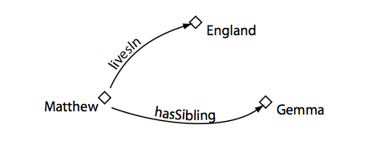
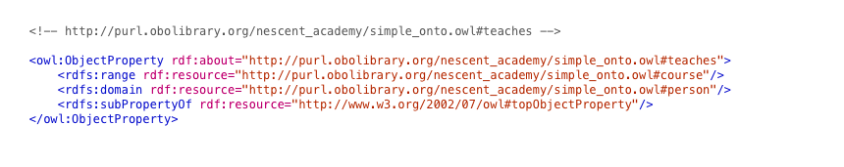
Object Properties
COURSE
Nescent
anatomy course
PERSON
teaches
Carlo
Object properties link an individual to an individual
The above representations means that the individuals Carlo and Nescent anatomy course are related through the teaches property
Properties may have a domain and a range specified. For instance the property teaches can have domain person and range course
Notes:
Example in Protégé through Object property

Slide 42
Datatype Properties
Datatype properties link an individual to an XML Schema Datatype value or an rdf literal
In other words, they describe relationships between an individual and data values
Datatype property may have domain and range
The domain can be only an OWL Class
The range can be some XML datatype or rdf literal
Torniai
has_last_name
Carlo

Slide 43
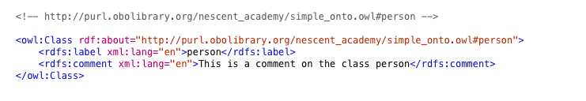
Annotation Properties
Annotation properties can be used to add information (metadata — data about data) to classes, individuals, object/datatype properties as well as ontologies itself (as we have seen)

Slide 44
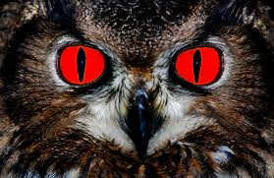
Protégé
Don’t panic: we won’t edit ontologies in a text editor ☺
We will use an Ontology editor
Application designed to assist in the creation or manipulation of ontologies
And Remember: when you manually edit an OWL file…
You go to OWL hell !!

Slide 45
Tutorial
Protégé tutorial

Slide 46
For later…

Slide 47
Property Domain and Ranges in OWL
In OWL domains and ranges should not be viewed as constraints to be checked!!
They are used as ‘axioms’ in reasoning
For example if the object property teaches has the domain set as person and the range set as course, we then apply the teaches property between Carlo and Fluffy, who is an individual of the class Pet
This would generally not result in an error
It would infer that the Fluffy must be a member of the class course
Unless Pets and Course are declared disjoint classes
Notes:
Here I have the protégé example…
Maybe something anatomical?

Slide 48
Some additional slides on Syntaxes..

Slide 49
Functional OWL Syntax
The OWL 2 Structural Specification describes what constitutes an ontology from a structural point of view
The first step towards concrete syntaxes is the functional syntax, which is a simple text based syntax that is used as a bridge between the structural specification and various concrete syntaxes
Notes:
OWL 2 Structural Specification: http://www.w3.org/TR/2009/REC-owl2-syntax-20091027/

Slide 50
RDF Based Syntaxes: OWL/XML
Neither standard XML tools like XPath or XSLT work well with RDF/XML representations of ontologies
There was a desire for a more regular and simple XML format
OWL/XML was invented as a concrete representation format for OWL ontologies
The format is essentially derived directly from the Functional Syntax

Slide 51
RDF Based Syntaxes: Turtle
Another RDF concrete syntax
This syntax is slightly less verbose and slightly more readable than RDF/XML
RDF based syntaxes do not really provide a convenient human readable format for representing complex OWL class expressions and OWL axioms

Slide 52
Acknowledgment
Some of the content is based form the OWL2 Web Ontology Language structural Specification and Functional-Style Syntax
http://www.w3.org/TR/owl2-syntax/
Some of the examples are taken from the Protégé OWL tutorial V1.3:
http://owl.cs.manchester.ac.uk/tutorials/protegeowltutorial/resources/ProtegeOWLTutorialP4_v1_3.pdf
Some material references Matthew Horridge (2010) OWL Syntaxes. Ontogenesis. http://ontogenesis.knowledgeblog.org/88

Slide 53
References
OWL:
http://www.w3.org/TR/owl2-overview/
OWL Syntaxe
http://ontogenesis.knowledgeblog.org/88
RDF:
http://www.w3.org/RDF/
Open World Assumption
http://en.wikipedia.org/wiki/Open_world_assumption
https://docs.google.com/present/view?id=dgxgr658_3dvdpxwhr

Slide 54
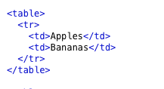

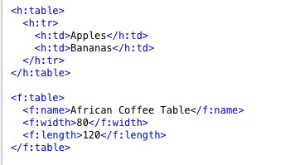

Namespaces

