Slide 1

An Introduction to OWL

Slide 2
What is OWL?
Web Ontology Language (OWL) is a language for writing ontologies for the Web
OWL 2 is the current version of OWL and a W3C recommendation as of October 2009
The previous version of OWL (OWL 1) was a W3C recommendation in 2004
An overview of the language can be found at: http://www.w3.org/TR/owl2-overview/

Slide 3
RDF
Ontologies support semantic classification of data
RDF is the data standard for the semantic web
Extremely simple and flexible data model (not a file format)
Also a W3C recommendation: http://www.w3.org/TR/2004/REC-rdf-primer-20040210/

Slide 4
RDF
Relate “things” with simple statements: triples
<subject> <predicate> <object>
<John> <hasPet> <Fido>
Everything has a global, unique identifier: URI
Objects/values can be “things” or literal values (text, number, date)

Slide 5
RDF data integration
Easy to combine separate datasets
  Shared identifiers
  Unordered collection of triples (facts)

Slide 6
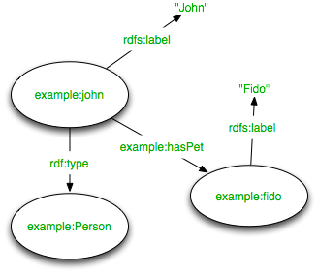
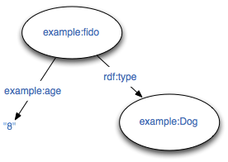
example:john example:hasPet example:fido
example:John rdfs:label “John”
example:fido rdfs:lable “Fido”
example:john rdf:type example:Person
Dataset 1
Dataset 2
example:fido rdf:type example:Dog
example:fido example:age “6”

Slide 7
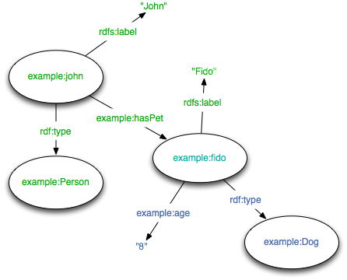
example:john example:hasPet example:fido
example:John rdfs:label “John”
example:fido rdfs:lable “Fido”
example:john rdf:type example:Person
example:fido rdf:type example:Dog
example:fido example:age “6”
Combined dataset

Slide 8
OWL - added semantics
Infer new RDF triples (facts) based on asserted axioms
OWL 2 Full - direct extension of RDF
OWL 2 DL - practical reasoning based on Description Logic
  strict separation of classes and instances
  entails some constraints on RDF

Slide 9
OWL primer
http://www.w3.org/TR/owl2-primer/

Slide 10
Satisfiability
Unsatisfiable class: impossible to have instances
Incoherent ontology: contains unsatisfiable classes
  still usable
Inconsistent ontology: contains instances of unsatisfiable classes
  not really usable: “anything follows from a contradiction”
  http://ontogenesis.knowledgeblog.org/1329

