Slide 1

Phenotype annotation
Jim Balhoff
NESCent Informatics, Phenoscape

Slide 2


Annotation
“Applying” ontologies to data
Tagging
Modeling — Knowledge Representation

Slide 3
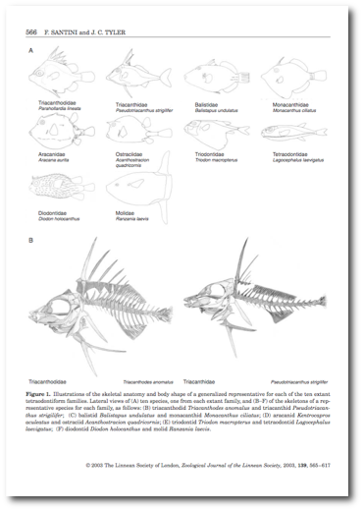
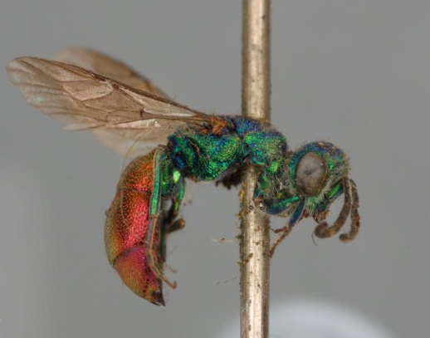
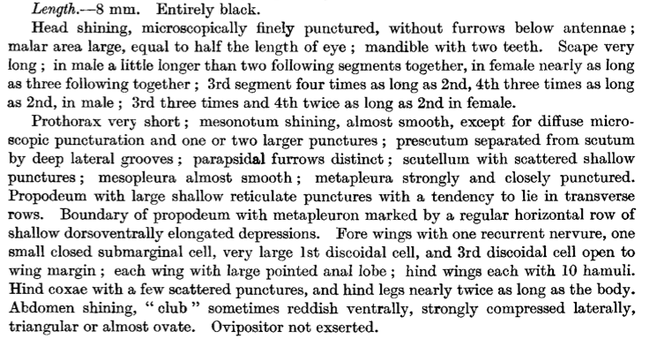
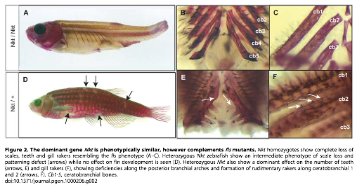
Phenotypic data
http://www.linnean-online.org/
Notes:
Comparative morphological studies
Specimen-based taxonomic descriptions
Developmental studies

Slide 4
Phenotype annotation
Ontology of phenotypes?
  Can be done, but could become unwieldy
Compositional approach: Entity–Quality

Slide 5
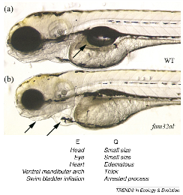
Entity–Quality model
Organism-specific anatomy entity terms are associated with more general phenotypic quality terms
Compositional approach allowing any number of features to be described for a given entity

Slide 6
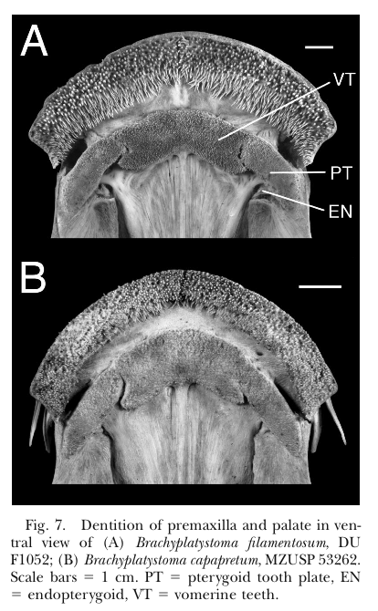
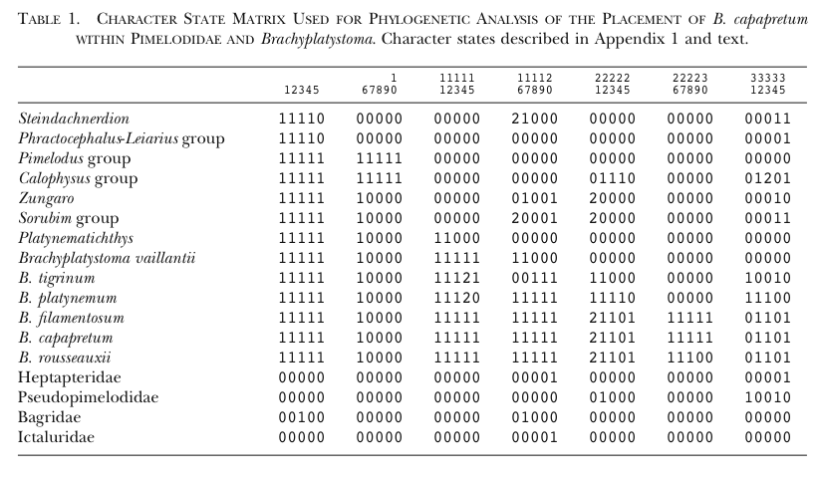
Brachyplatystoma capapretum: a New Species of Goliath Catﬁsh from the Amazon Basin, with a Reclassiﬁcation of Allied Catﬁshes (Siluriformes: Pimelodidae)
from Lundberg & Akama 2005
7. Ethmoid plate form: rounded [0]; quadrangular [1] (Lundberg et al., 1991b). Within Pimelodidae a uniquely derived and unreversed synapomorphy of Pimelodus group plus Calophysus group.

Slide 7
Entity-Quality Model for Evolutionary Phenotypes
Character
}
State
ethmoid plate form
rounded
morphology
shape
Entity (TAO)
Quality (PATO)
ethmoid cartilage
round
EQ phenotype

Slide 8
Creating annotations
Phenote — generic, configurable table editor
  loads ontologies, provides term autocomplete
Phenex — specialized for character matrix annotation
Custom web interfaces
Protégé OWL editor

Slide 9
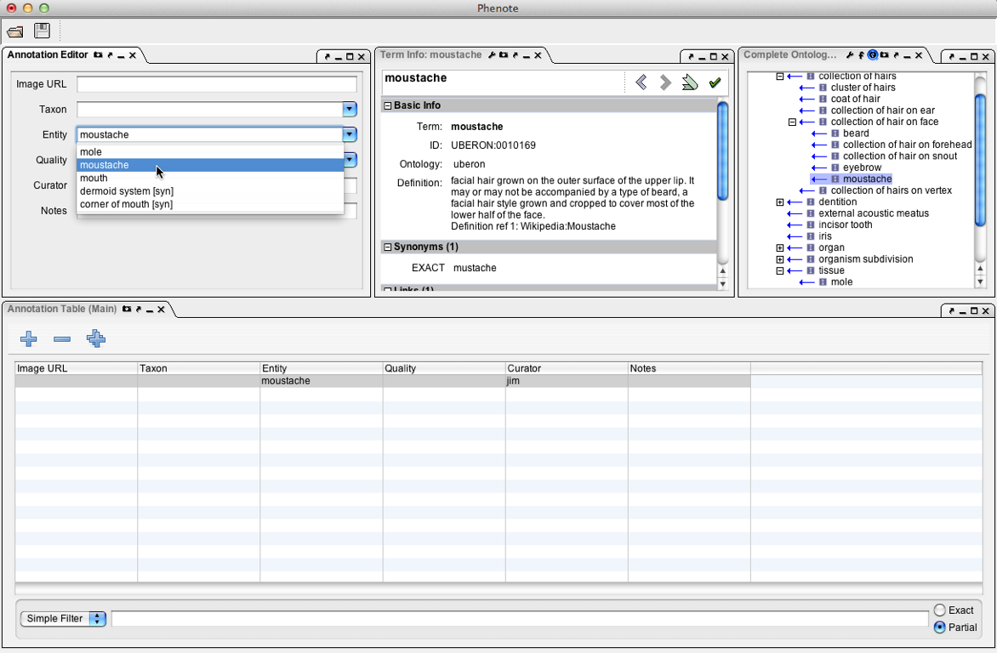
Phenote

Slide 10
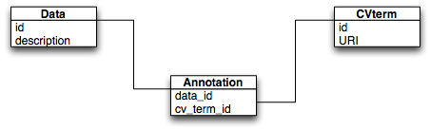
Using annotations
Tagging/keyword — provide search for data using ontology hierarchy
  “Yellow bristles apparent on head”
  PATO:yellow, HAO:seta, HAO:head

Slide 11
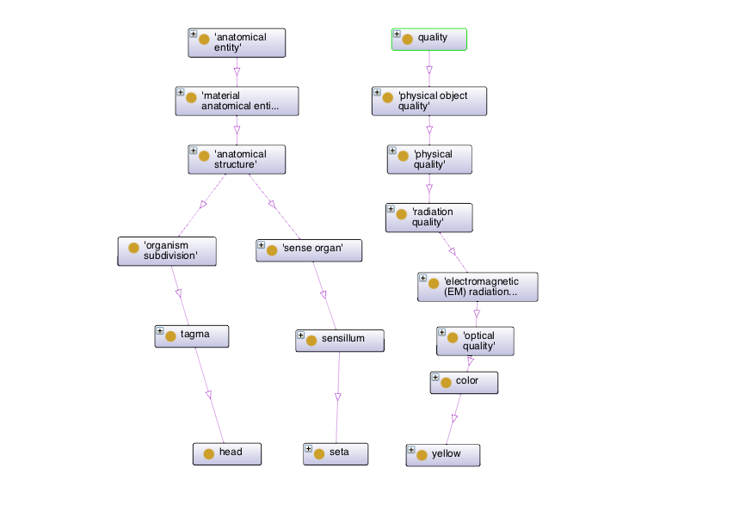
Can expand keyword query using hierarchy-aware middleware

Slide 12
Using annotations
“Yellow bristles apparent on head”
E and Q are not always sufficient
Post-composition: E = “bristle which is part of head”
L? — locator (“head”)
RE: Related/Dependent Entity — needed for some PATO qualities (“sensitivity toward”)
Notes:
we chose 3 terms, not just 2
where do they go?
locator -> ZFIN
could just use them all as tags, or start developing a richer model

Slide 13
Using annotations
Knowledge representation
  Construct semantic model using EQ components
  “Extend” ontology
  Describe class of organisms or structures using a logical definition

Slide 14
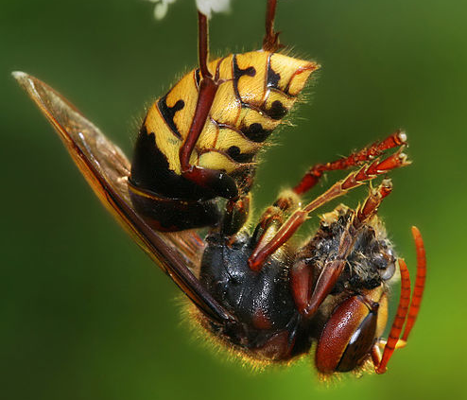
Using annotations
“Yellow bristles apparent on head”
OWL class expression
  has_part some (head and has_part some (seta and bearer_of some yellow))
head
seta
yellow
Type
Type
Type
has_part
has_part
bearer_of
_:x
_:y
_:z

Slide 15
Using annotations
Can use semantic annotations in reasoner enabled environments
  OWL-API code, Protégé
    Reasoners: HermiT, FaCT++, Pellet, ELK
  ZFIN, Phenoscape KB, Virtual Fly Brain

Slide 16
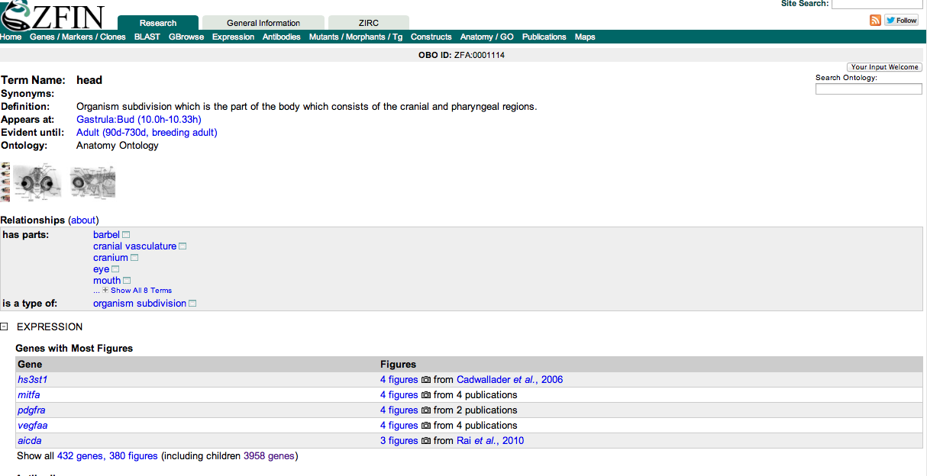
ZFIN annotations

Slide 17
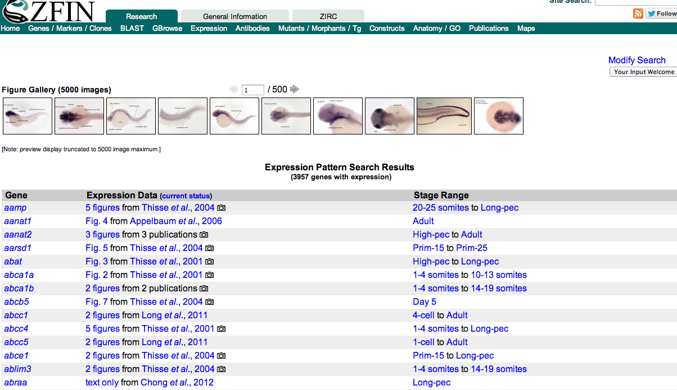
ZFIN annotations

Slide 18
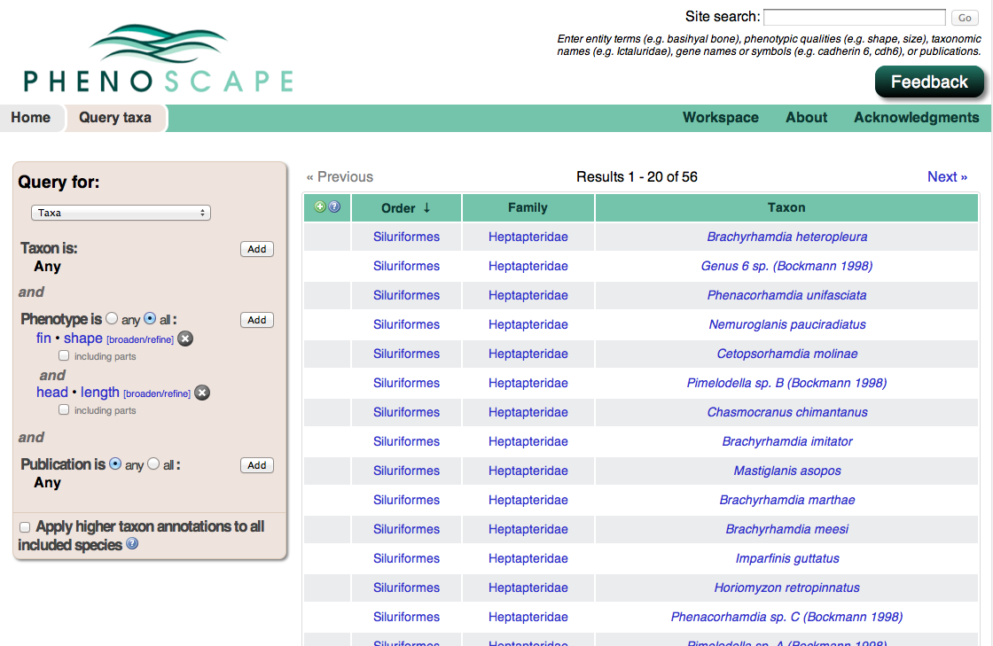
Phenoscape KB

Slide 19
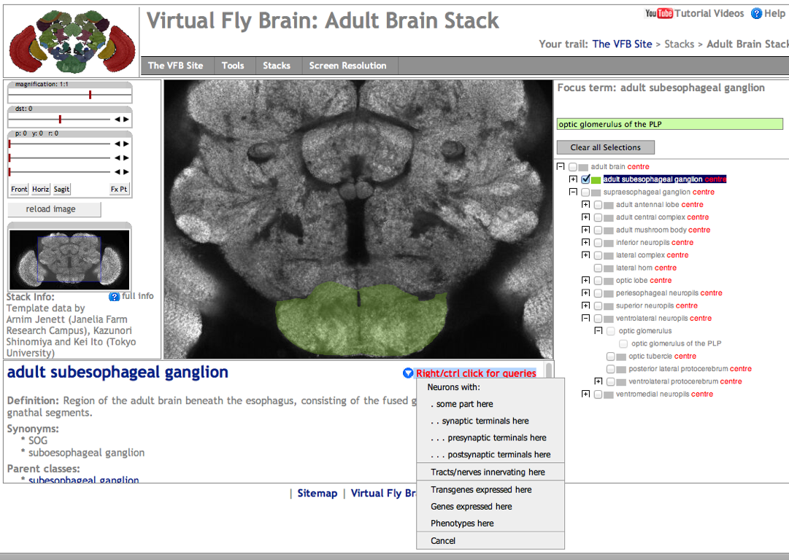
Virtual Fly Brain

Slide 20
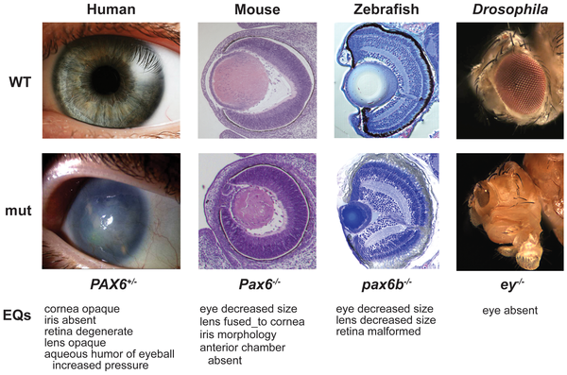
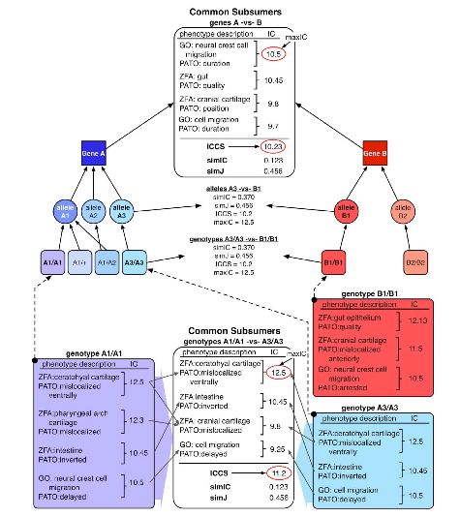
Semantic similarity
Washington N.L., Haendel M.A., Mungall C.J., Ashburner M., Westerfield M., Lewis S.E. 2009. Linking human diseases to animal models using ontology-based phenotype annotation. PLoS Biology. 7:e1000247. http://dx.doi.org/10.1371/journal.pbio.1000247

Slide 21
Phenex exercise
Download: http://phenoscape.org/wiki/Phenex
Data file: OLeary_et_al_2013.xml
Examples: Phenoscape curators’ guide to character annotation: http://phenoscape.org/wiki/Guide_to_Character_Annotation

