Slide 1

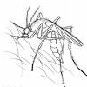
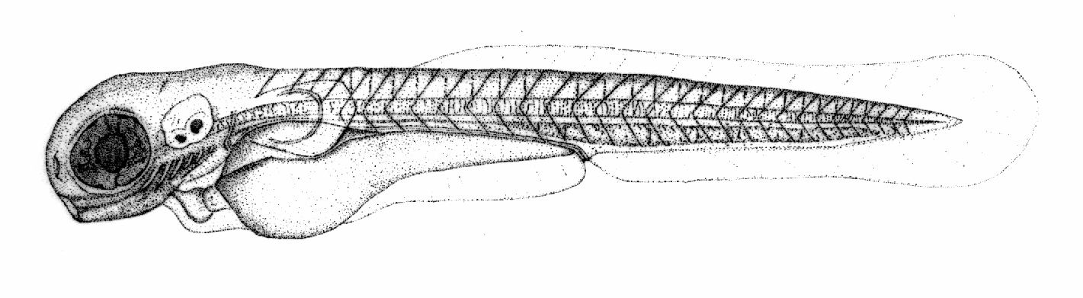





Ontology Best Practices
Melissa Haendel

Slide 2
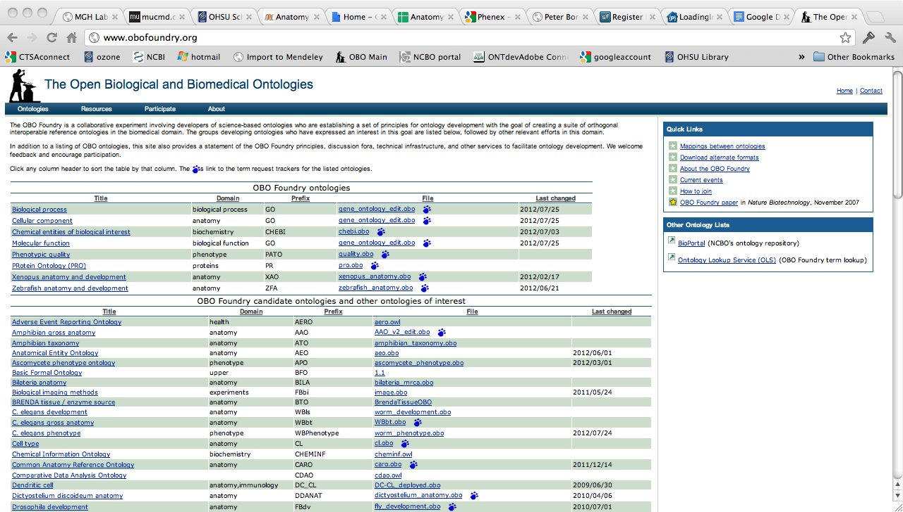
The OBO Foundry
http://www.obofoundry.org/
More than just a website, we are a community of ontology developers dedicated to working together using common principles

Slide 3
What is the difference between the OBO Foundry and the OBO Library?
A little history:
OBO Foundry established to be inclusive of ontologies that had been peer-reviewed and met OBO Foundry Principles
Numerous others wanted their ontologies included, and these were added to the OBO-Library on a to-be-reviewed basis
Over time, this approach was not sustainable, because the review process was lengthy and standards for review were in their infancy
The processes by which ontologies are released in multiple formats, pushed to Ontobee, etc. are performed on all the OBO library ontologies
Now:
We have been documenting new review practices and guidelines and reviewing the OBO Principles (Editorial working group)
We are developing more sophisticated mechanisms to manage ontologies (Technical working group)
We will be promoting the Foundry as a community and the OBO library as an integrated set of ontologies (Outreach working group)

Slide 4
OBO Foundry Principles
The purpose? To create a community of standards and collaboration that promote interoperability and quality development practices
FP 001 open
FP 002 format
FP 003 URIs
FP 004 versioning
FP 005 delineated content
FP 006 textual definitions
FP 007 relations
FP 008 documented
FP 009 users
FP 010 collaboration
FP 011 locus of authority
FP 012 naming conventions
FP 013 genus differentia
FP 014 BFO
FP 015 single inheritance
FP 016 maintenance
FP 017 instantiability
FP 018 orthogonality
FP 019 content
http://obofoundry.org/wiki/index.php/Category:Principles

Slide 5
Principle 01 - Open
Principle 02 - Format
The official OWL version of the ontology must have two annotations using the properties
dc:license
rdfs:comment
The license type goes in the dc:license field.
Recommended value: Creative Commons 3.0 CC-by license
The mode of attribution goes in the rdfs:comment
Common formal language in an accepted concrete syntax
OBO Format
OWL or OWL2 concrete syntax
RDF/XML
OWL2-XML
OWL2-Manchester Syntax
Common Logic concrete syntax
Principle 11 – Locus of authority
Principle 16 – Maintenance
Single person who is responsible for the ontology.
Additional contacts and lists are welcome.
Maintenance in light of scientific advance

Slide 6
Principle 03 - URIs
Principle 04 - Versioning
Each class and relation (property) in the ontology must have a unique URI identifier.
The URI should be constructed from a base URI, a prefix that is unique within the Foundry (e.g. GO, CHEBI, CL) and a local identifier (e.g. 0000001).
The local identifier should not consist of labels or mnemonics meaningful to humans.
The ID-space / prefix must be registered with the OBO library in advance.
http://www.obofoundry.org/id-policy.shtml
Email OBO-discuss and make a tracker item for prefix requests.
The ontology provider has procedures for identifying distinct successive versions
Principle 12 – Naming conventions
Have a plan that you can consistently apply, avoid acronyms, homonyms, plurals, catch-all terms.
See http://www.obofoundry.org/wiki/index.php/Naming

Slide 7
Principle 05 –
delineated content
Principle 06 –
textual definitions
Clearly specified and clearly delineated content
Textual definitions for a substantial and representative fraction. For terms lacking textual definitions, there should be evidence of implementation of a strategy to provide definitions for all remaining undefined terms.
Principle 08 - documented
Ontology is documented in a published paper or in manuals for developers and users

Slide 8
Principle 09 - Users
Principle 10 - Collaboration
The ontology has a plurality of independent users
It is assumed that OBO Foundry ontology developmentis carried out in a collaborative fashion and maintained in to ensure consistency with neighboring OBO Foundry ontologies.
Principle 18 – Orthogonality
Principle 17 - instantiability
ontology A orthogonal_to ontology B = A and B share no terms with the same meaning, modulo Mireoting
All the types represented by the terms in the ontology should be instantiable
types = what are described in textbooks
instances = what we observe, measure, perform experiments on

Slide 9
Principle 07 – relations
Principle 13 – Genus Differentia
The ontology uses relations which are unambiguously defined
Text definitions should be of the form:
An A (the superclass) that has differentiating characteristic(s) B
Principle 14 – BFO
Principle 15 – Single inheritance
Ontologies should be conceivable as the result of populating downwards from some fragment of BFO
Single asserted subclassing further subclassing is inferred

Slide 10
Foundry take-home messages
Use numeric URIs so that the meaning is truly in the definition and not the label
Make sure all entities have either text or logical defs, both is best.
Use a unique label for your classes – think about this in the context of the whole world, its ok to have community specific labels in addition to the unique label.
Use Version Control, and release versions
Delineate content and build according to your requirements – don’t attempt to represent all of reality!
Use upper ontologies and design documents to help structure your work
Document, document, document!

Slide 11
When to obsolete
Why are we discussing this in the communities section?
Because deprecating a class and the reasons for doing so are incredibly important to your community of users
Deprecate = Obsolete ≠ Destroy = Delete
Has your ontology been made available to the public? If yes, consider obsoleting rather than deleting. (Note- keeping your ontology in GoogleCode is public!! Once an ID is out in the wild, it needs to be tracked.)
Has the text or logical definition of the class or property changed substantially? Remember, the ID is attached to the logical/non-logical definition, NOT the label. Changing a label does not require obsolescence.
Is the term confounded and needs to be split or merged into another class? Consider using the replaced_by or consider annotation properties on obsoleted entities to point users to the right new entities
Communicate ontology changes, in particular obsolescence, in release notes and VC commits

Slide 12
Intrinsic ontology evaluation

Slide 13
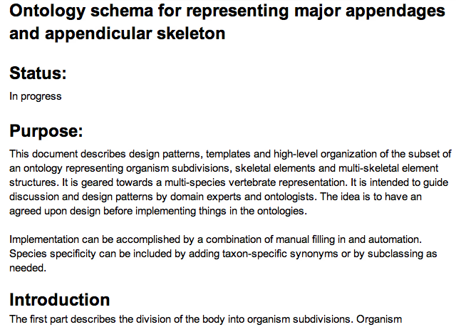
It’s all too easy just to dive in. Design documents help you plan ahead, ensure you are meeting requirements, and collaboratively decide design features.
http://bit.ly/OcMj9f
Example:

Slide 14
Metadata standards
Just like a class or property definition, we all need to use annotation properties in the same way. Note that we are working towards full interoperability between OBO standards and the IAO core metadata ontology. Here are some standards sources.:
OBO Annotation standards
http://www.geneontology.org/GO.format.obo-1_4.shtml#S.1.1
Information Artifact Ontology Core Metadata
http://code.google.com/p/information-artifact-ontology/wiki/OntologyMetadata
W3C standards:
http://www.w3.org/TR/2009/REC-owl2-quick-reference-20091027/#Annotations

Slide 15
Ontology documentation
Where does it happen?
Potentially too many places and at the same time, not enough!
Wikis: a nice public way to describe the overall content. Examples: uberon.org, http://code.google.com/p/eagle-i/wiki/Documentation
Commit messages. Example: https://code.google.com/p/cell-ontology/source/detail?r=44
Releases and release notes. Example: http://obi-ontology.org/page/Releases/2012-07-01
Internal documentation

Slide 16
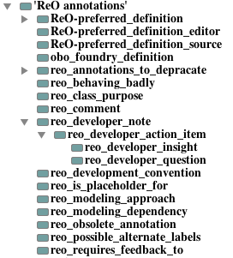
Internal documentation
We have a lot of annotation properties for this: Definitions, Definition source, Comments, Editor Notes, Feedback_to, etc. This is one of the best places to keep documentation of design choices- right in the ontology.
ReO- Reagent ontology- we are experimenting with defining more standard annotation properties. These will eventually go into IAO.
http://reagent-ontology.googlecode.com/svn/trunk/src/ontology/reo.owl
These properties allow query of the ontology – for example, generate term requests from all classes annotated with “requires_feedback_to”

Slide 17
Quality textual documentation and definitions
Definitions must not only describe a concept, but allow determination of real instances
Requires consideration of specific and precise concepts to be defined
This is where listing out properties and their use for definition are very helpful
=> Need a ‘concept first approach’ to definition creation

Slide 18
A ‘Concept-First Approach’ Example
Terminology of molecular labels is inconsistent: ‘probe’, ‘tracer’, ‘detector’, ‘reporter’, used variably to describe reagents with different characteristics
Conformance to varied label conventions has led to confusion, ambiguity, and inconsistency in different ontologies
Throw out the labels and consider the biologically important axes:
Axis 1 = Targeting: ability to specifically associate with a molecular target
Axis 2 = Detectability: ability to emit or produce some detectable signal
Notes:
We like to call this a concept first approach . . . . here is an example of modeling ‘molecular labels’, an area where the terminology is varied and imconsistent

Slide 19
A ‘Concept-First Approach’ Example
Axes applied to yield a set of principled subclasses,
and a more descriptive labeling scheme is applied
AXIS 2: DETECTABILITY
YES
NO
COVALENT
REPORTER
COVALENT
TRACKER
NO
(Alexafluors,
radioactive nucleotides)
(biotin,
digoxygenin)
AXIS : TARGETING
TARGETED
REPORTER
TARGETED
TRACKER
YES
(DAPI, coomassie,
labeled oligo probes)
(unlabeled antibodies,
oligo probes)
Results vetted by members of different stakeholder communities
Notes:
We like to call this a concept first approach . . . .

Slide 20
Label Bias
A common source of problems is developers imposing assumptions about the semantic content of a label.
Best to avoid using terms with varied and ambiguous meaning as primary labels . . .
e.g. ‘molecular probe’, ‘cell line’,
. . . or be careful to document this ambiguity, and give a precise definition that is clear about its specific view
OBO Foundry principle suggests use of numeric URIs which helps avoid label bias.
e.g. URIs not like http://xyzweb.org/ont/core#Position
But instead like: http://xyzweb.org/ont/core_43888887

Slide 21
Evaluating text definitions
Are all classes and properties defined? Do they avoid use of figurative or obscure language? Are there citations?
Are essential features for distinguishing from other classes included?
Aristotelian/genus-differentia structure is good for this
Especially important for imported classes
Is circularity avoided?
e.g. ‘specimen collection objective’ defined as the ‘objective to collect a specimen’
Are there clear instances in reality? Test against a set of candidate instances

Slide 22
Testing Definitions Against Instances
Example: ‘genetic material’
complex and nuanced concept, subject to varied interpretations
precise definition needed for use in diverse research communities (genomics, experimental biology, model organisms)
many definitions found on web are correct but vague and insufficient (not precise enough to delineate instances in reality)
e.g. “material of plant, animal, microbial or other origin containing functional units of heredity”
Notes:
MHB will make slide for #4 about capturing the correct extension from evaluating ‘genetic material’ - the test example of a cloning vector in a bacteria highlighted a problem with our definition and our structure of putting ‘genomic material’ as child of ‘genetic material’

Slide 23
Testing Definitions Against Instances
A more precise definition
“a nucleic acid macromolecule that is part of a cell or virion and has the disposition to be replicated and inherited by descendants.”
Start testing against instances
chromosomal DNA in dividing cells
chromosomal DNA in post-mitotic cells
Problem encountered already: a disposition for replication is not relevant in post-mitotic cells
Solution: Refine Definition
“a nucleic acid macromolecule that is part of a cell or virion and is inherited from an immediate ancestor, or incorporated in a manner that it has the disposition to be replicated and inherited by descendants.”
Notes:
“a nucleic acid macromolecule that is part of a cell or virion and is inherited from an immediate ancestor, or incorporated in a manner that it has the disposition to be replicated and inherited by descendants.”

Slide 24
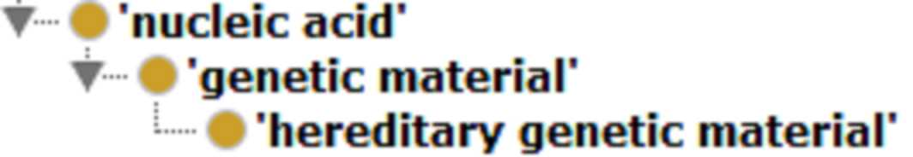
Testing Definitions Against Instances
Continue testing against instances
3. a gene targeting DNA construct transfected into a cell
4. a transiently transfected DNA expression construct
5. a microinjected siRNA oligo in a cell
Problem: some instances expected to be grouped with genetic material, but don’t meet our strict definition
Solution:
Rename original class with more descriptive label ‘hereditary genetic material’, and
Implement new ‘genetic material’ as a more inclusive parent class
Notes:
- Original class renamed more precisely as ‘hereditary genetic material’
- Subclassed under a new, more inclusive ‘genetic material’ class that covers any expressed nucleic acid in a cell/virion

Slide 25
Other Textual Documentation
Does the ontology include extensive synonyms?
Does the ontology include other internal documentation such as edit history? Creator/editor? Status? Modeling notes?
Are there examples of usage? Counter examples?
Sometimes a concept is so complex that a definition cannot disambiguate exclusion or inclusion.

Slide 26
Example of a difficult to define entity
Reagent:
a material entity that bears a reagent role by virtue of it being intended for application in a scientific technique to participate in (or have molecular parts that participate in) a chemical reaction that facilitates the generation of data about some distinct entity, or the generation of some distinct material specified output
A ph meter probe fits our best definition, but is not considered a reagent by biologists =>> document!

Slide 27
Is there complete metadata?
Can use scripts to check ontology for a number of important metadata bits
missing definitions, labels, source, example of usage
duplicate labels
mismatched synonyms
Inclusion of some sort of curation status or metadata complete annotation to indicate readiness of entities

Slide 28
Quality logical expressions
No true path violations
Common mistakes are to forget that the distant ancestors definitions apply, and misunderstandings about transitive properties. These are not always caught by reasoners.
A balance of realism and practicality
Are the concepts as expressed in the text definition aligned with the logical expressions?
Are there many concepts used in logical expressions for which there would be no instances collected?
Does the inferred classification makes sense biologically?

Slide 29
Ontology reuse
Is the ontology orthogonal to others (an OBO priniciple)?
Does the ontology reuse entities from other ontologies at key intersection points?
Does the ontology include a subset of external entities with the closure, or import entire external ontologies?

Slide 30
Testing the ontology against data
It is important to validate the ontology against real data. But this is the intrinsic talk, you might say…..
Data often tells you that your ontology has errors.

Slide 31
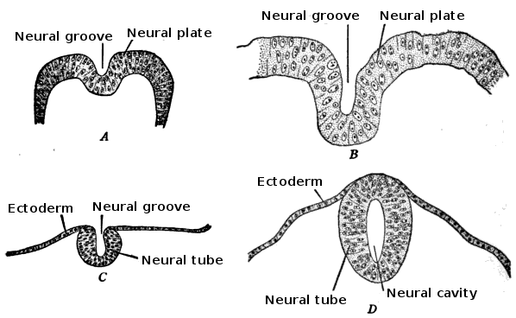
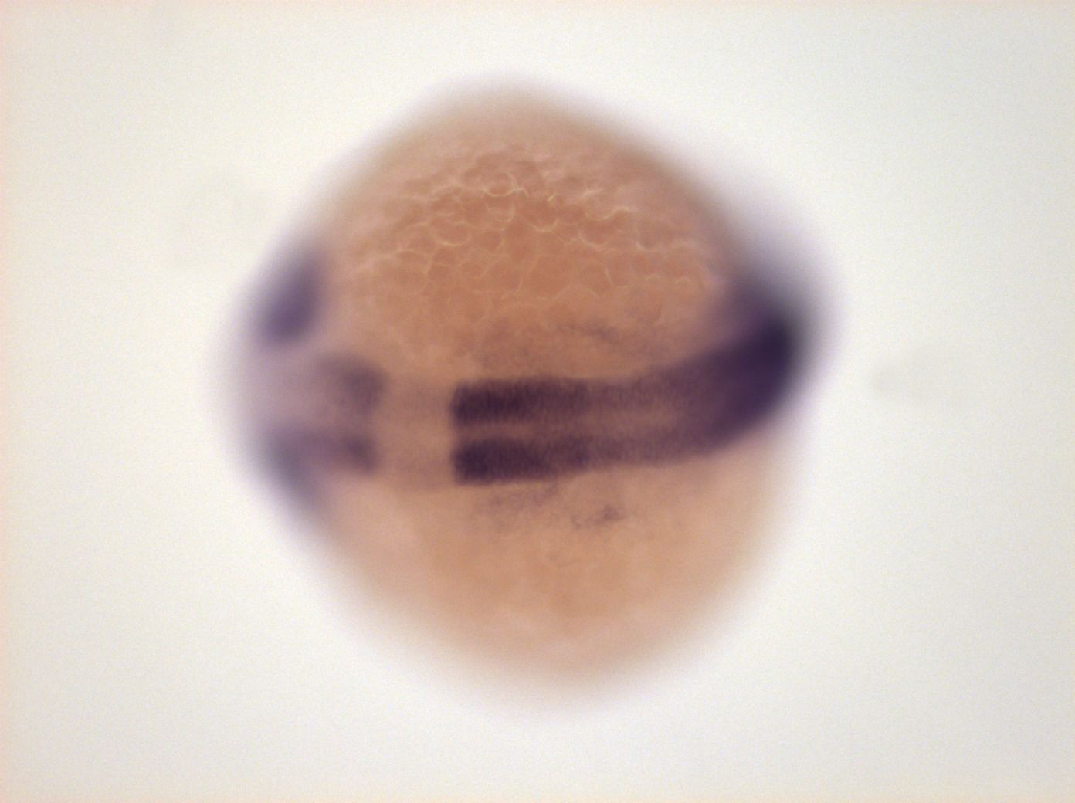
Iterative data-ontology evaluation
Ontology classes:
Neural plate
Neural tube
Ontology stage class definitions:
5-9 somites->10-13 somites
10-13 somites->prim5
Neural tube
Instance data:
9 somites
Neural plate or neural tube?

Slide 32
Ongoing intrinsic issues for development of biological ontologies
Lacking tools to enable visualization/editing via other transitive relations
Better ability to synchronize pieces of ontologies reused in another ontology
Standards for documentation, annotation properties and layering/import approaches for documenting in ontologies themselves, mechanisms for linking out to trackers/lists, wikis
Better ways to roll together text definitions from dependent classes

