Slide 1
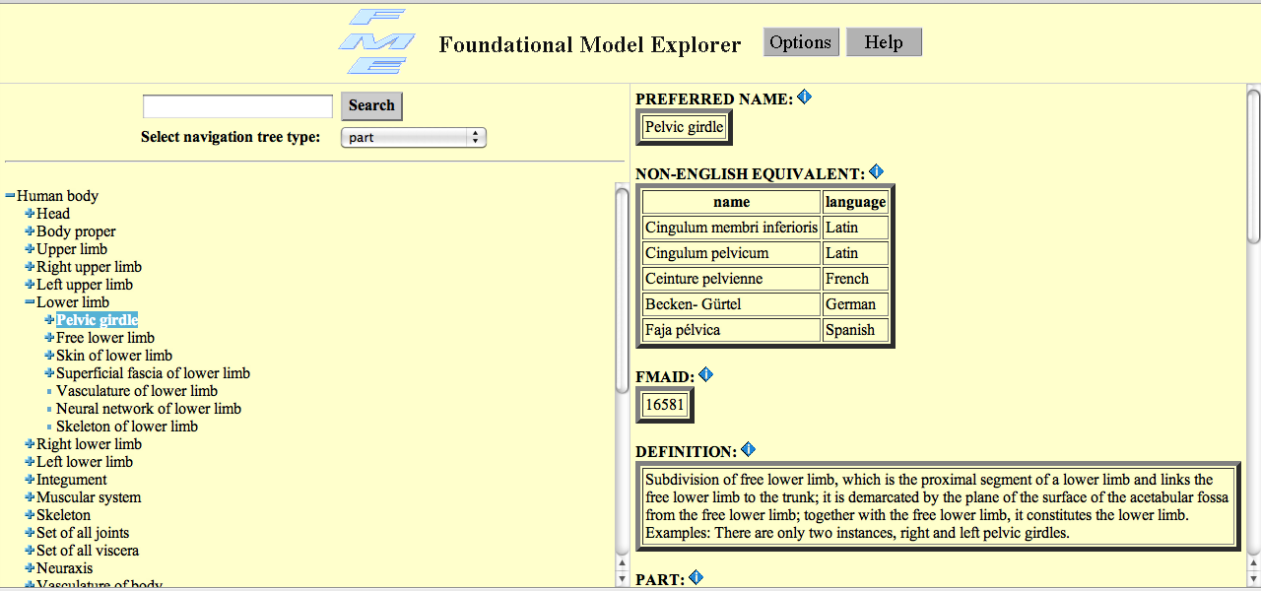
The Foundational Model of Anatomy
http://fme.biostr.washington.edu:8080/FME/index.html
One of the largest (83,281 classes) and earliest anatomy ontologies, purely structural differentia

Slide 2
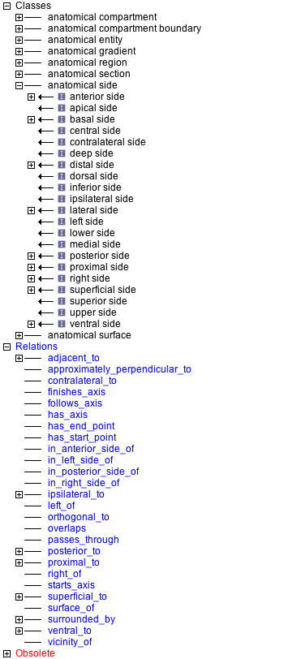
Spatial.obo

Slide 3
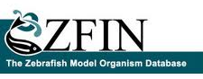
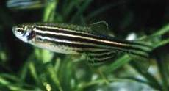
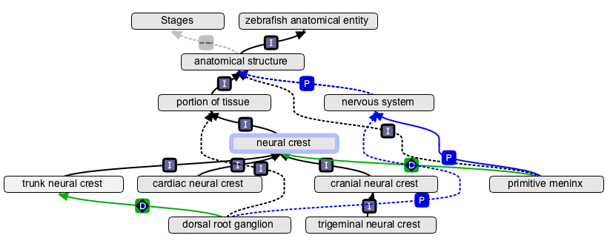
Species-centric ontologies The Zebrafish Anatomy Ontology
Used to record gene expression and phenotypes at different stages of development

Slide 4
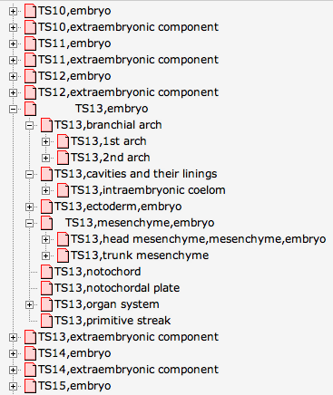
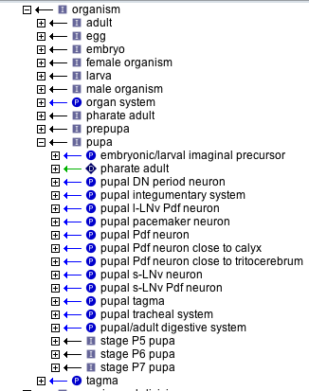
Representing development: three different approaches
pancreas
Start stage
End stage
Hatching:Long-pec
Adult stage
Zebrafish- each structure has a start stage and an end stage
EMAP mouse anatomy – each granular developmental stage has a partonomy
Fruitfly – partonomy by life cycle stage

Slide 5
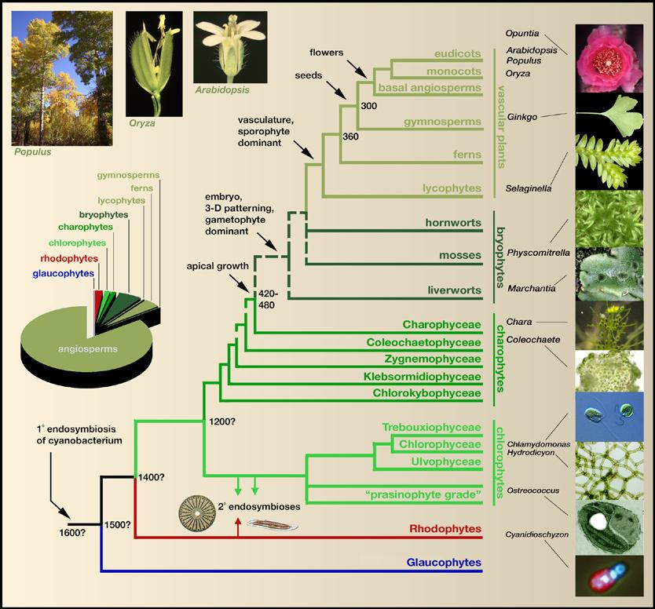
Multi-species anatomy ontologies
The Plant Ontology
Seed plants
(Angiosperms and Gymnosperms)
Pteridophytes
(Ferns and Lycopods)
Bryophytes
(Mosses, Hornworts and Liverworts)
Algae
Challenge is in representing diversity in anatomy, morphology, life cycles, growth patterns
Bowman et al, Cell, 2007
Notes:
Seed plants: angiosperms and gymnosperms
Pteridophytes: ferns and lycopods- selaginella
Bryophytes: mosses, liverworts, and hornworts
Algae

Slide 6
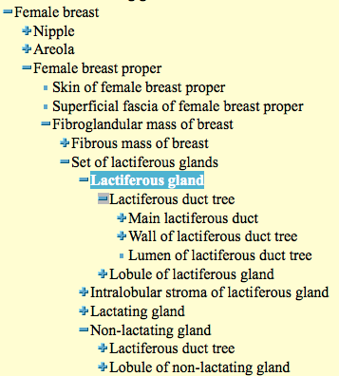
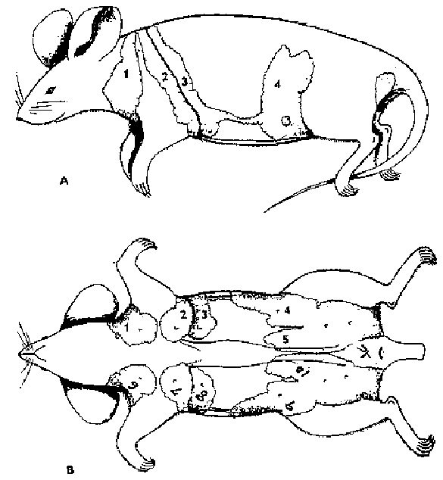
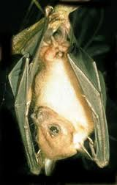

Ontologies built for one species may not work for others
http://ccm.ucdavis.edu/bcancercd/22/mouse_figure.html
http://fme.biostr.washington.edu:8080/FME/index.html

Slide 7
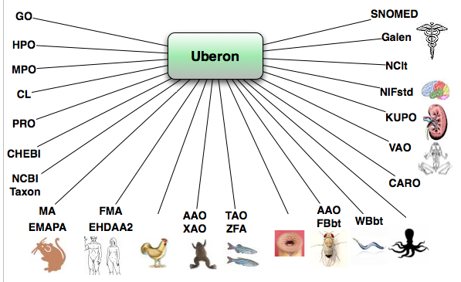
Uberon – a multi-species ontology for phenomics and evo-devo analyses
Uberon.org

Slide 8
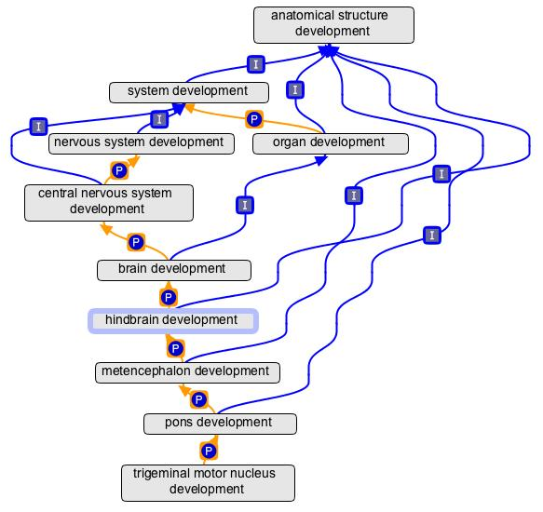
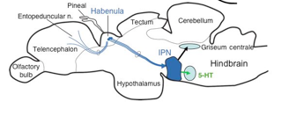
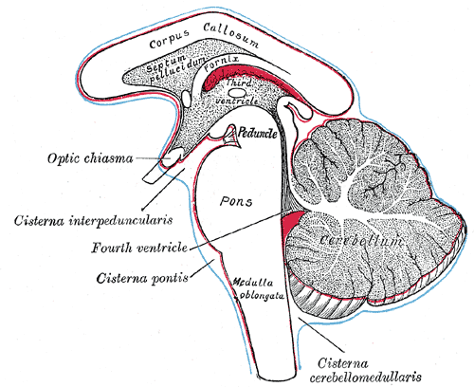
The Gene Ontology has an anatomy ontology
zebrafish
Look ma, no pons!
human
Notes:
Never in taxon

Slide 9
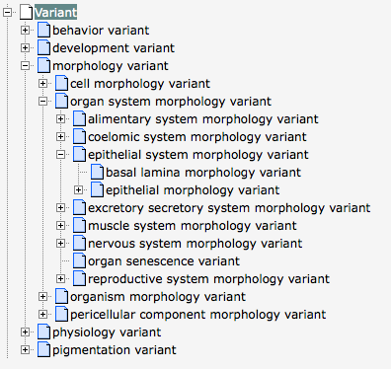
Phenotype ontologies also have inherent anatomy
WBbt
C. elegans
phenotype
Designed primarily for annotation of phenotypes within a single species

