Slide 1
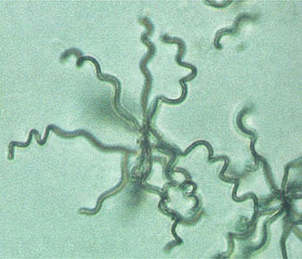
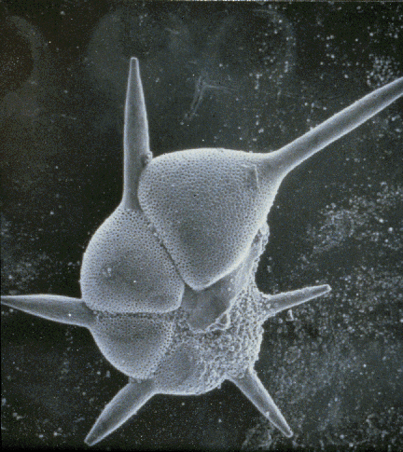
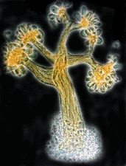
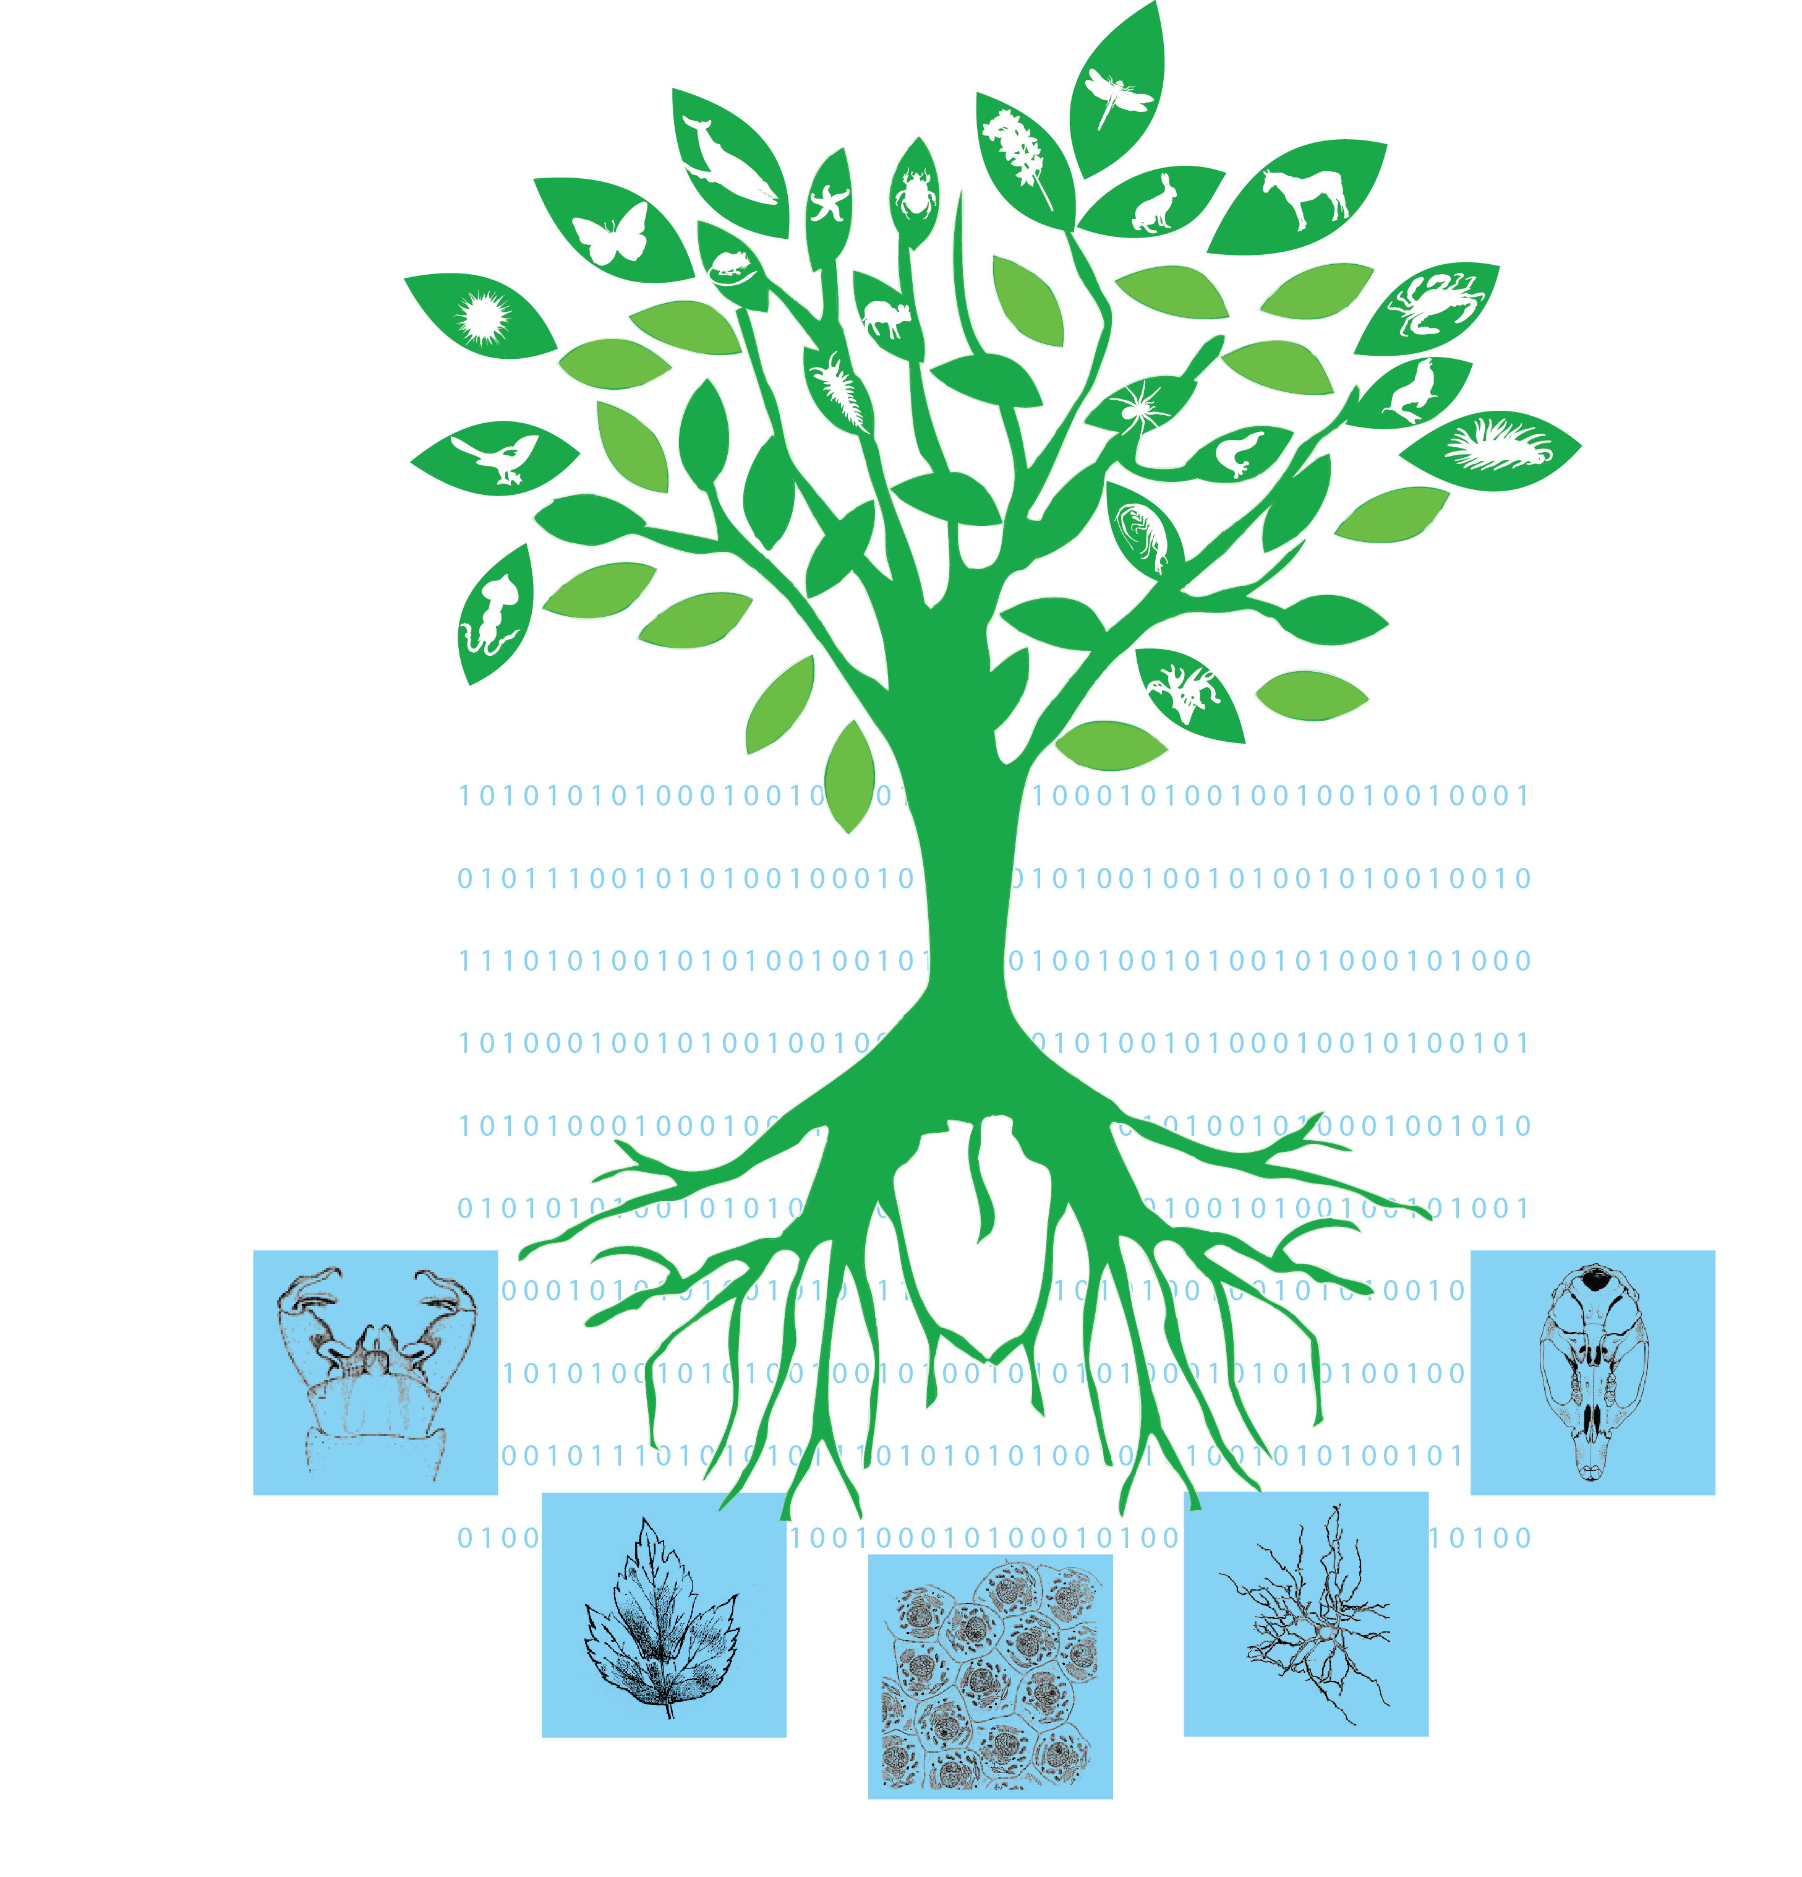
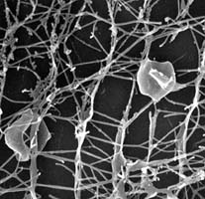
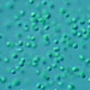
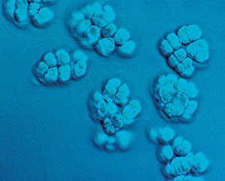
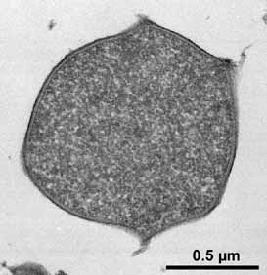
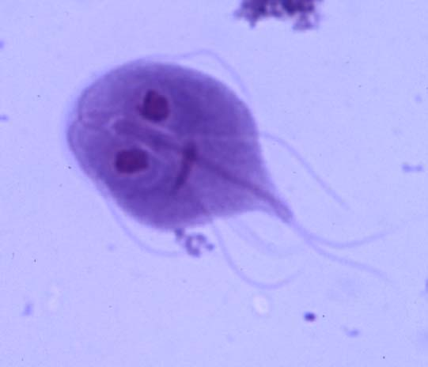
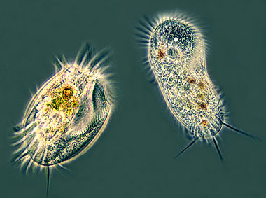
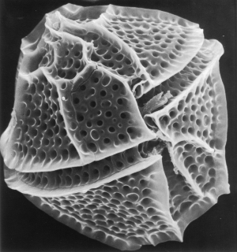
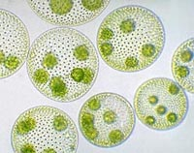
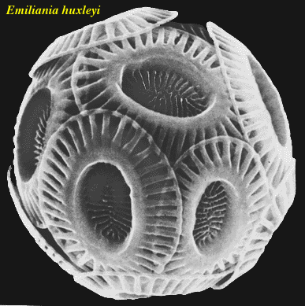
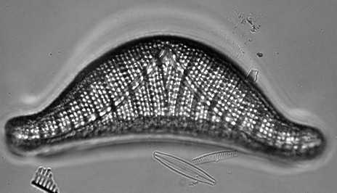
Next Generation Phenomics for the Tree of Life ....needs a Microbial Ontology!
Taking up phenomic data, making matrices and building trees

Slide 2
Natural Language Processing Tools
1. Annotate Characters from a Text Description (CharaParser – semantic identification of characters/terms using an ontology)
2. Translate Annotated Description Files to
Character Matrix (presence/absence)
3. Most work focused on Plants, less on Sponges & Diatoms
4. Extend Methods for Taxa Across the
Tree of Life
5. Integrate with OpenTree and Arbor to visualize character evolution across the Tree of Life

Slide 3
Microbial Descriptions are a Challenge
Different have different styles of taxonomic descriptions, character states and ecological traits
No microbial ontology to identify terms and relationships between terms for all/many microbes
Existing tools and non-microbial ontologies fail
Need a comprehensive microbial specific ontology

Slide 4
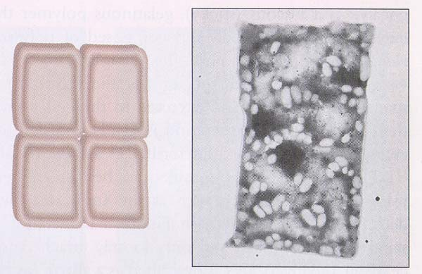
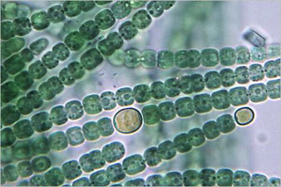
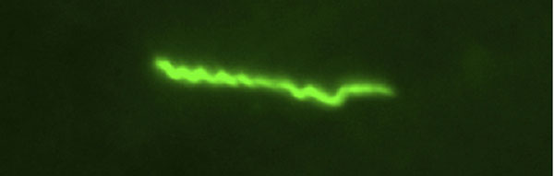
Spreadsheet of Terms
Collected terms from
400 descriptions of Archaea
107 from Mycoplasmas (pathogenic bacteria)
98 from Cyanobacteria
Many types of terms
metabolic (glucose, trehalose, oxygen, nitrate)
pH range (4-7.5, optimum 6.5), temp range (45-85C, optimum 70C), salinity range & optimum
shape (coccoid, bacillus, filamentous)
habitat (microbial mat, ocean, lake, stream sediment)
antibiotic resistance, lysis susceptibility

Slide 5
Vue File

Slide 6
Plans
Think about the core structure that will best leverage information/logic power in an ontology
Merge existing ontologies
Add to these ontologies
Existing Microbial Ontology (designed for E. coli)
CHEBI (Chemical entities of biological interest)
PATO (Phenotypic quality)
GO (Gene Ontology)
Request for additions to CHEBI and PATO?
Add additional classes and class restrictions

Slide 7
Use the Ontology
Use the ontology to extract and identify terms from microbial taxonomic descriptions
Automatically populate large character matrices
Study character evolution to facilitate
evolution/time
ecology
systematics
heavy emphasis on visualization

