Slide 1
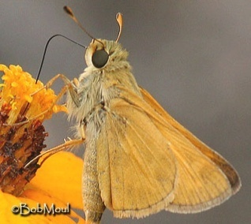
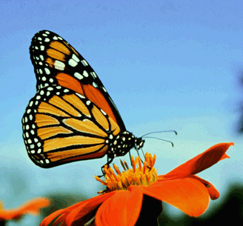
Ontologies for Butterflies
Ontologies Workshop
NESCent 2013
Elise Larsen
eliselarsen.umd@gmail.com
Project with:
Leslie Ries, SESYNC

Slide 2
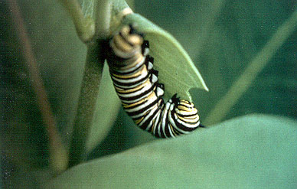
Main Project Goals
Knowledgebase for North American butterflies
(US, Can, Mexico)
Work with BAMONA, EOL
Life history information
Photos
Parameter values from published studies
Analytical approaches for monitoring data
Transect (state)
Checklist (NABA)
Opportunistic (museum and web portal)

Slide 3
Main Project Goals
Public access to monitoring data – for scientists and the general public
NABA
State programs (current in red, upcoming in green)
Academic programs (hatched red)
Visualization tools for data exploration
Maps
Trends

Slide 4
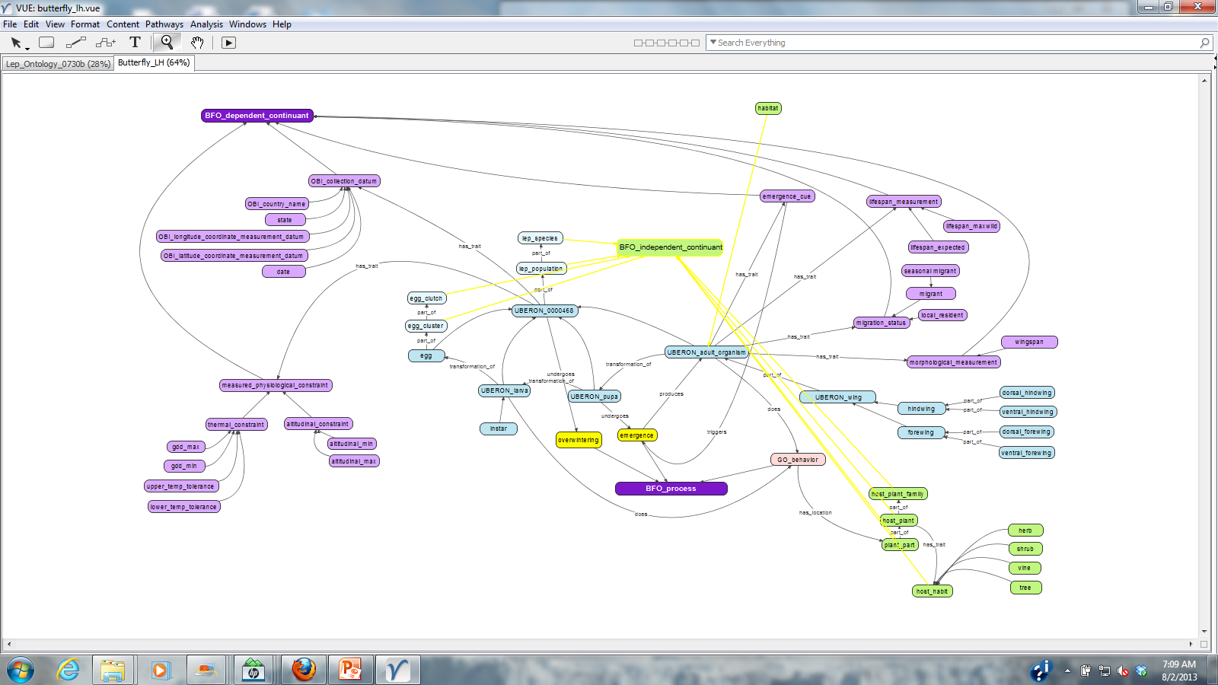
Vue File – Butterfly Life History & Ecological Traits
ENVO

Slide 5
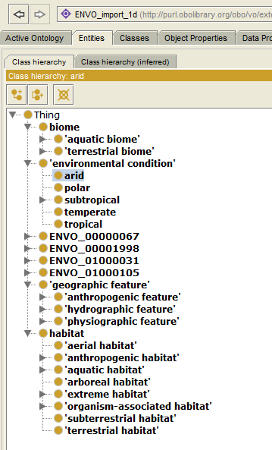
ENVO
Pros:
-Already addresses habitat
-Several useful excerpts
-detailed biome vocabulary
Cons:
-Inconsistent development
-many terms without text
definitions
-inconsistent use of axioms
-areas of interest less developed

Slide 6
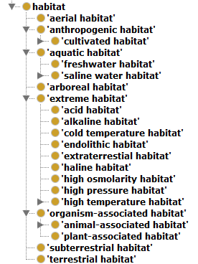
ENVO “Habitat”

Slide 7
HABITAT
BIOME A
uses
HABITAT A
Geographic Feature A
Definitions using
Env. Conditions?

Slide 8
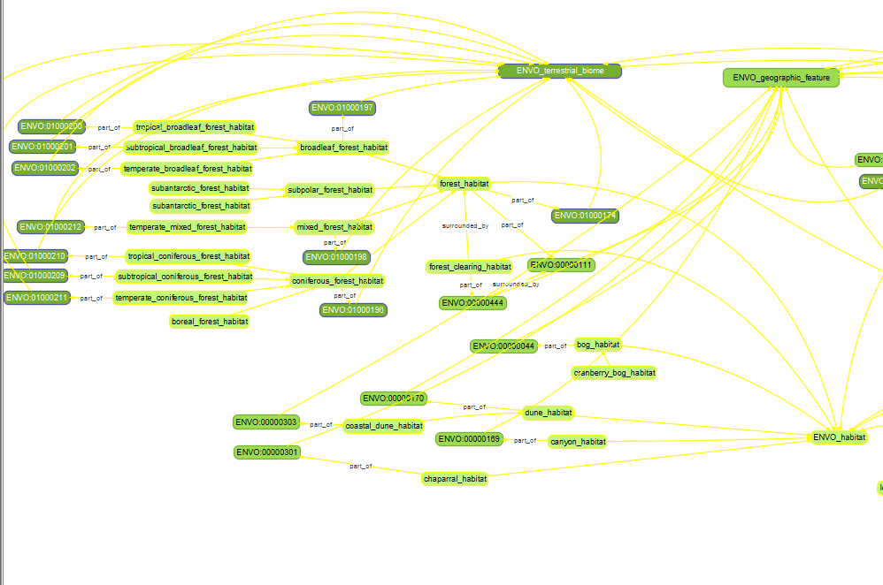
Vue File – Habitats to add in ENVO?

Slide 9
Progress
Brainstormed “habitat” ontology importing ENVO
Included logical definitions for some new classes
Started with more easily defined classes: desert biome
Brainstormed logical definitions
Associated environmental conditions, plants, etc
Connected to ENVO curators (Thanks Melissa)
and joined some listservs

Slide 10
Moving Forward
Big Question:
How can ontologies be most useful for our butterfly knowledgebase?
Next Steps:
Develop a better understanding of object properties
ID effective way for axioms based on numeric value (eg pH)
Take part in ENVO development

