Slide 1
Microcontroller Designs
Tommy Vu
Steven Peek
Dylan Davis
Nathan Hoffman

Slide 2
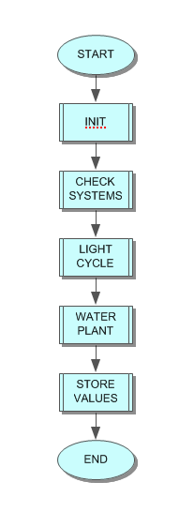
Main
The main method of the
microcontroller will water the
plants, store the values, and
take the pictures.

Slide 3
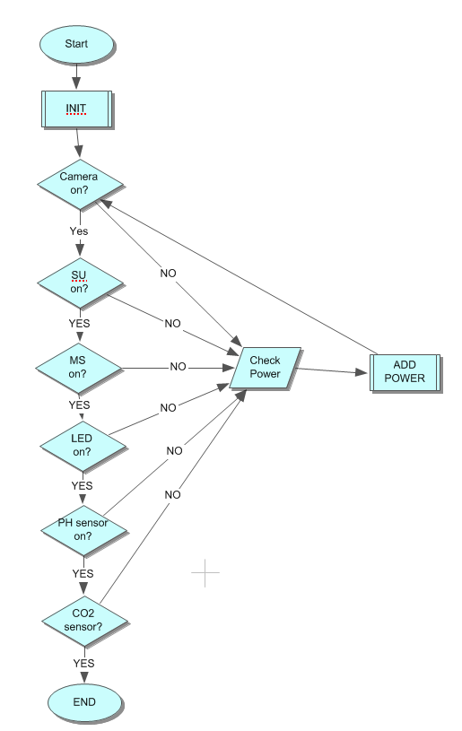
Systems Check
The system checks all sensors to make sure that sufficient power is reaching all of the sensor that we need.

Slide 4
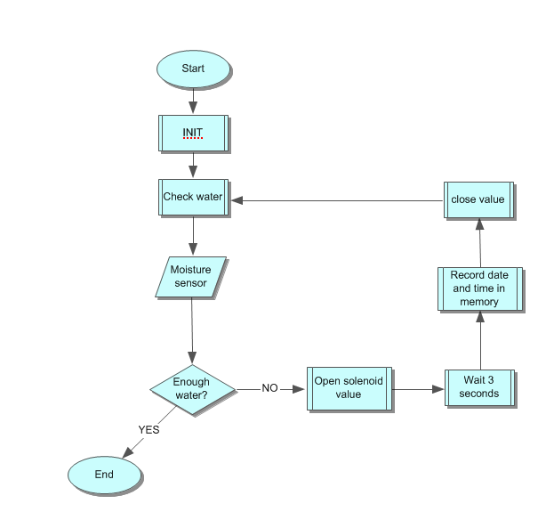
Water Plant
This system checks the water level and if needed opens the solenoid value for a set amount of time.
The microcontroller then records the date and time.
After it records and it closes that value and then checks the water level again.

Slide 5
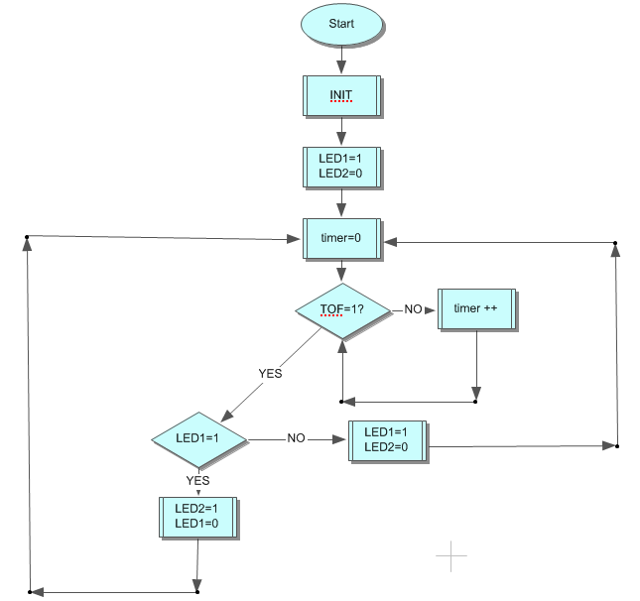
Light Cycle
LED1=Red
LED2=Blue
The light cycle program starts with the red on and the blue off.
The timer turns over every 12 hours.
When the timer equals 1 the microcontroller checks the Red LED. If red LED is off then it is turned on and the blue LED is turned off.
If the red LED is on the it is turned off and the blue LED is turned on.

Slide 6
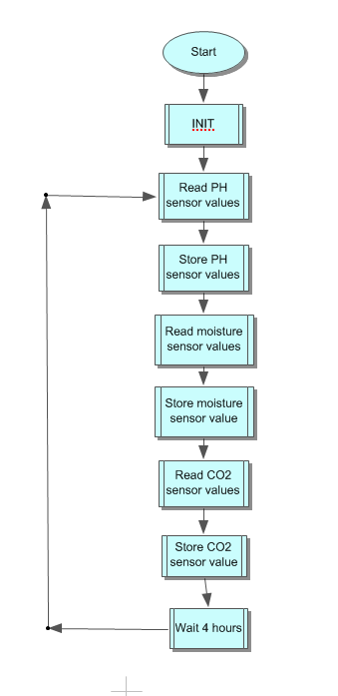
Store Data
This system reads all of the sensor values and then stores them.
The program then resets after 4 hours.

Slide 7
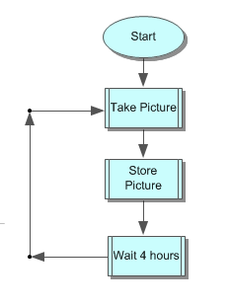
Take Picture
This system tells the camera to take a picture, store it and then wait 4 hours to repeat.

