Slide 1
Testing the accuracy of conservative regridding
Alexander Pletzer 24 Feb 2017

Slide 2
What is conservative regridding (in 2D)?
Bilinear vs conservative interpolation
Bilinear:
Field is nodal
Target is point
Interpolation weight is basis function evaluated at target position
Basis function is linear in the dimensions
Conservative:
Field is zonal (cell centred)
Target is area
Interpolation weight is basis function integrated over target area
Basis function is constant within cell

Slide 3
Graphically speaking…
Bilinear
Weight = area opposite to node
Conservative
Weight = overlap area

Slide 4
Why conservative interpolation is hard
Source grid
target
Find all the source cells containing the target nodes
Find all the intersections of target edges with source faces
Find all the intersections of target faces with source edges
Find all the source nodes inside the target

Slide 5
How to handle masking – not all cells are equal
Valid cell ratios
Valid face ratios
Valid edge ratios
On/off nodes
Attach a valid fraction cell to each cell
Attach a valid fraction face to each cell face
Attach a valid fraction edge to each edge cell
Attach on/off values to nodes

Slide 6
How to check the accuracy of conservative interpolation?
Field must be varying (at least linearly)
Either source or target grid must be non-trivial (overlap areas must be non-trivial)
Integral of field over any source or target cell must be known analytically
Ideally have some masking

Slide 7


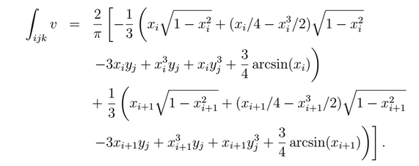
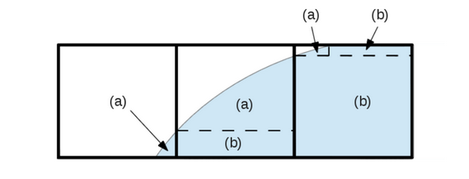
Poiseuille flow
Use exact integrals to set source field
Fully valid cell
Partially valid cell

Slide 8
Target grid can be polar

