Slide 1
Efficient conservative interpolation on 2D structured grids
Alexander Pletzer and Chris Scott 17 Jan 2017

Slide 2
Conservative interpolation requires computing the overlap between src and dst cells
Red: dst cell
Blue: src grid
{dstCellIndex: {srcCellIndex0: area0, srcCellIndex1: area1, …}

Slide 3
Need to compute intersection of two structured grids
Must split each dst grid cell into triangles that are entirely contained within src grid cells
To do this, must collect:
The dst grid nodes inside src grid cells
The src grid nodes inside the dst grid cells
The intersection of dst grid cell edges with scr grid cell edges

Slide 4
Use the grid to grid intersection points to triangulate each dst grid cell
Red: dst cell
Blue: src grid

Slide 5
Naïve algorithm for computing intersection points scales in # of src cells (N) * # of dst cells (M)
dstCellIndexToSrcCellIndex = {}
For dstCell in dstCells:
For dstCellNode in dstCell.getNodes():
# find dstCellNode location in src grid index space
point = findGridIndex(dstcellNode.getPosition(), srcGrid) # Newton search
dstCellIndexToSrcCellIndex[dstCellIndex][srcCellIndex].append(point)
For dstCellEdge in dstCell.getEdges():
# compute intersection of dstCellEdge with src grid
For srcCell in srcCells:
For srcCellEdge in srcCell.getEdges():
pos = findIntersection(srcCellEdge, dstCellEdge)
If pos is along dstCellEdge:
dstCellIndexToSrcCellIndex[dstCellIndex][srcCellIndex].append(point)
O(M)
O(16*N*M)

Slide 6
Faster implementation of edge to edge intersection
Collect all the dst cell node positions in src grid index space (as before)
For dstEdge in dstGrid.getEdges(): ~ O(M*2)
Get the start and end point of the edge in src grid index space (quick since we know the dst grid node positions in src grid index space)
Iterate over x and y direction: ~ O(2)
Iterate over the the src grid lines falling within the start/end edge locations: ~ O(sqrt(N/M))
Compute the intersection point of the src grid line with the edge
Infer the srcCellIndex from the intersection point
dstCellIndexToSrcCellIndex[dstCellIndex][srcCellIndex].append(point)
O(sqrt(N) * sqrt(M))

Slide 7
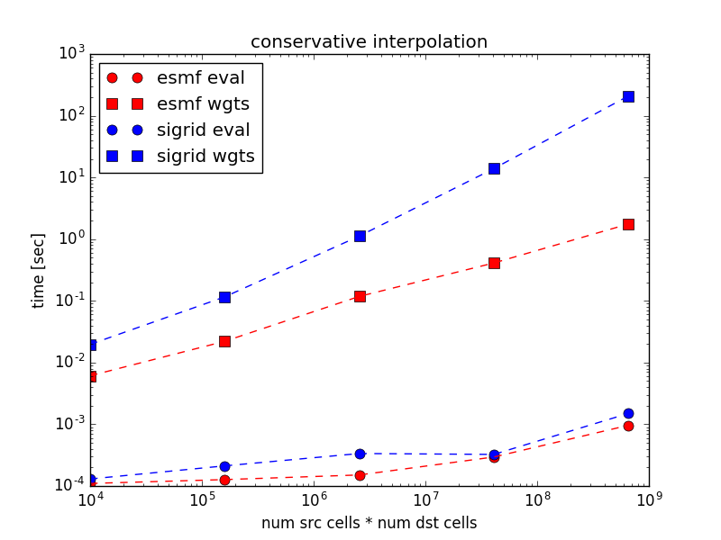
ESMF performance scales as sqrt(N * M)
O(N*M)
O(sqrt(N*M))

