Slide 1
X-fast and y-fast tries
Beating BST
Yunze Lian, Christopher Liao

Slide 2
Motivation
Reference: http://web.stanford.edu/class/cs166/lectures/15/Slides15.pdf
I take images and content from link above.
Many applications use deal with integers.
Integers only have so many bits.
If we know ahead of time that we are dealing with integers, can improve performance.
Do better than general purpose data structure (BST)

Slide 3
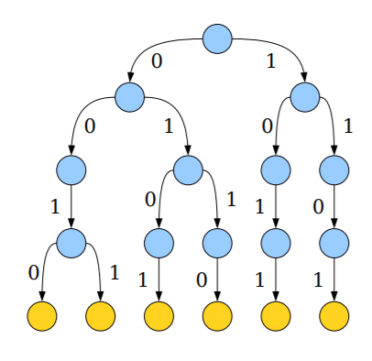
Bitwise Trie
A Trie is a prefix tree.
Good for storing strings.
Integers are just strings of bits.
Example: simple bitwise-trie used to store 4-bit integers.
Lookup time is number of bits O(log N).

Slide 4
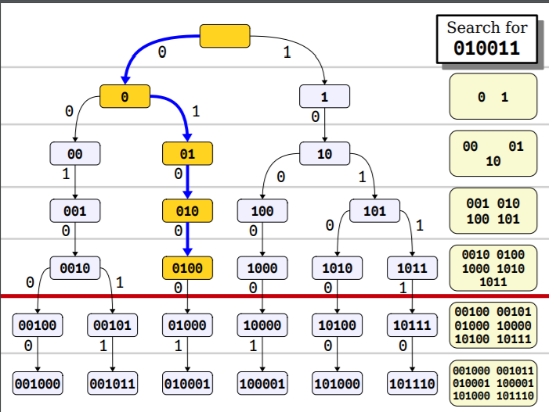
Reducing look-up time using hash table
Store prefix at each layer in a hash table.
Lookup time for preflix at each layer O(1).
Can binary search across layers for longest prefix.
Lookup time is O(log log N).

Slide 5
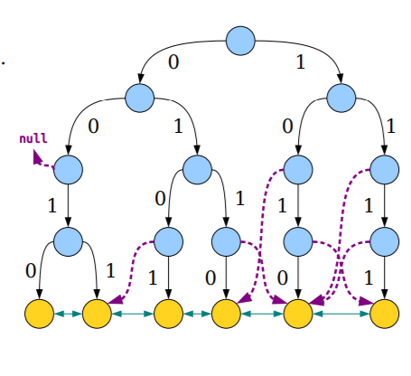
X-fast Trie
Prefixes at each level stored in hash table.
All data stored in leaves.
Internal node with only one child uses free pointer to point to either predecessor or successor leaf.
Leaves stored in doubly linked list.

Slide 6
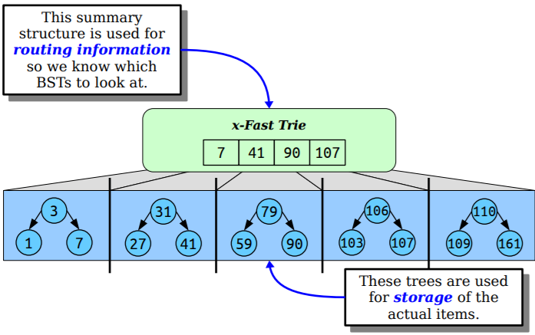
Y-fast Trie
Two level data structure.
Split data into chunks of size log(N).
Each chunk organized in BST.
Max value of each chunk stored in X-fast trie.

Slide 7
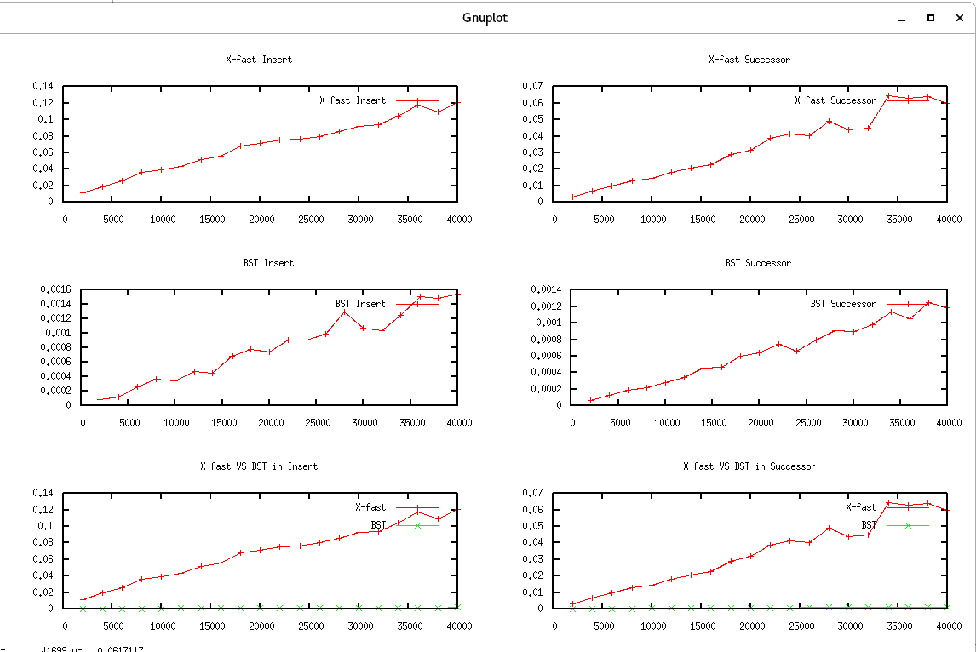

Slide 8
Complexity comparison
 | BST | X-fast Tries | Y-fast Tries
Space | O(n) | O(n log M) | O(n)
Search | O(log n) | O(log log M) | O(log log M)
Insert | O(log n) | O(log M) | O(log log M)
Delete | O(log n) | O(log M) | O(log log M)
Successor | O(log n) | O(log log M) | O(log log M)

