Slide 1
.NET and C#

Slide 2

.NET
.NET is a free and open-source framework for Windows, Linux, and macOS operating systems.
Notes:
C# was designed by Anders Hejlsberg, and its development team is currently led by Mads Torgersen. The most recent version is 8.0, which was released in 2019 alongside Visual Studio 2019 version 16.3.

Slide 3


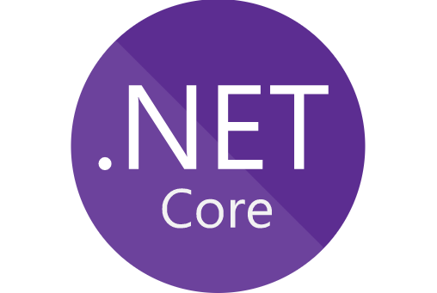
.NET Siblings
1
2
3
Notes:
.NET Framework: Supports entire API canvas and a variety of application platforms. Windows only.
Mono: Open source platform based on the .NET Framework and the ECMA standards for C# and the Common Language Infrastructure (CLI).
.NET Core: Runs on any platform. New lean modular cross-platform and open source version of .NET, written from ground up.
.NET Siblings (Alternate Implementations)

Slide 4
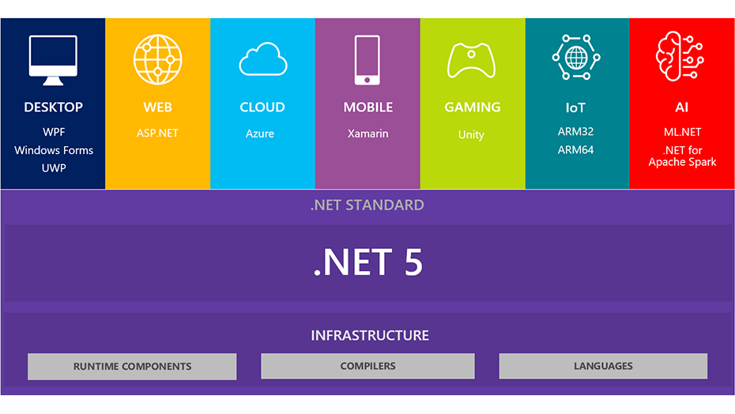
.NET 5
Notes:
.NET Framework: Supports entire API canvas and a variety of application platforms. Windows only.
Mono: Open source platform based on the .NET Framework and the ECMA standards for C# and the Common Language Infrastructure (CLI).
.NET Core: Runs on any platform. New lean modular cross-platform and open source version of .NET, written from ground up.
.NET Siblings (Alternate Implementations)

Slide 5
.NET History
1999
.NET Framework Started
2000
.NET 1.0 beta release
2001
CLI and C# ECMA verified
2004
Mono 1.0
2007
.NET 3.5 under Microsoft Reference Source License.
2017
.NET Core 2.0
2002
Microsoft and Intel worked to standardize CLI and C#
Mono Announced
.NET 1.0
2016
.NET Core 1.0
2015
CoreRT
2014
.NET Native (UWP)
.NET Core announced
2012
.NET 4.5
2010
.NET 4.0
Unity
2009
MonoTouch for iOS 1.0
2008
.NET 3.5
2003
ISO also Standardize both CLI and C#.
.NET Compact Framework 1.0
2006
.NET 2.0
Mono AOT
.NET Micro 1.0
Silverlight 1.0
2019
.NET Core 3.0
.NET 4.8
2020
.NET 5
2011
Mono for Android 1.0
.NET 6
2021

Slide 6
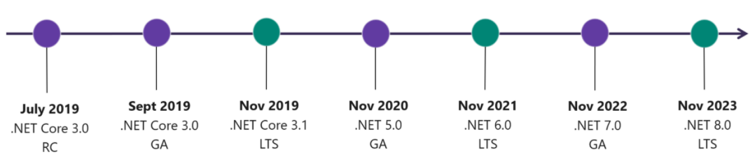
Versioning

Slide 7


.NET Architecture
CLI
CLR
Assemblies
Class Libraries: BCL/FCL
App models
Notes:
CLR - Execution engine of .NET Framework and offers many services such as memory management, type safety, exception handling, garbage collection, security and thread management.
FCL- provides user interface, data access, database connectivity, cryptography, web application development, numeric algorithms, and network communications.

Slide 8
.NET Design Principles
Interoperability
Language independence
Type safety
Portability
Security
Memory management
Performance

Slide 9
.NET Languages
C#
F*
Fantom
IronPython
IronScheme
JScript .NET
Limnor Studio
Managed Jscript
Nemerle
Oxygene
PeachPie
Phalanger
PowerBuilder
Small Basic
Silverfrost FTN95.
Synergy DBL .NET
Team Developer
Visual Basic .NET (VB.NET
Visual COBOL
PowerShell
X#
C++/CLI
ClojureCLR
Cobra
Component Pascal
Eiffel
F#

Slide 10
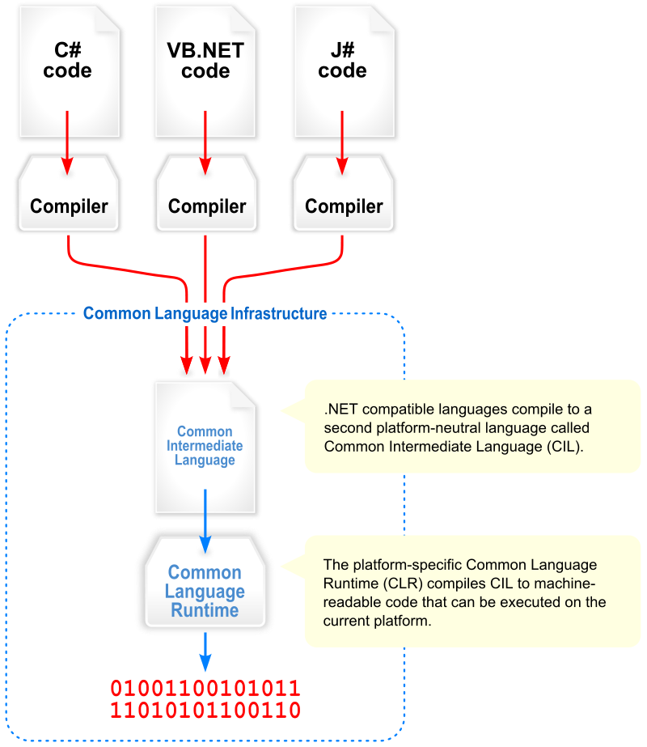

Slide 11
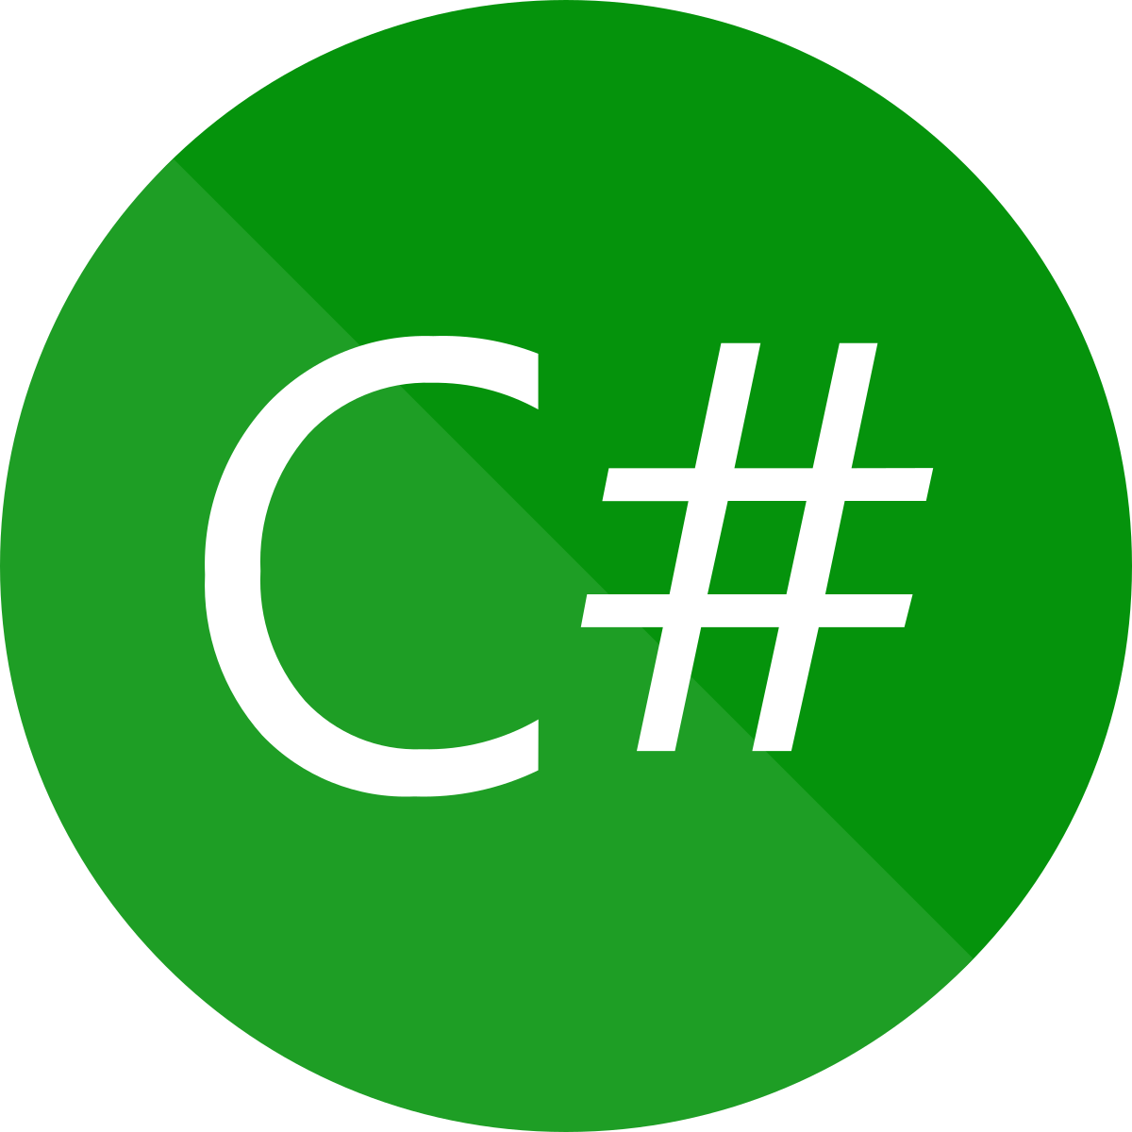
C# Programming Language
A general-purpose, multi-paradigm programming language encompassing strong typing, imperative, declarative, functional, generic, object-oriented and component-oriented programming disciplines.
C# is one of the programming languages designed for CLI.
Notes:
C# was designed by Anders Hejlsberg, and its development team is currently led by Mads Torgersen. The most recent version is 8.0, which was released in 2019 alongside Visual Studio 2019 version 16.3.

Slide 12
Distinguishing features (with C, C++, and Java)
Portability : Could generate machine code
Typing : var, new[], bool, safe implicit conversions etc.
Meta Programming : Attributes
Methods and functions : Scope modifier virtual keyword unlike Java, extension methods, dynamic for runtime method binding, strongly typed function pointer with delegate etc.
Property : Encapsulation for pair of methods – accessor (getter) and mutator (setter) operations
Namespace : Code isolation
Memory Access : Memory address pointers can be used with unsafe blocks
Polymorphism : No multiple inheritance, operator overloading unlike Java
LINQ : Querying IEnumerable<T> object, XML docs, ADO.NET Dataset and SQL database
Functional Programming : first-class functions and closures through anonymous delegates, lightweight lambda expressions, extension methods, list comprehension, tuples and pattern matching
Notes:
C# compiler could generate machine code like traditional compilers of C++ or Fortran.
bool (strict, integer is not assumed true/false), more type safe than C++ (safe implicit conversions enforced at compile-time, JIT and some cases runtime)
Query IEnumerable<T> object, XML docs, ADO.NET Dataset and SQL database with language structures like query expressions, lambda expressions, anonymous types , implicitly types variables, extension methods and object initializers.
Though imperative, supports first-class functions and closures through anonymous delegates, lightweight lambda expressions, extension methods, list comprehension, tuples and pattern matching

Slide 13
Integrated Development Environment (IDE)

Slide 14
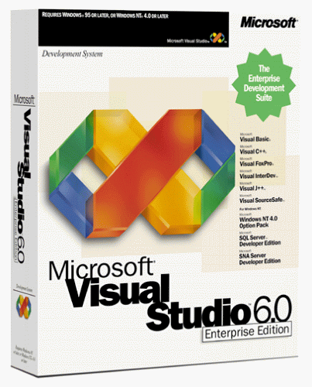
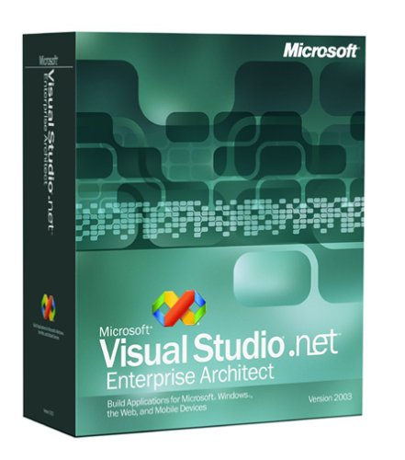
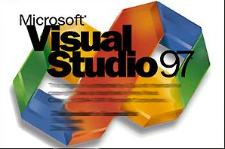
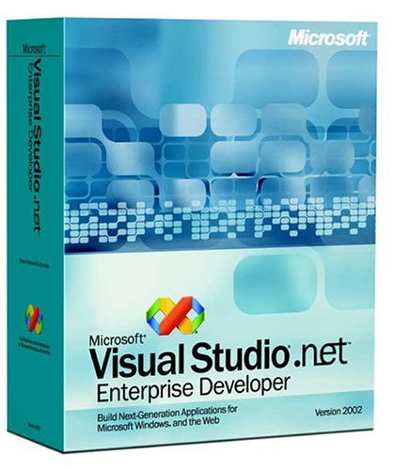

#vshistory
VS1998
VS2002
VS2003

Slide 15




VS2010
VS2012
VS2013

Slide 16




VS2015
VS2017
VS2019
VS2022

Slide 17


Slide 18
Version​ | Release Date​ | .NET | Visual Studio​
C# 1.0​ | Jan 2002​ | .NET 1.0​ | Visual Studio .NET 2002​
C# 1.1 and 1.2​ | Apr 2003​ | .NET 1.1​ | Visual Studio .NET 2003​
C# 2.0​ | Nov 2005​ | .NET 2.0​ | Visual Studio 2005​
C# 3.0​ | Nov 2007​ | .NET 2.0​ | Visual Studio 2008​
​ | ​ | .NET 3.0​ | Visual Studio 2010​
​ | ​ | .NET 3.5​ | ​
C# 4.0​ | Apr 2010​ | .NET 4​ | Visual Studio 2010​
C# 5.0​ | Aug 2012​ | .NET 4.5​ | Visual Studio 2012, Visual Studio 2013​
C# 6.0​ | Jul 2015​ | .NET 4.6, .NET Core 1.0​ | Visual Studio 2015​
C# 7.0​ | Mar 2017​ | .NET 4.6.2, .NET Core 1.1​ | Visual Studio 2017​
C# 7.1​ | Aug 2017​ | .NET 4.7, .NET Core 2.0​ | Visual Studio 2017(15.3)​
C# 7.2​ | Nov 2017​ | .NET 4.7.1, .NET Core 2.0​ | Visual Studio 2017(15.5)​
C# 7.3​ | May 2018​ | .NET 4.7.2, .NET Core 2.1​ | Visual Studio 2017(15.7)​
C# 8.0​ | Sep 2019​ | .NET 4.8, .NET Core 3.0​ | Visual Studio 2019(16.3)​
C# 9.0​ | Sep 2020​ | .NET 5.0​ | Visual Studio 2019 (16.8)​
C# 10​ | Sep 2021​ | .NET 6.0​ | Visual Studio 2022 (17.0)​
C# 11 | Nov 2022​ | .NET 7.0​ | Visual Studio 2022 (17.4)​

Slide 19
Nuts and bolts
Bitbucket Account / GitHub Account
Bitbucket Repository / GitHub Repository
Installations:
Latest .NET SDK
Visual Studio Code with C# extensions (For keyboard geeks)
Or Visual Studio 2022 any editions (For mouse lovers ☺)

Slide 20

Before We Start
Hello World - Introduction to C# interactive C# tutorial | Microsoft Docs

