Slide 1



Plant Disease Detection System

Slide 2

Learning Objectives
Learn how to preprocess and augment image datasets.
Gain hands-on experience in Python and machine learning.
Implement a deep learning model for classification.
Understand image processing techniques for plant disease detection.
GOAL
Source :
www.freepik.com/

Slide 3
Tools and Technology used
Python
OpenCV
NumPy
Jupyter Notebook
Google Colab
TensorFlow/Keras
PlantVillage Dataset

Slide 4
Methodology
Collected dataset of healthy and diseased plant leaves.
Built a CNN model using Keras.
Trained and evaluated the model.
Deployed the model or tested predictions on new images.
Preprocessed images (resizing, normalization, augmentation).

Slide 5
Problem Statement:
Identifying plant diseases early is critical to reduce crop loss.
Manual diagnosis is time-consuming and requires expert knowledge.
There's a need for an automated system to detect plant diseases from leaf images.

Slide 6
Solution:
Developed a deep learning model that detects and classifies plant diseases from images with high accuracy.
The model assists farmers in diagnosing diseases using smartphone photos.

Slide 7
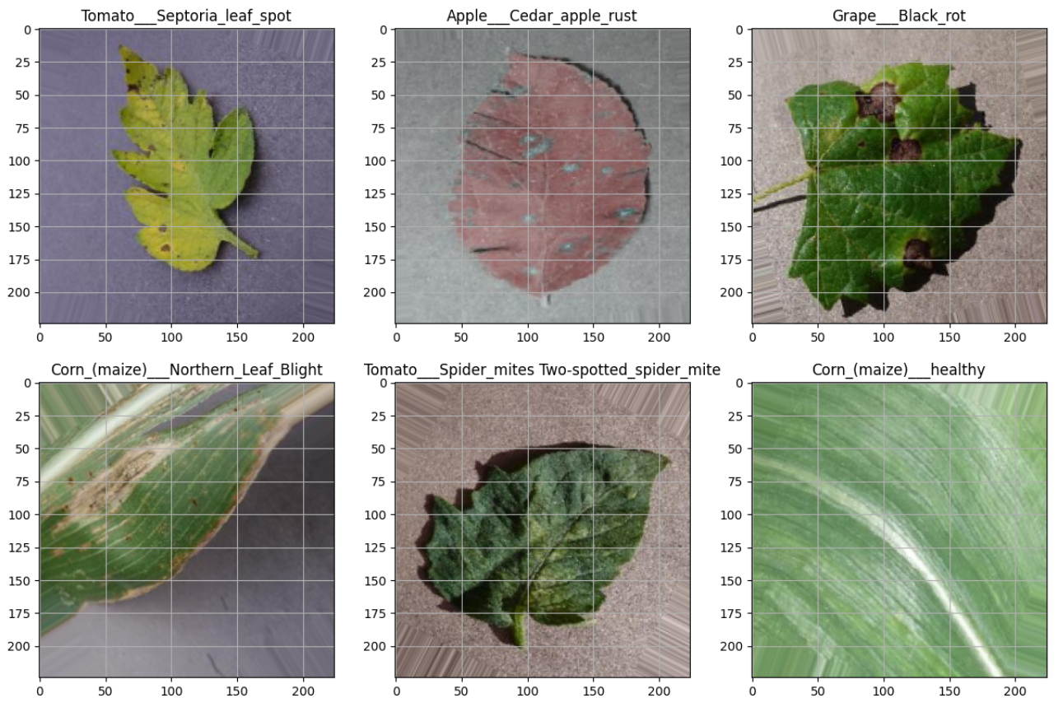
Screenshot of Output:

Slide 8
Conclusion:
Achieved 95%+ accuracy in plant disease classification.
Learned how to apply deep learning to real-world agricultural problems.
Future scope includes deploying as a mobile app for farmers.

