Slide 1


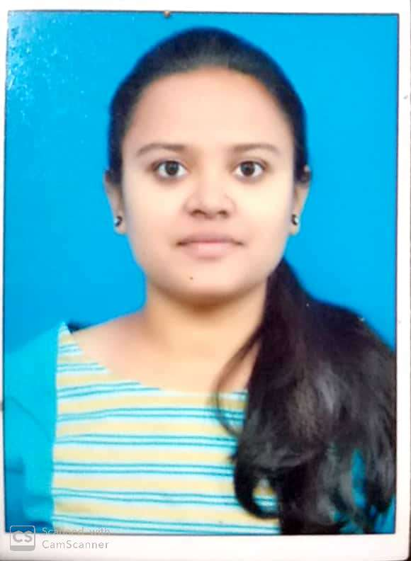
RedHat
About Me :
Name : Nethravathi M
College : REVA University
Github : https://github.com/NETHRAVATHI-M/python-code
/home/nethrabathi/O You Liked the Most :)

Slide 2
My learning : W1
RedHat
Achievements :
I got realy a very good experience speaking with industrial expertise Deepak Mishra discussing about how real projects work, and got a prior idea about how can i develop real world project,what are the cretiria that i supposed to consider etc..
Learning :
RHCSA: 1) Basic introduction to Red Hat Enterprise Linux(RHEL).
2) Virtualization and Some Basic Commands like cd,cat,ls
Python:Introduction to Python,data types like list,tuple,dictionary and different operations on these datatypes like update,delete etc..

Slide 3
RedHat
<Allocation of Room according to student Requirement >
SCQ(Situation Challenge Question):
Hostel Warden:1)Situation:- As Most of the people stay in hostel for thier higher
Studies, they have to get adjusted with different people. As a hostel warden it is my responsibility to put them into different rooms.But in this senario where most of the people fail to get adjusted with their roommates finaly will end up with fighting .
2)Challenge: It is very difficult to manage every students and solve their problems because most of the ask for room change.
3)Question: How can i solve this problem so that this kind of problems i should avoid in future?

Slide 4
User Stories :
As a developer , i can provide you a web apllication where students itself can choose what type of qualities or character their room partners should have .According to that you can allocate people into different rooms. I can also provide students to add their requeirments if not present in the requirements which i have given . This might help for the student who are gonna join in future.
Condition: I only should be a admin to commit my code changes if in future it requies..i am not selling the software to you but can give access to my GITHUB cloud only for your usage.
To develop this i need below mentioned requirements:
Hardware requirement: 8GB RAM for backup and recovery.
Computer with I3 OR I5 OR I7 processor.
Sotware Requirement: Server to run my code.
GCP(Google Cloud Platform) where i can host my application bcause it provides a very good security to my application.

