Slide 1
Spherical Aberrations

Slide 2
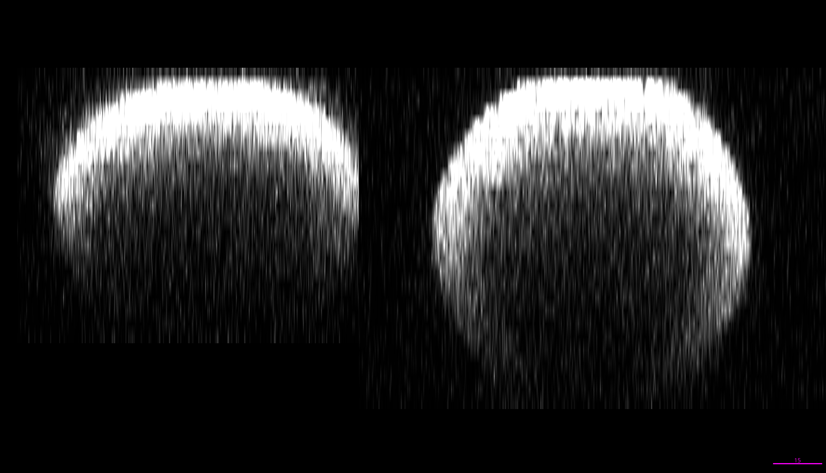
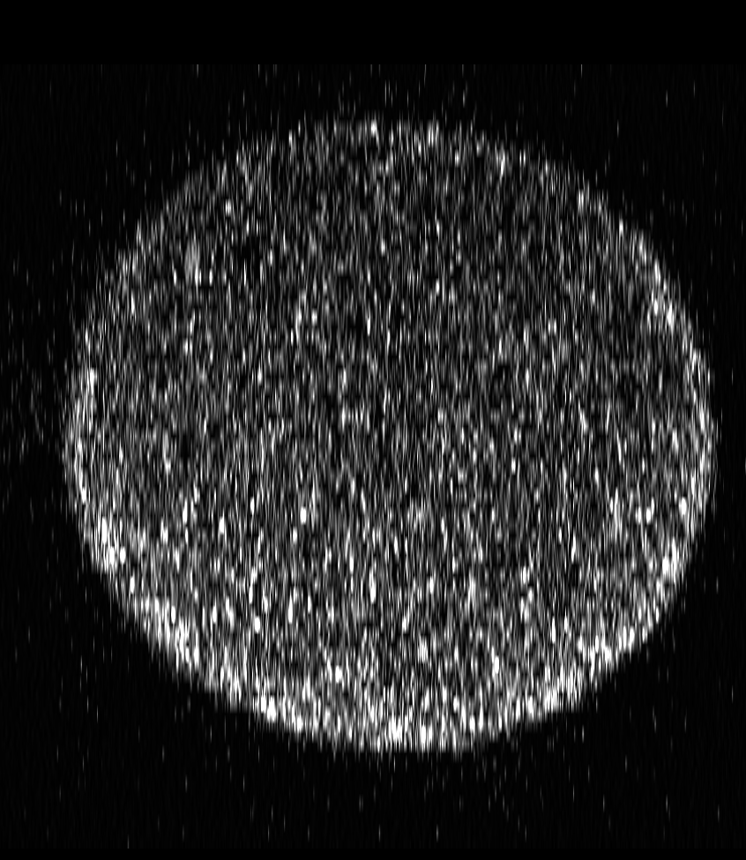
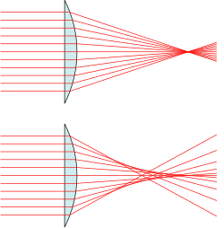



$$RI_{Imm.}=RI_{Mout}<R_{sample}$$
$$RI_{Imm.}<RI_{Mount}<R_{sample}$$
$$RI_{Imm.}=RI_{Mount}\sim R_{sample}$$
All rays meet at the
Focal point
Spherical aberrations
Z
X
Air objective
Water objective
Silicone objective
mount in optiprep
RI_{Mounting}
RI_{Sample}
RI_{Glass}
RI_{Immersion}
OBJECTIVE

