Slide 1
The OME-Zarr image data format
Christian Tischer & Erick Ratamero
Data Science Centre, EMBL

Slide 2
Content day 1
Digital image basics
Image metadata (data type, voxel size, channel info)
Big image data
  multi-resolution
  chunking
OME-Zarr
  versions

Slide 3
Content day 2
Sharing with external collaborators
Remote access for cloud computation
Challenges
Object storage

Slide 4
Resources
https://zenodo.org/records/17639350/files/Halfway_to_i2k_conference_2025_JohannesSoltwedel.pptx?download=1
https://github.com/zarr-developers/zarr-illustrations-falk-2022
https://docs.google.com/presentation/d/1Bc2G7gnIN7DCjY5N4DuA3bb2uQQCf-xL4aVPvfpS-oA/edit?slide=id.g2a02b0a1836_1_35#slide=id.g2a02b0a1836_1_35

Slide 5
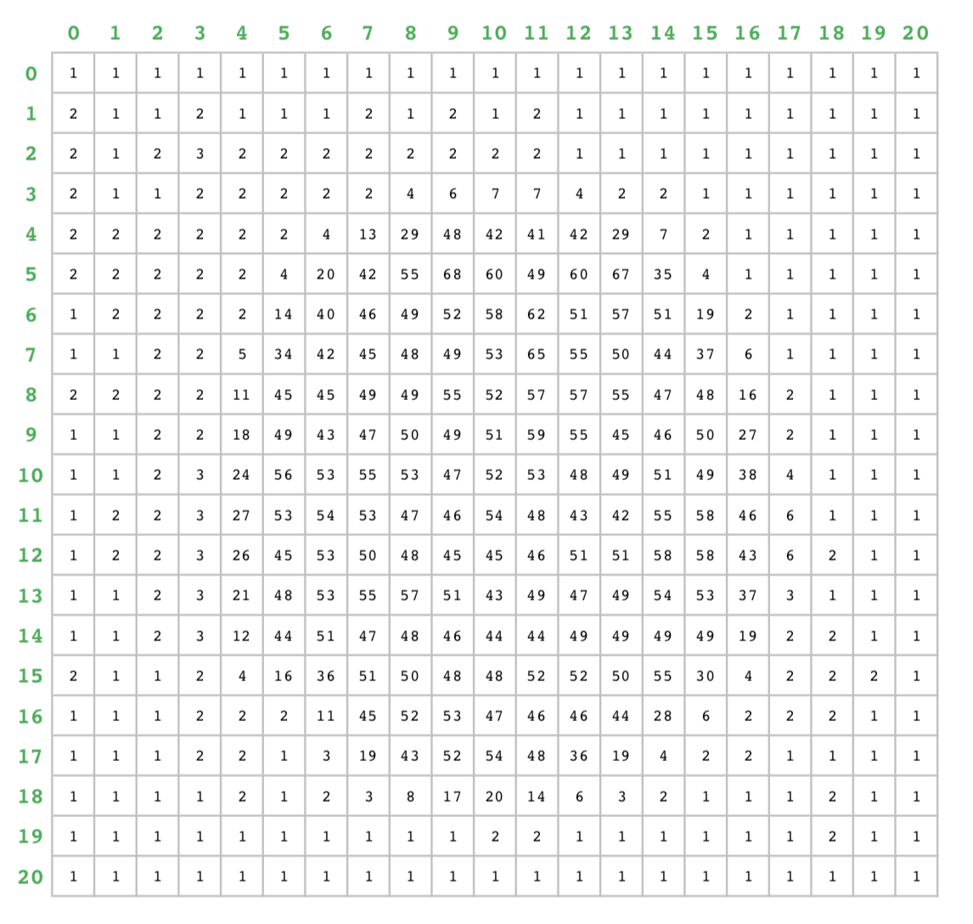
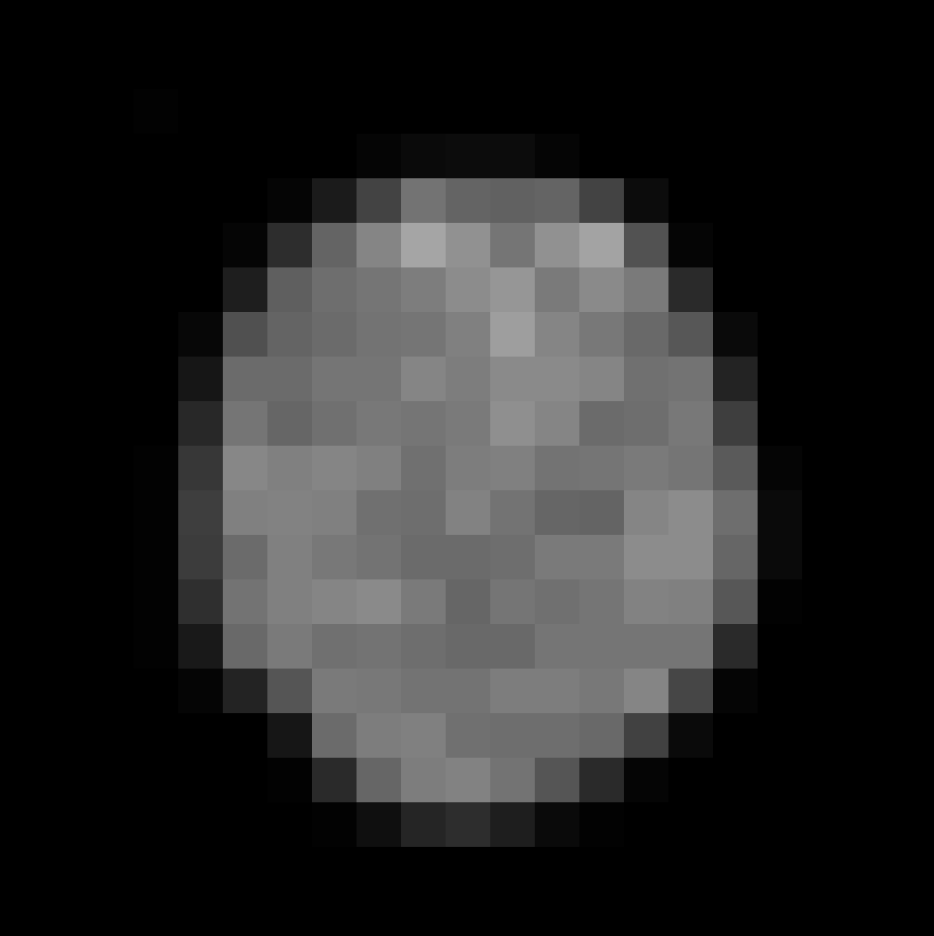

Slide 6
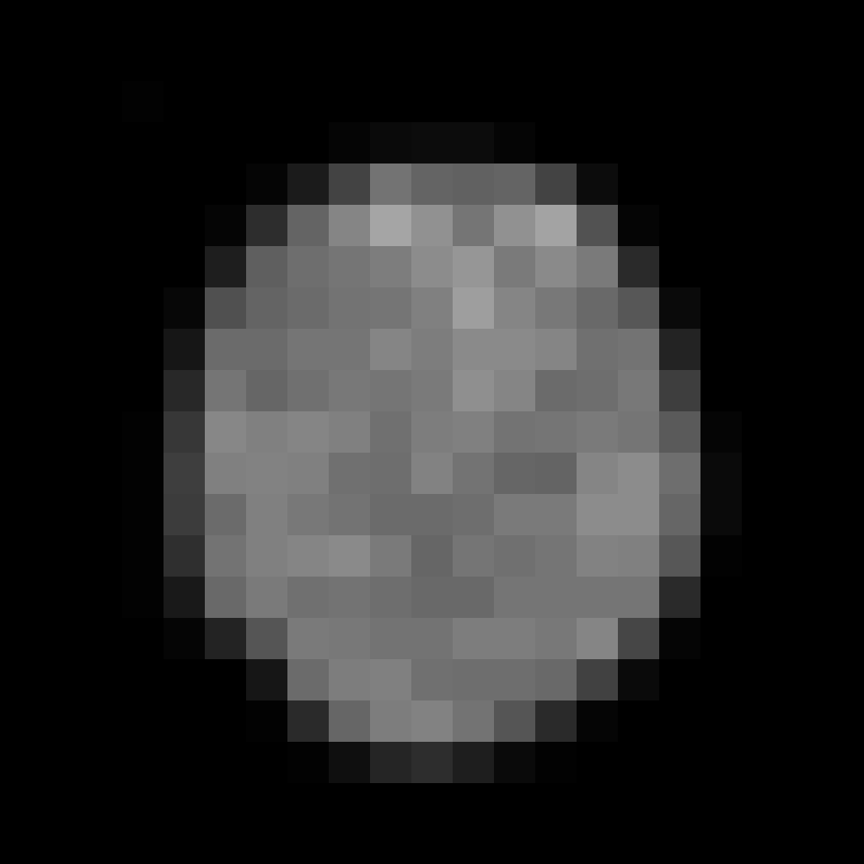
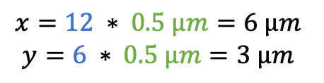
Index * Calibration = Calibrated coordinate
$$x=12 ∗ 0.5 µm=6 µm$$
$$y=6 ∗ 0.5 µm=3 µm$$
Origin (0,0)
(0,0)
Notes:
Example image: xy_8bit__nucleus_calibrated.tif

Slide 7
8-bit unsigned integer
00000000 = 0
00000001 = 2⁰ = 1
00000101 = 2⁰ + 2² = 5
11111111 = 2⁰ + 2¹ + … + 2⁷ = 255
16-bit unsigned integer
1111111111111111 = 2⁰ + 2¹ + … + 2¹⁵ = 65535
1000000000000000 = 2¹⁵ = 32768
0000111111111111 = 2⁰ + 2¹ + … + 2¹¹ = 4095
16-bit signed integer
0000000000000000 = +0
1000000000000000 = -0
1000000000000100 = -4
32-bit floating point
10000001000000000000000000000010 = - 1.? 2?
24-bit RGB
111111110000000001000000 = (255,0,64)

Slide 8
Metadata
Data
011100...10010100101000100000000000001000000000100010101000001010...
Pixel data start
Pixel data type (bit-depth)
Image dimensions
Compression
Pixel physical size
Microscope name
…
Width
0 | 8 | 2 | 42
10 | … | … | …
… | … | … | …
Height

Slide 9
Multi channel images

Slide 10
Channel 1
Y
C
Merged/Composite image
Y
X
X
Channel 2
2D + Channels
C
Y
Channel 3
X
Array shape (X, Y, C)

Slide 11
JPEG
…
OME-Zarr
PNG
IMS
OME-TIFF
LIF
CZI
ND2
XML/HDF5
ICS/IDS

Slide 12
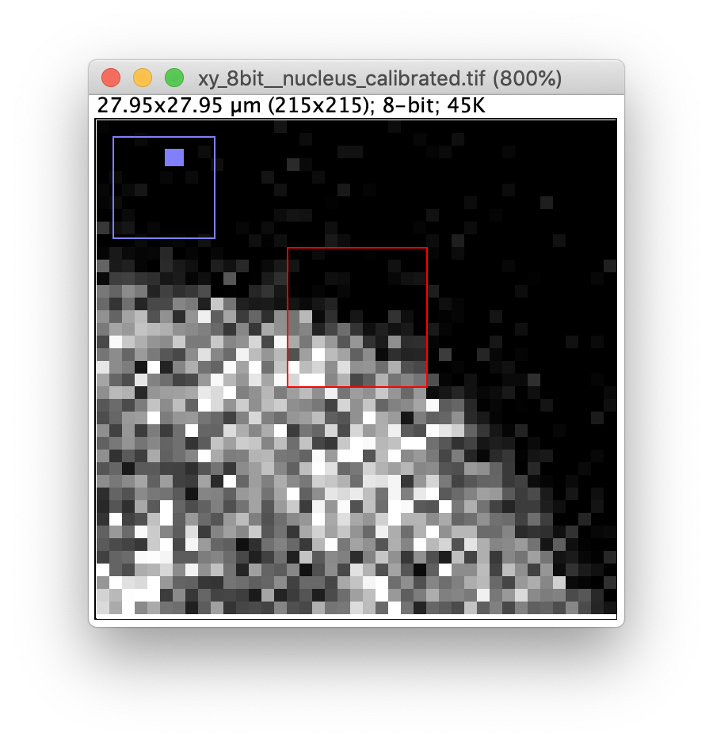
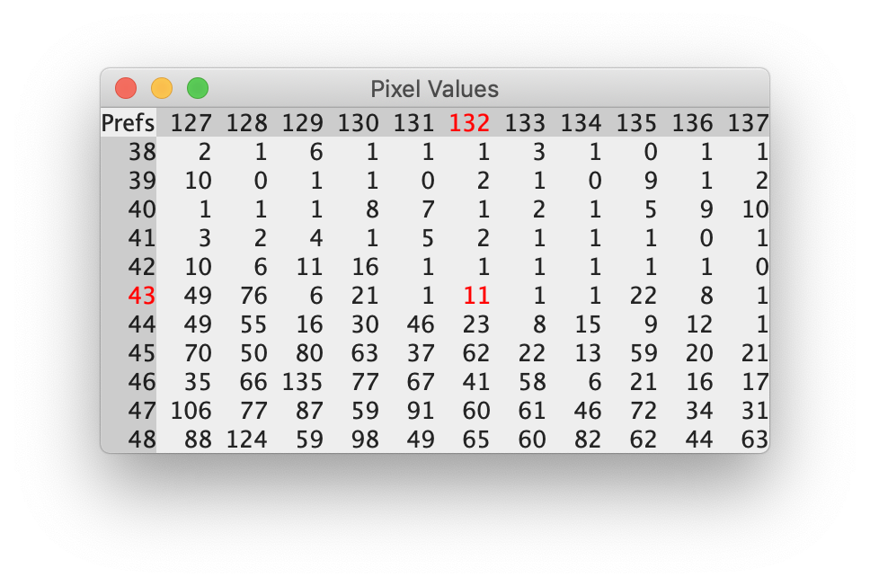
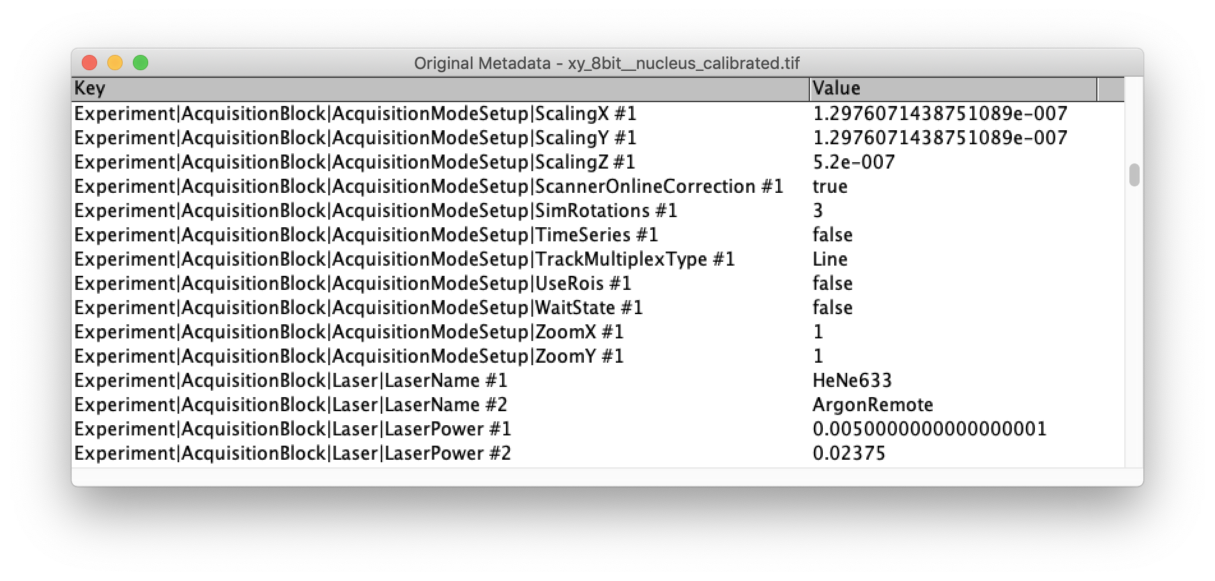

Slide 13
OME-TIFF

Slide 14
1010101100000000001000000000100010100001010000001010001001000001000101010000010010001011000011010000010010010110000110001001011000
TIFF header
Version
Byte order
Offset to first IFD
…
IFD
Pixel data type
Width
Height
Offset to data
Offset to next IFD
…
Data
One plane of pixel data
OME-XML
PixelPhysicalSize
Microscope settings
…
Plane 0: S = 0, Z = 0, T = 0, C = 0
Plane 1: S = 0, Z = 1, T = 0, C = 0
Plane 2: S = 0, Z = 2, T = 0, C = 0
Plane 3: S = 0, Z = 3, T = 0, C = 0
Plane 4: S = 1, Z = 0, T = 0, C = 0
Plane 5: S = 1, Z = 0, T = 0, C = 1
S = Series: Planes belonging to the same “image” with same width, height and data type

Slide 15
Big image data

Slide 16
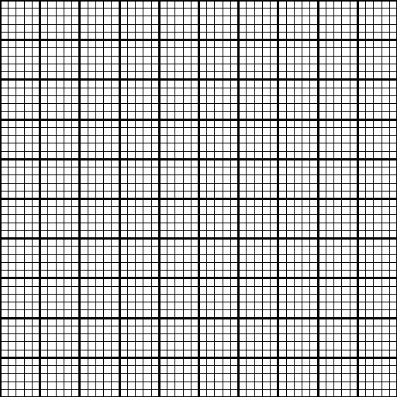

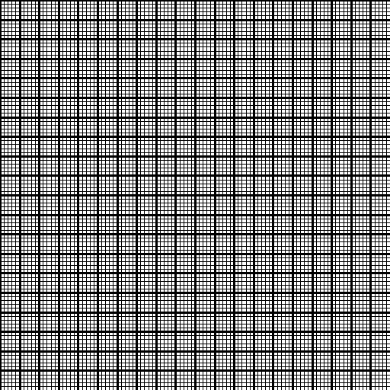

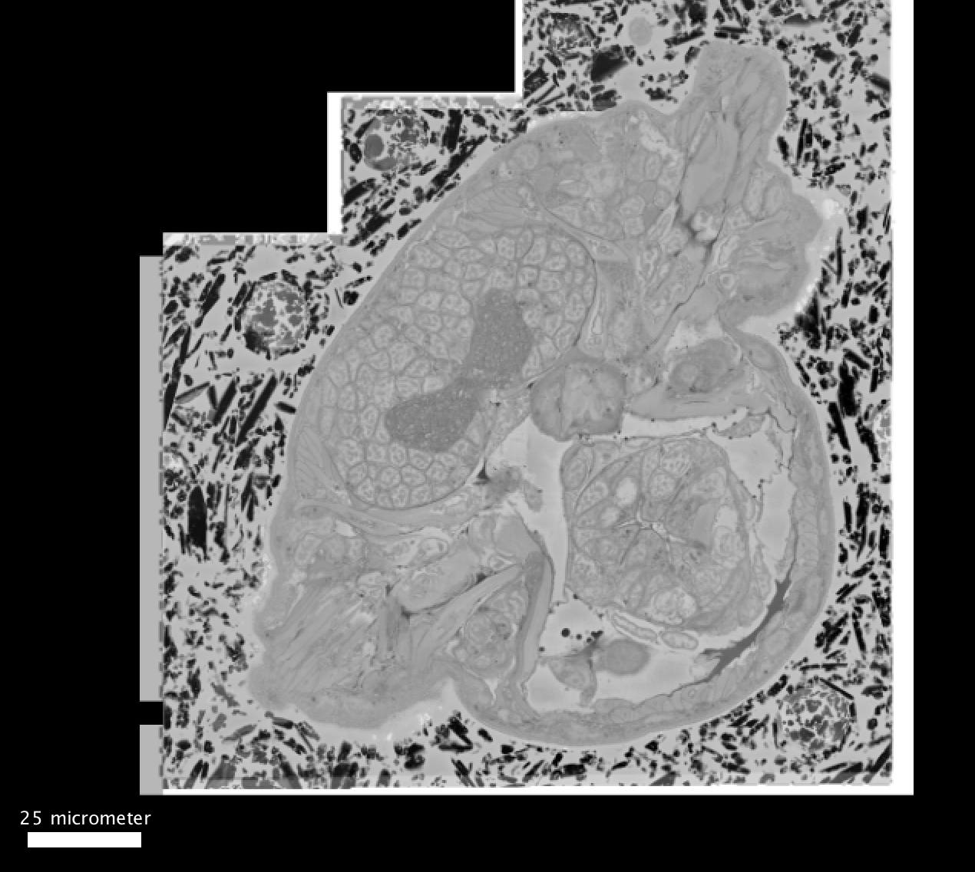
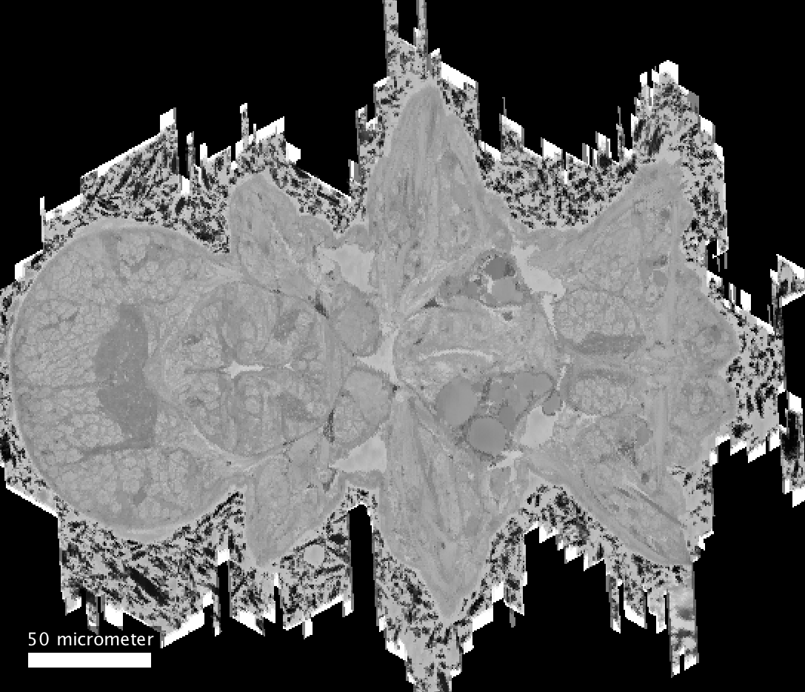
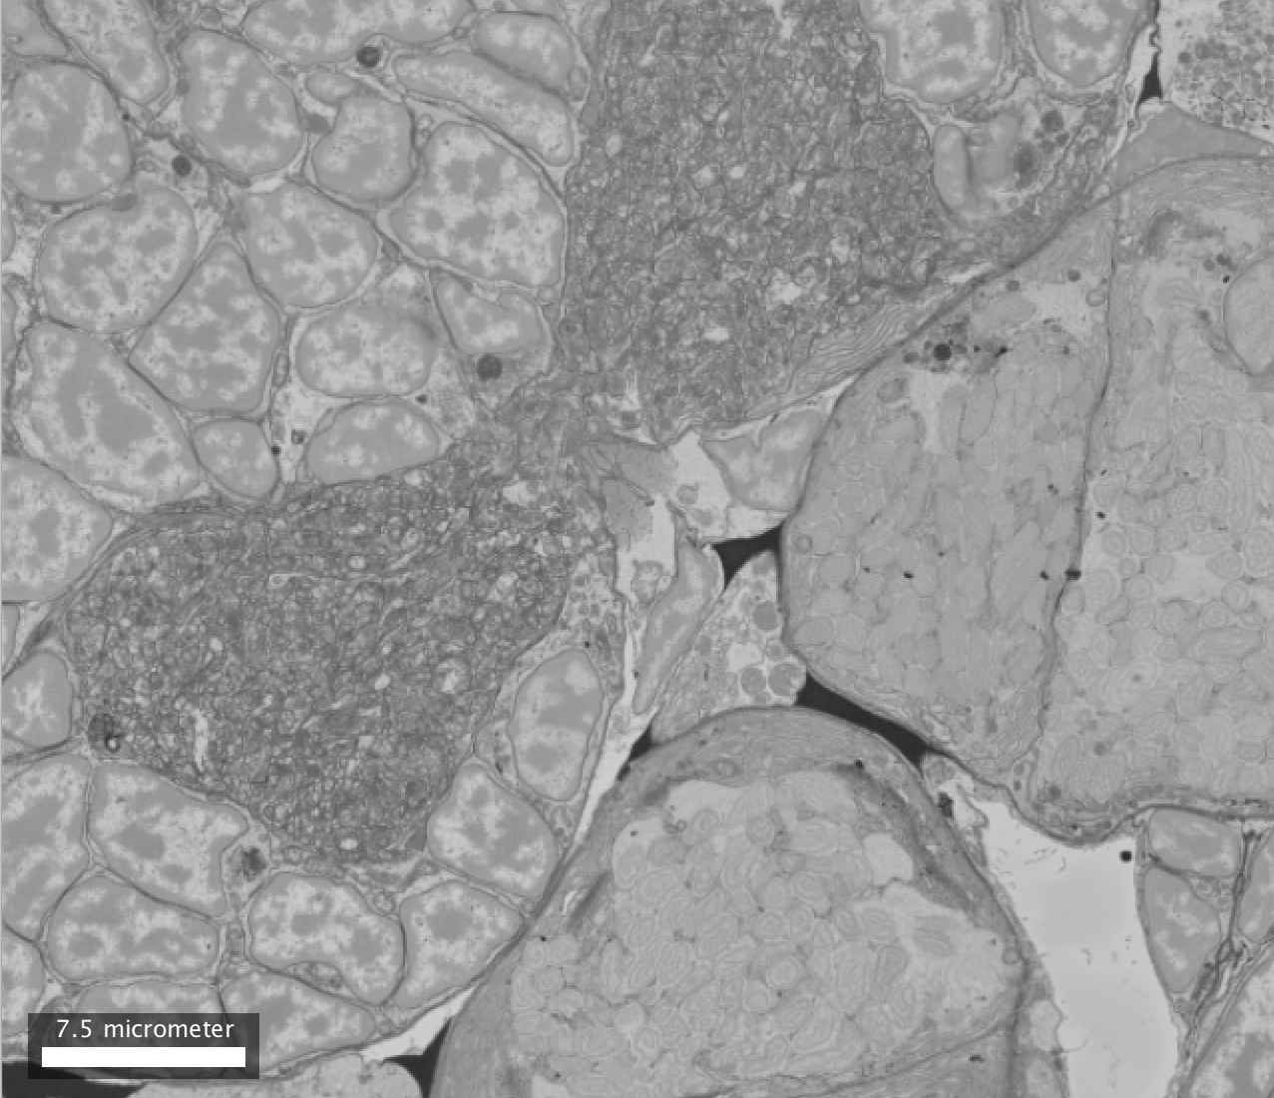
Metadata
Resolution 0
Resolution 1
1110010101100………00000000…100000000010001010…000101000000201000…10010000010001010…10000010……………010001010…1000001
Down-sampling
Row chunking
Square chunking
Metadata
Pixel data type
Offset to pixel data
Number of resolutions
Image dimensions (r)
Chunk dimensions (r)
Pixel physical size (r)
…

Slide 17
OME-Zarr builds on ZARR:
  Nested folder structure
  Metadata text files
  Binary data array chunks files
One OME-Zarr folder can contain multiple 5D images
Down-scale
Metadata JSON text files
Resolution folders
"axes": [ {"name": "t", "type": "time", "unit": "millisecond"}, {"name": "c", "type": "channel"}, {"name": "z", "type": "space", "unit": "micrometer"}, {"name": "y", "type": "space", "unit": "micrometer"}, {"name": "x", "type": "space", "unit": "micrometer"} ], "datasets": [ { "path": "0", "coordinateTransformations": [{"type": "scale", "scale": [1.0, 1.0, 0.5, 0.5, 0.5] }] }, { "path": "1", "coordinateTransformations": [{"type": "scale", "scale": [1.0, 1.0, 1.0, 1.0, 1.0] }] }, …
0/0
0/1
0/2
0/3
1/0
Binary chunk files

Slide 18


ftp
…
http

Slide 19
Zarr version 2 and version 3

