Slide 1
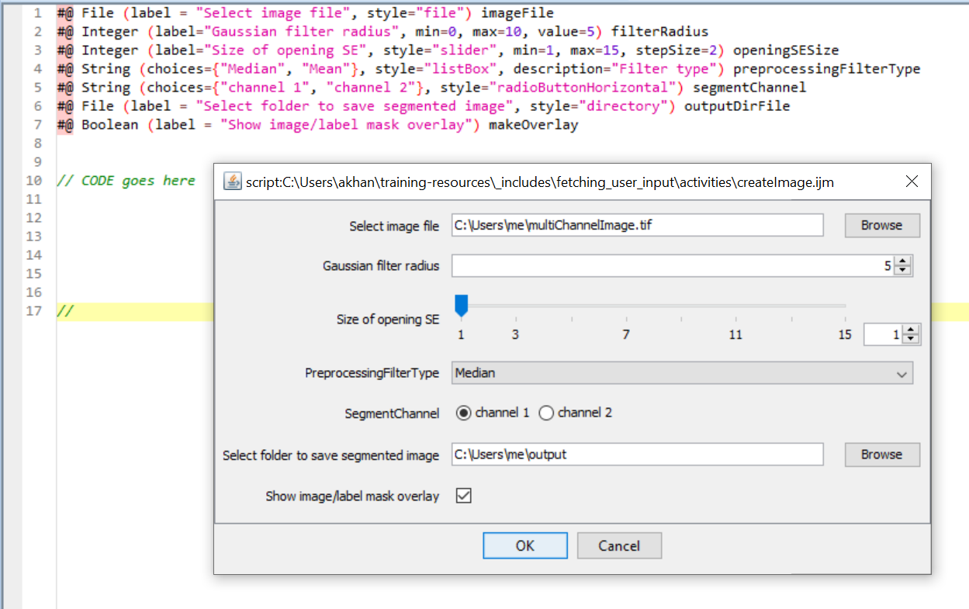
#@ parameter
script.ijm
Pop-up GUI for script.ijm
1
2
3
4
5
6
7

Slide 2
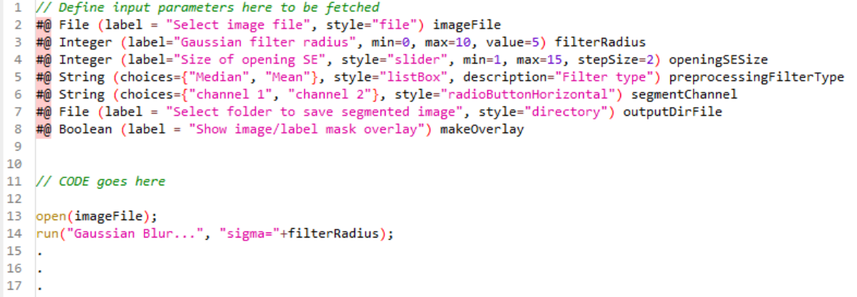
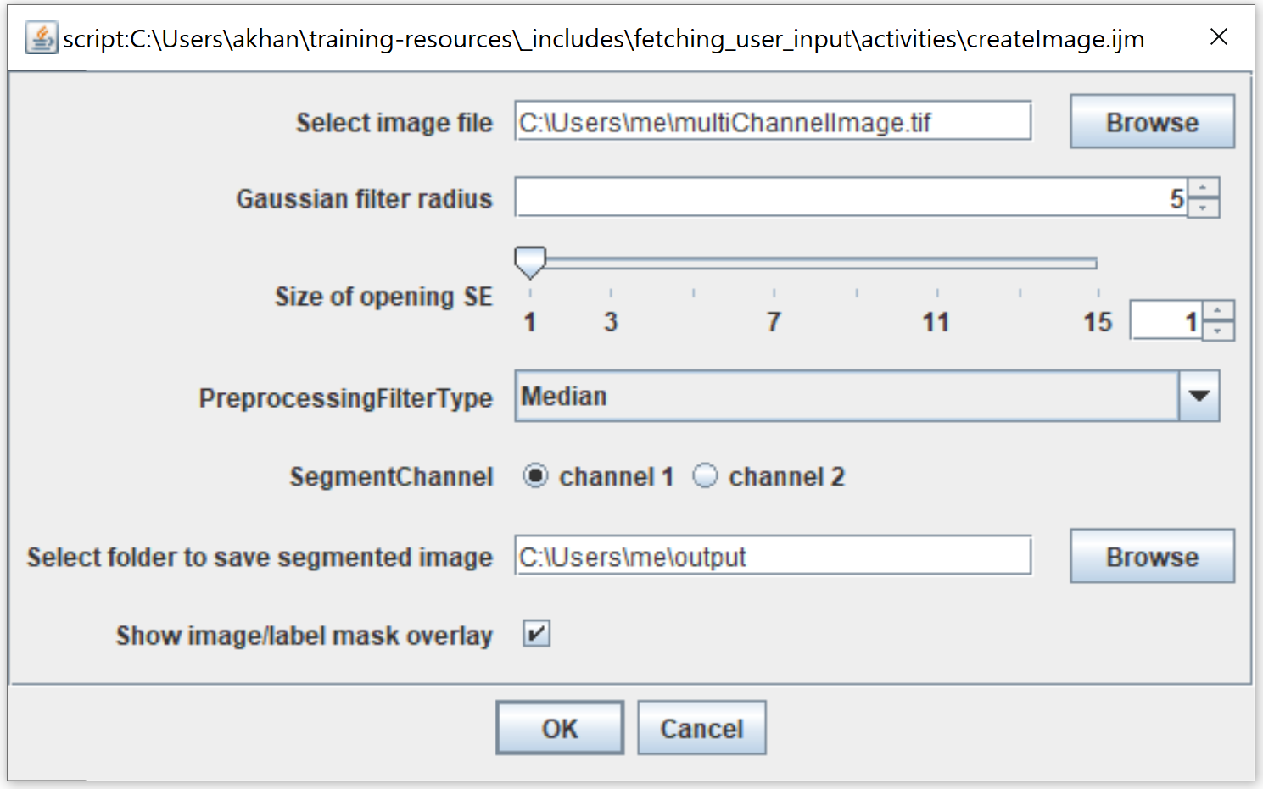
script
Pop-up GUI

Slide 3
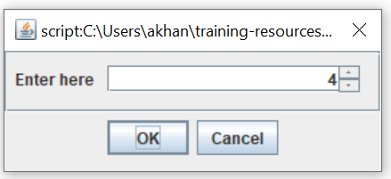
Creates variable
User dialog/entry
creation command
Has properties
Creates user dialog
Declares input type
Example script
X = createDialog(label = ‘Enter here’, type = ‘Integer’)
//CODE goes here
X = X + 5
print(X)
.
.
//
Value (input by user)
label
Dialog box
Script output
X = 9

Slide 4
…
smooth_image = smooth( image, 5 )
…
# parameter code block
filter_size = 5
# code
…
smooth_image = smooth( image, filter_size )
…
# fetch parameters via dialog
filter_size = create_dialog(label='Filter size', type=int, default=5)
# fetch parameters via command line
# example: run my_script –-filter_size 5
parser.add_argument('filter_size', type=int, default=5)
filter_size = args.filter_size
# fetch parameters via command line config file
# example: run my_script –-config /Users/config.yml
parser.add_argument('config', type=String)
filter_size = parse( args.config, 'filter_size' )

Slide 5
