Slide 1
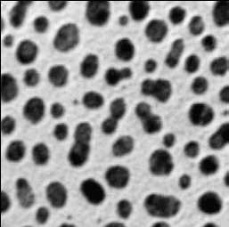
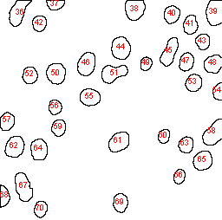
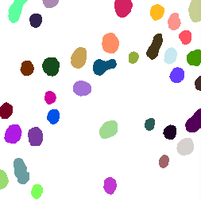
Measurements
table
Label | Area | X | Y | XM | YM
1 | 433 | 20.486 | 13.712 | 20.486 | 13.712
2 | 185 | 63.446 | 4.77 | 63.446 | 4.77
3 | 434 | 155.021 | 10.306 | 155.021 | 10.306
4 | 477 | 247.309 | 14.045 | 247.309 | 14.045
5 | 285 | 197.711 | 16.258 | 197.711 | 16.258
6 | 278 | 219.288 | 28.295 | 219.288 | 28.295
Input image
ROI set
Image analysis
ROI | X | Y | Width | Height
ROI 1 | 10 | 0 | 26 | 30
ROI 2 | 53 | 0 | 21 | 11
ROI 3 | 144 | 0 | 23 | 23
ROI 4 | 237 | 0 | 19 | 29
ROI 5 | 189 | 6 | 18 | 21
ROI 6 | 211 | 17 | 17 | 22
Label mask

Slide 2
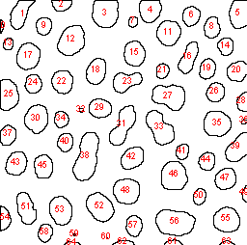
a) Label mask
b) Measurements table
c) ROI set
Label | Area | Perim. | X | Y
1 | 865 | 118.326 | 128.923 | 44.272
2 | 793 | 116.811 | 53.4 | 42.165
3 | 737 | 102.083 | 54.219 | 92.591
4 | 961 | 180.125 | 157.198 | 113.365
5 | 402 | 91.74 | 95.754 | 138.192
6 | 778 | 142.267 | 41.621 | 169.522
ROI | X | Y | Width | Height
ROI 1 | 10 | 0 | 26 | 30
ROI 2 | 53 | 0 | 21 | 11
ROI 3 | 144 | 0 | 23 | 23
ROI 4 | 237 | 0 | 19 | 29
ROI 5 | 189 | 6 | 18 | 21
ROI 6 | 211 | 17 | 17 | 22

Slide 3
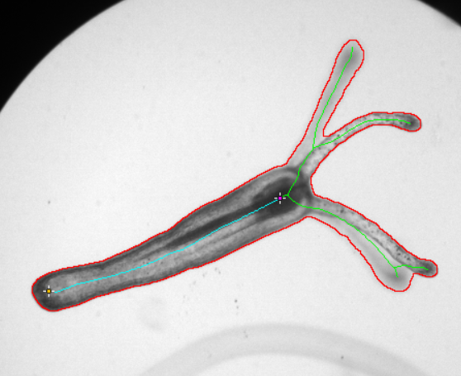
a) Label mask
b) Measurements table
c) ROI set
Label | Area | Perim. | X | Y
1 | 865 | 118.326 | 128.923 | 44.272
2 | 793 | 116.811 | 53.4 | 42.165
3 | 737 | 102.083 | 54.219 | 92.591
4 | 961 | 180.125 | 157.198 | 113.365
5 | 402 | 91.74 | 95.754 | 138.192
6 | 778 | 142.267 | 41.621 | 169.522

